Slide 1
Vehicle Maintaince System
Prepared By:
14BCA046 Jill Patel
14BCA030 Abhishek Patel
14BCA062 Tejash Patel
Project Guide:Tushar Mehta

Slide 2
Index
Introduction To definition
Scope
Details About Users
Data Dictionaries
System layouts
Working of system
Future Enhancements

Slide 3
1.Introduction To Definition
Our system is “vehicle maintenance system” where user can get information about his car and he can get the details of the past services records and if the user comes to us for the first time he can book a service also and out system also offers selling of parts which can be fitted in the car and the user can buy parts for this car like “side glasses” and the payment will be done by COD ( cash on delivery ) and few services which we will provide in future are car wash facilities.
Front End : PHP
Back End : Oracle Database

Slide 4
scope
The scope of our system is proactive vehicle maintenance and cost management
User can track past service records
We can maintain and store customers data
Customers can get their vehicles privately serviced
They can get car details and can also get details of other cars
They can also purchase car accessories

Slide 5
Details About Users
Our system has two proficient users.
ADMIN:
view/edit/delete vehicle details
View/edit/delete customer details
service expense details
vehicle repair history
Booking status details
User:
login or register themselves
View car details
service booking
Print service bills
Print service reports

Slide 6
Data Dictionaries
Table name : Sign Up
Description : Contain details for sign up
Field Name | Data Type | Size | Description |  | Constraint
Email_id | Varchar2 | 20 | Contain email id | -
Gender | Char | 1 | Gender | -
First_name | Varchar2 | 15 | Contain name | -
Mobile No | Varchar2 | 13 | Contain Phone No. | -
Username | Varchar2 | 10 | Id | Primary Key
Password | Varchar2 | 10 | Password | -

Slide 7
Table Name : Customer
Description : contains details of the customer and stores them
Field Name | Data Type | Size | Description |  | Constraint
Cust_id | Varchar2 | 20 | Contain cust id | Primary key
First_name | Varchar2 | 15 | Contain name | -
Email | Varchar2 | 30 | Contain email | -
Gender | Char | 1 | Contain gender | Check constraint
DOB | Varchar2 | 10 | Contains DOB | -
Address | Varchar2 | 40 | Contains Address | -
Phone | Number | 10 | Contains phone no | -
Table Name: Servicing
Description : contains the details of the vehicle and its servicing details
Field Name | Data Type | Size | Description |  | Constraint
Service_id | Varchar2 | 30 | Contains the service no | Primary key
Customer Id | Varchar2 | 15 | Contains vechicle name | Foreign key
Start Date | Date |  | Service Date | -
Work | Varchar2 | 50 | Servicing Details | -
Meter reading | Number | 6 | Contains meter reading | -
Cost | Number | 6 | Contains the cost | -

Slide 8
Table Name : Inventory/Items
Description : Contains the details of payment and mode of payment.
Field Name | Data Type | Size | Description |  | Constraint
Part_name | Varchar2 | 30 | Contains Part name | -
Item Id | Varchar2 | 4 | Contains part number | Primary key
Quantity | Number | 4 | Contains on hand number | -
Car_id | Varchar2 | 10 | Contains car id | Foreign key
Price | Int | 6 | Contains price | -
Reorder_level | Number | 3 | Contains the reorder level | -
Table Name : Car Details
Description : conatins the details of the vechicle
Field Name | Data Type | Size | Description |  | Constraint
Car id | Varchar2 | 10 | Contains the id of vehicle | Primary key
Model name | Varchar2 | 20 | Contains the name of vehicle | -
Vehicle chassis no | Number | 6 | Contains the chassis number of vehicle | Check constraint
Vehicle manufacturing Date | Date | - | Contains the manufacturing date of the vehicle | -
Vehicle price | number | 6 | Contains price | -

Slide 9
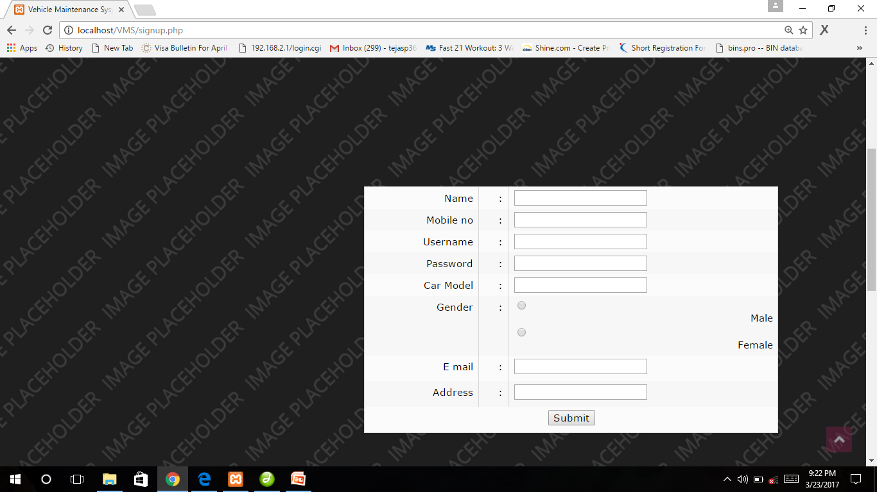
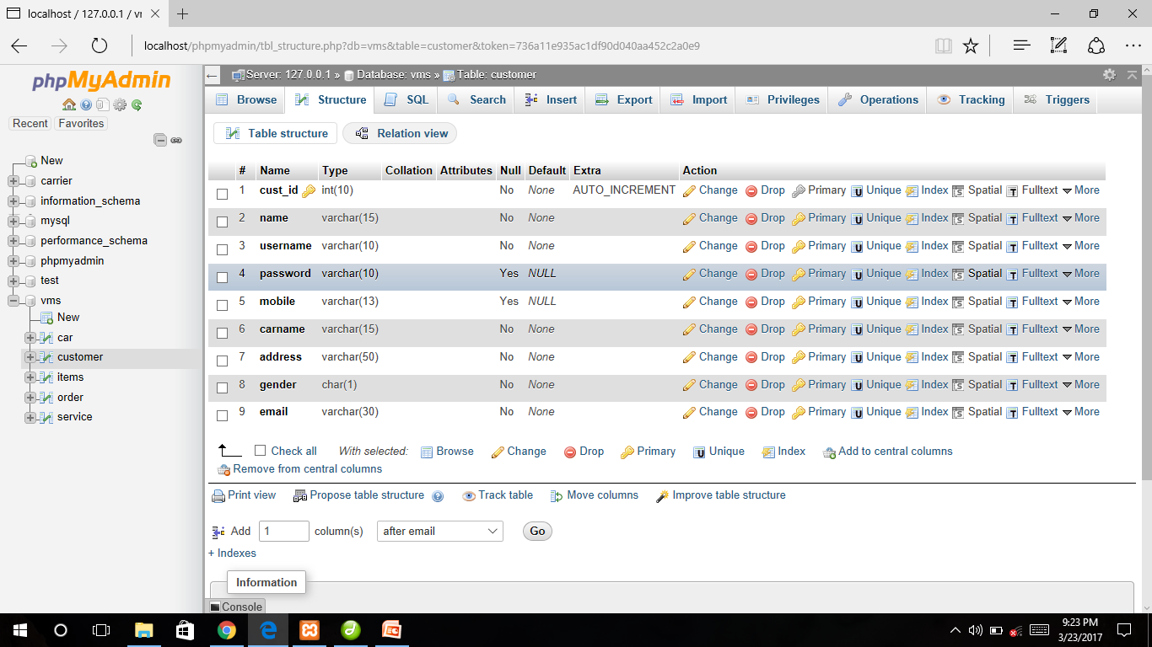
System layouts
This is a screenshot of signup page.

Slide 10
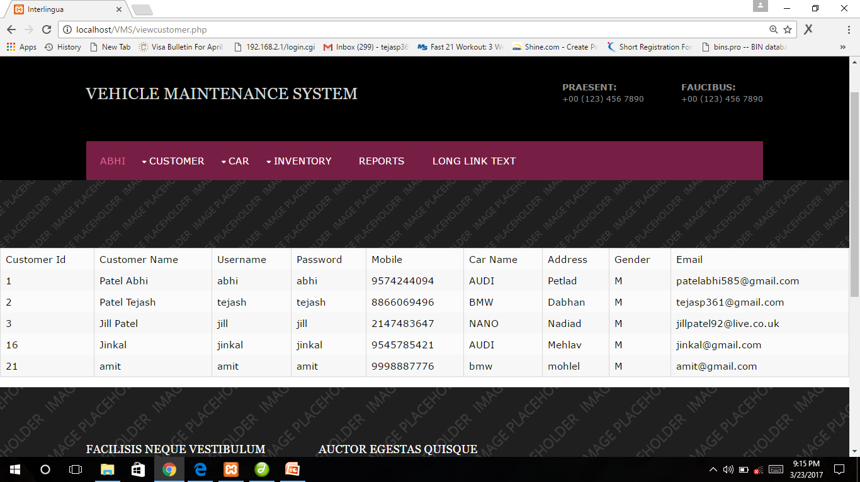
System Layouts
This screenshot is of view customer

Slide 11
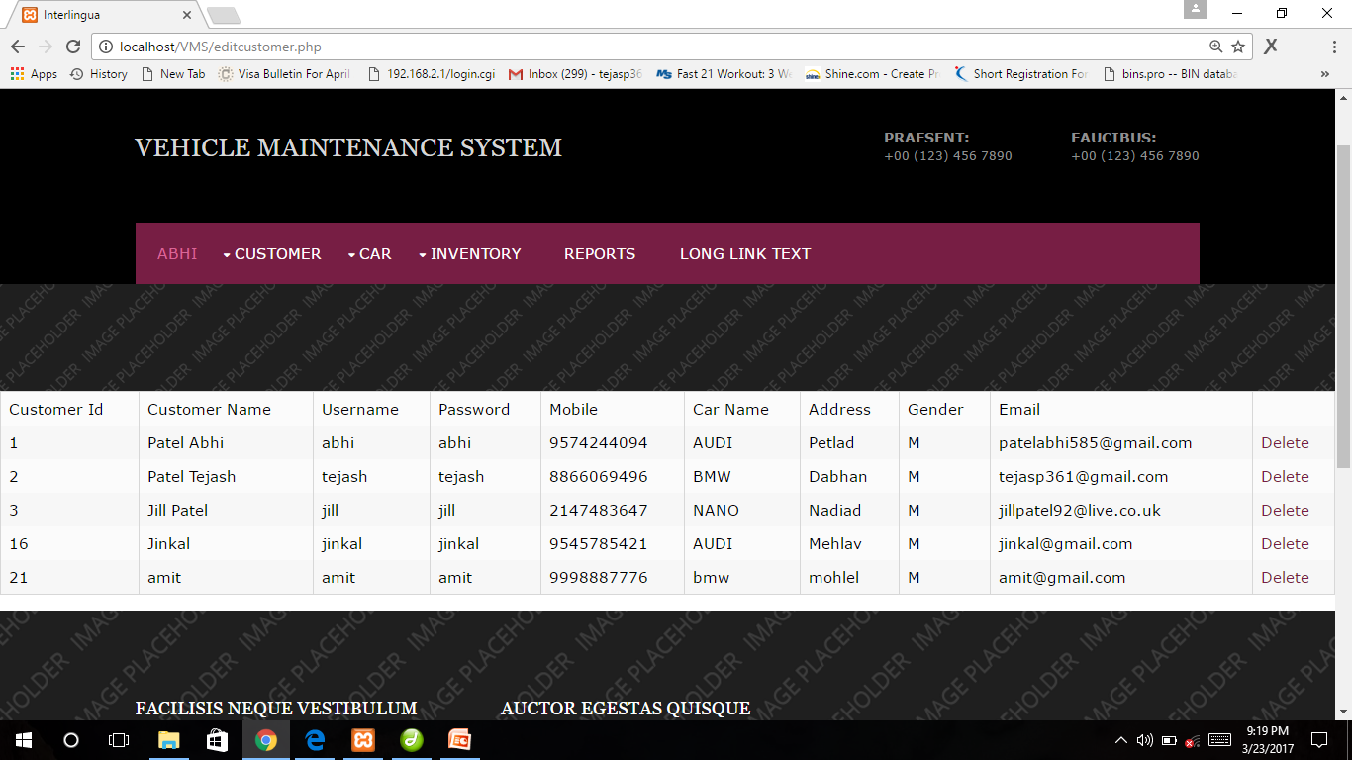
System Layouts
This screenshot is of edit customer

Slide 12
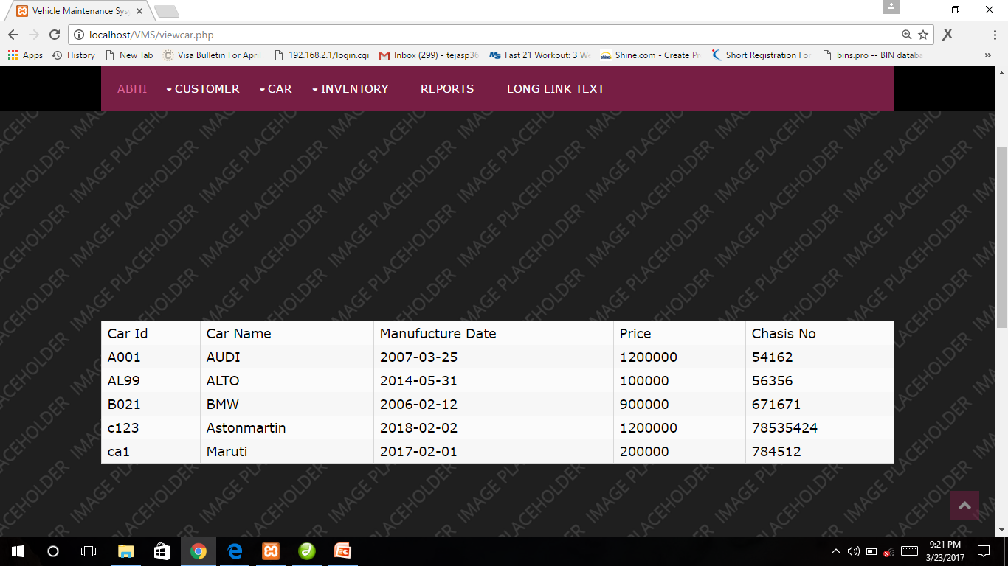
System Layouts
This screenshot is of view car

Slide 13
Working of system
There are different kind of modules are available in our system like login module, service module, accessories purchase module, reports Module etc.
So the if the admin logs in with his id and password than the admin panel will open up and the second aspect that is if the customer logs in than the customer panel will open up and he can book a service there get his past service records there and he can even buy car accessories there by going to the parts tab and he can even print out his bills there and all this data is stored and managed inside our database.
This all process is done online, except servicing so it makes the shopping easy.

Slide 14
Future enhancement
car wash facility
Car paint facility
Car modification facility
buy/sell pre-owned cars

Slide 15
Thank You . . . .

