Slide 1
TREES

Slide 2
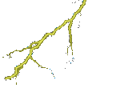
















Trees
Notes:
Trees are a very useful data structure. Many different kinds of trees are used in Computer Science. We shall study just a few of these.

Slide 3
Nature Lover’s View Of A Tree
leaves
branches
root

Slide 4

Computer Scientist’s View
root
leaves
branches
nodes
Notes:
Branches meet at nodes.

Slide 5
Trees
A tree is recursively defined as a set of one or more nodes where one node is designated as the root of the tree and all the remaining nodes can be partitioned into non-empty sets each of which is a sub-tree of the root.
Types of Trees
  General Trees
  Forests
  Binary Trees
  Expression Trees
  Tournament Trees

Slide 6
Applications of Trees
Trees are used to store simple as well as complex data. Here simple means an int value, char value and complex data (structure).
Trees are often used for implementing other types of data structures like hash tables, sets, and maps.
A self-balancing tree, Red-black tree is used in kernel scheduling to preempt massively multi-processor computer operating system use.
Another variation of tree, B-trees are used to store tree structures on disc. They are used to index a large number of records.
B-trees are also used for secondary indexes in databases, where the index facilitates a select operation to answer some range criteria.
Trees are used for compiler construction.
Trees are also used in database design.
Trees are used in file system directories.
Trees are also widely used for information storage and retrieval in symbol tables.

Slide 7

Linear Lists And Trees
Linear lists are useful for serially ordered data.
  (e₀, e₁, e₂, …, e_{n-1})
  Days of week.
  Months in a year.
  Students in this class.
Trees are useful for hierarchically ordered data.
  Employees of a corporation.
    President, vice presidents, managers, and so on.

Slide 8
Hierarchical Data And Trees
The element at the top of the hierarchy is the root.
Elements next in the hierarchy are the children of the root.
Elements next in the hierarchy are the grandchildren of the root, and so on.
Elements that have no children are leaves.

Slide 9
Example Tree
President
root
children of root
VP1
VP2
VP3
Manager1
Manager2
Manager
Manager
grand children of root
Worker Bee
great grand child of root

Slide 10
Definition
A tree t is a finite nonempty set of elements.
One of these elements is called the root.
The remaining elements, if any, are partitioned into trees, which are called the subtrees of t.

Slide 11
Subtrees
President
root
VP1
VP2
VP3
Manager1
Manager2
Manager
Manager
Worker Bee

Slide 12
Leaves
President
VP1
VP2
VP3
Manager1
Manager2
Manager
Manager
Worker Bee

Slide 13
Parent, Grandparent, Siblings, Ancestors, Descendants
President
VP1
VP2
VP3
Manager1
Manager2
Manager
Manager
Worker Bee

Slide 14
Levels
President
Level 0
Level 1
VP1
VP2
VP3
Manager1
Manager2
Manager
Manager
Level 3
Worker Bee
Level 4

Slide 15

Caution
Some texts start level numbers at 1 rather than at 0.
Root is at level 0.
Its children are at level 1.
The grand children of the root are at level 2.
And so on.
We shall number levels with the root at level 0.

Slide 16
height = depth = number of levels
President
Level 0
Level 1
VP1
VP2
VP3
Manager1
Manager2
Manager
Manager
Level 2
Worker Bee
Level 3

Slide 17
Node Degree = Number Of Children
President
3
2
VP1
1
VP2
1
VP3
0
0
1
0
Manager1
Manager2
Manager
Manager
Worker Bee
0

Slide 18
Tree Degree = Max Node Degree
President
3
2
VP1
1
VP2
1
VP3
0
0
1
0
Manager1
Manager2
Manager
Manager
Worker Bee
0
Degree of tree = 3.
Notes:
Note that it is possible to have a tree whose degree is (say) 3 and whose root has a
degree that is < 3.

Slide 19
Binary Tree
Finite (possibly empty) collection of elements.
A nonempty binary tree has a root element.
The remaining elements (if any) are partitioned into two binary trees.
These are called the left and right subtrees of the binary tree.

Slide 20
Differences Between A Tree & A Binary Tree
No node in a binary tree may have a degree more than 2, whereas there is no limit on the degree of a node in a tree.
A binary tree may be empty; a tree cannot be empty.

Slide 21
Differences Between A Tree & A Binary Tree
The subtrees of a binary tree are ordered; those of a tree are not ordered.
a
a
b
b
Are different when viewed as binary trees.
Are the same when viewed as trees.

Slide 22
General Trees
General trees are data structures that store elements hierarchically.
The top node of a tree is the root node and each node, except the root, has a parent.
A node in a general tree (except the leaf nodes) may have zero or more sub-trees.
General trees which have 3 sub-trees per node are called ternary trees.
However, the number of sub-trees for any node may be variable. For example, a node can have 1 sub-tree, whereas some other node can have 3 sub-trees.

Slide 23
Tree
Difference between Binary Tree &General Tree
General Tree | Binary Tree
1. General tree is a tree in which each node can have many children or nodes. | Whereas in binary tree, each node can have at most two nodes.
2. The sub tree of a general tree do not hold the ordered property. | While the subtree of binary tree hold the ordered property.
3. In data structure, a general tree can not be empty. | While it can be empty.
4. In general tree, a node can have at most n(number of child nodes) nodes. | While in binary tree, a node can have at most 2(number of child nodes) nodes.
5. In general tree, there is no limitation on the degree of a node. | While in binary tree, there is limitation on the degree of a node because the nodes in a binary tree can’t have more than two child node
6. In general tree, there is either zero sub tree or many sub tree. | While in binary tree, there are mainly two subtree: Left-subtree and Right-subtree.

Slide 24
Forests
A forest is a disjoint union of trees. A set of disjoint trees (or forest) is obtained by deleting the root and the edges connecting the root node to nodes at level 1.
Every node of a tree is the root of some sub-tree. Therefore, all the sub-trees immediately below a node form a forest.
A forest can also be defined as an ordered set of zero or more general trees.
While a general tree must have a root, a forest on the other hand may be empty because by definition it is a set, and sets can be empty.
We can convert a forest into a tree by adding a single node as the root node of the tree.

Slide 25
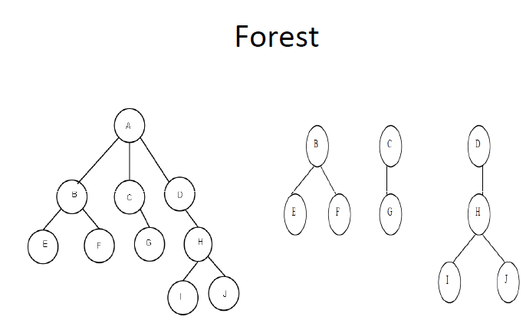

Slide 26
Binary Trees
A binary tree is a data structure which is defined as a collection of elements called nodes.
In a binary tree, the topmost element is called the root node, and each node has 0, 1, or at the most 2 children.
Every node contains a data element, a "left" pointer which points to the left child, and a "right" pointer which points to the right child.
The root element is pointed by a "root" pointer.
If root = NULL, then it means the tree is empty.
1
ROOT NODE
T₁
2
3
T₂
R – Root node (node 1)
T₁- left sub-tree (nodes 2, 4, 5, 8, 9)
T₂- right sub-tree (nodes 3, 6, 7, 10, 11, 12)
4
5
6
7
8
9
10
11
12

Slide 27
Binary Trees - Key Terms
Parent: If N is any node in T that has left successor S1 and right successor S2, then N is called the parent of S1 and S2. Correspondingly, S1 and S2 are called the left child and the right child of N. Every node other than the root node has a parent.
Sibling: S1 and S2 are said to be siblings. In other words, all nodes that are at the same level and share the same parent are called siblings (brothers).
Level number: Every node in the binary tree is assigned a level number. The root node is defined to be at level 0. The left and right child of the root node have a level number 1. Similarly, every node is at one level higher than its parents.
Leaf node: A node that has no children.
Degree: Degree of a node is equal to the number of children that a node has.

Slide 28
Binary Trees - Key Terms
In-degree of a node is the number of edges arriving at that node.
Out-degree of a node is the number of edges leaving that node.
Edge: It is the line connecting a node N to any of its successors
Path: A sequence of consecutive edges is called a path.
Depth: The depth of a node N is given as the length of the path from the root to the node N. The depth of the root node is zero.
Height: It is the total number of nodes on the path from the root node to the deepest node in the tree. A tree with only a root node has a height of 1.
A binary tree of height h has at least h nodes and at most 2^{h+1} – 1 nodes. This is because every level will have at least one node and can have at most 2 nodes.
The height of a binary tree with n nodes is at least log₂(n+1) and at most n.

Slide 29
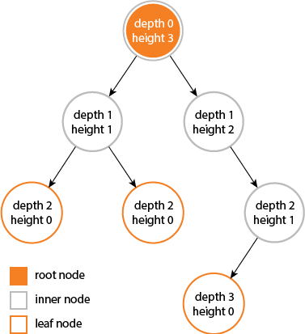

Slide 30
Binary Trees - Key Terms
Similar binary trees: Given two binary trees T and T’ are said to be similar if both these trees have the same structure.
A
TREE T
F
TREE T”
B
C
G
H
D
I
E
J
Copies of binary trees: Two binary trees T and T’ are said to be copies if they have similar structure and same content at the corresponding nodes.
A
TREE T
A
TREE T”
B
C
B
C
D
E
D
E

Slide 31
Properties of Binary Tree
The maximum number of nodes at level ‘l’ of a binary tree is 2^{l}.
Maximum number of nodes in a binary tree of height ‘h’ is 2^{h+1} – 1.

Slide 32
Complete Binary Trees
A complete binary tree is a binary tree which satisfies two properties.
First, in a complete binary tree every level, except possibly the last, is completely filled.
Second, all nodes appear as far left as possible
In a complete binary tree T_{n}, there are exactly n nodes and level r of T can have at most 2^{r} nodes.
The formula to find the parent, left child and right child can be given as:
If K is a parent node, then its left child can be calculated as
2 * K and its right child can be calculated as 2 * K + 1.
For example, the children of node 4 are 8 (2*4) and 9 (2* 4 + 1).
Similarly, the parent of node K can be calculated as | K/2 |.
1
2
3
4
5
6
7
8
9
10
11
12
13

Slide 33
Extended Binary Trees
A binary tree T is said to be an extended binary tree (or a 2-tree) if each node in the tree has either no child or exactly two children.
In an extended binary tree nodes that have two children are called internal nodes and nodes that have no child or zero children are called external nodes. In the figure internal nodes are represented using a circle and external nodes are represented using squares.
To convert a binary tree into an extended tree, every empty sub-tree is replaced by a new node. The original nodes in the tree are the internal nodes and the new nodes added are called the external nodes.
Extended binary tree
Binary tree

Slide 34
Binary Tree Representation
Array representation.
Linked representation.

Slide 35
Array Representation of Binary Trees
Sequential representation of trees is done using a single or one dimensional array. Though, it is the simplest technique for memory representation, it is very inefficient as it requires a lot of memory space.
A sequential binary tree follows the rules given below:
One dimensional array called TREE is used.
The root of the tree will be stored in the first location. That is, TREE[1] will store the data of the root element.
The children of a node K will be stored in location (2*K) and (2*K+1).
The maximum size of the array TREE is given as (2^{h+1}-1), where h is the height of the tree.
An empty tree or sub-tree is specified using NULL. If TREE[1] = NULL, then the tree is empty.
20
15
35
12
17
21
39
16
18
36
45

Slide 36
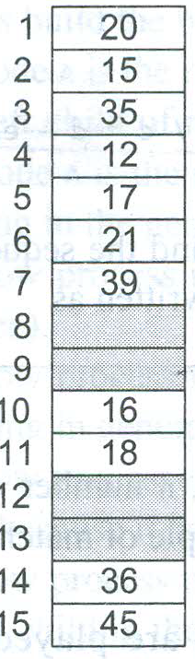

Slide 37
Array Representation
Number the nodes using the numbering scheme for a full binary tree. The node that is numbered i is stored in tree[i].
1
a
2
3
b
c
4
5
6
7
d
e
f
g
8
9
10
h
i
j
tree[]
a
b
c
d
e
f
g
h
i
j
0
5
10

Slide 38
Right-Skewed Binary Tree
1
a
b
3
7
c
15
d
tree[]
a
-
b
-
-
-
c
-
-
-
-
-
-
-
d
0
5
10
15
An n node binary tree needs an array whose length is between n+1 and 2^{n}.

Slide 39
Linked Representation of Binary Trees
In computer’s memory, a binary tree can be maintained either using
a linked representation or using sequential representation.
In linked representation of binary tree, every node will have three parts: the data element,
a pointer to the left node and
a pointer to the right node.
So in C, the binary tree is built with a node type given as below.
struct node
{
struct node* left;
int data;
struct node* right;
};
1
2
3
4
5
6
7
X
8
X
X
9
X
X
10
X
X
11
X
X
12
X

Slide 40
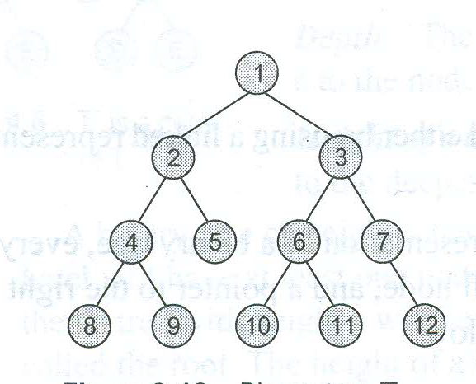

Slide 41
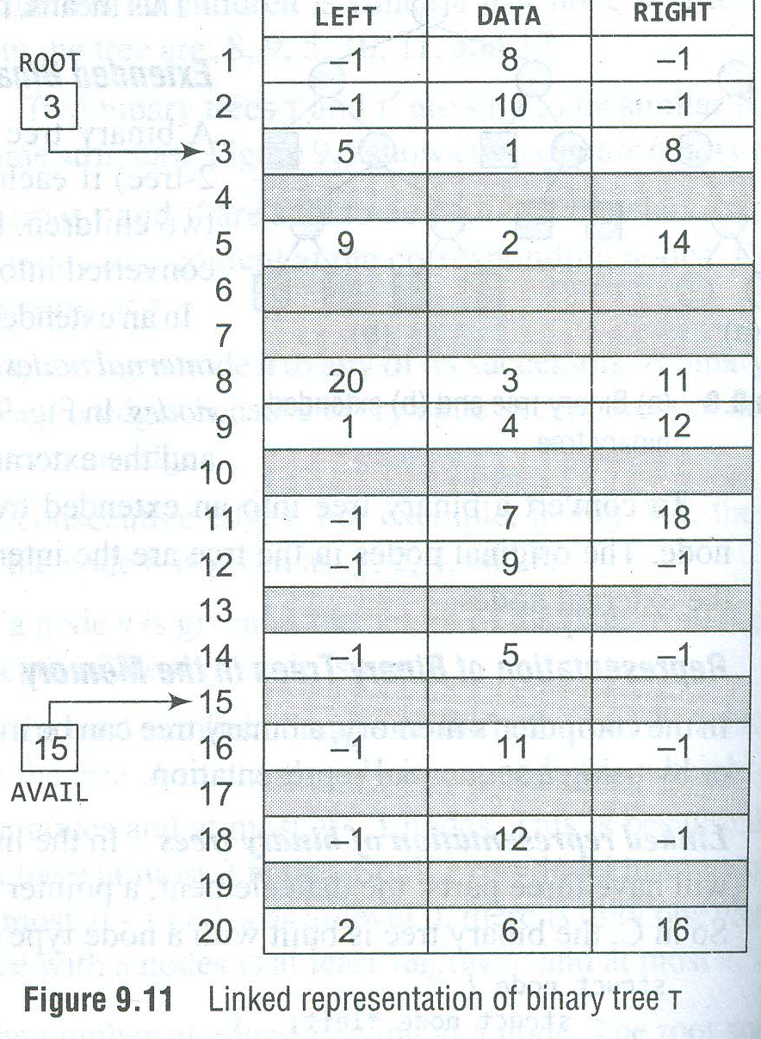

Slide 42
Linked Representation
Each binary tree node is represented as an object whose data type is TreeNode.
The space required by an n node binary tree is
n * (space required by one node).
Notes:
Notice that a linked representation always take space that is linear in the number of elements in the tree. An array representation may take an exponential amount of space!

Slide 43
Some Binary Tree Operations
Determine the height.
Determine the number of nodes.
Make a clone.
Determine if two binary trees are clones.
Display the binary tree.
Evaluate the arithmetic expression represented by a binary tree.
Obtain the infix form of an expression.
Obtain the prefix form of an expression.
Obtain the postfix form of an expression.

Slide 44
Expression Trees
Binary trees are widely used to store algebraic expressions. For example, consider the algebraic expression Exp given as:
Exp = (a – b ) + ( c * d)
This expression can be represented using a binary tree as shown in figure
+
-
*
a
b
c
d

Slide 45
Tournament Trees
In a tournament tree (also called a selection tree), each external node represents a player and each internal node represents the winner of the match played between the players represented by its children nodes.
These tournament trees are also called winner trees because they are being used to record the winner at each level.
We can also have a loser tree that records the loser at each level.
a
a
e
a
d
e
g
a
b
c
d
e
f
g
h

Slide 46
Binary Search Trees
A binary search tree (BST), also known as an ordered binary tree, is a variant of binary tree in which the nodes are arranged in order.
In a BST, all nodes in the left sub-tree have a value less than that of the root node.
Correspondingly, all nodes in the right sub-tree have a value either equal to or greater than the root node.
The same rule is applicable to every sub-tree in the tree.
Due to its efficiency in searching elements, BSTs are widely used in dictionary problems where the code always inserts and searches the elements that are indexed by some key value.

Slide 47
Binary Search Tree
39
27
45
18
29
40
54
9
21
28
36
59
10
19
65
60

Slide 48
Difference between Binary Tree & Binary Search Tree
Binary Tree | Binary Search Tree
1. BINARY TREE is a non linear data structure where each node can have almost two child nodes. | BINARY SEARCH TREE is a node based binary tree which further has right and left subtree that too are binary search tree.
2. BINARY TREE is unordered hence slower in process of insertion, deletion and searching. | Insertion, deletion, searching of an element is faster in BINARY SEARCH TREE than BINARY TREE due to the ordered characteristics.
3. In BINARY TREE there is no ordering in terms of how the nodes are arranged. | In BINARY SEARCH TREE the left subtree has elements less than the nodes element and the right subtree has elements greater than the nodes element.

Slide 49
Threaded Binary Trees
A threaded binary tree is same as that of a binary tree but with a difference in storing NULL pointers.
In the linked representation of a BST, a number of nodes contain a NULL pointer either in their left or right fields or in both. This space that is wasted in storing a NULL pointer can be efficiently used to store some other useful piece of information.
For example, the NULL entries can be replaced to store a pointer to the in-order predecessor, or the in-order successor of the node. These special pointers are called threads and binary trees containing threads are called threaded trees. In the linked representation of a threaded binary tree, threads will be denoted using dotted lines.

Slide 50
Threaded Binary Trees
In one way threading, a thread will appear either in the right field or the left field of the node.
If the thread appears in the left field, then it points to the in-order predecessor of the node. Such a one way threaded tree is called a left threaded binary tree.
If the thread appears in the right field, then it will point to the in-order successor of the node. Such a one way threaded tree is called a right threaded binary tree.
1
Binary tree with one way threading
1
2
3
2
3
4
5
6
7
4
X
5
6
X
7
8
9
10
11
12
X
8
X
9
X
10
X
11
X
12
X

Slide 51
Threaded Binary Trees
In a two way threaded tree, also called a doubled threaded tree, threads will appear in both the left and right fields of the node.
While the left field will point to the in-order predecessor of the node, the right field will point to its successor.
A two way threaded binary tree is also called a fully threaded binary tree.
1
Binary tree with two way threading
1
2
3
2
3
4
5
6
7
4
5
6
7
8
9
10
11
12
X
8
9
10
11
12
X

Slide 52
Traversing a Binary Tree
Traversing a binary tree is the process of visiting each node in the tree exactly once in a systematic way.
There are three different algorithms for tree traversals, which differ in the order in which the nodes are visited.
These algorithms are:
Pre-order algorithm
In-order algorithm
Post-order algorithm

Slide 53
Pre-order Algorithm
To traverse a non-empty binary tree in preorder, the following operations are performed recursively at each node.
The algorithm starts with the root node of the tree and continues by:
Visiting the root node
Traversing the left subtree
Traversing the right subtree
A
B
C
D
E
A, B, D, C, E, F, G, H and I
F
G
H
I

Slide 54
Preorder Traversal
void preOrder(treePointer ptr)
{
if if(ptr)
{
visit(t);
preOrder(ptr->leftChild);
preOrder(ptr->rightChild);
}
}
Notes:
Ptr points to the root of the subtree being traversed.

Slide 55
Preorder Example (Visit = print)
a
b
c
a
b
c

Slide 56
Preorder Example (Visit = print)
a
b
c
f
d
e
g
j
h
i
a
b
d
g
h
e
i
c
f
j
Notes:
During the traversal, t starts at the root, moves to the left child b of the root, then to the left child d of b. When the traversal of the left subtree of b is complete, t, once again, points to the node b. The t moves into the right subtree of b. When the traversal of this right subtree is complete, t again points to b. Following this, t points to a. We see that t points to every node in the binary tree three times – once when you get to the node from its parent (or in the case of the root, t is initially at the root), once when you return from the left subtree of the node, and once when you return from the node’s right subtree. Of these three times that t points to a node, the node is visited the first time.

Slide 57
Preorder Of Expression Tree
/
*
+
e
f
+
-
a
b
c
d
/
*
+
a
b
-
c
d
+
e
f
Gives prefix form of expression!

Slide 58
In-order Algorithm
To traverse a non-empty binary tree in in-order, the following operations are performed recursively at each node.
The algorithm starts with the root node of the tree and continues by,
Traversing the left subtree
Visiting the root node
Traversing the right subtree
A
B
C
D
E
F
B, D, A, E, H, G, I, F and C
G
H
I

Slide 59
Inorder Traversal
void inOrder(treePointer ptr)
{
if if(ptr )
{
inOrder(ptr->leftChild);
visit(ptr);
inOrder(ptr->rightChild);
}
}

Slide 60
Inorder Example (Visit = print)
a
b
c
b
a
c

Slide 61
Inorder Example (Visit = print)
a
b
c
f
d
e
g
j
h
i
g
d
h
b
e
i
a
f
j
c

Slide 62
Inorder By Projection (Squishing)
a
b
c
f
d
e
g
j
h
i
g
d
h
b
e
i
a
f
j
c

Slide 63
Inorder Of Expression Tree
/
*
+
e
f
+
-
a
b
c
d
a
+
b
*
c
-
d
/
e
+
f
Gives infix form of expression (sans parentheses)!

Slide 64
Post-order Algorithm
To traverse a non-empty binary tree in post-order, the following operations are performed recursively at each node.
The algorithm starts with the root node of the tree and continues by,
Traversing the left subtree
Traversing the right subtree
Visiting the root node
A
B
C
D
E
F
D, B, H, I, G, F, E, C and A
G
H
I

Slide 65
Postorder Example (Visit = print)
a
b
c
b
c
a

Slide 66
Postorder Traversal
void postOrder(treePointer ptr)
{
if if(ptr)
{
postOrder(ptr->leftChild);
postOrder(ptr->rightChild);
visit(ptr);
}
}

Slide 67
Postorder Example (Visit = print)
a
b
c
f
d
e
g
j
h
i
g
h
d
i
e
b
j
f
c
a

Slide 68
Postorder Of Expression Tree
/
*
+
e
f
+
-
a
b
c
d
a
b
+
c
d
-
*
e
f
+
/
Gives postfix form of expression!

Slide 69
Traversal Applications
a
b
c
f
d
e
g
j
h
i
Make a clone.
Determine height.
Determine number of nodes.
Notes:
Make a clone using postorder traversal … clone the left subtree, clone the right subtree, clone the root in the visit step.
Determine height using postorder traversal … determine the height of the left subtree, determine the height of the right subtree, in the visit step add 1 to the max of the already determined heights of the left and right subtrees.
Determine number of nodes using preorder, inorder, or postorder traversal … initialize a counter to 0, add 1 to the counter in the visit step.

Slide 70
Level Order
Let ptr be a pointer to the tree root.
while (ptr != NULL)
{
visit node pointed at by ptr and put its children on a FIFO queue;
if FIFO queue is empty, set ptr = NULL;
otherwise, delete a node from the FIFO queue and call it ptr;
}

Slide 71
Level-Order Example (Visit = print)
a
b
c
f
d
e
g
j
h
i
a
b
c
d
e
f
g
h
i
j

Slide 72
Binary Tree Construction
Suppose that the elements in a binary tree are distinct.
Can you construct the binary tree from which a given traversal sequence came?
When a traversal sequence has more than one element, the binary tree is not uniquely defined.
Therefore, the tree from which the sequence was obtained cannot be reconstructed uniquely.

Slide 73
Some Examples
preorder = ab
a
a
b
b
inorder = ab
b
a
a
b
postorder = ab
b
b
a
a
level order = ab
a
a
b
b

Slide 74
Binary Tree Construction
Can you construct the binary tree, given two traversal sequences?
Depends on which two sequences are given.

Slide 75
Preorder And Postorder
preorder = ab
a
a
postorder = ba
b
b
Preorder and postorder do not uniquely define a binary tree.
Nor do preorder and level order (same example).
Nor do postorder and level order (same example).

Slide 76
Inorder And Preorder
inorder = g d h b e i a f j c
preorder = a b d g h e i c f j
Scan the preorder left to right using the inorder to separate left and right subtrees.
a is the root of the tree; gdhbei are in the left subtree; fjc are in the right subtree.
a
gdhbei
fjc

Slide 77
Inorder And Preorder
a
gdhbei
fjc
preorder = a b d g h e i c f j
b is the next root; gdh are in the left subtree; ei are in the right subtree.
a
b
fjc
gdh
ei

Slide 78
Inorder And Preorder
a
b
fjc
gdh
ei
preorder = a b d g h e i c f j
d is the next root; g is in the left subtree; h is in the right subtree.
a
b
fjc
d
ei
g
h

Slide 79
Inorder And Postorder
Scan postorder from right to left using inorder to separate left and right subtrees.
inorder = g d h b e i a f j c
postorder = g h d i e b j f c a
Tree root is a; gdhbei are in left subtree; fjc are in right subtree.

Slide 80
Inorder and preorder Traversal
Preorder : ABDHECFIGJK
Inorder : DHBEAIFCJGK

Slide 81
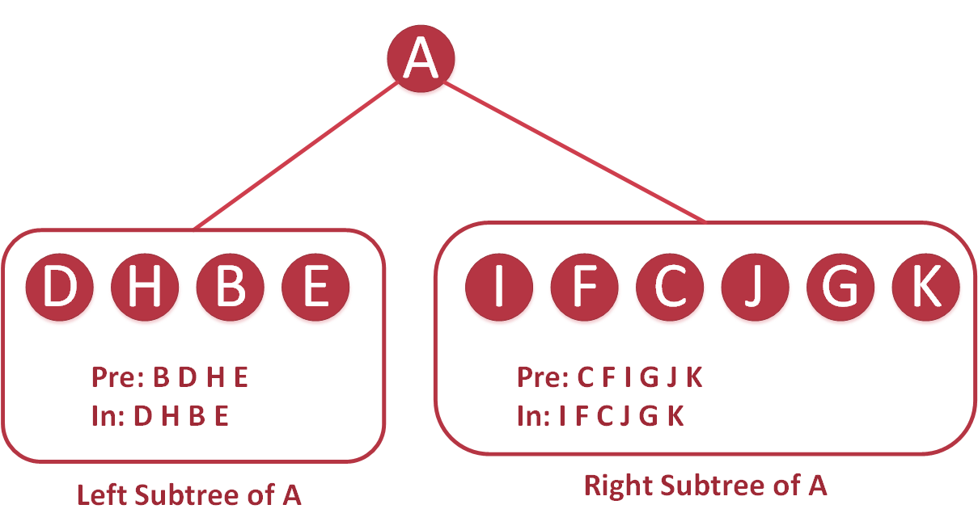

Slide 82
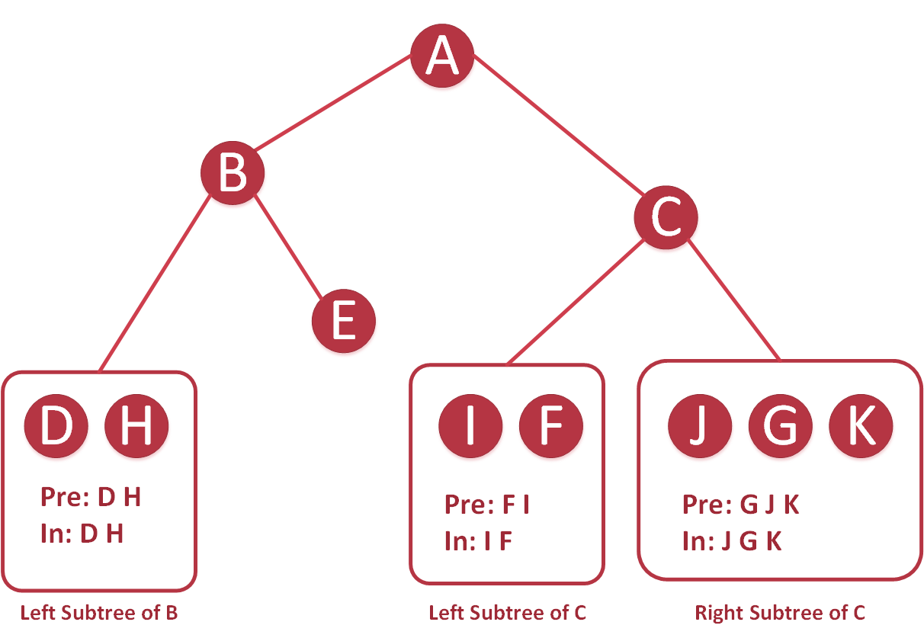

Slide 83
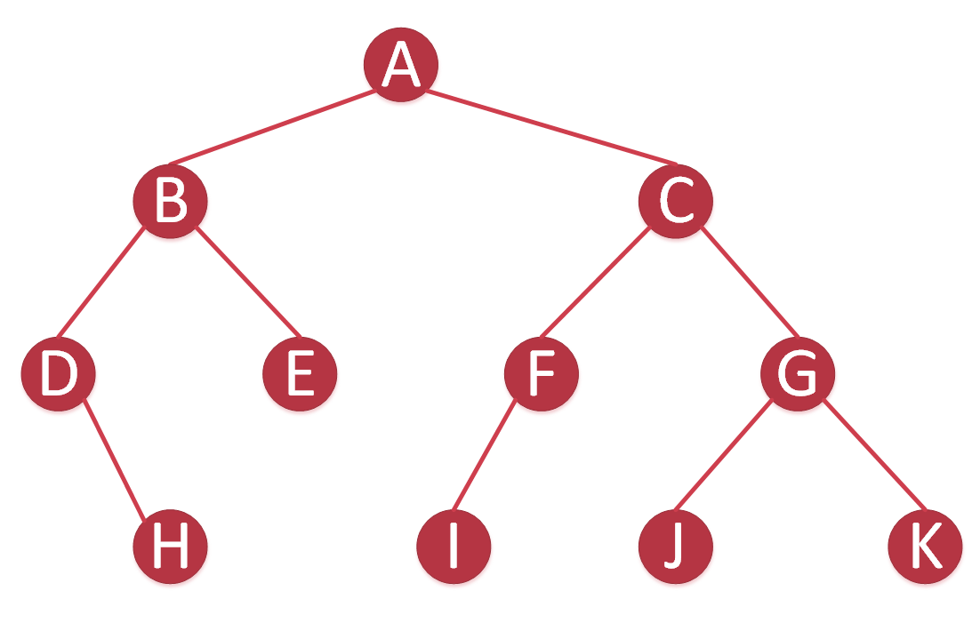

Slide 84
Inorder and postorder Traversal
Postorder : HIDJEBKFGCA
Inorder : HDIBEJAKFCG

Slide 85
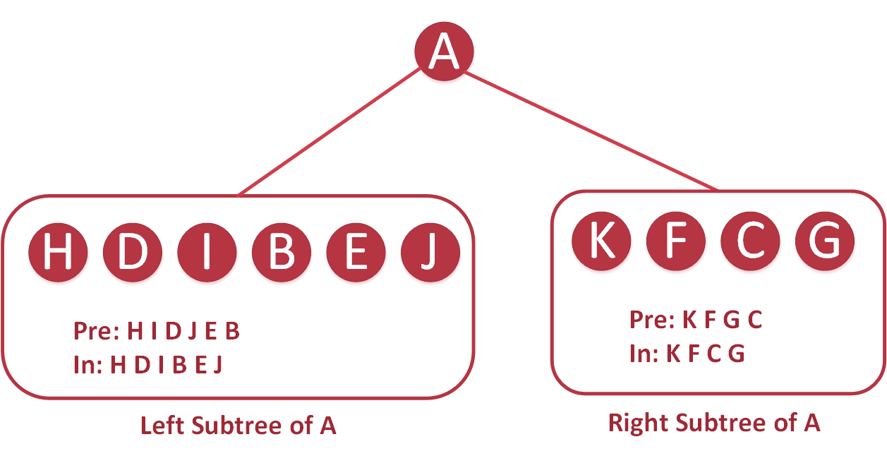

Slide 86
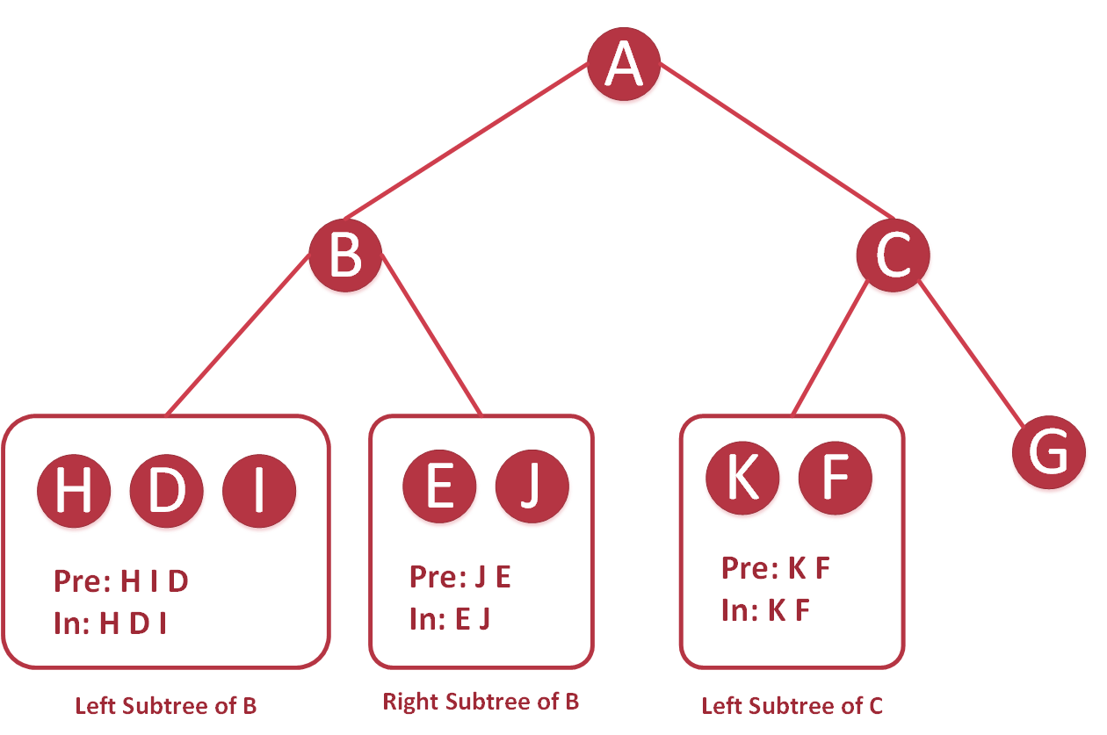

Slide 87
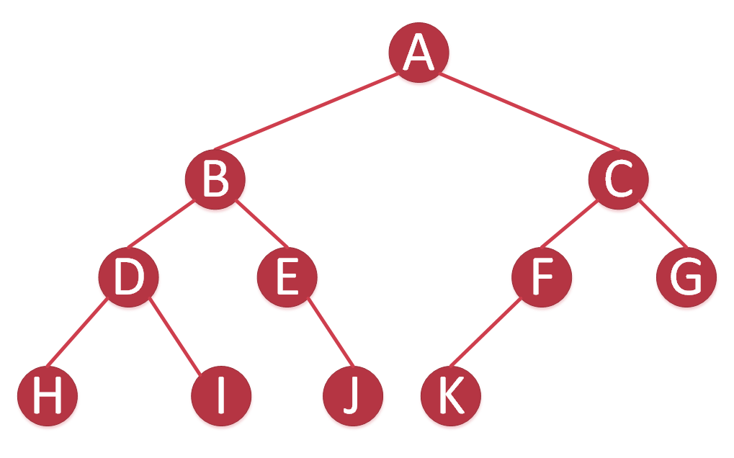

Slide 88
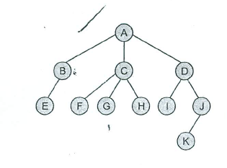
Creating a binary tree from a general tree

Slide 89
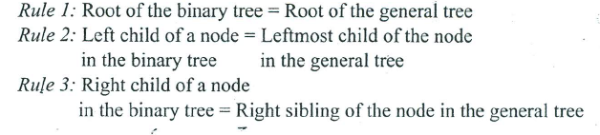
Rules

Slide 90

Step -1

Slide 91

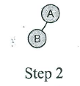
Step-2

Slide 92
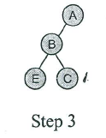
Step-3

Slide 93
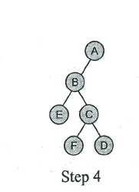
Step-4

Slide 94
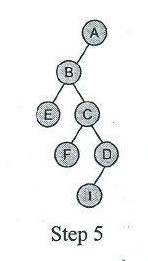
Step-5

Slide 95

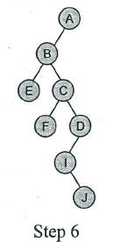
Step-6

Slide 96
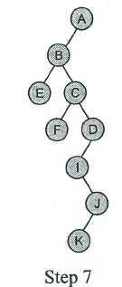
Step-7

Slide 97
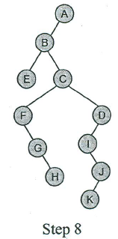
Step-8

Slide 98
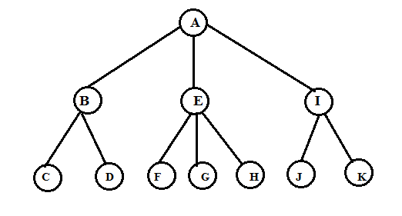
Converting General Tree to Binary Tree
Example 2:
General Tree

Slide 99
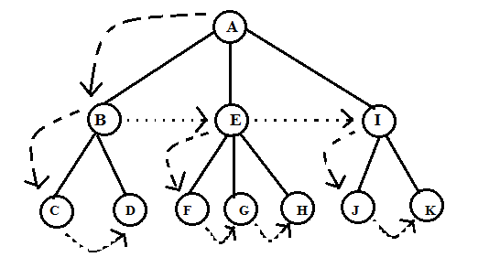
Arrows pointing to nodes that will become left and right children in binary tree.

Slide 100
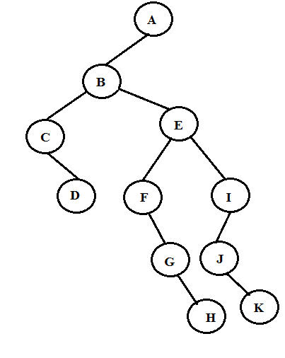
Binary Tree

Slide 101
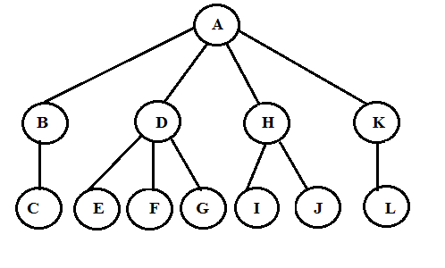
Example 3
General Tree

Slide 102
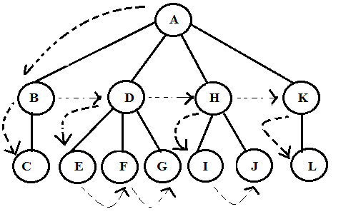
Arrows pointing to nodes that will become left and right children in binary tree.

Slide 103
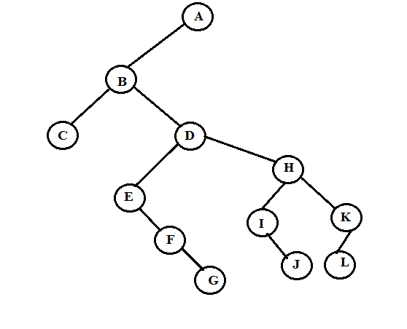
Binary Tree

Slide 104
Binary Search Trees
A binary search tree (BST), also known as an ordered binary tree, is a variant of binary tree in which the nodes are arranged in order.
In a BST, all nodes in the left sub-tree have a value less than that of the root node.
Correspondingly, all nodes in the right sub-tree have a value either equal to or greater than the root node.
The same rule is applicable to every sub-tree in the tree.
Due to its efficiency in searching elements, BSTs are widely used in dictionary problems where the code always inserts and searches the elements that are indexed by some key value.

Slide 105
Binary Search Tree
39
27
45
18
29
40
54
9
21
28
36
59
10
19
65
60

Slide 106
Creating a Binary Search from Given Values
45, 39, 56, 12, 34, 78, 32, 10, 89, 54, 67
45
45
45
45
45
45
45
39
56
39
56
39
56
39
39
56
39
56
12
78
12
12
78
12
34
45
34
34
32
39
56
45
45
12
78
39
56
39
56
10
34
12
54
78
12
54
78
32
10
34
89
67
10
34
89
32
32

Slide 107
Searching for a Value in a BST
The search function is used to find whether a given value is present in the tree or not.
The function first checks if the BST is empty. If it is, then the value we are searching for is not present in the tree, and the search algorithm terminates by displaying an appropriate message.
However, if there are nodes in the tree then the search function checks to see if the key value of the current node is equal to the value to be searched.
If not, it checks if the value to be searched for is less than the value of the node, in which case it should be recursively called on the left child node.
In case the value is greater than the value of the node, it should be recursively called on the right child node.

Slide 108
Algorithm to Search a Value in a BST
searchElement (TREE, VAL)
Step 1: IF TREE->DATA = VAL OR TREE = NULL, then
Return TREE
ELSE
IF VAL < TREE->DATA
Return searchElement(TREE->LEFT, VAL)
ELSE
Return searchElement(TREE->RIGHT, VAL)
[END OF IF]
[END OF IF]
Step 2: End

Slide 109
Algorithm to Insert a Value in a BST
Insert (TREE, VAL)
Step 1: IF TREE = NULL, then
  Allocate memory for TREE
SET TREE->DATA = VAL
  SET TREE->LEFT = TREE ->RIGHT = NULL
ELSE
  IF VAL < TREE->DATA
  Insert(TREE->LEFT, VAL)
  ELSE
  Insert(TREE->RIGHT, VAL)
[END OF IF]
[END OF IF]
Step 2: End

Slide 110
Deleting a Value from a BST
The delete function deletes a node from the binary search tree.
However, care should be taken that the properties of the BSTs do not get violated and nodes are not lost in the process.
The deletion of a node involves any of the three cases.
Case 1: Deleting a node that has no children.
For example, deleting node 78 in the tree below.
45
45
45
45
39
56
39
56
39
56
39
56
54
78
54
78
54
78
54
55
55
55
55

Slide 111
Deleting a Value from a BST
Case 2: Deleting a node with one child (either left or right).
To handle the deletion, the node’s child is set to be the child of the node’s parent.
Now, if the node was the left child of its parent, the node’s child becomes the left child of the node’s parent.
Correspondingly, if the node was the right child of its parent, the node’s child becomes the right child of the node’s parent.
45
45
45
45
39
56
39
56
39
56
39
56
54
78
54
78
54
78
55
78
55
55
55

Slide 112
Deleting a Value from a BST
Case 3: Deleting a node with two children.
To handle this case of deletion, replace the node’s value with its in-order predecessor (largest value in the left sub-tree) or in-order successor (smallest value in the right sub-tree).
The in-order predecessor or the successor can then be deleted using any of the above cases.
45
45
45
45
39
56
39
56
39
55
39
55
54
78
54
78
54
78
54
78
55
80
55
80
55
80
80

Slide 113
Algorithm to Delete from a BST
Delete (TREE, VAL)
Step 1: IF TREE = NULL, then
  Write “VAL not found in the tree”
ELSE IF VAL < TREE->DATA
  Delete(TREE->LEFT, VAL)
ELSE IF VAL > TREE->DATA
  Delete(TREE->RIGHT, VAL)
ELSE IF TREE->LEFT AND TREE->RIGHT
SET TEMP = findLargestNode(TREE->LEFT)
SET TREE->DATA = TEMP->DATA
Delete(TREE->LEFT, TEMP->DATA)
ELSE
SET TEMP = TREE
IF TREE->LEFT = NULL AND TREE ->RIGHT = NULL
SET TREE = NULL
ELSE IF TREE->LEFT != NULL
SET TREE = TREE->LEFT
ELSE
SET TREE = TREE->RIGHT
[END OF IF]
FREE TEMP
[END OF IF]
Step 2: End

Slide 114
Determining the Height of a BST
In order to determine the height of a BST, we will calculate the height of the left and right sub-trees. Whichever height is greater, 1 is added to it.
Since height of right sub-tree is greater than the height of the left sub-tree, the height of the tree = height (right sub-tree) + 1= 2 + 1 = 3
Height (TREE)
Step 1: IF TREE = NULL, then
Return 0
ELSE
SET LeftHeight = Height(TREE->LEFT)
SET RightHeight = Height(TREE->RIGHT)
IF LeftHeight > RightHeight
Return LeftHeight + 1
ELSE
Return RightHeight + 1
[END OF IF]
[END OF IF]
Step 2: End
45
39
78
54
80

Slide 115
Determining the Number of Nodes
To calculate the total number of elements/nodes in a BST, we will count the number of nodes in the left sub-tree and the right sub-tree.
Number of nodes = totalNodes(left sub-tree) + total Nodes(right sub-tree) + 1
totalNodes (TREE)
Step 1: IF TREE = NULL, then
Return 0
ELSE
Return totalNodes(TREE->LEFT) +
totalNodes(TREE->RIGHT) + 1
[END OF IF]
Step 2: End

Slide 116
Finding the Mirror Image of a BST
Mirror image of a binary search tree is obtained by interchanging the left sub-tree with the right sub-tree at every node of the tree. For example, given the tree T, the mirror image of T can be obtained as T’.
45
T
45
T’
39
78
78
39
54
79
79
54
MirrorImage (TREE)
Step 1: IF TREE != NULL , then
MirrorImage(TREE->LEFT)
MirrorImage(TREE->RIGHT)
SET TEMP = TREE->LEFT
SET TREE->LEFT = TREE->RIGHT
SET TREE_>RIGHT = TEMP
[END OF IF]
Step 2: End

Slide 117
Deleting a BST
To delete/remove the entire binary search tree from the memory, we will first delete the elements/nodes in the left sub-tree and then delete the right sub-tree.
deleteTree (TREE)
Step 1: IF TREE != NULL , then
deleteTree (TREE->LEFT)
deleteTree (TREE->RIGHT)
Free (TREE)
[END OF IF]
Step 2: End

Slide 118
Finding the Smallest Node in a BST
The basic property of a BST states that the smaller value will occur in the left sub-tree.
If the left sub-tree is NULL, then the value of root node will be smallest as compared with nodes in the right sub-tree.
So, to find the node with the smallest value, we will find the value of the leftmost node of the left sub-tree.
However, if the left sub-tree is empty then we will find the value of the root node.
findSmallestElement (TREE)
Step 1: IF TREE = NULL OR TREE->LEFT = NULL, then
Return TREE
ELSE
Return findSmallestElement(TREE->LEFT)
[END OF IF]
Step 2: End

