Slide 1
Object Oriented Programming using Java
By
Prof. R. S. Yadav
Notes:
Notes for title slide

Slide 2
Course Description
This is an introductory course, where students learn and practice essential programming skills using the Java programming language. This course provides an overview of Object Oriented Programming (OOP) concepts using Java/C++. It helps to understand basic OOP concepts and assist in applying these concepts. The principles behind OOP discussed. It covers object-oriented principles such as classes, objects, abstraction, composition, Inheritance, polymorphism, and interfaces. These concepts can be implemented in the Java language. Along the way, many of the Java library classes are seen that can be organized to solve a variety of problems.

Slide 3
Course Description (cont.)
The Java collection classes are studied. Additional topics include exception handling, database connectivity with JDBC, and multi-threading. The course is programming intensive. By the end of this course student will able to understand the basics of OOP and be prepared to take on more complex challenges. A lab course is associated with it to strengthen the concepts.

Slide 4
Course Outline (To be covered in 30 lectures)
Core Java: Introduction to Object Oriented Software development through Java. Classes and Objects. (6)
Inheritance, Polymorphism, Nested classes and interfaces, Exceptions, Strings, Packages, The I/O Package.(8)
Advanced Java: Event Handling, AWT, Swing, Applets, Multi-Threading, Generic, The collection frameworks.(8)
Networking, Java Server Pages (JSP), Java Servlet, Enterprise Java Beans (EJB), Java Messaging Service (JMS), Java Database connectivity (JDBC).(6)
Text Books
Jaime Nino and Frederick A. Hosch, “Introduction to programming and object oriented design using JAVA” Wieley Publication.
Kathy Sierra and Bert Bates, “Head First Java”, 2nd edition, O’Reilly
Herbert Schildt , “Java : The Complete Reference”, 9th edition, Oracle Press
Cay S. Horstmann and Gary Cornell , “Core Java Volume I & II”, 10th edition, Prentice-Hall
Tony Gaddis, “Starting Out with Java: From Control Structures through Objects”, 6th edition, Pearson
David Flanagan, “Java in a Nutshell”, 5th edition, O’Reilly

Slide 5
What is Java?
A programming language.
  As defined by Gosling, Joy, and Steele in the Java Language Specification
A platform
  A virtual machine (JVM) definition.
  Runtime environments in diverse hardware.
A class library
  Standard APIs for GUI, data storage, processing, I/O, and networking.

Slide 6
History
James Gosling and Sun Microsystems
Oak
Java, May 20, 1995, Sun World
HotJava
  The first Java-enabled Web browser
JDK Evolutions
J2SE, J2ME, and J2EE (not mentioned in the book, but could discuss here optionally)

Slide 7
Characteristics of Java
Java is simple
Java is object-oriented
Java is distributed
Java is interpreted
Java is robust
Java is secure
Java is architecture-neutral
Java is portable
Java’s performance
Java is multithreaded
Java is dynamic

Slide 8
Java Development Kit (JDK) Versions
JDK 1.02 (1995)
JDK 1.1 (1996)
Java 2 software development kit (SDK) v 1.2 (a.k.a JDK 1.2, 1998)
Java 2 SDK v 1.3 (a.k.a JDK 1.3, 2000)
Java 2 SDK v 1.4 (a.k.a JDK 1.4, 2002)

Slide 9
JDK Editions
Java Standard Edition (J2SE): Core JAVA
  J2SE can be used to develop client-side standalone applications or applets.
Java Enterprise Edition (J2EE):Advance JAVA
  It is an enterprise platform which is mainly used to develop web and enterprise applications. It is built on the top of Java SE platform. It includes topics like Servlet, JSP(Sava Server Page), Web Services, EJB(Enterprise Java Beans), JPA(Java Persistence API) etc.
Java Micro Edition (J2ME): Micro/Mobile
  J2ME can be used to develop applications for mobile devices such as cell phones.

Slide 10
JAVA (Integrated Development Environment)Tools
Forte by Sun MicroSystems
Borland JBuilder
Microsoft Visual J++
WebGain Café
IBM Visual Age for Java

Slide 11
Java Applications
Stand-alone Applications
  Just like any programming language
Applet
  Run under a Java-Enabled Browser
Midlet
  Run in a Java-Enabled Mobile Phone
Servlet
  Run on a Java-Enabled Web Server
Switchlet
Machine learning

Slide 12
Why Java?
Network Programming in Java is very different than in C/C++
  Much more language support
  Error handling
  No pointers! (garbage collection)
  Threads are part of the language.
  Some support for common application level protocols (HTTP).
  Dynamic class loading and secure sandbox execution for remote code.
  Source code and bytecode-level portability.

Slide 13
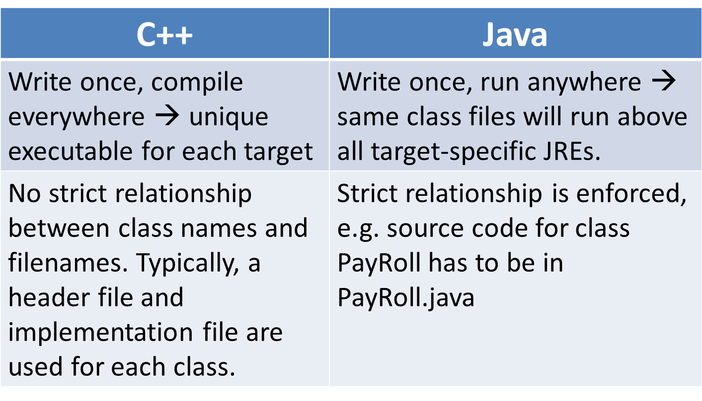
C++ vs. Java: differences
Appendix A: Introduction to Java

Slide 14
Java Processing and Execution
Begin with Java source code in text files: Model.java
A Java source code compiler produces Java byte code
  Outputs one file per class: Model.class
  May be standalone or part of an IDE
A Java Virtual Machine loads and executes class files
  May compile them to native code (e.g., x86) internally

Slide 15
What is in a .class file?
Create source file
Compile source file into .class file
Run the .class file

Slide 16
Advantages of Bytecode
Bytecode is architecture independent (and writing a VM is easier than rewriting a compiler for every architecture)
VMs can enforce different levels of security automatically (applets versus applications)
Just In-Time (JIT) compiling helps achieve same or better speed than traditional compiled code

Slide 17
Java Bytecode
Stack-based virtual machine
Small instruction set: 202 instructions (all are 1 byte opcode + operands)
Memory is typed
Every Java class file begins with magic number 3405691582 = 0xCAFEBABE

Slide 18
Javap examples
javac -g Test1.java
javap -c Test1
public class Test1 {
public int add(int a, int b) {
int c= a+b;
return c;
}
}
…
public int add(int, int);
Code:
0: iload_1
1: iload_2
2: iadd
3: istore_3
4: iload_3
5: ireturn
// push onto stack
// push onto stack
// add var 1 and 2
// store as local var 3
// store onto stack
// return int
Javap included with Java Development Kit (JDK)

Slide 19
Thank you
?

