Slide 1
Introduction to Java
R. S. Yadav
Notes:
Notes for title slide

Slide 2
Some Salient Characteristics of Java
Java is platform independent: the same program can run on any correctly implemented Java system
Java is object-oriented:
  Structured in terms of classes, which group data with operations on that data
  Can construct new classes by extending existing ones
Java designed as
  A core language plus
  A rich collection of commonly available packages
Java can be embedded in Web pages

Slide 3
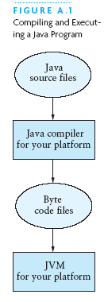
Compiling and Executing a Java Program

Slide 4
Processing and Running HelloWorld
javac HelloWorld.java
  Produces HelloWorld.class (byte code)
java HelloWorld
  Starts the JVM and runs the main method

Slide 5
Classes and Objects
The class is the unit of programming
A Java program is a collection of classes
  Each class definition (usually) in its own .java file
  The file name must match the class name
A class describes objects (instances)
  Describes their common characteristics: is a blueprint
  Thus, all the instances have these same characteristics
These characteristics are:
  Data fields for each object
  Methods (operations) that do work on the objects

Slide 6
A Little Example of import and main
import java.util.Scanner; // all classes of scanner
public class HelloWorld { // starts a class
public static void main (String[] args) {
// starts a main method
// in: array of String; out: none (void)
}
}
public = can be seen from any package
static = not “part of” an object

Slide 7
Class example
import java.util.Scanner;
public class student
{
public static void main(String[] args)
{
Scanner sc=new Scanner( System.in);
System.out.println("Please enter your Roll Number");
int rollNumber=sc.nextInt();
System.out.println( "please enter you first name");
String firstName =sc.next();
System.out.println("please enter your last name");
String lastName =sc.next();
System.out.println("Roll Number: "+rollNumber + " First Name: "+firstName +" Last Name: "+lastName);
sc.close();
}
}

Slide 8
References and Primitive Data Types
Java distinguishes two kinds of entities
  Primitive types
  Objects
Primitive-type data is stored in primitive-type variables
Ex- int a=10;
Reference variables store the address of an object
Ex- A a = new A();
  No notion of “object (physically) in the stack”
  No notion of “object (physically) within an object”

Slide 9
Primitive Data Types
Represent numbers, characters, boolean values
Integers: byte, short, int, and long
Real numbers: float and double
Characters: char
Boolean : boolean

Slide 10
Primitive Data Types
Data type | Range of values
byte | -128 .. 127 (8 bits)
short | -32,768 .. 32,767 (16 bits)
int | -2,147,483,648 .. 2,147,483,647 (32 bits)
long | -9,223,372,036,854,775,808 .. ... (64 bits)
float | +/-10⁻³⁸ to +/-10⁺³⁸ and 0, about 6 digits precision
double | +/-10⁻³⁰⁸ to +/-10⁺³⁰⁸ and 0, about 15 digits precision
char | Unicode characters (generally 16 bits per char)
boolean | True or false

Slide 11
Operators
subscript [ ], call ( ), member access .
pre/post-increment ++ --, boolean complement !, bitwise complement ~, unary + -, type cast (type), object creation new
* / %
binary + - (+ also concatenates strings)
signed shift << >>, unsigned shift >>>
comparison < <= > >=, class test instanceof
equality comparison == !=
bitwise and &
bitwise or |

Slide 12
Operators
logical (sequential) and &&
logical (sequential) or ||
conditional cond ? true-expr : false-expr
assignment =, compound assignment += -= *= /= <<= >>= >>>= &= |=

Slide 13
Data Type Compatibility and Conversion
Widening conversion:
  In operations on mixed-type operands, the numeric type of the smaller range is converted to the numeric type of the larger range
  In an assignment, a numeric type of smaller range can be assigned to a numeric type of larger range
byte to short to int to long
Long to float to double
Its also called auto promotion.

Slide 14
Data Type Compatibility and Conversion
Narrowing
  Converting a value of larger range to value of smaller range.
  Example: int i; byte b; b=i; //invalid
  b= (byte)i; //valid
For type conversion and casting the Assignment Operator is used between the two values.
General form: var = exp
Example: int i=10;
long m=10000L;
double d=Math.PI;//PI=3.1415….
i=(int)m;//cast
m=i;//widening
m=(long)d;//cast
d=m;widening

Slide 15
datatype size
class SizePrimitiveTypes {
public static void main(String[] args) {
System.out.println("Size of byte: " + (Byte.SIZE/8) + " bytes."); System.out.println("Size of short: " + (Short.SIZE/8) + " bytes."); System.out.println("Size of int: " + (Integer.SIZE/8) + " bytes."); System.out.println("Size of long: " + (Long.SIZE/8) + " bytes."); System.out.println("Size of char: " + (Character.SIZE/8) + " bytes."); System.out.println("Size of float: " + (Float.SIZE/8) + " bytes."); System.out.println("Size of double: " + (Double.SIZE/8) + " bytes.");
} }
OUTPUT ======
D:\JavaPrograms>javac SizePrimitiveTypes.java
D:\JavaPrograms>java SizePrimitiveTypes
Size of byte: 1 bytes.
Size of short: 2 bytes.
Size of int: 4 bytes.
Size of long: 8 bytes.
Size of char: 2 bytes.
Size of float: 4 bytes.
Size of double: 8 bytes.

Slide 16
Instance Variables
Instance variables store the data of an object
Instance of a class: an object of the class
The class declaration specifies the instance variables:
  public class Counter
  {
  private int value;
  …
  }

Slide 17
Instance Variables
An instance variable declaration consists of the following parts:
  access specifier (private)
  type of variable (such as int)
  name of variable (such as value)
Each object of a class has its own set of instance variables
You should declare all instance variables as private

Slide 18
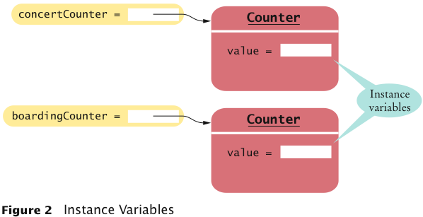
Instance Variables

Slide 19
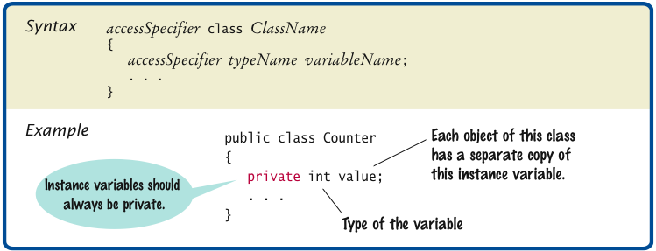
Syntax 3.1 Instance Variable Declaration

Slide 20
What is static
The static keyword is used when a member variable of a class has to be shared between all the instances of the class.
All static variables and methods belong to the class and not to any instance of the class

Slide 21
When can we access static variable ?
When a class is loaded by the virtual machine all the static variables and methods are available for use.
Hence we don’t need to create any instance of the class for using the static variables or methods.
Variables which don’t have static keyword in the definition are implicitly non static.

Slide 22
Example
Class staticDemo{
public static int a = 100; // All instances of staticDemo have this variable as a common `
variable
public int b =2 ;
public static showA(){
System.out.println(“A is “+a);
}
}
Class execClass{
public static void main(String args[]){
staticDemo.a = 35; // when we use the class name, the class is loaded, direct access to a without any instance
staticDemo.b=22; // ERROR this is not valid for non static variable
staticDemo demo = new staticDemo();
demo.b = 200; // valid to set a value for a non static variable after creating an instance.
staticDemo.showA(); //prints 35
}
}

Slide 23
Static and Non-static
We can access static variables without creating an instance of the class
As they are already available at class loading time, we can use them in any of our static methods.
We cannot use non static methods and variables without creating an instance of the class as they are bound to the instance of the class.
They are initialized by the constructor when we create the object using new operator.

Slide 24
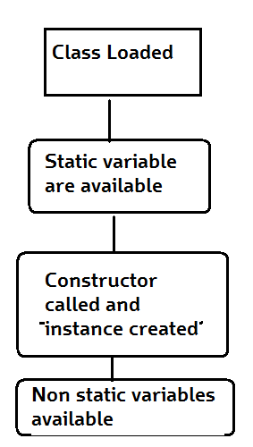
How static variable works?
Basic Steps of how objects are created
Class is loaded by JVM
Static variable and methods are loaded and initialized and available for use
Constructor is called to instantiate the non static variables
Non static variables and methods are now available
As all the non static variable are available only after the constructor is called, there is a restriction on using non static variable in static methods.

Slide 25
Why do we need static variable ?
Static methods are identified to be mostly used when we are writing any utility methods.
We can also use static variables when sharing data.
When sharing data do keep in mind about multithreading can cause inconsistency in the value. (synchronize the variable)

Slide 26
Local Variables
A code block’s local variables are those declared in the code block.
  NOT variables from higher code blocks: A in above example is local variable for block 1 only
  NOT variables declared in nested sub-blocks: B in above example is NOT local to block 1.
A class’s fields are not considered local variables: they are member variables

Slide 27
Local Variables
A method’s parameters are local to the block of the method’s body.
  public void aMethod(int A){...};
If new variables are declared in the initialization of a for loop, they are local to the loop body.
  for (int i = 0; i < N; i++);
i’s scope is just the body of the loop.

Slide 28
Hiding fields
If a local variable is declared with the same name as an in scope field, that field is “hidden” or “shadowed”.
  class MyClass {
  int A; // field
  public void someMethod() {
  String A;// Local variable
  }

Slide 29
Methods
There are two type of method in java : instance and static method.
Method are define inside the class.
In case of instance method it will be created for each object of class.
In instance java method each object is created independently consisting of methods and data.
In case we want to share some methods we have to declare the method as static type. Here it will allocate common area shared by each object.

Slide 30
Methods
class stringbuffer_input{
public void string_input() //instance method
{
StringBuffer sb=new StringBuffer("Hello");
sb.insert(5,"JAVA");
System.out.println(sb);
}
public static void replace_string() //static method
{
String s1= "Naveen kumar Gupta";
// for group of character replacement
// String replaceString=s1.replace("Naveen kumar","Pramod");
String replaceString=s1.replace(" ","p");
System.out.println(replaceString);
}

Slide 31
References
Material available at following url :-
https://www.google.com/search?ei=-fNiW_aeMIvwvgTir4ioDA&q=instance+method&oq=insta&gs_l=psy-ab.1.0.0i67k1j0i131k1j0i67k1l3j0i131k1j0i67k1l4.6081.7454.0.10245.5.5.0.0.0.0.184.785.0j5.5.0....0...1.1.64.psy-ab..0.5.783...0.0.1z0m7TjkWLU
https://stackoverflow.com/questions/6766343/best-practice-for-getting-datatype-sizesizeof-in-java
https://www.javatpoint.com/q/3783/what-is-instance-methods-in-java?

Slide 32
Thank You
?

