Slide 1
Introduction to garbage collection and array in Java
R. S. Yadav
Notes:
Notes for title slide

Slide 2
Digital lock
Q. No. 1.You are required to model simple digital lock with integer digit combination of three security keys. The combination is set into unlock when it is
created security keys. To open the lock user must give correct combination given in term of single digit at a time. The lock explicitly remember last three digits entered.
Q. No. 2.You are required to model simple digital lock with integer digit combination of three security keys. The combination is set into unlock when it is
created security keys. To open the lock user must give correct combination given in term of single digit at a time. The lock instead of remembering last three digits entered to make the lock open. The lock remembers if last digit entered was first security key and if last two digits were first two security keys.

Slide 3
(Solution 1) Digital lock
/* Program to implement digital lock security where system explicitly remember
last three digit entered*/
import java.util.Scanner;
class CombinationLock{
private int firstCombinationDigit;
private int secondCombinationDigit;
private int thirdCombinationDigit;
private int firstEnteredDigit;
private int secondEnteredDigit;
private int thirdEnteredDigit;
private boolean open;
// Constructor
public CombinationLock(int combinationKey)
{
thirdCombinationDigit=combinationKey%10;
combinationKey =combinationKey/10;
secondCombinationDigit=combinationKey%10;
firstCombinationDigit=combinationKey/10;
open=true;
firstEnteredDigit=-1;
secondEnteredDigit=-1;
thirdEnteredDigit=-1;
}// Constructor

Slide 4
(Solution 1) Digital lock
public boolean open()
{
return open;
}//open
public void close ()
{
open=false;
firstEnteredDigit=-1;
thirdEnteredDigit=-1;
secondEnteredDigit=-1;
}//close
//Combinantion_key_input public void digit_input( int digit)
{
firstEnteredDigit=secondEnteredDigit;
secondEnteredDigit=thirdEnteredDigit;
thirdEnteredDigit=digit;
if(firstEnteredDigit==firstCombinationDigit && secondEnteredDigit==secondCombinationDigit &&thirdEnteredDigit==thirdCombinationDigit)
open= true;
}//digit_input
}//class CombinantionLock

Slide 5
(Solution 1) Digital lock
public class DigitalLock
{
static int securityKey, digit;
public static void main(String[] args) {
Scanner sc=new Scanner(System.in);
//CombinationLock lock=new CombinationLock();
System.out.println("please enter security key : ");
securityKey=sc.nextInt();
CombinationLock lock=new CombinationLock(securityKey);
//lock.Combinantion_key_input( securityKey);
System.out.println("lock status : "+ lock.open());
lock.close();
System.out.println("lock status : "+ lock.open());
while (!lock.open())
{
System.out.println("please enter digit : ");
digit=sc.nextInt();
lock.digit_input(digit);
}
System.out.println("lock status : "+ lock.open());
}//main
}//class DigitalLock

Slide 6
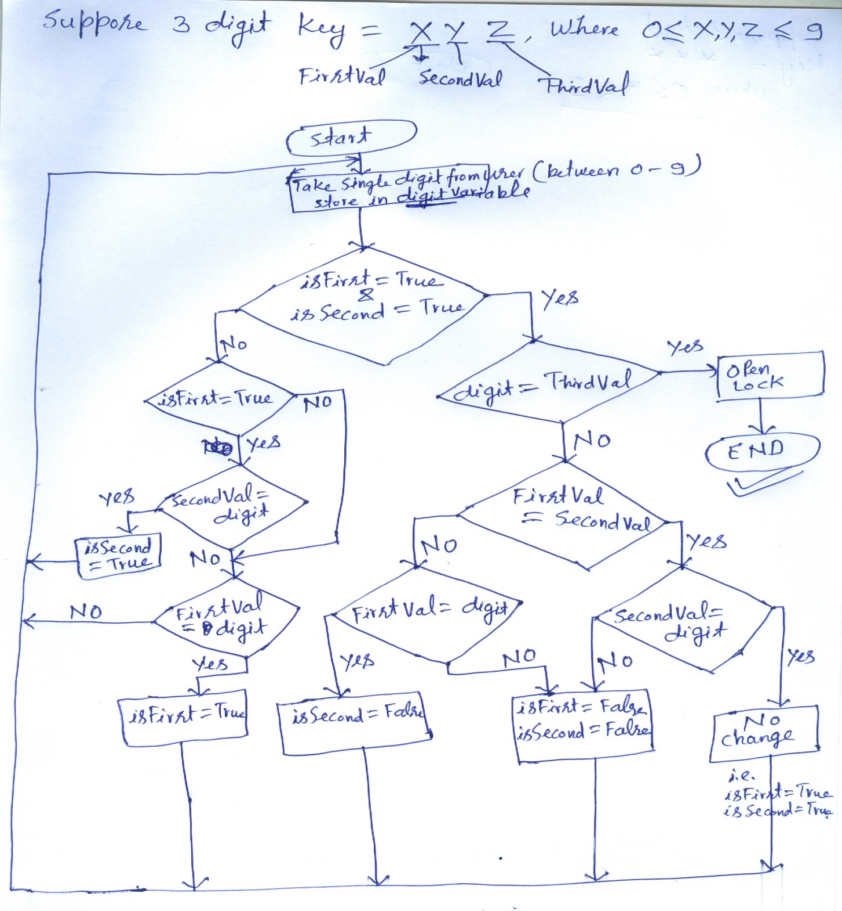

Slide 7
(Solution 2) Digital lock
/* Program to implement digital lock security where system explicitely remember
last three digit entered on occurrence of following conditions
1. Last digit entered is first combination digit
2. Last two digit entered were first two digit combination*/
import java.util.Scanner;
class CombinationLock{
private int firstCombinationDigit;
private int secondCombinationDigit;
private int thirdCombinationDigit;
private boolean open, haveFirst, haveSecond, haveThird;
// Constructor
public CombinationLock(int combinationKey)
{
thirdCombinationDigit=combinationKey%10;
combinationKey =combinationKey/10;
secondCombinationDigit=combinationKey%10;
firstCombinationDigit=combinationKey/10;
open=true;
haveFirst=false;
haveSecond=false;
haveThird=false;
}// Constructor

Slide 8
(Solution 2) Digital lock
public boolean haveFirst(int digit)
{
return digit==firstCombinationDigit;
}//haveFirst
public boolean haveSecond(int digit)
{
return digit==secondCombinationDigit;
}//haveSecond
public boolean haveThird(int digit)
{
return digit==thirdCombinationDigit;
}//haveSecond
public boolean open()
{
return open;
}//open
public void close ()
{
open=false;
}//close

Slide 9
(Solution 2) Digital lock
public void digit_input( int digit)
{
if (haveFirst&&haveSecond) {
haveThird=haveThird(digit);
if(haveThird) open=true;
else{ // else if(haveThird)
if(firstCombinationDigit==secondCombinationDigit)
{
if(!(haveSecond=haveSecond(digit))){ haveFirst=false;haveSecond=false;}
}//if(firstCombinationDigit==secondCombinationDigit)
else//if(firstCombinationDigit==secondCombinationDigit)
{
if(haveFirst=haveFirst(digit))haveSecond=false;
else{ haveFirst=false;haveSecond=false;}
}//if(firstCombinationDigit==secondCombinationDigit)
}//else if(haveThird)
}//if (haveFirst&&haveSecond)
else{//if (haveFirst&&haveSecond)
if (haveFirst) haveSecond=haveSecond(digit);
else// elseif (haveFirst)
{
haveFirst=haveFirst(digit);
haveSecond=false;
}// elseif (haveFirst)
}//elseif (haveFirst&&haveSecond)
}//digit_input
}//class CombinantionLock

Slide 10
(Solution 2) Digital lock
public class DigitalLockCondition
{
static int securityKey, digit;
//static boolean lockStatus,open;
public static void main(String[] args) {
Scanner sc=new Scanner(System.in);
//CombinationLock lock=new CombinationLock();
System.out.println("please enter security key : ");
securityKey=sc.nextInt();
CombinationLock lock=new CombinationLock(securityKey);
//lock.Combinantion_key_input( securityKey);
System.out.println("lock status : "+ lock.open());
lock.close();
System.out.println("lock status : "+ lock.open());
while (!lock.open())
{
System.out.println("please enter digit : ");
digit=sc.nextInt();
lock.digit_input(digit);
//if ( lockStatus) open=true;
}//while (!lock.open())
System.out.println("lock status : "+ lock.open());
}//main
}//class DigitalLock

Slide 11
Garbage Collection
What is garbage and how can we deal with it?
Garbage collection schemes
  Reference Counting
  Mark and Sweep

Slide 12
How Objects are Created in Java
An object is created in Java by invoking the new() operator.
Calling the new() operator, the JVM will do the following:
  allocate memory;
  assign fields their default values;
  run the constructor;
  a reference is returned.

Slide 13
How Java Reclaims Objects Memory
Java does not provide the programmer any means to destroy objects explicitly
The advantages are
  No dangling reference problem in Java (i.e. in C & C++)
  Easier programming
  No memory leak problem (i.e. in C & C++)

Slide 14
What is Garbage?
Garbage: unreferenced objects
  Student ali= new Student();
  Student khalid= new Student();
  ali=khalid;
Now ali Object becomes a garbage,
It is unreferenced Object
Ali Object
ail
khalid
Khalid Object

Slide 15
What is Garbage Collection?
What is Garbage Collection?
  Finding garbage and reclaiming memory allocated to it.
Why Garbage Collection?
  the heap space occupied by an un-referenced object can be recycled and made available for subsequent new objects
When is the Garbage Collection process invoked?
  When the total memory allocated to a Java program exceeds some threshold.
Is a running program affected by garbage collection?
  Yes, the program suspends during garbage collection.

Slide 16
Advantages of Garbage Collection
Garbage collection eliminates the need for the programmer to deallocate memory blocks explicitly
Garbage collection helps ensure program integrity.
Garbage collection can also dramatically simplify programs.

Slide 17
Disadvantages of Garbage Collection
Garbage collection adds an overhead that can affect program performance.
Garbage collection requires extra memory.
Programmers have less control over the scheduling of CPU time.

Slide 18
Helping the Garbage Collector
Reuse objects instead of generating new ones.
  This program generates one million objects and prints them out, generating a lot of garbage
    for (int i=0;i<1000000; ++i) {
    SomeClass obj= new SomeClass(i);
    System.out.println(obj);
    }
  Using only one object and implementing the setInt() method, we dramatically reduce the garbage generated.
    SomeClass obj= new SomeClass();
    for (int i=0;i< 1000000; ++i) {
    obj.setInt(i);
    System.out.println(onj);
    }
Eliminate all references to objects that are no longer needed
  This can be done by assigning null to every variable that refers to an object that is no longer needed

Slide 19
Common Garbage Collection Schemes
Main methods of garbage collection:
  Reference counting
  Mark-and-sweep

Slide 20
Reference Counting Garbage Collection
Main Idea: Add a reference count field for every object.
This Field is updated when the number of references to an object changes.
Example
Object p= new Integer(57);
Object q = p;
p
57
refCount = 2
q

Slide 21
Reference Counting (cont'd)
The update of reference field when we have a reference assignment ( i.e p=q) can be implemented as follows
  if (p!=q)
  {
  if (p!=null)
  --p.refCount;
  p=q;
  if (p!=null)
  ++p.refCount;
  }
Example:
Object p = new Integer(57);
Object q= new Integer(99);
p=q
p
57
refCount = 0
q
99
refCount = 2

Slide 22
Reference Counting (cont'd)
Reference counting will fail whenever the data structure contains a cycle of references and the cycle is not reachable from a global or local reference
head
ListElements
ListElements
ListElements
next
next
next
refCount = 1
refCount = 1
refCount = 1

Slide 23
Reference Counting (cont'd)
Advantages
  Conceptually simple: Garbage is easily identified
  It is easy to implement.
  Immediate reclamation of storage
  Objects are not moved in memory during garbage collection.
Disadvantages
  Reference counting does not detect garbage with cyclic references.
  The overhead of incrementing and decrementing the reference count each time.
  Extra space: A count field is needed in each object.
  It may increase heap fragmentation.

Slide 24
Mark-and-Sweep Garbage Collection
The mark-and-sweep algorithm is divided into two phases:
  Mark phase: the garbage collector traverses the graph of references from the root nodes and marks each heap object it encounters. Each object has an extra bit: the mark bit – initially the mark bit is 0. It is set to 1 for the reachable objects in the mark phase.
  Sweep phase: the Garbage collection scans the heap looking for objects with mark bit 0 – these objects have not been visited in the mark phase – they are garbage. Any such object is added to the free list of objects that can be reallocated. The objects with a mark bit 1 have their mark bit reset to 0.

Slide 25
Mark and Sweep (cont'd)
Advantages
  It is able to reclaim garbage that contains cyclic references.
  There is no overhead in storing and manipulating reference count fields.
  Objects are not moved during Garbage collection – no need to update the references to objects.
Disadvantages
  It may increase heap fragmentation.
  It does work proportional to the size of the entire heap.
  The program must be halted while garbage collection is being performed.

Slide 26
Four States of Memory Chunks
Free = not holding an object; available for allocation.
Unreached = Holds an object, but has not yet been reached from the root set.
Unscanned = Reached from the root set, but its references not yet followed.
Scanned = Reached and references followed.

Slide 27
Mark and Sweep Algorithm
Garbage Detection
    Depth-first search to mark live data cells (cells in heap reachable from variables on run-time stack).
Garbage Reclamation
    Sweep through entire memory, putting unmarked nodes on freelist. Sweep also unmarks the marked nodes.
L9GC
ceg860 (Prasad)

Slide 28
Mark-and-Sweep
Basic idea
  go through all memory and mark every chunk that is referenced
  make a second pass through memory and remove all chunks not marked
OS
0
1
2
3
p2 = 650
p2 = 360
0
100
350
450
600
Mark chunks 0, 1, and 3 as marked
Place chunk 2 on the free list (turn it into a hole)

Slide 29
Mark and Sweep Example
root
A
0
B
0
C
0
D
0
E
0
F
0
free
After mark:
root
A
1
B
0
C
1
D
0
E
0
F
1
free
After sweep:
root
A
0
B
0
C
0
D
0
E
0
F
0
free
L9GC
ceg860 (Prasad)

Slide 30
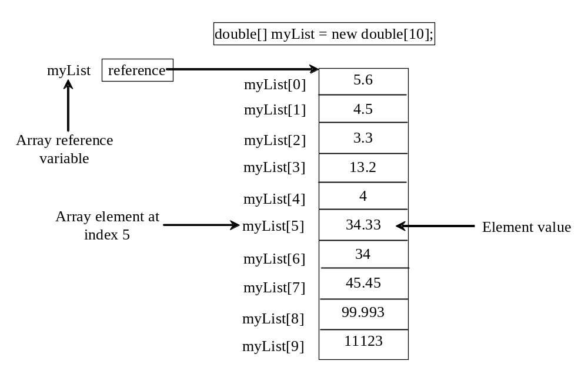
Introducing Arrays
Array is a data structure that represents a collection of the same types of data.

Slide 31
Declaring Array Variables
datatype[] arrayRefVar;
Example:
double[] myList;
datatype arrayRefVar[]; // This style is allowed, but not preferred
Example:
double myList[];

Slide 32
Creating Arrays
arrayRefVar = new datatype[arraySize];
Example:
myList = new double[10];
myList[0] references the first element in the array.
myList[9] references the last element in the array.

Slide 33
Declaring and Creating in One Step
datatype[] arrayRefVar = new
datatype[arraySize];
double[] myList = new double[10];
datatype arrayRefVar[] = new
datatype[arraySize];
double myList[] = new double[10];

Slide 34
The Length of an Array
Once an array is created, its size is fixed. It cannot be changed. You can find its size using
    arrayRefVar.length
For example,
    myList.length returns 10

Slide 35
Default Values
When an array is created, its elements are assigned the default value of
  0 for the numeric primitive data types,
  '\u0000' for char types, and
  false for boolean types.

Slide 36
Array Initializers
Declaring, creating, initializing in one step:
double[] myList = {1.9, 2.9, 3.4, 3.5};
This shorthand syntax must be in one statement.

Slide 37
Declaring, creating, initializing Using the Shorthand Notation
double[] myList = {1.9, 2.9, 3.4, 3.5};
This shorthand notation is equivalent to the following statements:
double[] myList = new double[4];
myList[0] = 1.9;
myList[1] = 2.9;
myList[2] = 3.4;
myList[3] = 3.5;

Slide 38
Processing Arrays
(Initializing arrays)
(Printing arrays)
(Summing all elements)
(Finding the largest element)
(Finding the smallest index of the largest element)

Slide 39
Enhanced for Loop
JDK 1.5 introduced a new for loop that enables you to traverse the complete array sequentially without using an index variable. For example, the following code displays all elements in the array myList:
  for (double value: myList)
  System.out.println(value);
In general, the syntax is
  for (elementType value: arrayRefVar) {
  // Process the value
  }
You still have to use an index variable if you wish to traverse the array in a different order or change the elements in the array.

Slide 40
Example: Testing Arrays
Objective: The program receives 6 numbers from the user, finds the largest number and counts the occurrence of the largest number entered.
Suppose you entered 3, 5, 2, 5, 5, and 5, the largest number is 5 and its occurrence count is 4.

Slide 41
Two-dimensional Arrays
// Declare array ref var
dataType[][] refVar;
// Create array and assign its reference to variable
refVar = new dataType[10][10];
// Combine declaration and creation in one statement
dataType[][] refVar = new dataType[10][10];
// Alternative syntax
dataType refVar[][] = new dataType[10][10];

Slide 42
Declaring Variables of Two-dimensional Arrays and Creating Two-dimensional Arrays
int[][] matrix = new int[10][10];
or
int matrix[][] = new int[10][10];
matrix[0][0] = 3;
for (int i = 0; i < matrix.length; i++)
for (int j = 0; j < matrix[i].length; j++)
matrix[i][j] = (int)(Math.random() * 1000);
double[][] x;

Slide 43
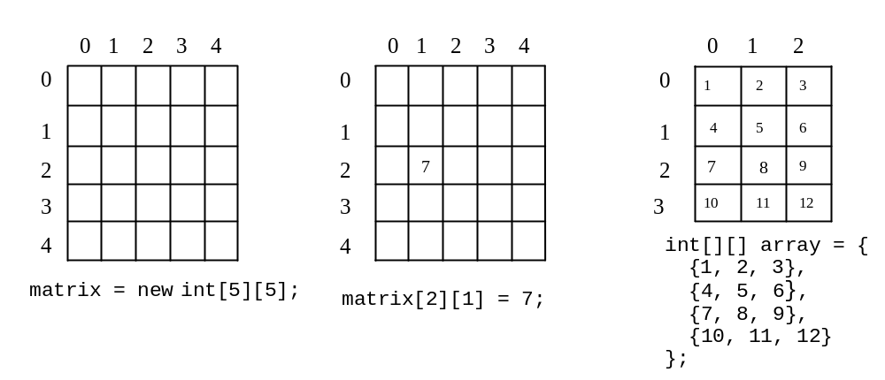
Two-dimensional Array Illustration
matrix.length? 5
matrix[0].length? 5
array.length? 4
array[0].length? 3

Slide 44
Declaring, Creating, and Initializing Using Shorthand Notations
You can also use an array initializer to declare, create and initialize a two-dimensional array. For example,
int[][] array = {
{1, 2, 3},
{4, 5, 6},
{7, 8, 9},
{10, 11, 12}
};
int[][] array = new int[4][3];
array[0][0] = 1; array[0][1] = 2; array[0][2] = 3;
array[1][0] = 4; array[1][1] = 5; array[1][2] = 6;
array[2][0] = 7; array[2][1] = 8; array[2][2] = 9;
array[3][0] = 10; array[3][1] = 11; array[3][2] = 12;
Same as

Slide 45
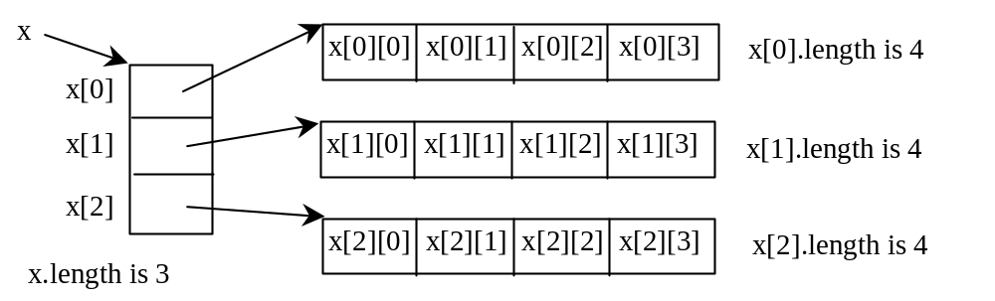
Lengths of Two-dimensional Arrays
int[][] x = new int[3][4];

Slide 46
Lengths of Two-dimensional Arrays, cont.
int[][] array = {
{1, 2, 3},
{4, 5, 6},
{7, 8, 9},
{10, 11, 12}
};
array.length
array[0].length
array[1].length
array[2].length
array[3].length
array[4].length ArrayIndexOutOfBoundsException

Slide 47
Ragged Arrays
Each row in a two-dimensional array is itself an array. So, the rows can have different lengths. Such an array is known as a ragged array. For example,
int[][] matrix = {
{1, 2, 3, 4, 5},
{2, 3, 4, 5},
{3, 4, 5},
{4, 5},
{5}
};
matrix.length is 5
matrix[0].length is 5
matrix[1].length is 4
matrix[2].length is 3
matrix[3].length is 2
matrix[4].length is 1

Slide 48
Problems sheet on array
Note: You are required to write the program in java using object oriented concept where a small functionality is required to be used as member function of a class. Further, data are represented form of array. Also write the abstract of classes.
Convert integer decimal number to binary number
Convert floating point decimal number to binary number
Convert binary number to floating point decimal number
Count the number of 1’s in binary number using shift ( left or right) operators.
You are required to generate a four bit cyclic binary counter that starts counting in upward direction from given value and on reaching to the highest value of counting starts counting in reverse direction up to the given value for upward counting. It repeat the cycle. Your program get binary input from user and display each output as four binary digits starting from most significant digit to the least significant digit. Further, you are required to add a delay of 10000 iteration using for loop between two consecutive output displayed. The display must be sufficient for distinguishing two consecutive displays.
Sort an integer array in ascending order using bubble sort.
Merge two ascending order sorted integer array into ascending order sorted array.

Slide 49
Problems sheet on array (cont.)
Note: You are required to write the program in java using object oriented concept where a small functionality is required to be used as member function of a class. Further, data are represented form of array.
Merge two ascending order sorted integer array into descending order sorted array.
Merge two sorted integer array where first one is in ascending order while second one in descending order into ascending order sorted array.
Sort an integer array in ascending order using merge sort.
You are required to compute the following activities on two dimensional integer array.
Transpose the array.
Sum the diagonal elements.
Print the upper triangular of the array.
add the two arrays.
multiply two arrays.

