Slide 1
THIS Keyword
Keyword THIS is a reference variable in Java that refers to the current object.
The various usages of 'THIS' keyword in Java are as follows:
It can be used to refer instance variable of current class
It can be used to invoke or initiate current class constructor
It can be passed as an argument in the method call
It can be passed as argument in the constructor call
It can be used to return the current class instance

Slide 2
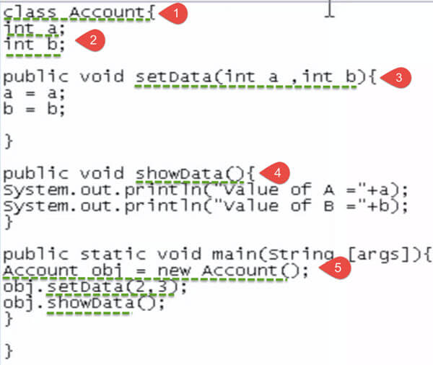
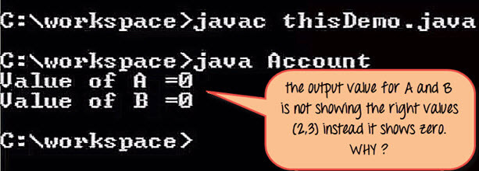
THIS Keyword (Cont…)

Slide 3
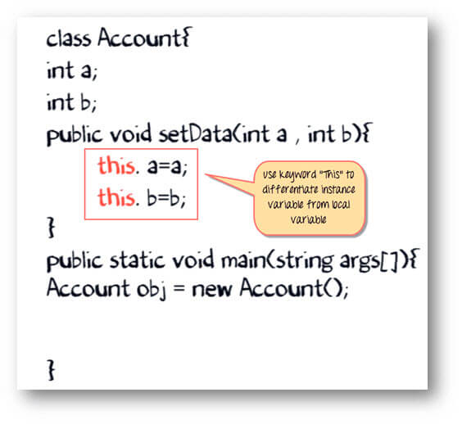
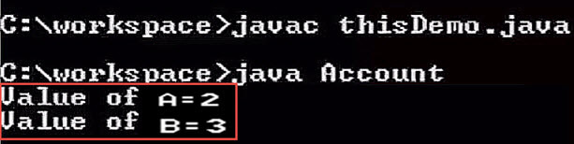
THIS Keyword (Cont…)

Slide 4
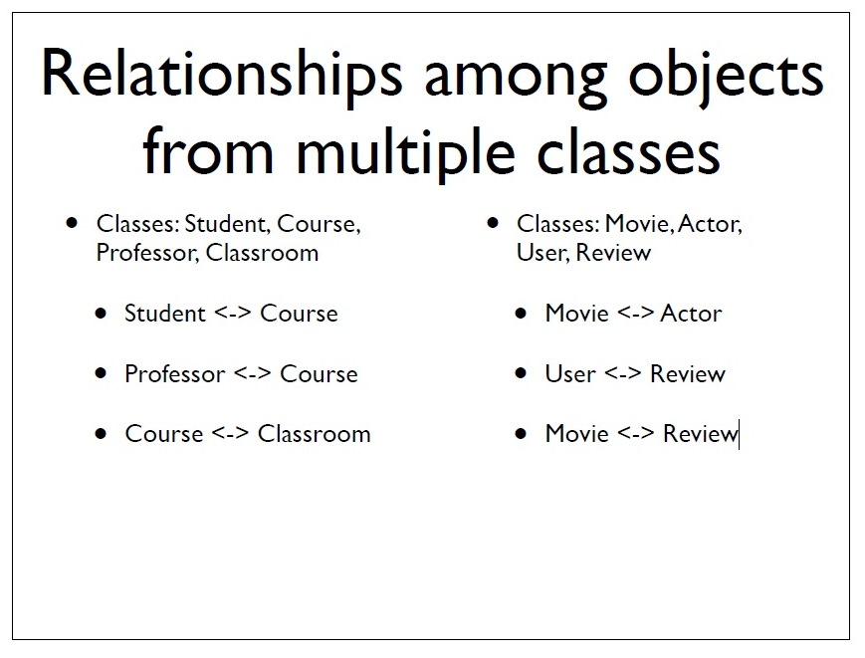

Slide 5
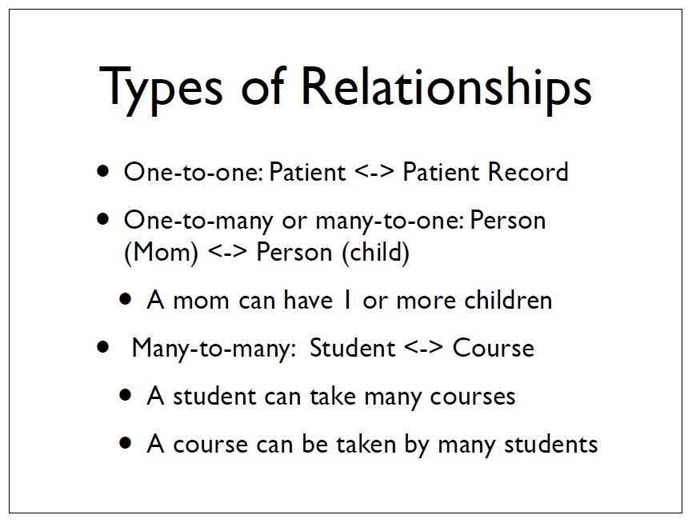

Slide 6
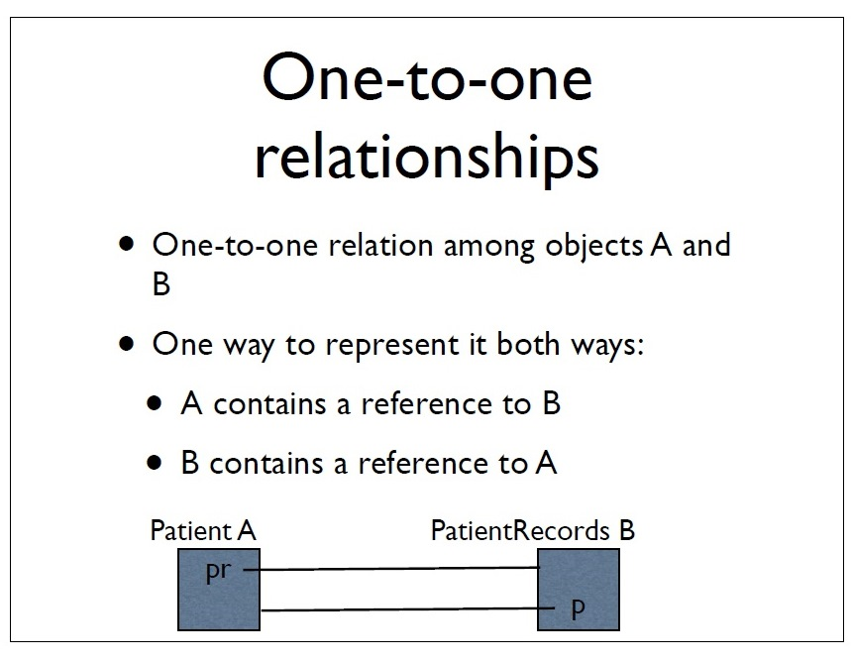

Slide 7
import java.util.Scanner;
class student{
private int studentID;
private String studentName;
private String studentfathersName;
private teacher Teacher;
// constructor
public student()
{
studentID=1234456;
studentName="ABC";
studentfathersName="XYZ";
}//constructor
public void student_input()
{
Scanner sc=new Scanner( System.in);
System.out.println("Please enter student's Id");
studentID=sc.nextInt();
System.out.println( "please enter student's name");
studentName=sc.next();
System.out.println("please enter student's father name");
studentfathersName =sc.next();
}
// set student record
public void set_student( int a, String s1,String s2, teacher s3)
{
this.studentID=a;
this.studentName=s2;
this.Teacher=s3;
System.out.println("Teachername: "+s3.teacherName);
}//set student record
// output
public void student_output()
{
System.out.println("student's Id:" +studentID);
System.out.println( "student's name: "+studentName);
System.out.println("student's father name: "+studentfathersName);
System.out.println("Teachername: "+Teacher.studentTeacherName());
Teacher.teacher_output();
}//output
}//class student

Slide 8
//class teacher
class teacher{
private int teacherID;
public String teacherName;
private String teacherfathersName;
private student Student;
// constructor
public teacher()
{
teacherID=98765;
teacherName="LMN";
teacherfathersName="RST";
}//constructor
public void teacher_input()
{
Scanner sc=new Scanner( System.in);
System.out.println("Please enter teacher's Id");
teacherID=sc.nextInt();
System.out.println( "please enter teacher's name");
teacherName=sc.next();
System.out.println("please enter teacher's father name");
teacherfathersName =sc.next();
}
public String studentTeacherName()
{
return teacherName;
}
// output
public void teacher_output()
{
System.out.println("teacher's Id:" +teacherID);
System.out.println( "teacher's name: "+teacherName);
System.out.println("teacher's father name: "+teacherfathersName);
}//output
}//class teacher
public class student_teacher
{
public static void main(String[] args)
{
student s1=new student();
teacher t1=new teacher();
s1.set_student( 5555, "hello","Ram", t1);
//s1.student_input();
s1.student_output();
}//main
}//student_teacher

Slide 9


Inheritance
The objectives of this chapter are:
To explore the concept and implications of inheritance
  Polymorphism
To define the syntax of inheritance in Java
To understand the class hierarchy of Java
To examine the effect of inheritance on constructors

Slide 10
Terminology
Inheritance is a fundamental Object Oriented concept
A class can be defined as a "subclass" of another class.
  The subclass inherits all data attributes of its superclass
  The subclass inherits all methods of its superclass
  The subclass inherits all associations of its superclass
The subclass can:
  Add new functionality
  Use inherited functionality
  Override inherited functionality
superclass:
Person
- name: String
- dob: Date
subclass:
Employee
- employeeID: int
- salary: int
- startDate: Date

Slide 11
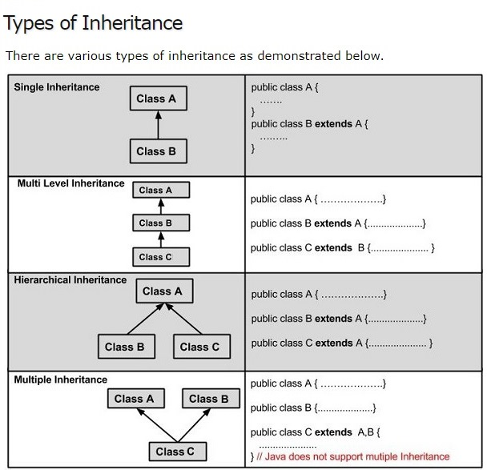
A very important fact to remember is that Java does not support multiple inheritance. This means that a class cannot extend more than one class. Therefore following is illegal −
Example public class extends Animal, Mammal{}

Slide 12
Inheritance Hierarchy
Each Java class has one (and only one) superclass.
  C++ allows for multiple inheritance
Inheritance creates a class hierarchy
  Classes higher in the hierarchy are more general and more abstract
  Classes lower in the hierarchy are more specific and concrete
There is no limit to the number of subclasses a class can have
There is no limit to the depth of the class tree.
Class
Class
Class
Class
Class
Class
Class
Class

Slide 13
What really happens?
When an object is created using new, the system must allocate enough memory to hold all its instance variables.
  This includes any inherited instance variables
  With the use of the extends keyword, the subclasses will be able to inherit all the properties of the superclass except for the private properties of the superclass.
In this example, we can say that an Employee "is a kind of" Person.
  An Employee object inherits all of the attributes, methods and associations of Person
Person
- name: String
- dob: Date
Person
name = "John Smith"
dob = Jan 13, 1954
Employee
name = "Sally Halls"
dob = Mar 15, 1968
employeeID = 37518
salary = 65000
startDate = Dec 15, 2000
is a kind of
Employee
- employeeID: int
- salary: int
- startDate: Date

Slide 14
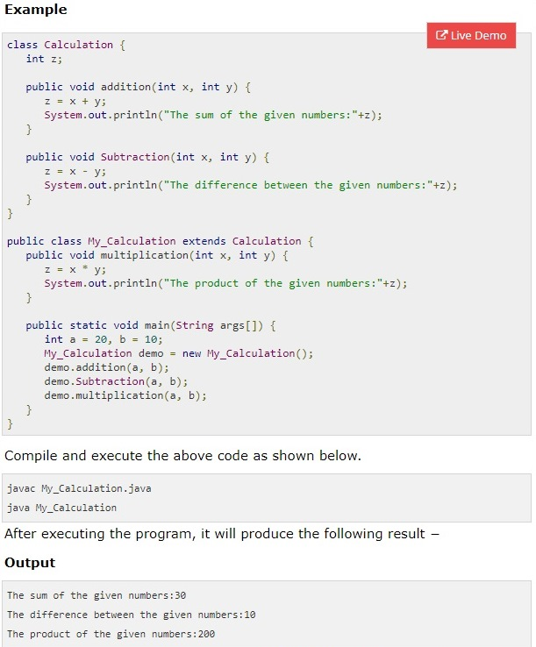

Slide 15
protected Members
protected access
  Intermediate level of protection between public and private
  protected members accessible by
    superclass members
    subclass members
    Class members in the same package
  Subclass access to superclass member
    Keyword super and a dot (.)

Slide 16
Problems sheet
Note: You are required to write the program in java using object oriented concept where a small functionality is required to be used as member function of a class. Also write the abstract of classes.
You are required to create a database that has employee identification, employee name, fathers name, address, date of birth, designation, hourly payments rate and maximum payments that an employee can be paid in month for 100 hours. You may use the array concept for storing the records of 100 employees.
You are required to write classes for student details (name, registration number, fathers name), address (current address, permanent address, contact number, email Id) using inheritance concept where address is child class.
Further you are required to extend the problem no 2 for addition of the classes, using inherit concept, Courses Registered (Course name, credit, course number, associated teachers), Academic records( name of degree, year of passing, university/board, percentage marks), Payments Details ( bank name, transaction id, amount, date).
You are required to create array of string of 10 elements. Further sort the array in ascending order. The string comparison can be with or without case sensitive.
You are given a paragraph consisting of words, Convert this para graph to tokens (word) to be stored in array of string in sorted order where sorted array does not have duplicate words.
You are given a paragraph consisting continuous alphabets, Convert this para graph to tokens of fixed size. Store the tokens in array of string in sorted order where sorted array does not have duplicate words.
You are given a paragraph consisting continuous alphabets, Convert this para graph to tokens based on occurrence of particular characters. Store the tokens in array of string in sorted order where sorted array does not have duplicate words.

Slide 17
import java.util.Scanner;
class string {
private String string1, string2;
private String []splitArray;
stringArray sa =new stringArray();
public string() {
string1="Rohan is a good boy. His father is farmer";
string2="RamisiagoodboyHisfatherisfarmer";
}
public void output(){
System.out.println("String: "+string1);
}
//split words
public void split() {
String[] strArray = string1.split(" ");
for (int i=0;i<strArray.length;i++)
System.out.println(strArray[i]);
}
//split with fixed length
public String [] splitFixedSize(String s, int size) {
int j=0;
String []strArray = new String[(int)(Math.ceil((double)s.length()/size))];
for (int i = 0; i < s.length(); i += size) {
strArray[j]=s.substring(i, Math.min(s.length(), i + size)); j++;
}
for (int i=0;i<strArray.length;i++)
System.out.println(strArray[i]);
return strArray;
}
public void sorting() {
splitArray=splitFixedSize(string2, 3);
sa.sortingAscending(splitArray);
sa.array_Output(splitArray);
}//sorting
}//class string
class stringArray
{
// private int numberOfElements;
private String []arrayElements=new String [] {"Ram", "Ram", "Gobil", "yadav", "Navin"};
private String []arrayElements2;
private String []DestinationArray=new String[10];
private String []ArraySort=new String[10];
// Constructor for fixed string array size
public stringArray()
{
//for (int x = 0; x <10 ; x++)
//arrayElements[x]=0;
//Initialization off array
arrayElements=new String [] {"Ram", "Ramm", "Gobil", "yadav", "Navin"};
arrayElements2=new String[] {"Abhay", "kumar", "avinish", "Dinesh", "Singh"};
}

Slide 18
//for coppying from one string array to the another array
public String [] copy_Array_elements(int a) {
String []b= new String [a];
for (int i = 0; i <a; i++)
b[i]=arrayElements[i];
return b;
}
// for sorting the string array in ascending order
public void sortingAscending(int a) {
String temp, smallest;
int index=0;
for (int i = 0; i <a; i++) {
smallest=arrayElements[i];
index=i;
for (int j = i+1; j <a; j++) {
if ( smallest.compareTo(arrayElements[j])>0) {smallest=arrayElements[j]; index=j;}
}//for (int j = 0; j <a; j++)
// swap the elements
if ( i!=index) {
System.out.println("swapped elements indexes "+i +" "+index); temp=arrayElements[index];
arrayElements[index]=arrayElements[i];
arrayElements[i]=temp;
}
}//for (int i = 0; i <a; i++)
}//sortingAscending
//for input to the String array
public void array_Input(int a) {
Scanner b=new Scanner(System.in);
System.out.println("please enter string array of"+a+" elements: ");
for (int x = 0; x <a ; x++)
arrayElements[x]=b.next();
}
//for copying the array into another array
// array is passed as parameter
public void array_copy(String a[]) {
for (int i = 0; i <a.length; i++)
arrayElements[i]=a[i];
}
//for output of the array
public void array_Output(int a) {
System.out.println("Array elements: ");
for (int i = 0; i <a; i++)
System.out.println("Array elements of "+i +" element : "+ arrayElements[i]);
}
//for output of the array
// array is passed as parameter
public void array_Output(String a[]) {
System.out.println("Array elements: ");
for (int i = 0; i <a.length; i++)
System.out.println("Array elements of "+i +" element : "+ a[i]);
}

Slide 19
public void sortingAscendingUppercase()
{
uppercase_Array_elements();
sortingAscending(5);
}//sortingAscending
}//class string array
public class StringProcessing
{
static int number;
String largest;
static String []sourceArray1= new String[] {"Ram", "shyam", "Gobil", "yadav", "Navin"};
public static void main(String[] args)
{
Scanner sc=new Scanner(System.in);
System.out.println("please enter number of elements in array");
number=sc.nextInt();
stringArray a=new stringArray();
string s1=new string();
s1.sorting();
//s1.splitFixedSize();
//a.sortingAscendingUppercase();
//a.array_Input(number);
//a.sortingAscending(number);
//a.array_Output(number);
}//main
}//ArrayProcessing

