Slide 1
Analog and Digital Electronics Lab (EC13203) IT-A1 Lab-2 (Design of Basic Gate by using Universal Gate)
Dr. Anand Sharma
Assistant Professor
ECED, MNNIT Allahabad

Slide 2
Experiment No.-2
Design of Logic Gate using Universal Gate

Slide 3
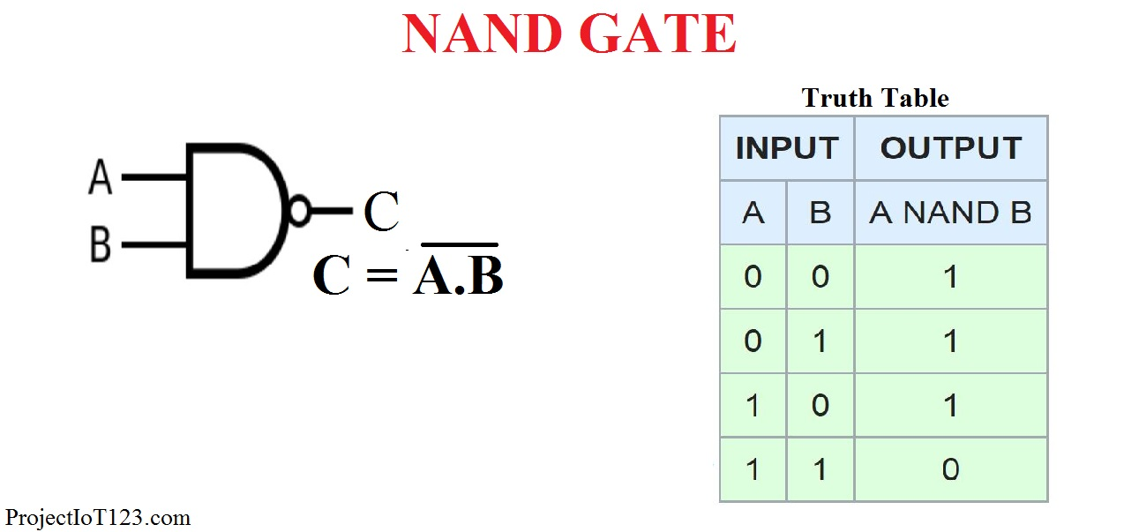
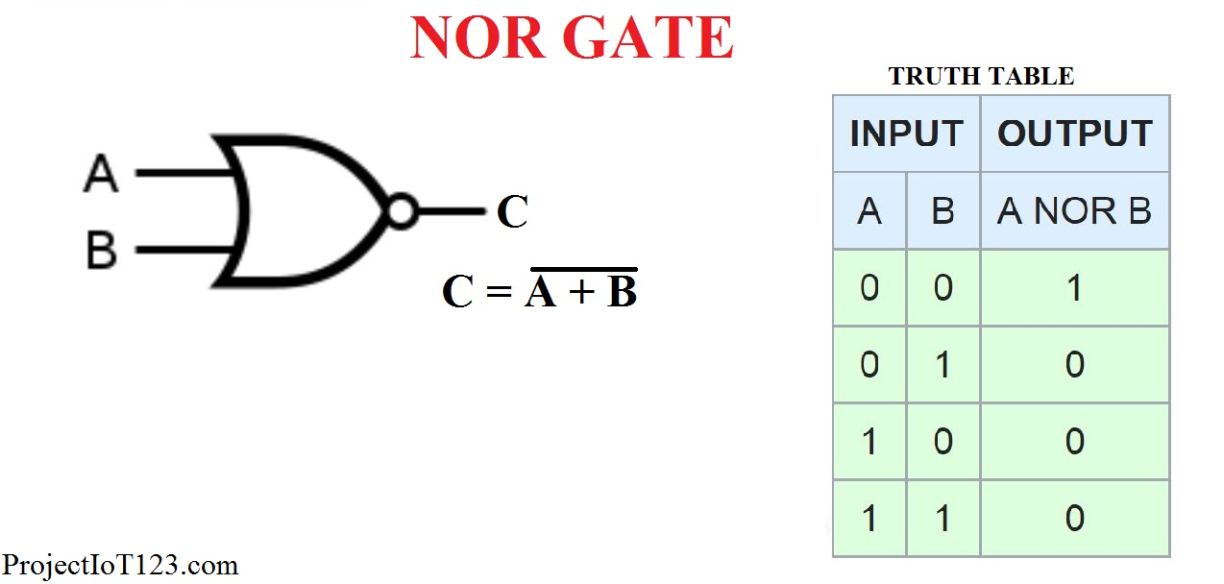
Universal Gates

Slide 4
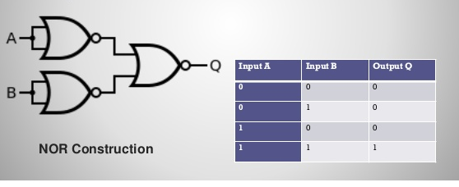
Implement AND using NOR

Slide 5
Cont.…
Implement OR using NOR
Implement NOT using NOR
Implement NAND using NOR
Implement OR using NAND
Implement NOT using NAND
Implement NOR using NAND
Implement EXOR using NOR
Implement EXNOR using NOR
Implement EXOR using NAND
Implement EXNOR using NAND

