Slide 1
Analog and Digital Electronics Lab (EC13203) IT-A1 Lab-3 (Design of Half Adder and Full Adder by using Basic Gates/Universal Gate)
Dr. Anand Sharma
Assistant Professor
ECED, MNNIT Allahabad

Slide 2
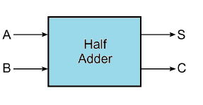
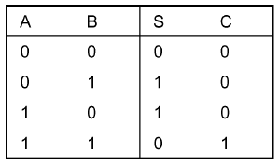
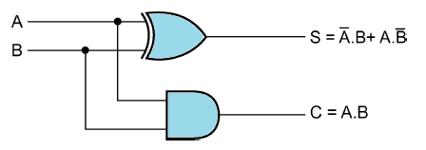
Half Adder
Block Diagram
Truth Table
Implementation with basic logic gates

Slide 3
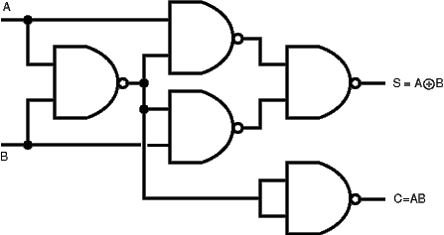
Cont.…
Implementation with Universal logic gates

Slide 4
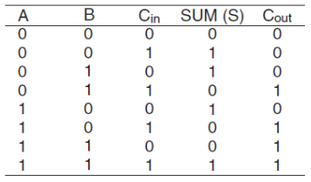
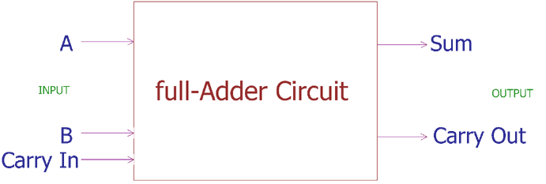
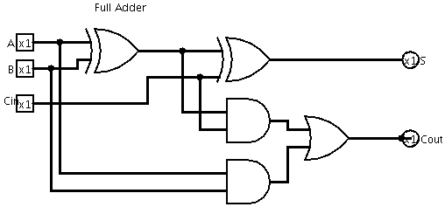
Full Adder
Block Diagram
Truth Table
Implementation with basic logic gates

Slide 5
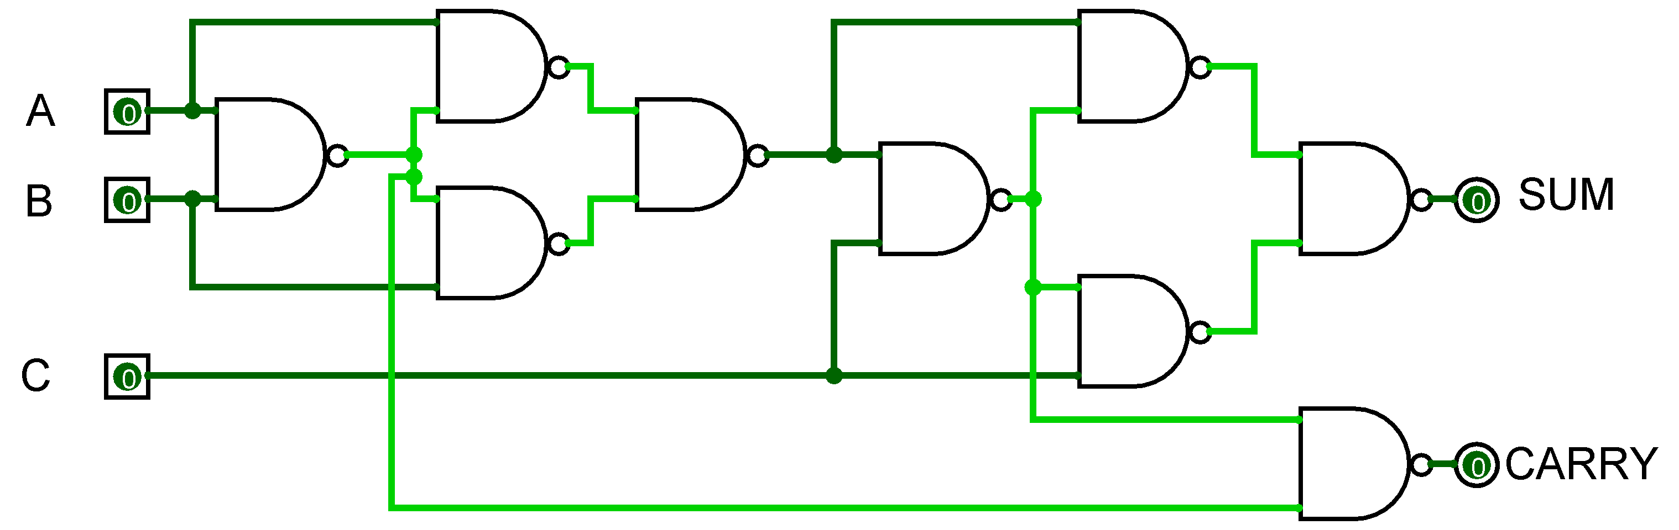
Cont.…
Implementation with Universal logic gates

