Slide 1
Analog and Digital Electronics Lab (EC13203) IT-A1 Lab-7 (Design of 4*1 MUX using basic gates and Full Adder implementation using 4*1 MUX )
Dr. Anand Sharma
Assistant Professor
ECED, MNNIT Allahabad

Slide 2
Multiplexer
Multiplexer is combinational logic network which has 2^{n} inputs, n select lines and has only one output.
Multiplexers are also known as “Data n selector, parallel to serial convertor, many to one circuit, universal logic circuit​”.

Slide 3
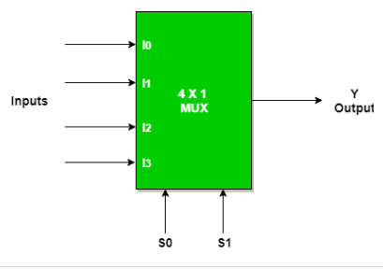
LOGIC DAIGRAM FOR 4:1 MUX

Slide 4
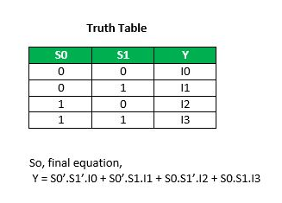
Truth Table

Slide 5
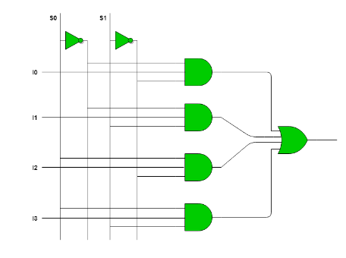
Truth Table

Slide 6
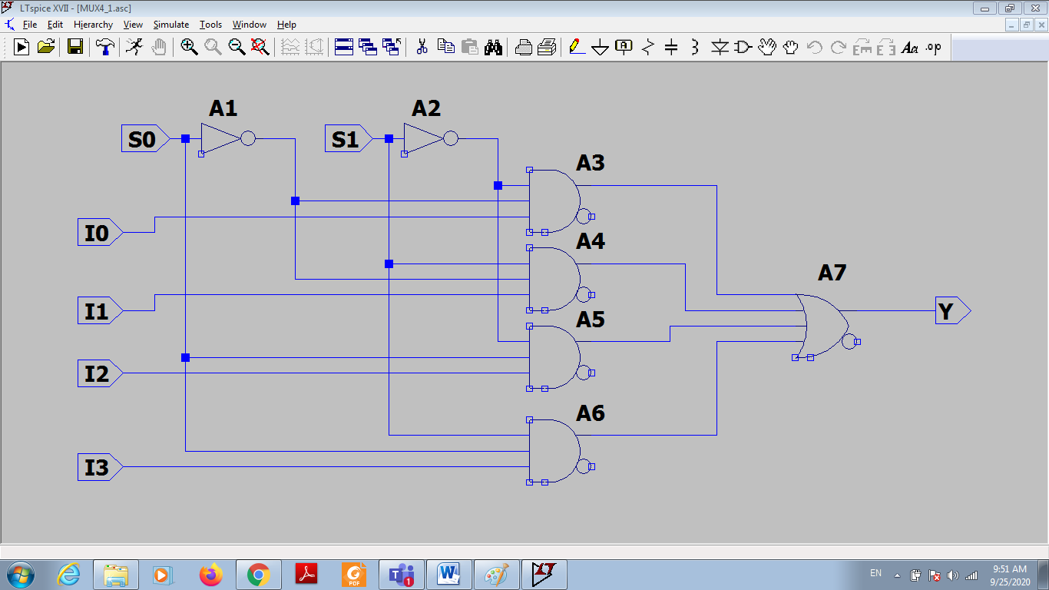
In LTSpice

Slide 7
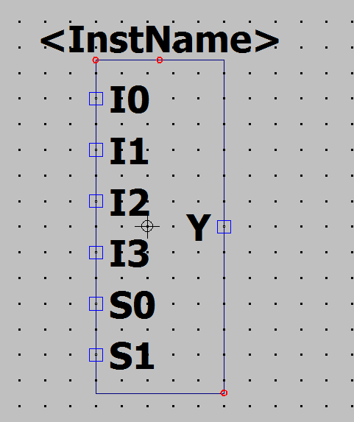
Symbol generation in LTSpice
Hierarchy>Open this sheet symbol>Yes

Slide 8
Full Adder using 4:1 Mux

Slide 9
Truth Table for Full Adder
A | B | Cin | Sum | Cout
0 | 0 | 0 | 0 | 0
0 | 0 | 1 | 1 | 0
0 | 1 | 0 | 1 | 0
0 | 1 | 1 | 0 | 1
1 | 0 | 0 | 1 | 0
1 | 0 | 1 | 0 | 1
1 | 1 | 0 | 0 | 1
1 | 1 | 1 | 1 | 1

Slide 10
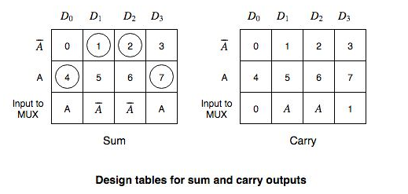
Design Table
B’C’ B’C BC’ BC
B’C’ B’C BC’ BC

Slide 11
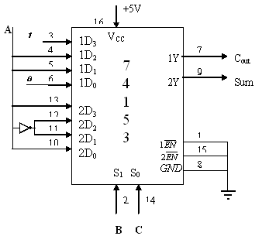
Circuit Diagram of Full Adder using 74LS153

Slide 12
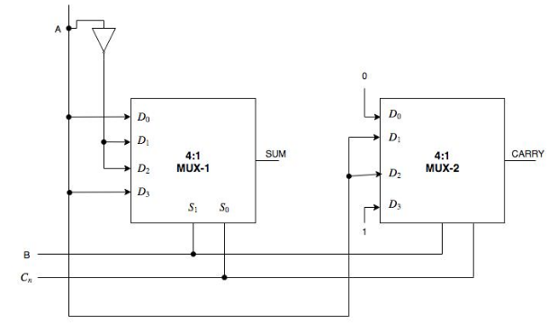
Full Adder using 4:1 Mux

Slide 13
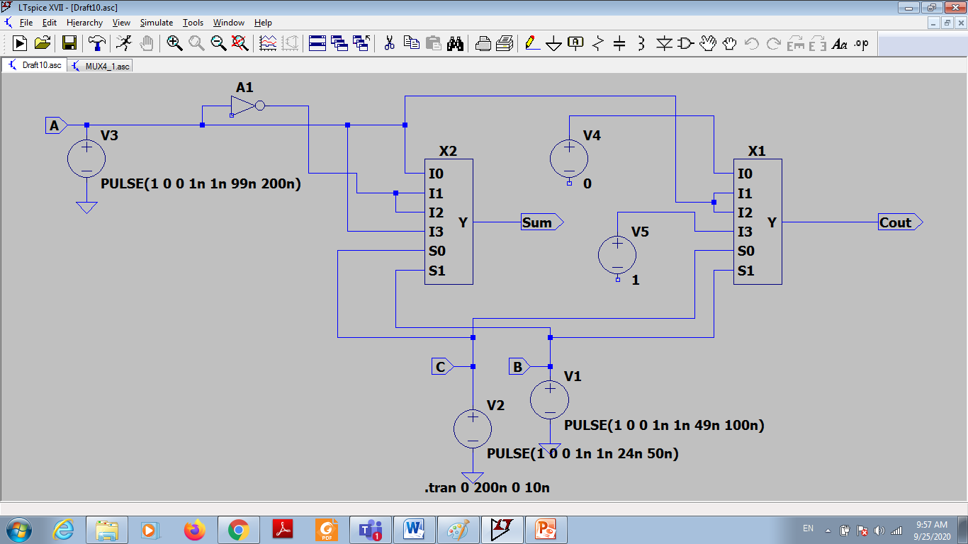
Full adder in LTSpice

Slide 14
Procedure
Use K-Map to find expressions for Sum and Carry and implement using Multiplexer.
Connections are made as per the circuit diagram, for Full Adder.
Give the input digital values as per the truth table and verify the output on the LEDs of the trainer kit.

