Slide 1

Project title -
“Connected Fleet: A one step solution for fleet operations with optimized security and productivity”

Slide 2
Guided by:- Mr. Bhupendra Pratap Singh
Presented by:-
Mr. Abdur Kidwai (220340126001)
Mr. Abhishek Sahu (220340126002)
Mr. Sharukh Atar (220340126005)
Mr. Nimesh Nagar (220340126018)
Mr. Tushar Jadhav (220340126030

Slide 3
Benefits of Connected Fleet -
Vehicle tracking to pinpoint the precise location of vehicles
Live Monitoring of goods environment
Safe and secure
Customized service
Remote diagnostics and maintenance alerts.
Expandable

Slide 4
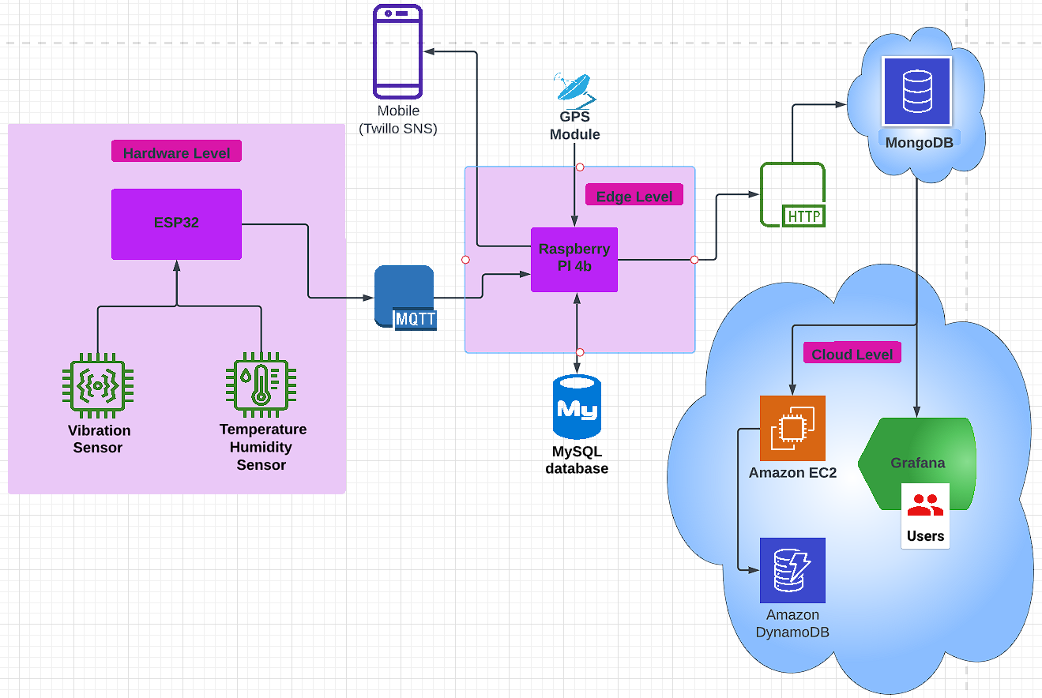
Block diagram -

Slide 5
Hardware components -
ESP32
Raspberry PI (4 model b)
Temperature & Humidity sensor (DHT22)
Vibration sensor (SW420)
GPS module (Neo-6M)

Slide 6
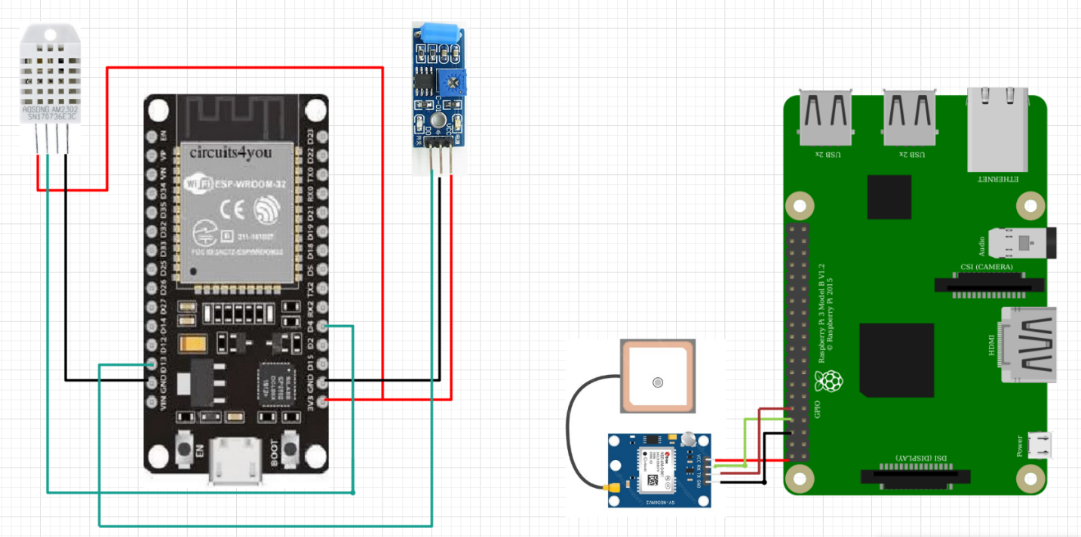
Circuit diagram -

Slide 7
Results

Slide 8
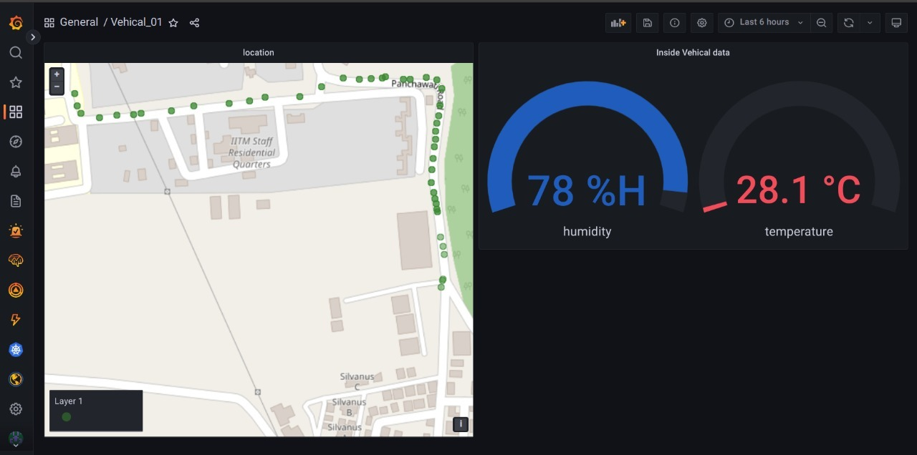
Grafana dashboard -

Slide 9
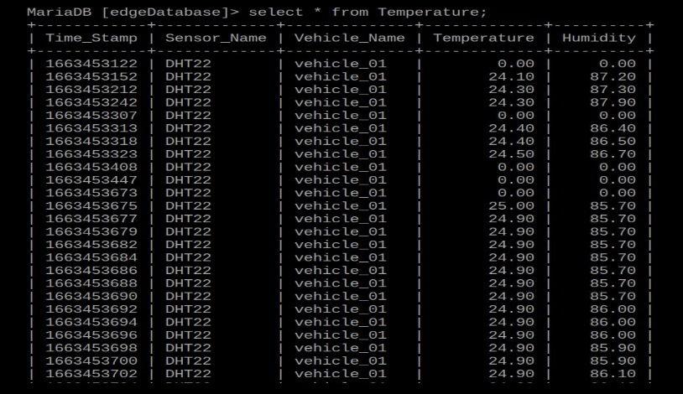
Sensor Data Showing up in database-

Slide 10
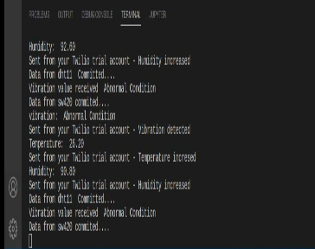
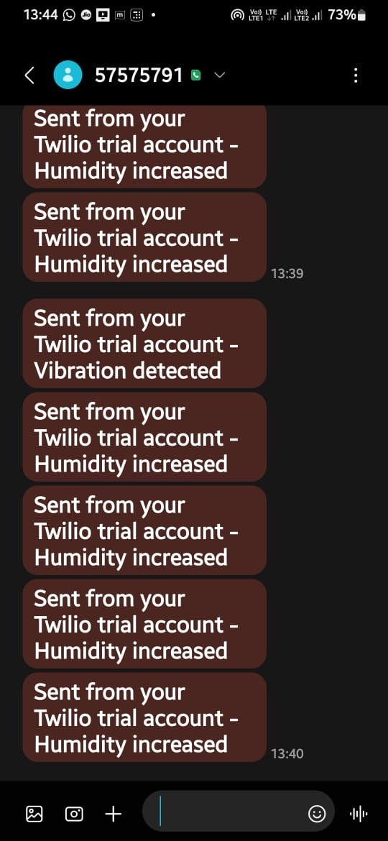
Notification alert -

Slide 11
Future scope -
Remote Accessibility
AI-Enabled Route Planning
monitoring of driver behavior and vehicle performance.
Autonomous Vehicles

Slide 12
The End

