Slide 1

Social Media Live Project Submission
Facebook Campaign
Student Name:ABHISHEK
TRIPATHI

Slide 2
Campaign Problem Statement
Slide 1
{Please write down the problem statement and information provided to you}
Blog Name, Theme and Link: EDUCATION,Learnings for students, https://abhicars.upgradcampustest.xyz/
Budget provided: 500inr
Objective: Main aim is to promote Eduation
TG: students

Slide 3
Explain the targeting parameters
Slide 2
{Identify the targeting parameters you’d select to amplify your blog. Give reasons for the same, even if it is NA.}
Targeting parameters:
Age Range -10-21
Location -India
Interests-Primary education and higher
Any other relevant targeting parameters- no

Slide 4
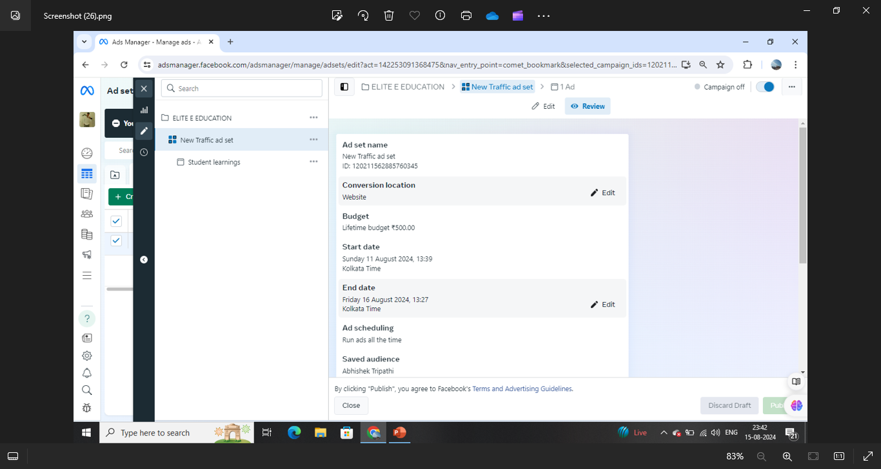
Campaign Summary Screenshot 1
Slide 3
{Submit screenshots of the campaign order summary for your ad. This should be submitted in 2 slides – a screenshot of Ad Set (slide 4/current slide) with Campaign name, Campaign objective, bidding strategy, budget, ad scheduling and the screenshot of actual ad (slide 5/next slide) with image, headline, text and CTA.}

Slide 5
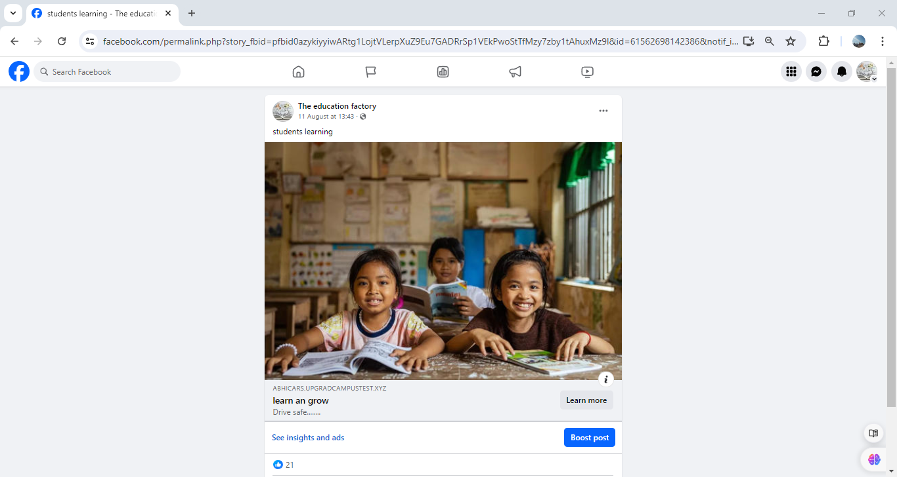
Campaign Summary Screenshot 2
Slide 4
{Screenshot of the actual Ad with image, headline, text and CTA.}

Slide 6
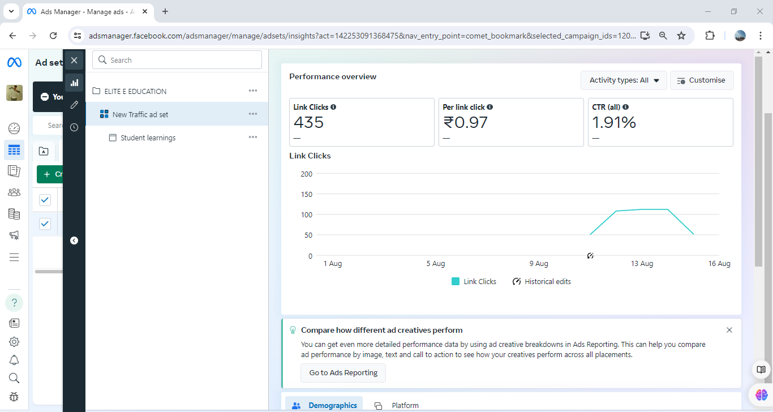
Campaign Result Screenshot for Performance
Slide 5
{Share the performance screenshot, we have attached a sample screenshot for your reference. Please ensure that the screenshot mentions the Result Rate. Customise the default metrics to enable the result rate being shown.}

Slide 7
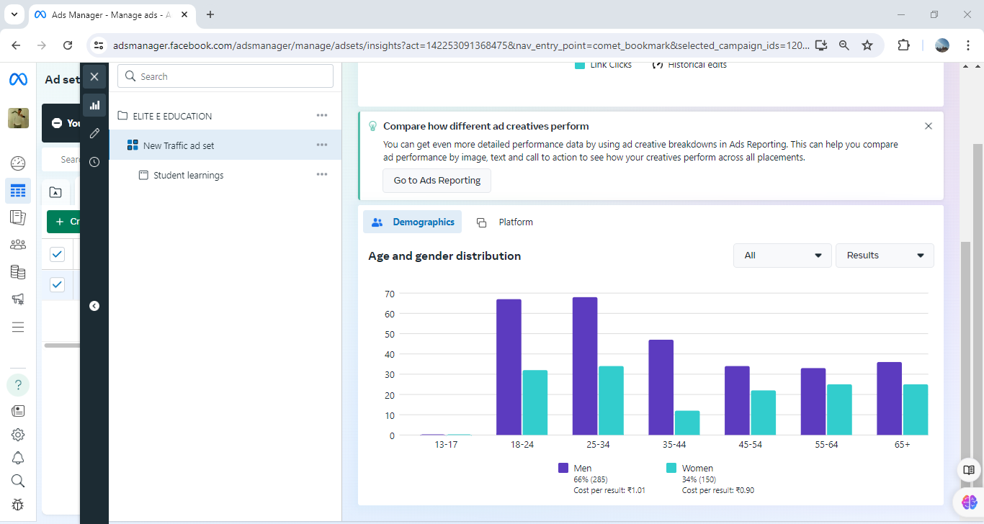
Campaign Result Screenshot for Demographics
Slide 6
{Share the demographics screenshot,we have attached a sample screenshot for your reference}

Slide 8
Summary
Slide 7
Write a short summary covering following points: (Word limit - 200 words)
What KPIs will you use to analyse the ad performance?
ANS:-AD impression:- 26,765
AD REACH:-22,991 ,CTR OF 1.62% ,CPC OF 0.97
Was the campaign a success or not?
LINK CLICKS:- 435 , CTR CPC:- 1.62% , CPC:-Rs 0.97
Based on the results obtained, suggest some targeting optimisations that you would perform. (atleast 2)
Changing the age group to 8 to 24
Targeting to parents because they will take the decision focusing on them between 28 to 45.

Slide 9
Disclaimer: All content and material on the upGrad Campus website is copyrighted, either belonging to upGrad Campus or its bonafide contributors and is purely for the dissemination of education. You are permitted to access, print and download extracts from this site purely for your own education only and on the following basis: You can download this document from the website for self-use only. Any copies of this document, in part or full, saved to disk or to any other storage medium, may only be used for subsequent, self-viewing purposes or to print an individual extract or copy for non-commercial personal use only. Any further dissemination, distribution, reproduction, copying of the content of the document herein or the uploading thereof on other websites, or use of the content for any other commercial/unauthorised purposes in any way which could infringe the intellectual property rights of upGrad Campus or its contributors, is strictly prohibited. No graphics, images or photographs from any accompanying text in this document will be used separately for unauthorised purposes. No material in this document will be modified, adapted or altered in any way. No part of this document or upGrad Campus content may be reproduced or stored in any other website or included in any public or private electronic retrieval system or service without upGrad Campus’s prior written permission. Any rights not expressly granted in these terms are reserved.

