Slide 1

MEASUREMENT BASED PERFORMANCE ANALYSIS OF 3G AND 4G LTE NETWORK
Supervised By: Dr. Dalia Nandi
By:
RUPAK KALITA (CSE/16032/187)
ADITYA (CSE/16003/160)
ABHISHEK KUMAR (CSE/16002/159)

Slide 2
Aim of Project
Part-1: to make a analysis model for the dimensions of mobile network which will help the users many folds.
Part-2:to make a predictive model for network strength and signal speed

Slide 3
Methodology for Network Analysis
The main objective of this study/project is to make a analysis model for the dimensions of mobile network which will help the users many folds.Our test processes were designed with the following assumptions and settings :
1. Each network was tested concurrently to ensure that environmental conditions were the same for each service operator.
2. Identical handsets were used for each network.
3. We collected our data using a mobile application developed by us, namely a “Speed-test” app which can store the network speed

Slide 4
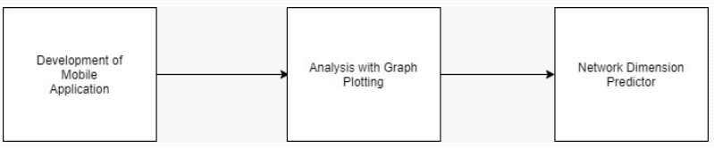
Process Flow Diagram

Slide 5
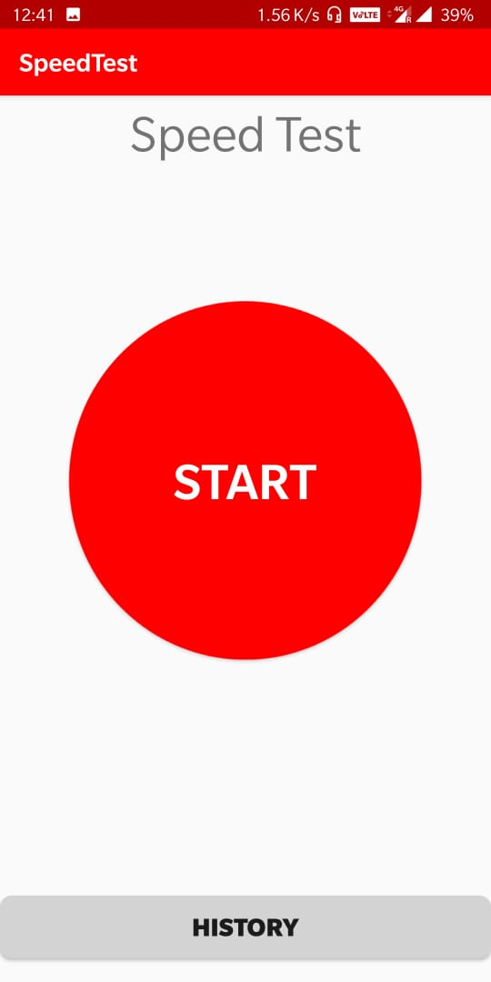
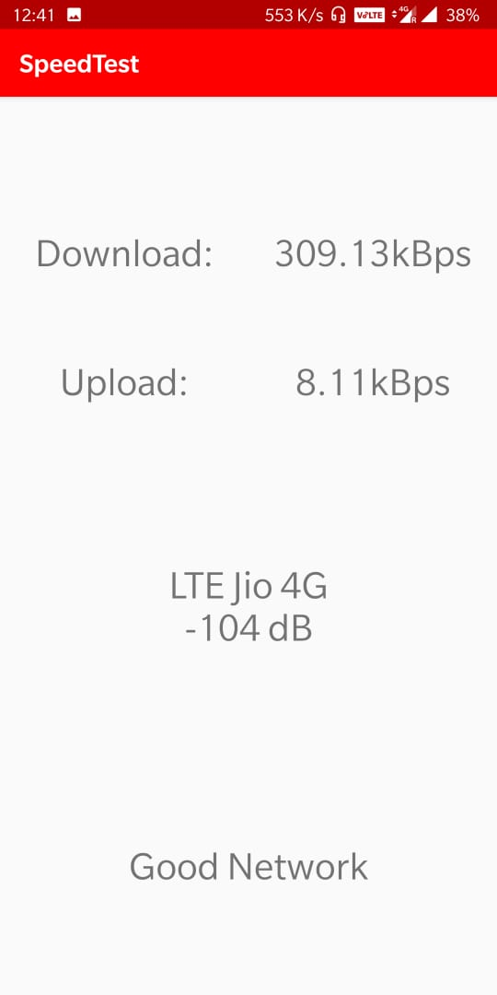
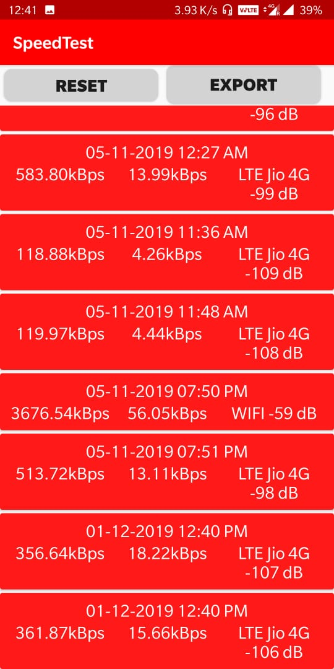

Slide 6
Steps for Analysis
1. We have collected data (upload and download speed) for the whole month in an interval of 15 minutes.
2. Average of the all the intervals into a single value (discarded last few days).
3. Usage of RegEx to recover the values from the text of the csv files.
4. Separation of the files on the basis of:
Operator names
Operations performed i.e upload, download speed etc.
On the basis of platforms used.
On the basis of network type i.e 3G, 4G etc.

Slide 7
Various Analysis
Various analysis has been done throughout the process.
1. Comparison of download speeds in 4G between 2 operators i.e Airtel and Jio.
2. Comparison of upload speeds in 4G between 2 operators i.e Airtel and Jio.
3. Comparison of Signal strengths in 2 platforms using different operators.
4. Comparison of download speeds in 3G and 4G using a single operator.
5. Comparison of upload speeds in 3G and 4G using a single operator

Slide 8
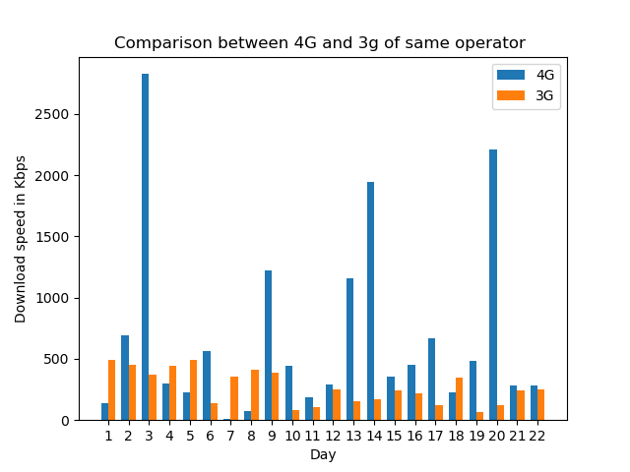
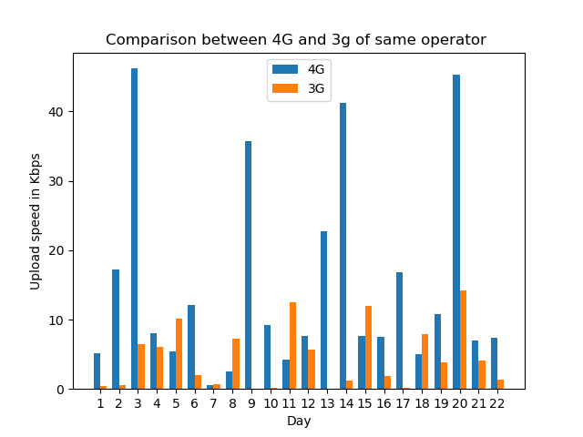
Comparison of Download and upload speed between 4G and 3G of same operator

Slide 9
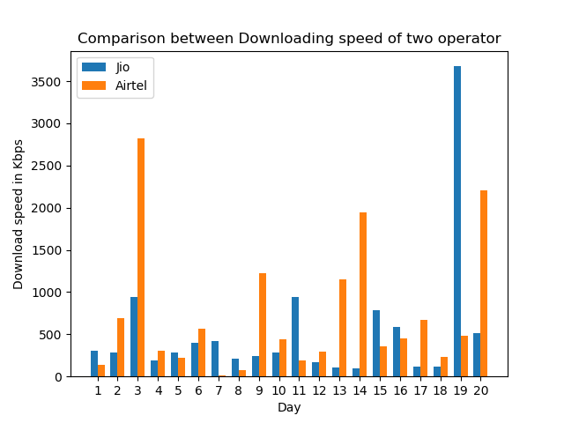
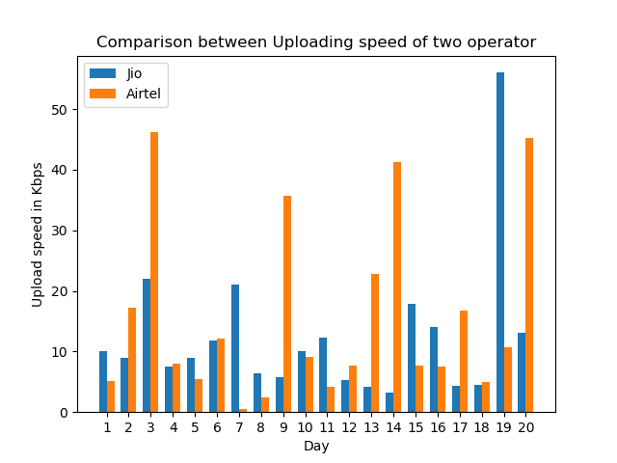
Comparison of Download and upload speed between 4G and 3G of two operator

Slide 10
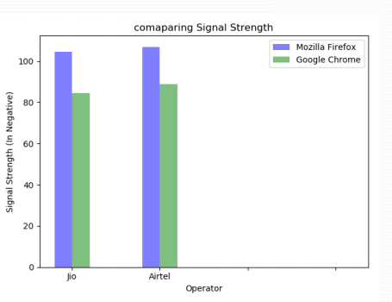
Comparison of Signal strengths in Google Chrome And Firefox platforms using Airtel and Jio operators

Slide 11
Result and analysis
Two metrics parameters, namely network signal strength and speed are considered in this research.
Our results show that, on average, 4G networks performed much better than 3G networks throughout across all the measurement areas.
According to the analysis, Google Chrome performs better in both the network operators.
It can be seen how 4G has evolved. It shows a way above performance than 3G.
In every aspects, 4G beats 3G in terms of speed, signal strength etc.

Slide 12
Methodology for Network Parameters Prediction
In the second phase, we tried and completed the predictive model for signal strength measurement and download speed prediction.
We pre-processed the data based on our model.
Here,we used two approach named as Linear regression and LSTM.
The machine learning part includes the predictive model which is done using the data provided to us.
In this prediction ,we also calculate error and accuracy measures of both the algorithms.
The objective in this was to reduce the RMSE to a large extent.

Slide 13
Selection of the model
The prediction models basically depends upon the previous data which is given as input and is time dependent.
We started with Linear Regression in which the RMSE levels were quite high, which led us to shift towards deep learning model which is time dependent.
RNN models are the best in these cases. We used LSTM as because it is time dependent and works on the basis of time stamps.

Slide 14

Software Used For Network Parameters Prediction
Advantage of Google colab
Group of coders used at same time for a particular task.
Online Pre-install all Python, Machine Learning and Deep learning Library
Easy to use as simple interface
Support to store Huge Dataset into Google Drive

Slide 15
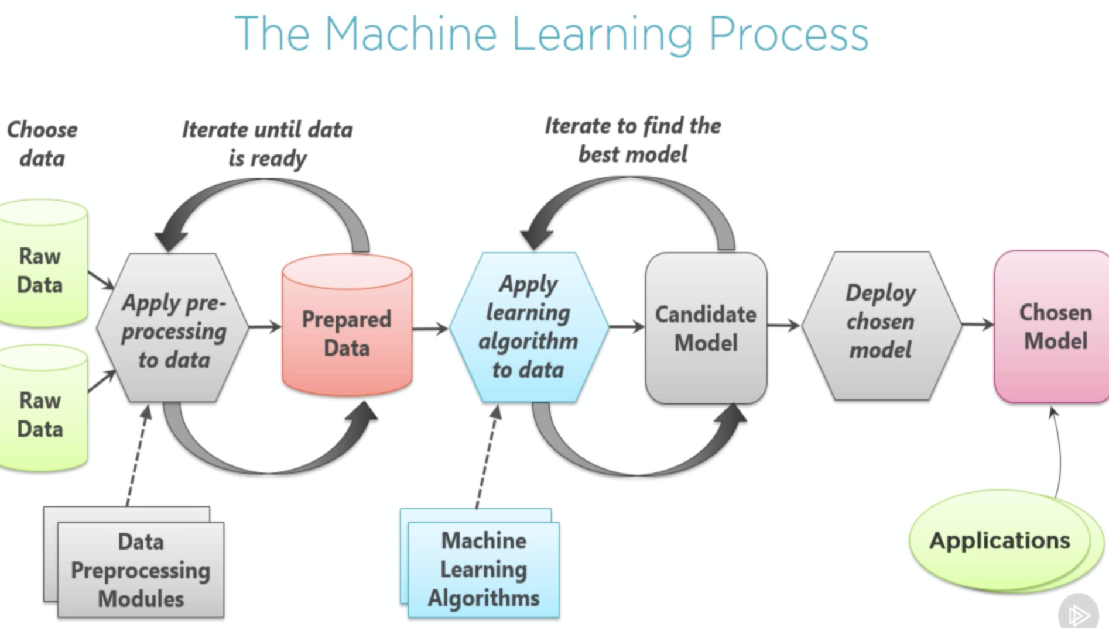

Slide 16
Pre-processing of Data for Network Parameters prediction
Step1: Reading data and creating DataFrames
The data is read from the raw dataset given. It is converted to a csv format. CSV format is more preferred as reading and writing data is quite easy and easily accessible.
The data frames are created on the basis of the columns required from the dataset given and proper formatting to data time.

Slide 17
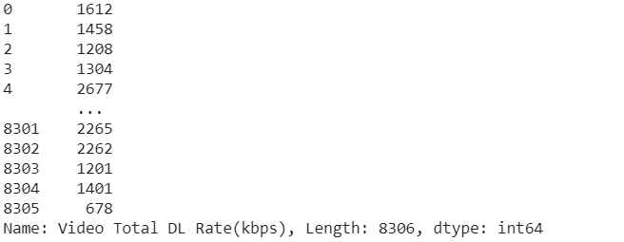
Output of reading and creating DataFrame

Slide 18
Pre-processing of Data for Network Parameters prediction
Step2: Binning of the data
then we use binning method for data smoothing or handle the noisy data ,in which pre-processed data is first sorted on the basis of time and distributed into various time slot.

Slide 19
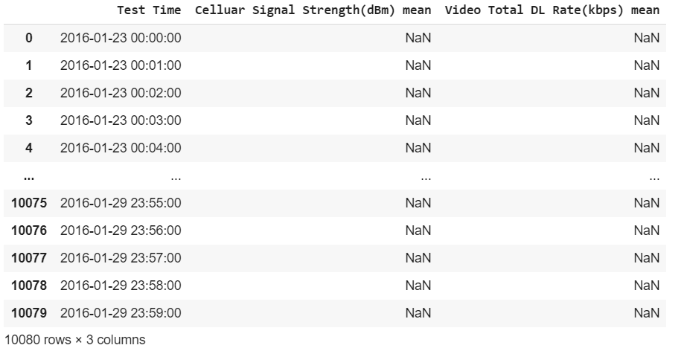
Output of Binning of the data

Slide 20
Pre-processing of Data for Network Parameters prediction
Step3: Data Visualization
Now,we plot the real data after binning of data using matplotlib.
We have done both the type of plotting i.e normal plotting of real data and Scattered plotting of real data
We have plot for both the network parameters prediction i.e Video Download Speed and Signal Strength

Slide 21
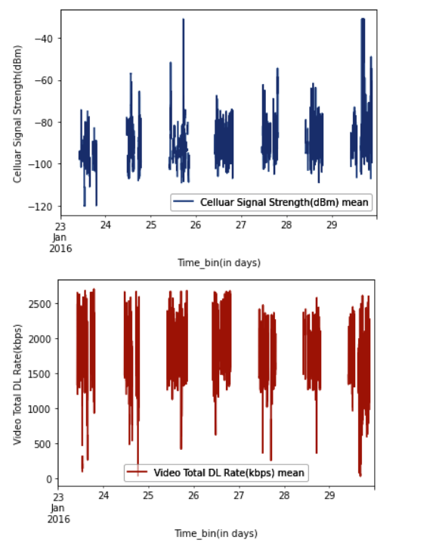
Output of Data Visualization(Normal plotting)

Slide 22
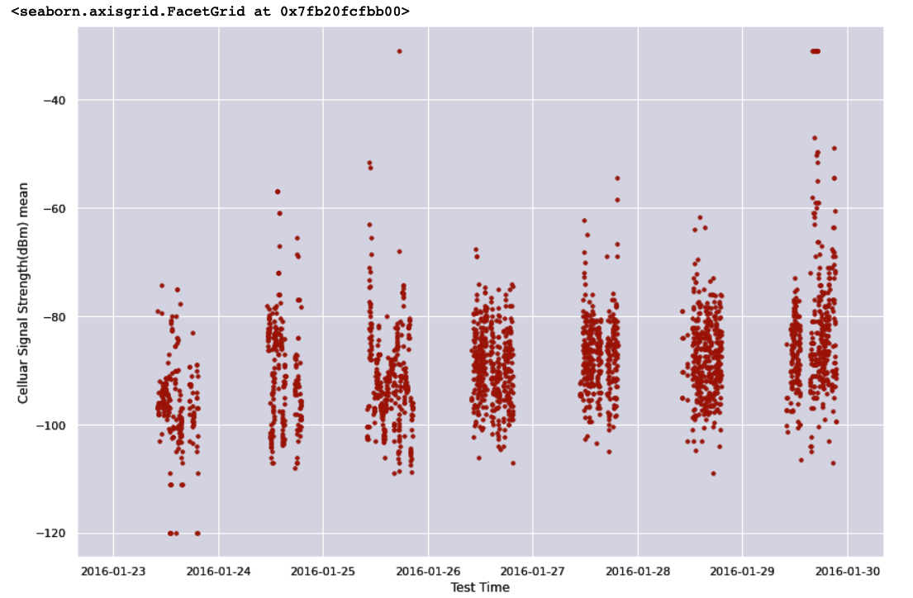
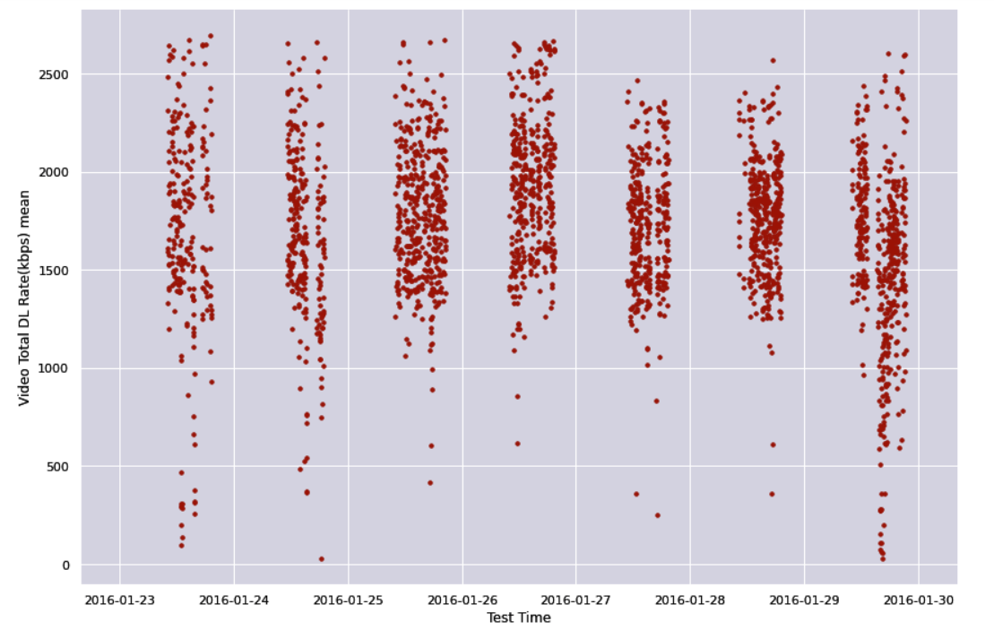
Output of Data Visualization(Scattered plotting)

Slide 23
Pre-processing of Data for Network Parameters prediction
Step 4: Filling of NaN value
Then we fill the Not A number(NaN) value by its previous value so that there we get a continuous graph (not any gaps between data and time stamp) so that we gets more accurate predictive result.

Slide 24
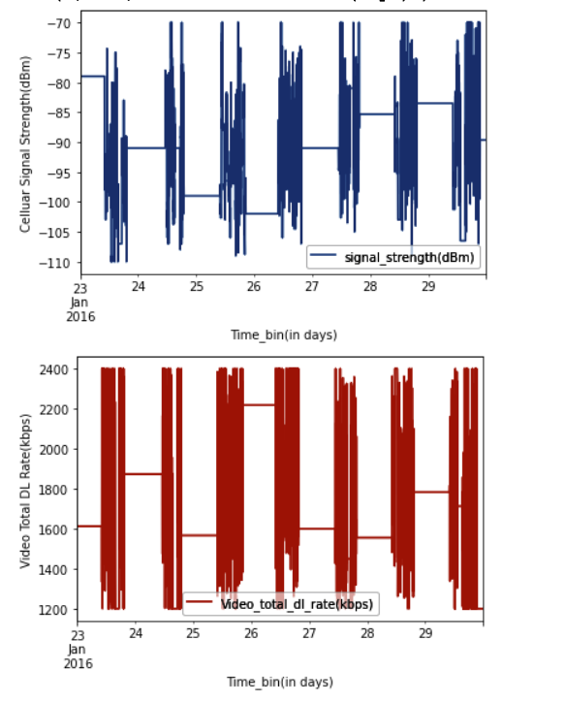
Output of filling of NaN value( Normal Plot)

Slide 25
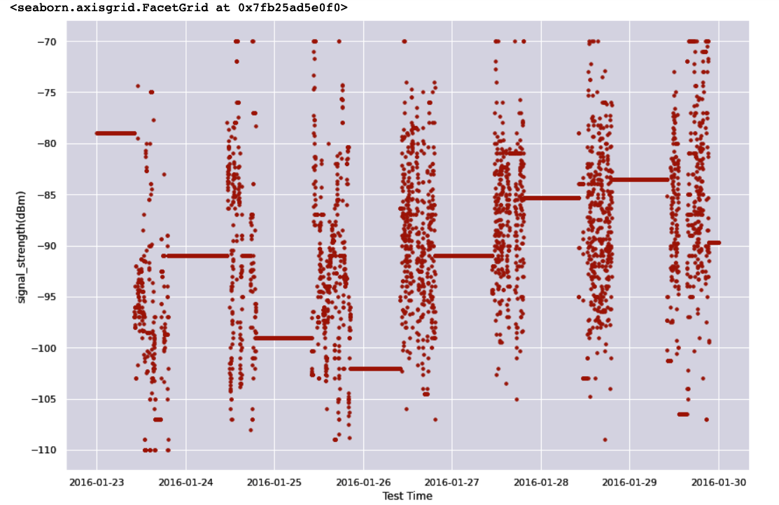
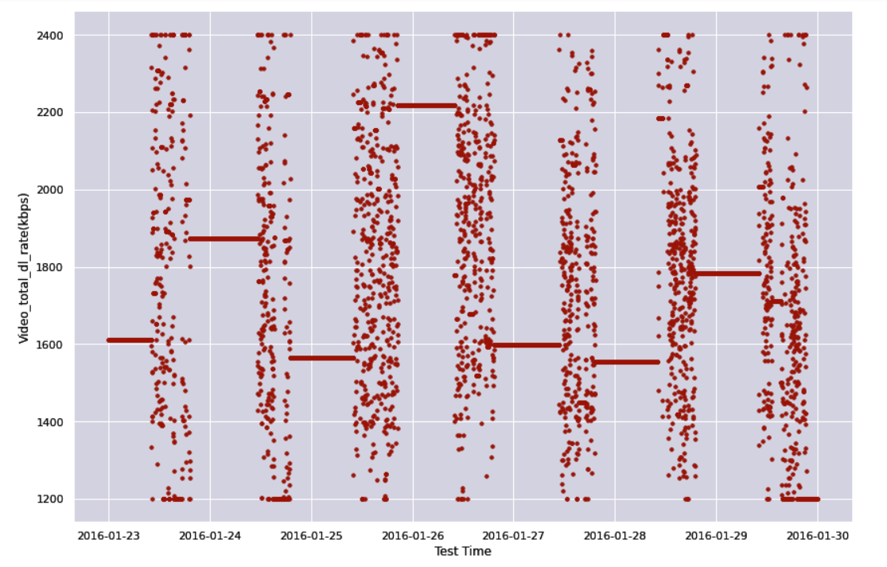
Output of filling of NaN value( Scattered Plot)

Slide 26
Prediction of network parameters using LSTM
Step1:Preprocessing of Data before Training (Scaling the data)
Scaling of data is a method used to normalize the range of independent variables or features of data.
There are various types of normalization.
We have choosen to do min-max scaling, which is the simplest method and consists in rescaling the range of features to scale the range in [0, 1] or [−1, 1]. Selecting the target range depends on the nature of the data.

Slide 27
Prediction of network parameters using LSTM
Step2: Training Phase of LSTM model
After scaling we need to transform the data into a format that is appropriate for modeling with LSTM
LSTM models are a type of recurrent neural network capable of learning sequences of observations. This may make them a network well suited to time series forecasting.
The number of epochs is the number of complete passes through the training dataset.
The LSTM use the sequence in the training phase.

Slide 28
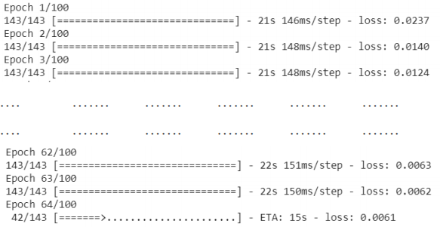
Output of Training of Data using LSTM

Slide 29
Prediction of network parameters using LSTM
Step3: Accuracy measure in LSTM model
After training phase ,you take the entire sequence as input to our RNN and extract the final output produced.
We can then compare your predicted output with the expected output, for each input in the sequence, and measure the error.
Usually, people train RNNs by measuring the cross-entropy error for each output pair in the predicted and expected sequence, and then take the mean of that value.

Slide 30
Prediction of network parameters using LSTM
Step4: Graphical Analysis of Data
Plot real data vs Predicted data Prediction of network parameters using LSTM.
Now, we plot the real data after binning of data using matplotlib and seaborn python library.
We have plot for both the network parameters prediction i.e Video Download Speed and Signal Strength.

Slide 31
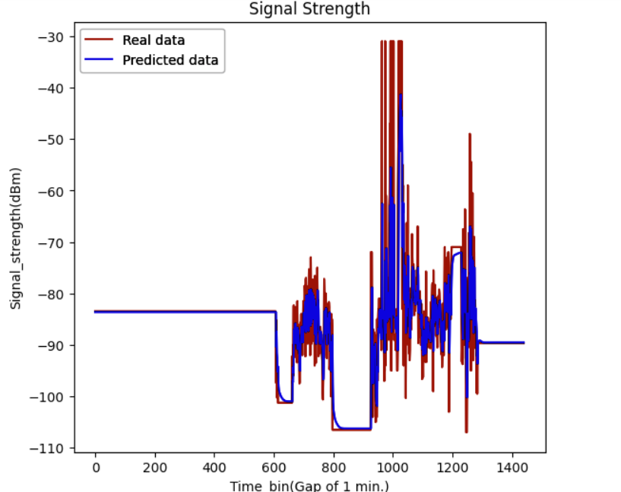
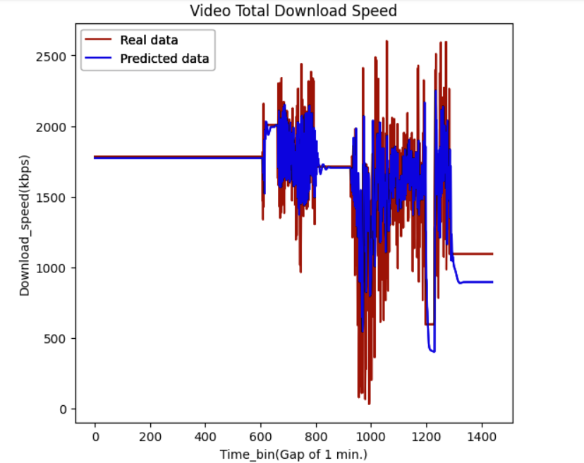
Output of Prediction of network parameters using LSTM

Slide 32
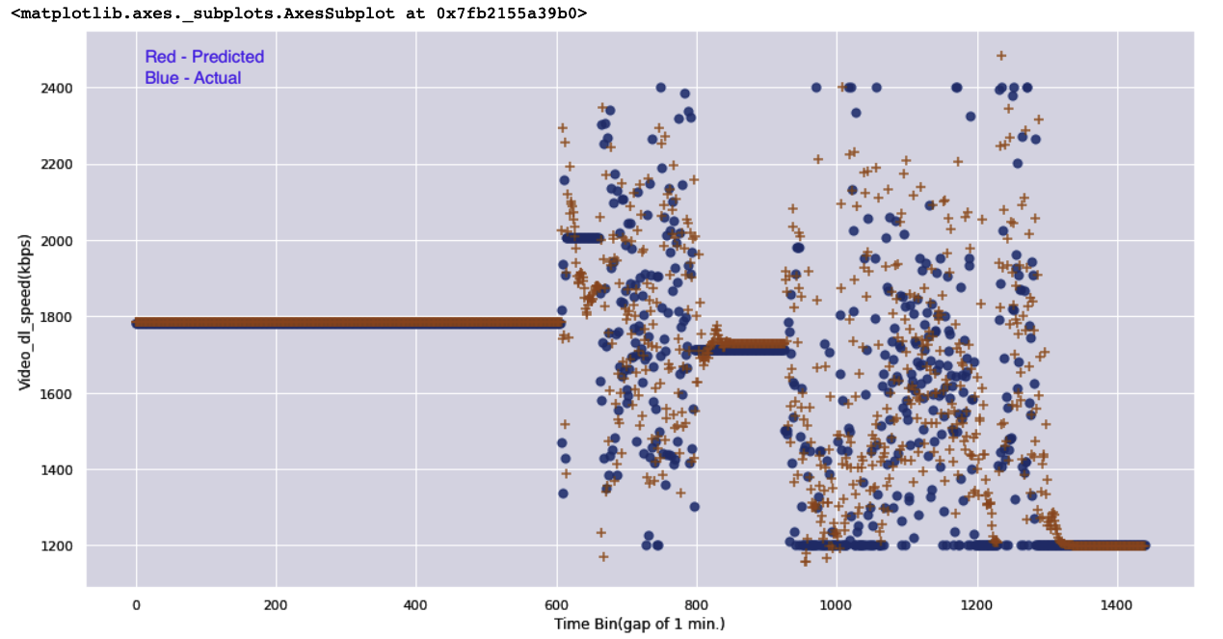
Output of Prediction of network parameters using LSTM

Slide 33
Prediction of network parameters using Linear Regression
Step1: Linear regression Model Training and Model evaluation
For Linear Regression, we have to pre-process the data. As it has no requirements of dependent and independent datasets, we directly input the data of download speed data. We fit the data into the Linear regression model.
Step2: Graphical Analysis of Data
The comparison between the actual and the predicted graphs for download speed and signal strength using Linear Regression is given below. The red graphs is the predicted graph while the blue graph is the actual one. It can be easily seen that the error margin is quite high while the graph predicted is not properly aligned with the real data graph.

Slide 34
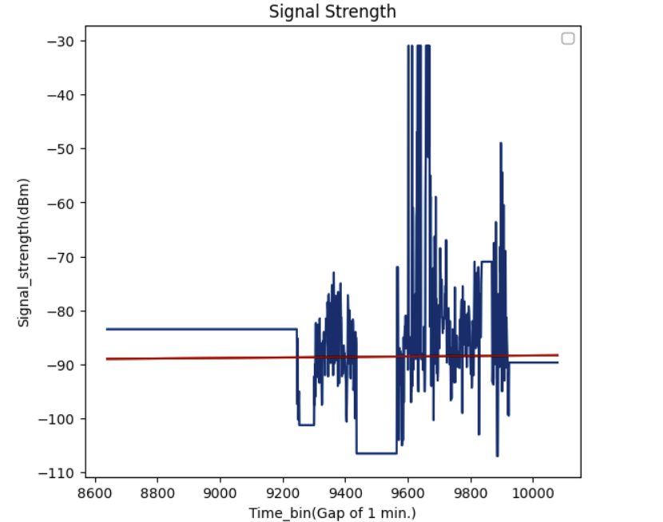
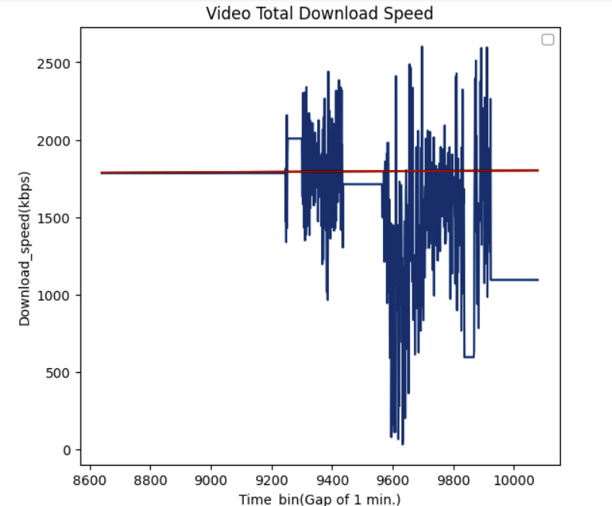
Output of Graphical Analysis

Slide 35
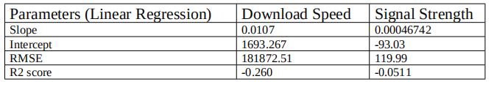
Error analysis of LSTM and Linear regression
The error and graphical scores for Linear Regression is given below with error such as RMSE and R2 score.The errors can be seen being very high.

Slide 36
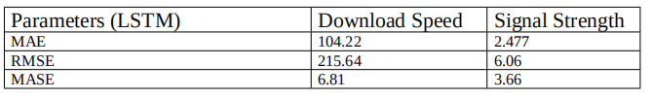
Error analysis of LSTM and Linear regression
The errors obtained for LSTM are listed below. We tried to find out 3 types of errors such as MAE,RMSE and MASE .The errors can be seen to be reduced to a large extent.

Slide 37
Reason for difference in RMSE between LSTM and Linear regression
LSTM can not only process single data points, but also entire sequences of data.
LSTM networks are well-suited to classifying, processing and making predictions based on time series data.
In contrast , We used Linear regression for prediction which is a linear approach to modelling the relationship between dependent variable and one or more independent variables).

Slide 38
Conclusion
We have successfully implemented the LSTM model in our project for singal strength and download speed prediction.
The RMSE is also reduced to a large extent in the due course of time.
Practical application of this model still has many blockers and restrictions. One of the major factor is the weather, which has a larger impact on the network strength and also the connectivity of the handset

Slide 39
Future Scope
To make a predictive model which can predict the dimensions of the network.
To come up with more large no of dataset and predicted our channel capacity more and more accuretely.
A notification feature will be added to the model which will notify the users about the dimensions of the network .
Other factors relating to the consumer experience of using mobile services can also be considered.
Analysis of mobile broadband services delivered to other devices, the performance of mobile virtual network operators (MNVOs) may be examined in future.

Slide 40
References
[1] Ian Goodfellow, Yoshua Bengio, and Aaron Courville. Deep learning. MIT press, 2016.
[2] Roderforte. , Zingo. Zhang, and Yong. Li, “Using lstm and neural network methods for traffic flow prediction,” in Association of Automation (YAC), Youth Academic Annual Conference of. IEEE, 2016
[3] Ian Goodfellow, Yoshua Bengio, and Aaron Courville. Deep learning. MIT press, 2016.
[4] Jürgen Schmidhuber. Deep learning in neural networks: An overview. Neural networks, 61:85–117, 2015.
[5] Maltsev, Pudeyev, Bolotin et al., “Channel modeling and characterization,” MiWEBA FP7-ICT-608637/V1.0, 2014
[6] Tensorflow ,keras and scikit-learn documentation “https://www.tensorflow.org/resources/learn-ml ,
“https://keras.io/guides/ ,
“https://scikit-learn.org/stable/tutorial/index.html

Slide 41
THANK YOU

