Slide 1

URBANKART (E-COMMERCE WEBSITE)
Ms. Adiba Khan - 230340120009
Mr. Amber Selwaria - 230340120023
Mr. Atul Patankar- 230340120039
Mr. Abhishek Rajendra Gupta- 230340120072
Mr. Laxmikant Kulkarni - 230340120103
Ms. Poonam Patil -230340120146

Slide 2
OBJECTIVE
Our project, “UrbanKart”, is a web-based application which aims to provide users with an easy to navigate and visually appealing medium to browse through a category of products and shop for the products they desire.

Slide 3
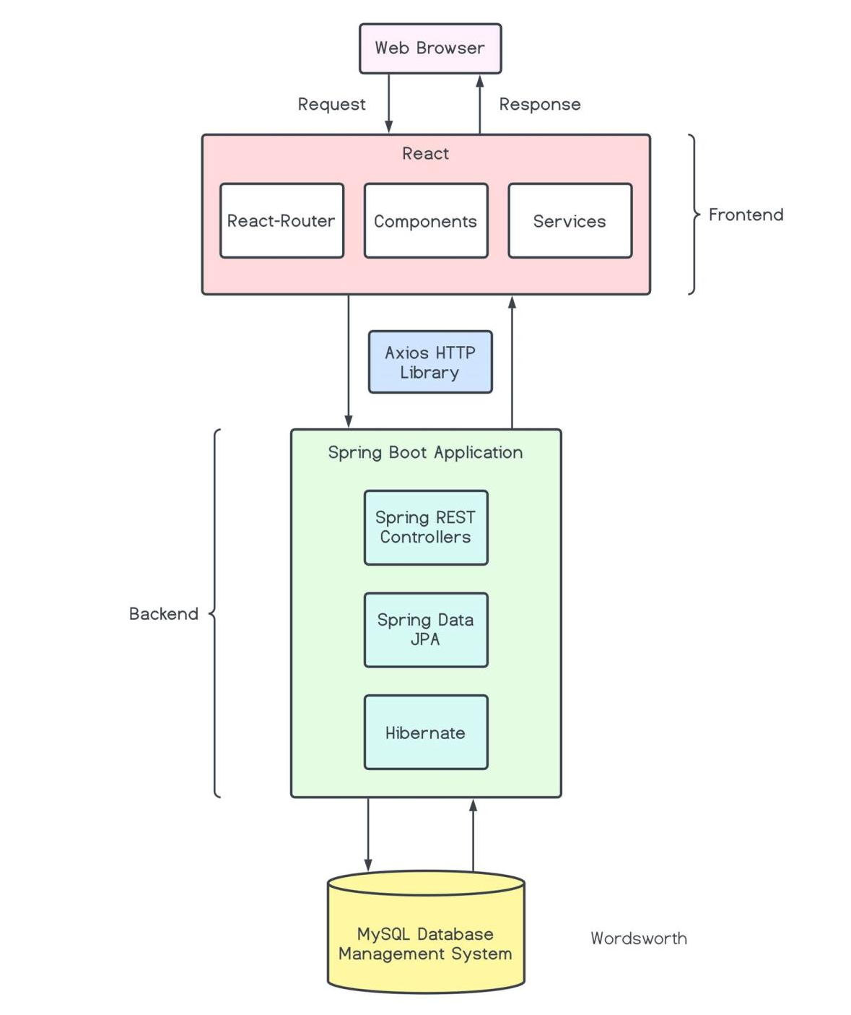
PROJECT ARCHITECTURE
A. FRONT END
React
B. BACKEND
Spring Boot
Spring Data JPA
REST
C. DATABASE MANAGEMENT SYSTEM
MYSQL

Slide 4
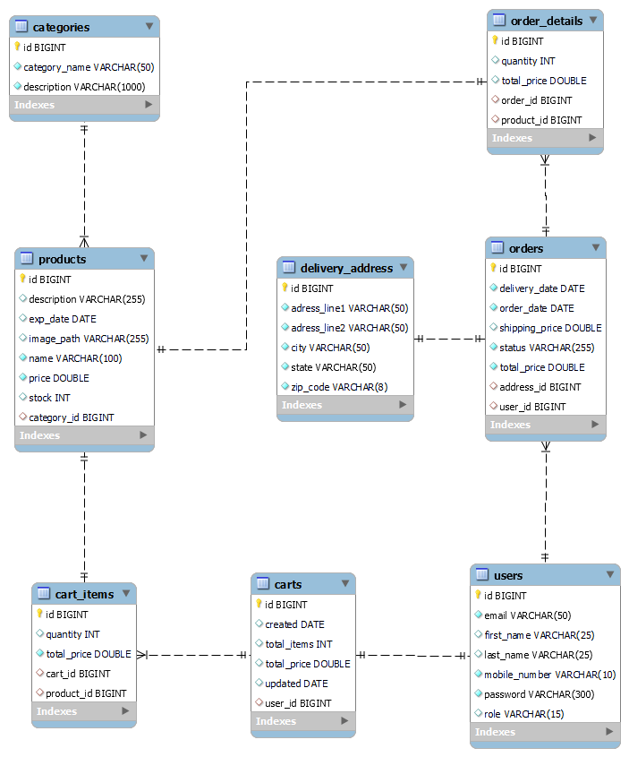
ER DIAGRAM

Slide 5
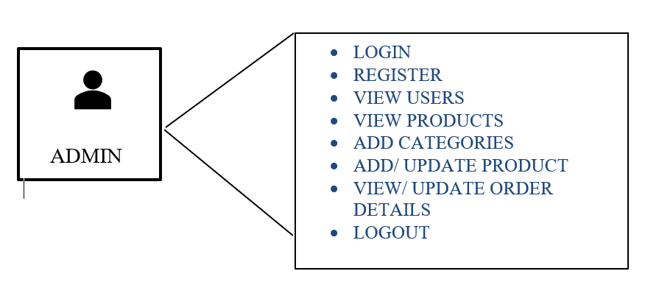
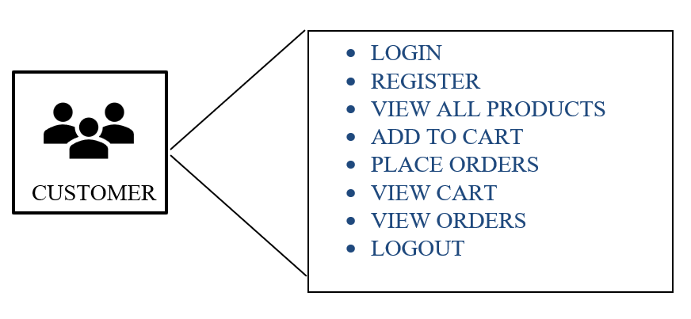
USE CASE DIAGRAM

Slide 6
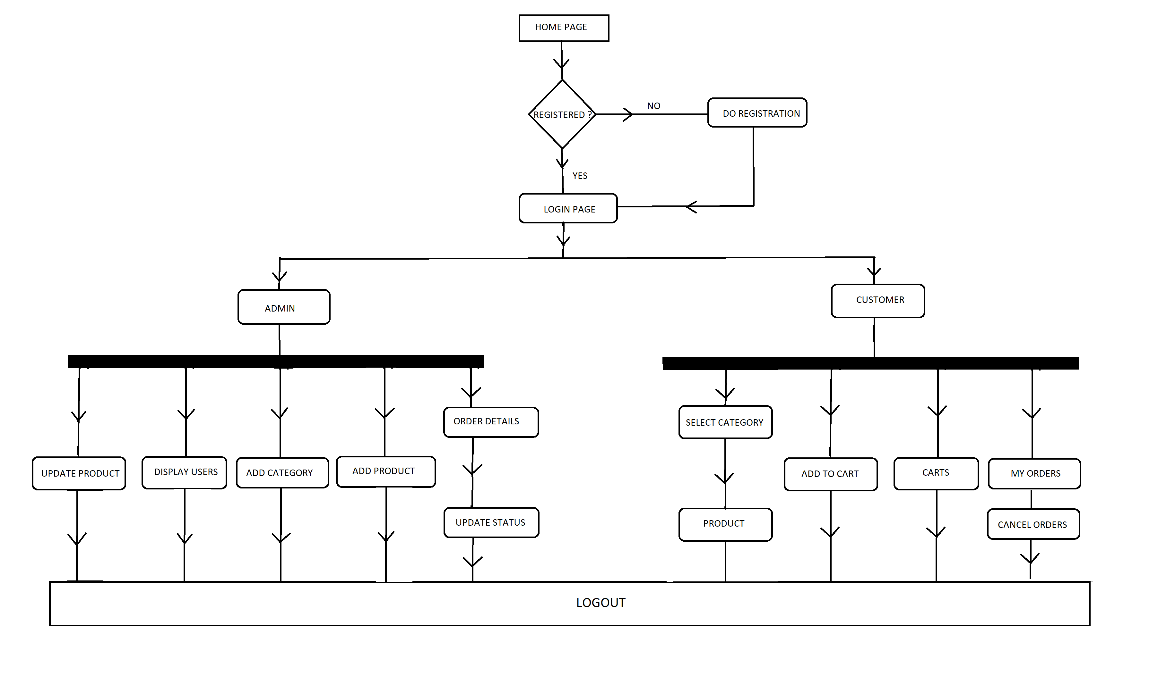
ACTIVITY DIAGRAM

Slide 7

LET’S SEE DEMO

Slide 8
THANKYOU

