Slide 1

Online Shopping Store
Presented by,
TeamB

Slide 2
Agenda
Introduction
Software and Hardware Requirements
Screenshots
Reference

Slide 3
Introduction
Online shopping has become a popular way of shopping for consumers.
It offers a numerous business activities and huge market.
Social media is no longer known only as a media that facilitates its users to present themselves on the internet but also as media to sell some products to consumers known as an online shop.
Because of the numerous advantages and benefits, more people say that they prefer online shopping over conventional shopping these days.
Online shopping or marketing via internet is the use of technology for better marketing production.

Slide 4
Software Hardware Requirement:
Software Requirements
Microsoft Visual Studio 2019
SQL Server Management studio
Hardware Requirements
Operating System: Windows 10
Processor: Intel I5 x86 Min
RAM: 4.00 GB Min

Slide 5
Technologies used:
ASP.Net framework MVC
HTML
CSS
JavaScript
BootStrap
MSSQL

Slide 6
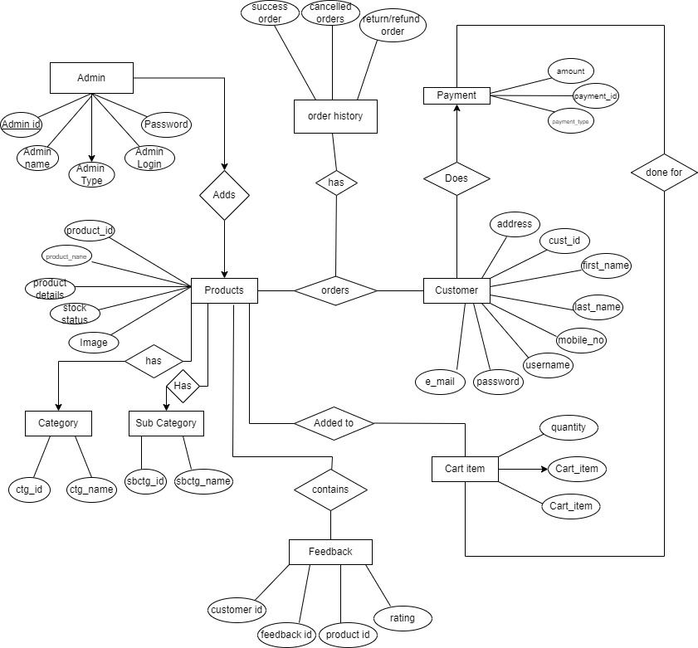
ER diagram

Slide 7
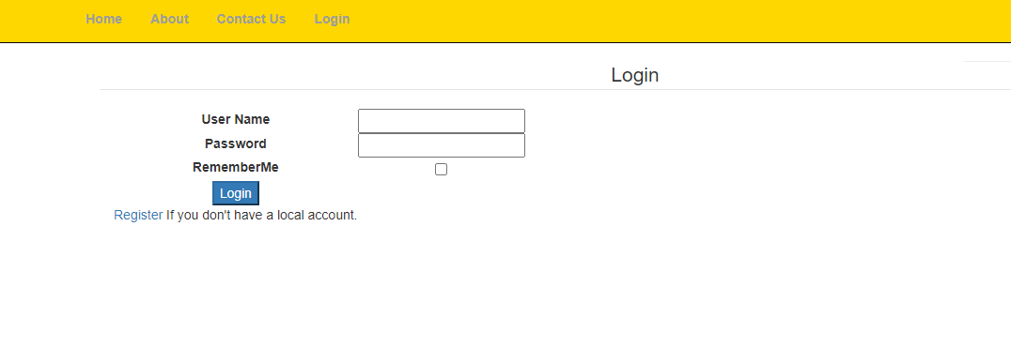
Screen shots Login

Slide 8
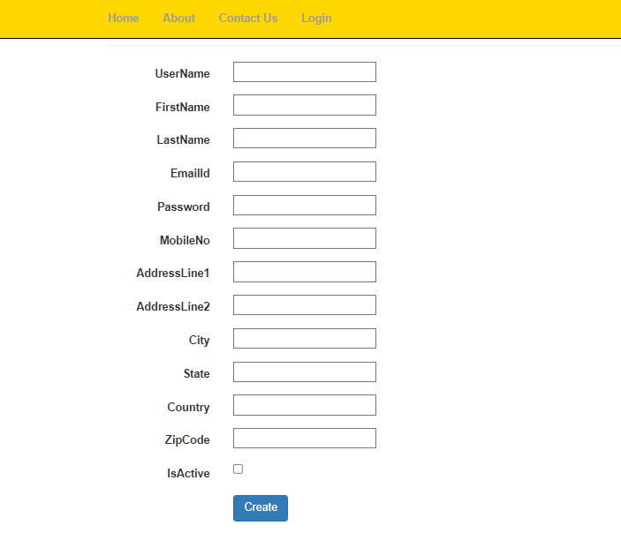
Screen shots Registration

Slide 9
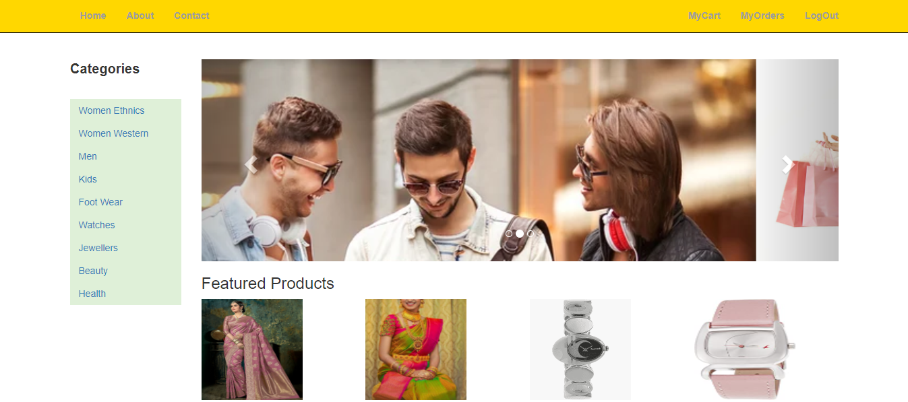
Screen shots Home

Slide 10
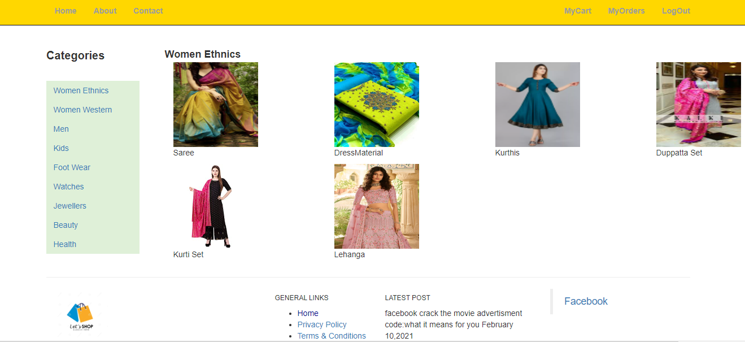
Screen shots Categories

Slide 11
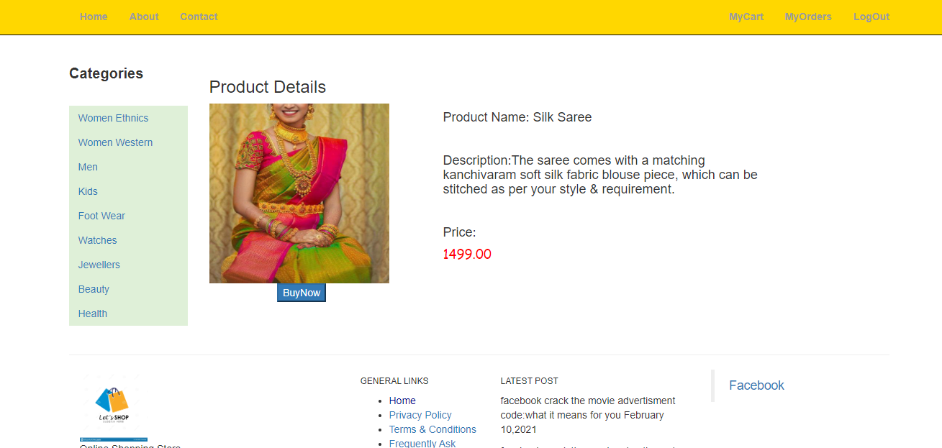
Screen shots Product Details

Slide 12
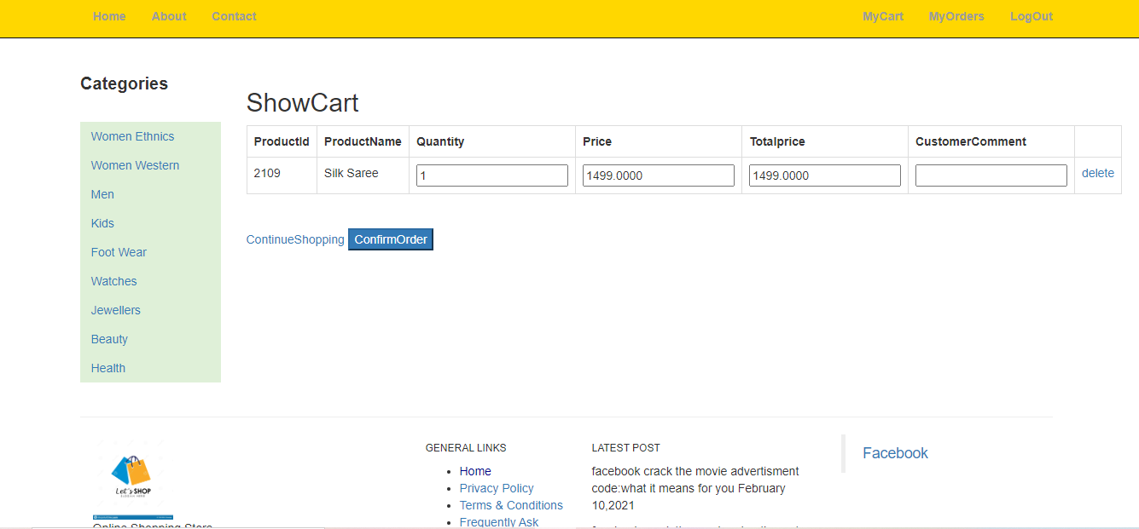
Screen shots cart

Slide 13
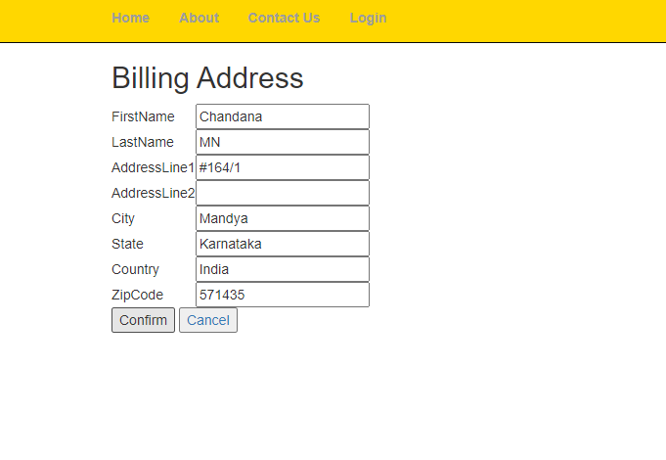
Screen shots Billing Address

Slide 14
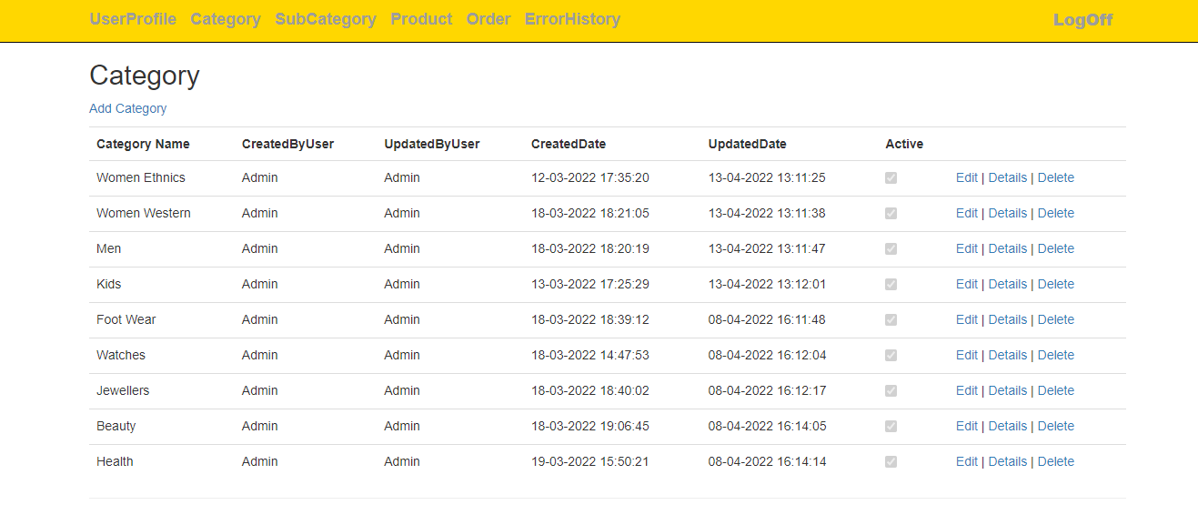
Screen shots Admin Page

Slide 15
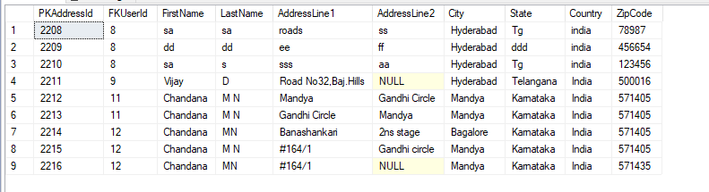
Screen shots Database

Slide 16
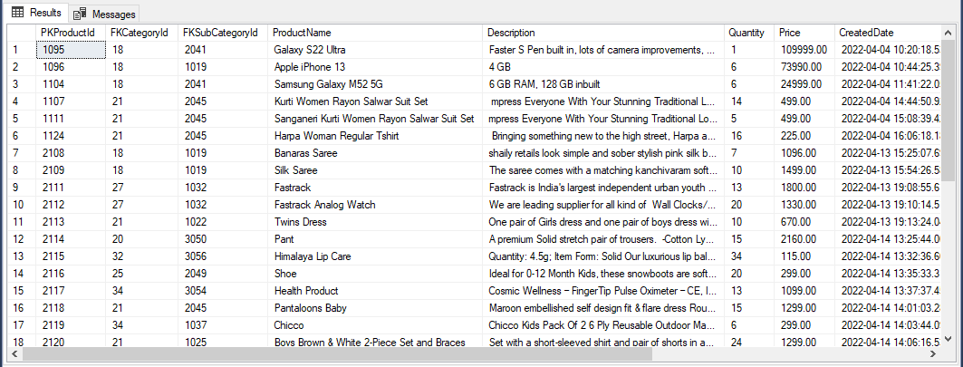
Screen shots

Slide 17
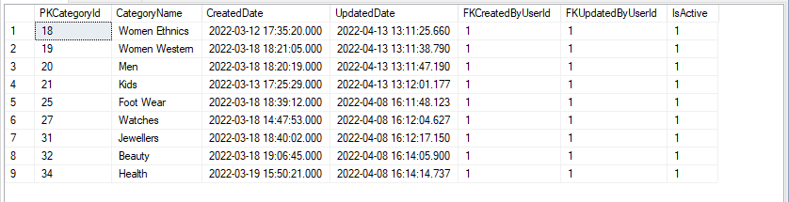
Screen shots

Slide 18
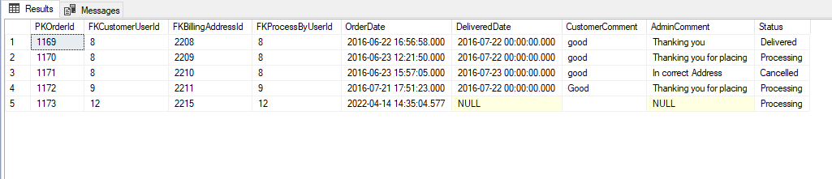
Screen shots

Slide 19
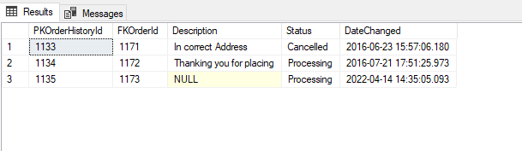
Screen shots

Slide 20
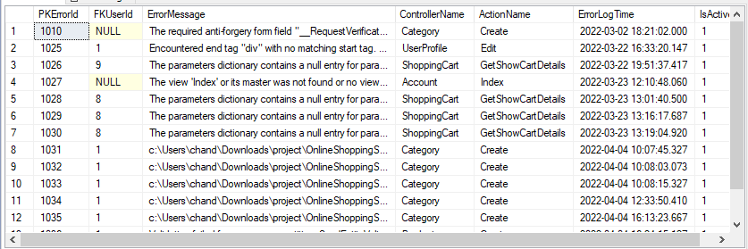
Screen shots

Slide 21
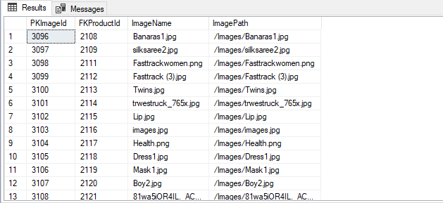
Screen shots

Slide 22

Screen shots

Slide 23
Thank you

