Slide 1
Programming I
Overview

Slide 2
Instructor
Narendra Pershad
npershad@my.centennialcollege.ca
Software Program Cluster, ICET, SETAS
Rm. A2-30
Ext. 8231
Work location
P:\npersh\COMP100\common
P:\npersh\COMP100\001…002 etc.
Remote file access
netdrive.centennialcollege.ca

Slide 3
Why Programming I?
This is the prerequisite for all other COMP courses
Provides the foundation for logical thinking and problem solving
Develops an appreciation for sound/proper coding standards
Introduces the tools that will be used in all programming courses
Instills ethical practices for school and later for work

Slide 4
Major Concepts
Data Types
Sequence
Selection
Iteration
Methods
Arrays

Slide 5
Evaluation Scheme
Lab Assignments – 30%
Assignments 6 – 20%
Quizzes – 7 – 10%
Test – 70%
Test 1 – week 5
Test 2 – week 9
Test 3 – week 14

Slide 6
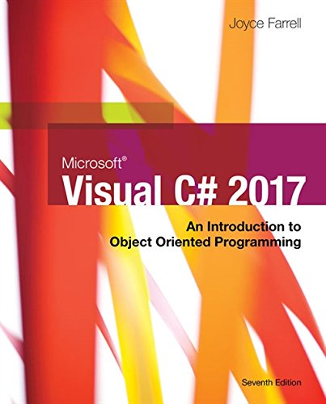
Textbook and Learning Materials
Microsoft® Visual C# 2017: An Introduction to Object-Oriented Programming, 7th Edition Joyce Farrell, ISBN-10: 9781337102100 | ISBN-13: 978-1337102100, 784 Pages, published by Cengage Learning, 2017. Available on Safari IT Books online.
MSDN Documentation
Lecture Slides
Instructor Demonstration
youtube

Slide 7
Responsibilities
Regular and punctual
Must have Visual Studio ready
Complete all assignment etc.
Do the required reading before class
If you are absent, you are responsible for the missed materials
Must show up for all tests!

Slide 8
Honesty
No plagiarism
You will be ask to verify any work submitted to the instructor

Slide 9
PLAR
Prior Learning Assessment Recognition
This course is available for PLAR

Slide 10
Labs and Assignments
50% after a missed deadline
100% penalty after the second day of classes

Slide 11
Questions

