Slide 1
SSD Project Schedule Creator
Project Evaluation
TEAM 28

Slide 2
AGENDA
Introduction​
Logic and Assumptions
Review Progress
npm packages
Results

Slide 3
Introduction
Develop JS Framework to create schedules for schools, colleges, events and conferences.

Slide 4
Logic and Assumptions
Assumptions
Logic
All events are of same duration.
All breaks are of same duration except the last break.
Breaks will not be scheduled at the start and end of the schedule.
Number of events and breaks should be at least 1.
Number of breaks should be less than number of events.
Our Program takes input of start-time, end-time, no-of events and no-of breaks, schedule date, schedule name.
Output will be the schedule consisting time-slots of events and breaks.
Schedules can be downloaded in two formats (csv and json).
Schedules can be created for multiple dates
Breaks are evenly distributed between the events.
Total-Break-Duration = Duration of one event.

Slide 5
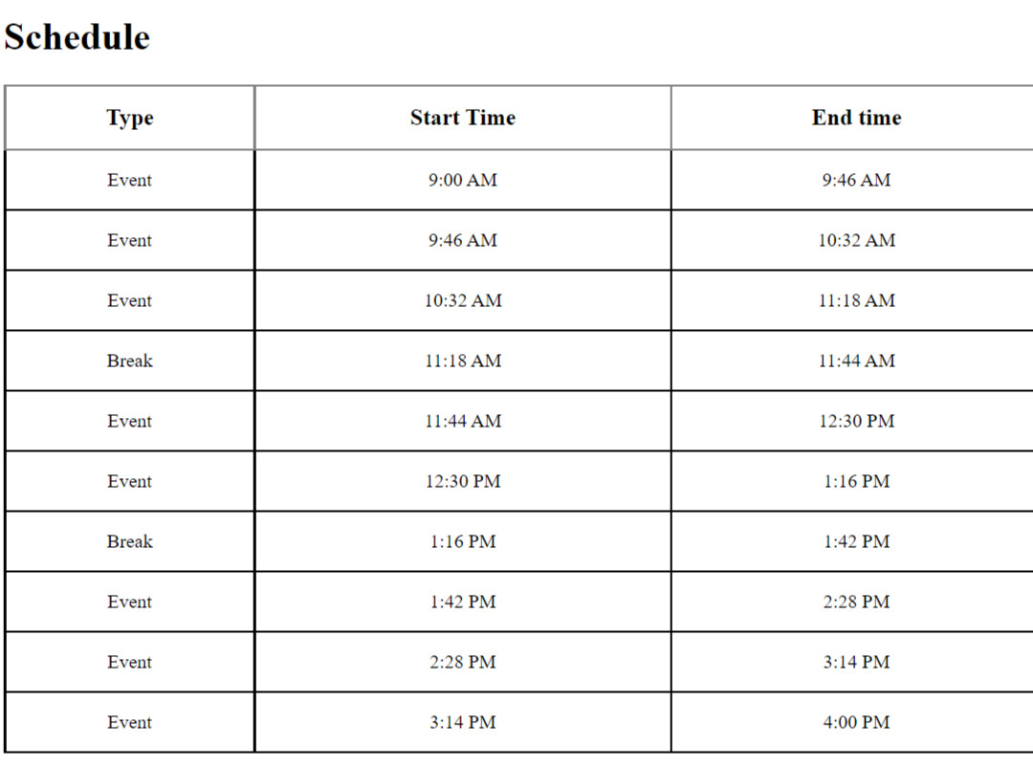
Review Progress
Screenshot of the schedule created using the above code

Slide 6
Changes after review
Export into csv, json ✅
Take user input using form ✅
Add Multiple day scheduling ✅
Editable event names✅
Descriptive time labels (Morning, Afternoon, Evening ,Night) ✅
Made npm package (schedule_creator_ssd_team_28) ✅
Front End changes ✅

Slide 7
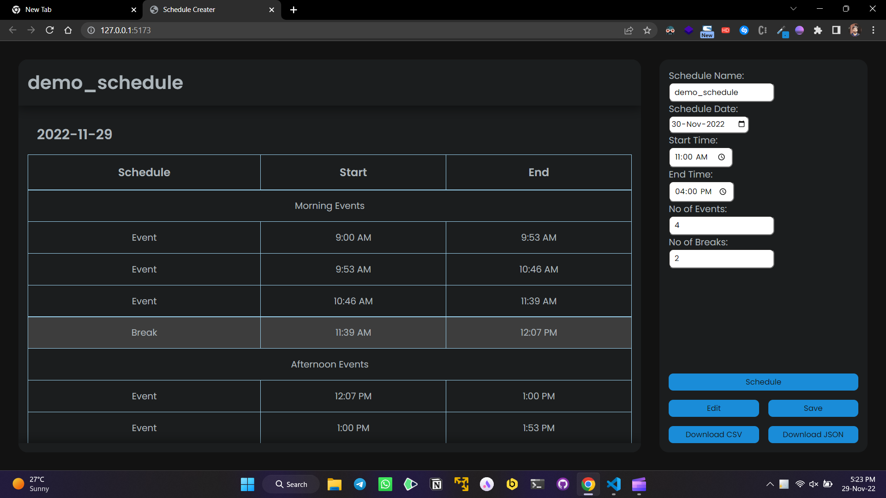
Front End

Slide 8
NPM packages
Library Installation
npm install schedule_creator_ssd_team_28
Library Usage
create_schedule({start_time, end_time, no_events, breaks, output_format,schedule_name, schedule_date})
Demo Instructions
The demo of using the npm package is present in frontend_new folder.
To run the demo follow these instructions:
cd frontend_new npm install npm run dev

Slide 9
results
Option to add and change the names and descriptions of events ✅
Option to create multiple day schedules.✅
Option to download/export the created schedule.✅
Finally, transforming it into a JS Library.✅

Slide 10
THANK YOU

