Slide 1
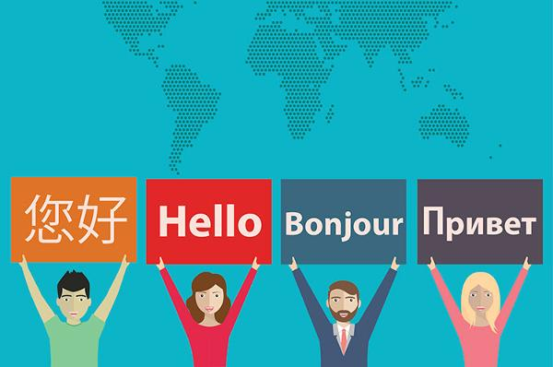
Translator

Slide 2
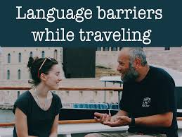
Why we need Translator ?
When you are travelling.
What is the challenges we face ?
Yes, You guess it right.
It’s the Language barrier.
“If you talk to a man in a language he understands, that goes to his head. If you talk to him in his own language, that goes to his heart.” – Nelson Mandela

Slide 3
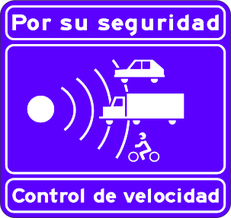
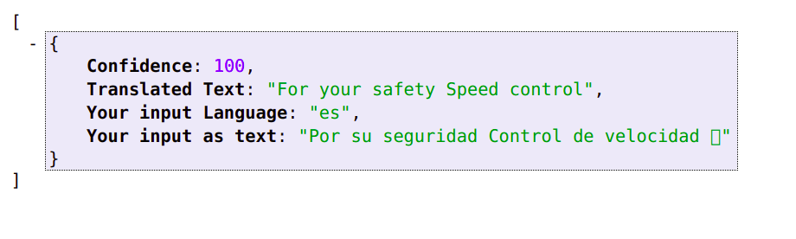
Do You understand what this sign board mean ?
What if you misjudge and you caught by traffic police
Don’t worry Translator is there for you

Slide 4
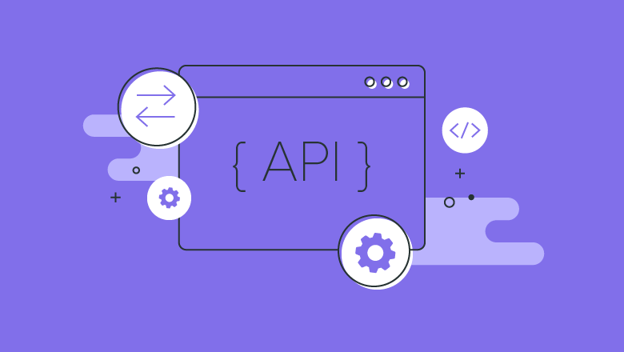
Why API ?
Automation: with APIs, computers rather than people can manage the work.
Application: because APIs can access the app components,
Efficiency: when access is provided to an API, the content generated can be published automatically and is available for every channel.

Slide 5
Mainly our Translator is do:
Speech Recognition (Speech-to-text)
OCR (Image to Text)
Text Translation
Speech Synthesis (Text-to-Speech)

Slide 6
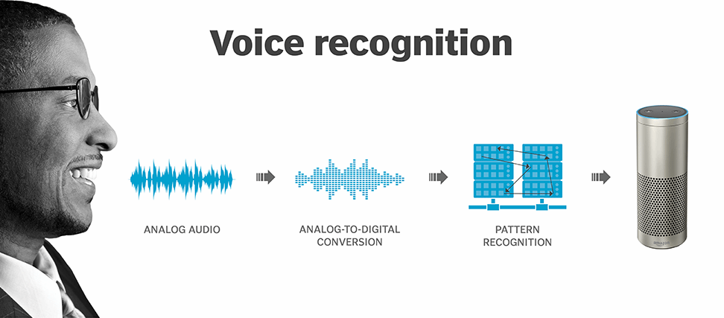
Speech Recognition (Speech-to-text)

Slide 7
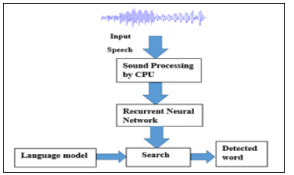
The basic recognition of speech system

Slide 8
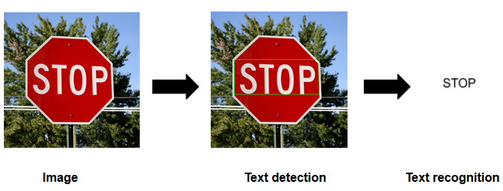
2. OCR (Image to Text)

Slide 9
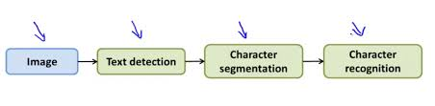

Slide 10
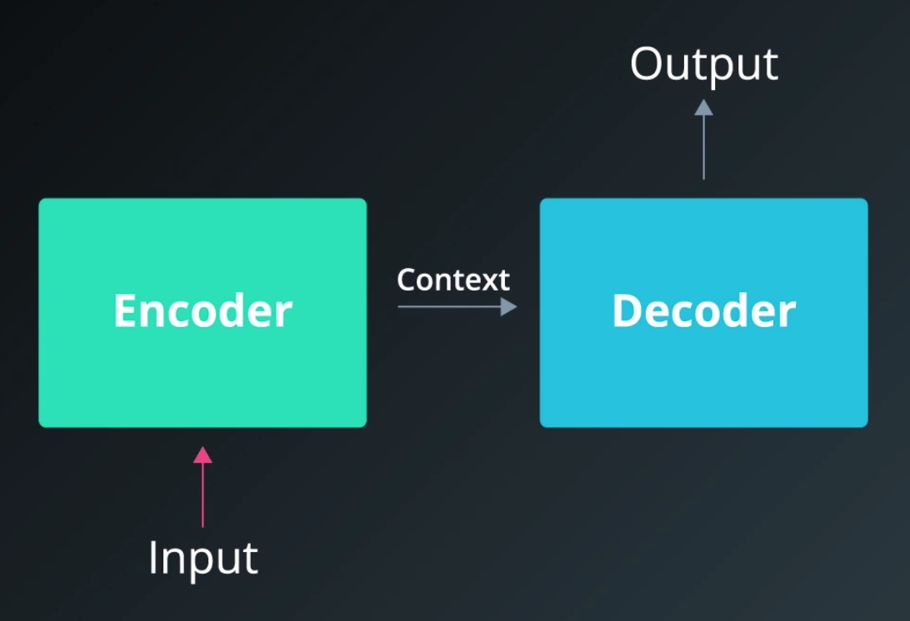
3. Text Translation

Slide 11
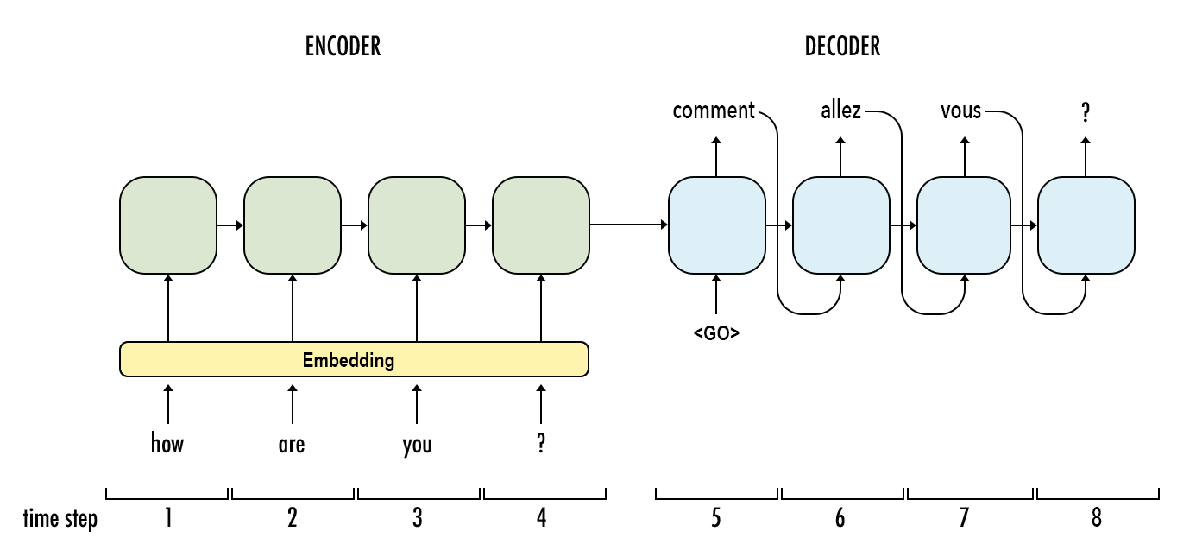

Slide 12
Thank you

