Slide 1


Brand Guidelines
Logo · Color · Type · Voice · Applications
by Prixa Technologies · v2.0 · Lalitpur, Nepal

Slide 2
CONTENTS
Inside this book
01
Foundation
The idea, positioning, essence, values
02
Logo
Lockups, safe area, sizing, misuse
03
Visual system
Color, type, the mark, grid
04
Voice & messaging
Principles, framework, language
05
Applications
Web, app, collaboration, social, merch
snowberry
02

Slide 3
01
Foundation
What Snowberry believes, and who it is for.

Slide 4
01 · FOUNDATION / THE IDEA
The quality of a story should
decide how far it travels —
not the
size of the team behind it.
Snowberry is the AI-native publishing engine that makes that true at any scale — from a single reporter to a national newsroom.
snowberry
04

Slide 5
01 · FOUNDATION / POSITIONING
Where we stand
FOR
WHO WE WIN
Media organizations who refuse to let operational complexity limit editorial ambition.
The Newsroom Builder
Buyer — scale without a hundred engineers.
The Storyteller
WE ARE
User — get the story out, zero friction.
The AI-native publishing engine that decouples reach from headcount — built engine-first, not a CMS with AI added on.
The Independent Voice
Proof there is no floor — same engine for one.
snowberry
05

Slide 6
01 · FOUNDATION / ESSENCE & VALUES
Amplitude.
One word holds the brand. Amplitude is the height of a wave — its power, set by nothing but itself. The story sets the amplitude; the engine carries it to full height.
THE FIVE VALUES
01
02
03
04
05
Story first
Zero friction
Proven, not promised
Built, not borrowed
Timeless over trendy
Reach, not features.
Friction is failure.
Evidence first.
We own the engine.
Built for the decade.
snowberry
06

Slide 7
02
Logo
One mark, used with discipline.

Slide 8

02 · LOGO / PRIMARY
The horizontal wordmark is the primary logo. Always use the supplied artwork — never re-type or re-draw it.
Primary colours are Snowberry Blue on light, white on blue or imagery. No other colourways exist.
snowberry
08

Slide 9


02 · LOGO / LOCKUPS
Three lockups
Horizontal
Stacked
Icon
Primary. Default.
Square & tight spaces.
App, avatar, favicon.
snowberry
09

Slide 10
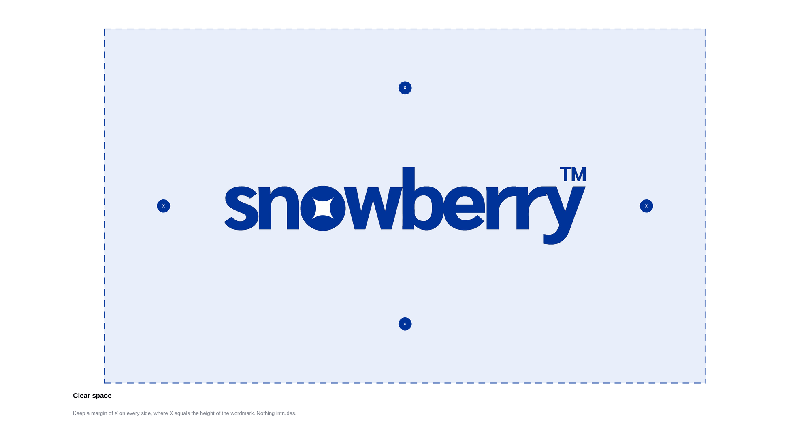
02 · LOGO / SAFE AREA
Clear space
X
The clear space is X on every side, where X is the height of the wordmark. Keep type, images, and edges out of this zone.
snowberry
10

Slide 11
02 · LOGO / MINIMUM SIZE
Minimum size
Below these sizes legibility breaks down and the mark must not be used. When in doubt, give it more room, not less.
Wordmark — 120 px wide (digital) · 25 mm (print)
Icon — 24 px minimum
snowberry
11

Slide 12

02 · LOGO / BACKGROUNDS
On backgrounds
Blue on white
White on blue
White on ink/photo
Primary positive.
Primary reverse.
For dark or busy backgrounds.
Maintain strong contrast. Never place the blue wordmark on blue, or on a busy image — switch to white.
snowberry
12

Slide 13
02 · LOGO / MISUSE
Never do these
✕
Don't recolour
✕
Don't stretch
✕
Don't rotate
Only blue or white.
Keep proportions.
The mark stays level.
✕
Don't add effects
✕
Don't crowd it
✕
Don't outline
No shadow or glow.
Respect clear space.
No strokes on the mark.
snowberry
13

Slide 14
03
Visual system
Color, type, the mark, and the grid.

Slide 15
03 · VISUAL SYSTEM / COLOR
~70% of every layout
Snow White
#FFFFFF — backgrounds, reverse logo
Ice
#E8EEFA — panels & fills
Ink
#0D0D12 — text & dark grounds
Snowberry Blue
Grey
HEX 003399
RGB 0 · 51 · 153
CMYK 100 · 67 · 0 · 40
#787C86 — secondary text
snowberry
15

Slide 16
03 · VISUAL SYSTEM / TYPOGRAPHY
Aa
Display
Speak at full volume.
46–72 pt Bold
Headline
The room for the story
28–40 pt Bold
Subhead
Reach earned by the work
Arial / Helvetica
18–22 pt Regular
The neo-grotesque that defines the International Typographic Style. One family, used with weight and scale — never decoration.
Body
Draft to published, zero friction.
13–15 pt Regular
Caption
SNOWBERRY · BRAND
9–11 pt · tracked
snowberry
16

Slide 17

03 · VISUAL SYSTEM / THE MARK
What the star means
An aperture
An opening — the room built for the story to come through.
A north star
Direction and reach; the point a story travels toward.
Full volume
Four points pushing outward — expression at full amplitude.
The same star sits inside the “o” of snowberry — mark and name are one.
snowberry
17

Slide 18
03 · VISUAL SYSTEM / LAYOUT
The grid & principles
01 Negative space is a material
Let the page breathe. Empty space is intentional, not unfilled.
02 Align to the grid
Every element starts on a column. Nothing floats.
03 Type does the work
Hierarchy comes from weight and scale, not ornament.
04 Flat, always
No gradients, no drop shadows, no bevels.
12-column grid · align everything to it
snowberry
18

Slide 19
04
Voice &
messaging
How Snowberry sounds, and what it says.

Slide 20
04 · VOICE / PRINCIPLES
A confident builder who reveres the craft of storytelling. Proof in one hand, respect for the writer in the other.
WE ARE
WE ARE
WE ARE
WE ARE
Proven
Reverent about the story
Plain & sharp
Timeless
NOT
NOT
NOT
NOT
not boastful
not sentimental
not jargon-heavy
not trend-chasing
snowberry
20

Slide 21
04 · MESSAGING / FRAMEWORK
The messaging house
ROOF The quality of a story should decide its reach, not the size of the team. Snowberry makes it true at any scale.
PILLAR 01
PILLAR 02
PILLAR 03
Proven at scale
Built, not retrofitted
Zero friction, any scale
A decade in market.
Billions of reader visits.
Growth others take 5 years to reach.
Engine built ground-up.
Agentic AI runs the operation.
Owned brief to performance.
One reporter to national desk.
Text, audio, visual.
Draft to distribution, no fight.
FOUNDATION Expression is the oldest human act. As long as humans have something to say, the need for the room never ends.
snowberry
21

Slide 22
04 · MESSAGING / KEY LINES
Speak at full volume.
Public hero line.
The story was always yours. We built the room.
Brand & manifesto line.
The engine WordPress couldn't build.
Sales / challenger line.
Reporters and editors, on steroids.
Product capability line.
snowberry
22

Slide 23
04 · MESSAGING / LANGUAGE
Say this, not that
SAY THIS
NOT THIS
Speak at full volume
Post your content
The engine we built
Our CMS / platform
Reach earned by the story
Go viral
Access to knowledge
Access to information
Built, not retrofitted
AI-powered features
Proven across a decade
Trusted by many
snowberry
23

Slide 24
05
Applications
The brand in the world.

Slide 25
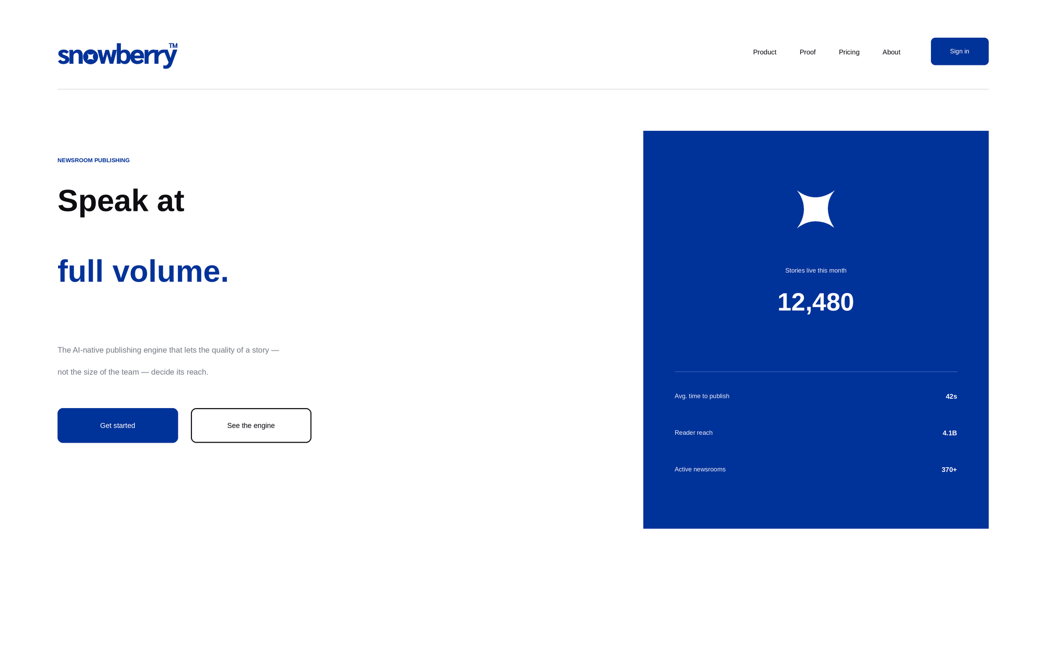
05 · APPLICATIONS / WEB
Website
Big type, hard left alignment, generous white space, one blue product panel. The homepage hero is the brand thesis in one screen.
snowberry
25

Slide 26
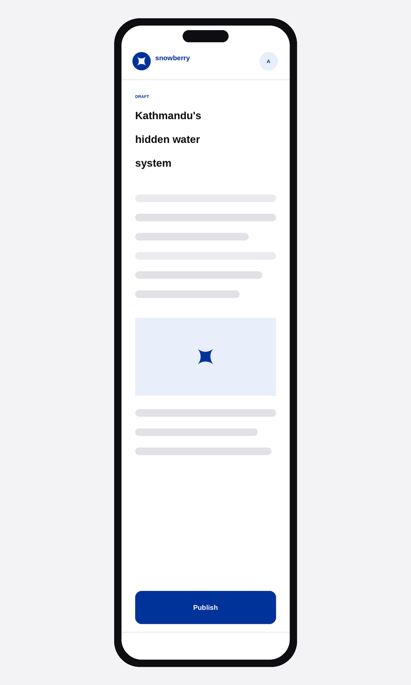
05 · APPLICATIONS / MOBILE
Mobile app
THE EDITOR IN YOUR POCKET
Draft, edit, and publish from anywhere. The interface disappears — verbs over labels, one primary action per screen, the writer always in flow.
Distraction-free editor
One-tap Publish
Star marks AI-assisted blocks
Light, fast, frictionless
snowberry
26

Slide 27
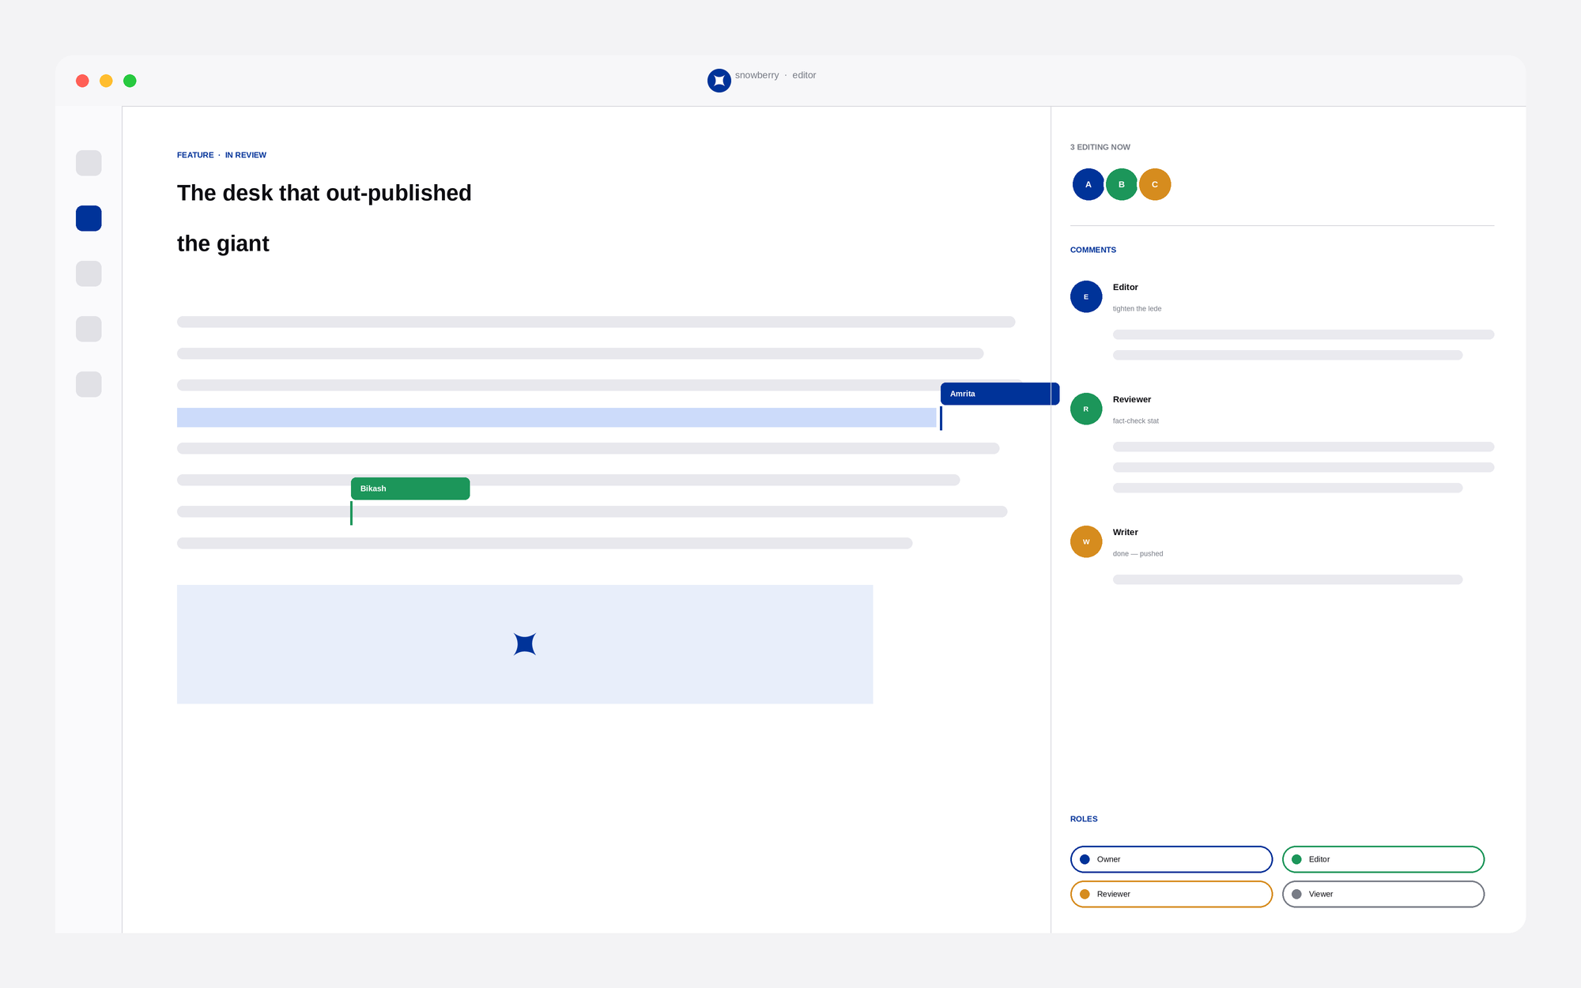
05 · APPLICATIONS / COLLABORATION MODULE
Built for the whole desk
Real-time co-editing
Multiple writers, one document, live cursors.
Roles & permissions
Owner, Editor, Reviewer, Viewer.
Inline comments
Feedback where the work happens.
Presence
See who's in the story, right now.
snowberry
27

Slide 28
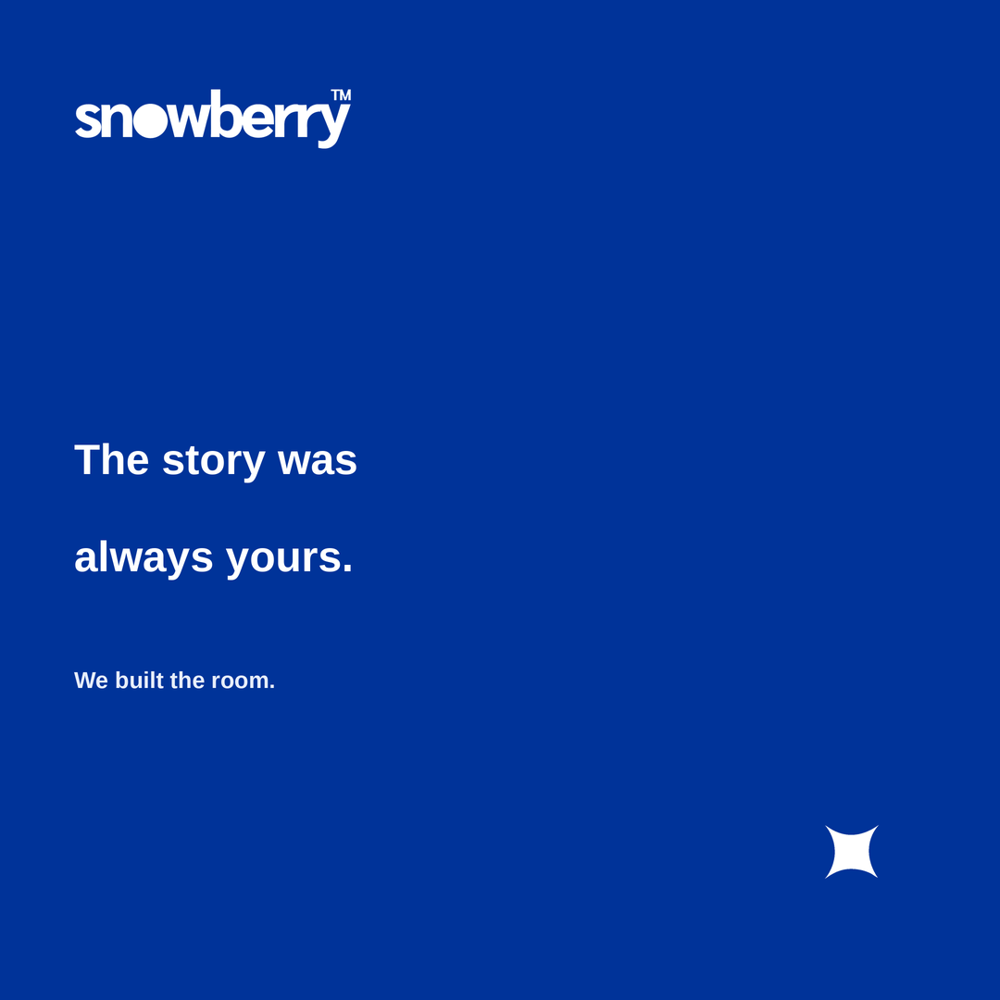
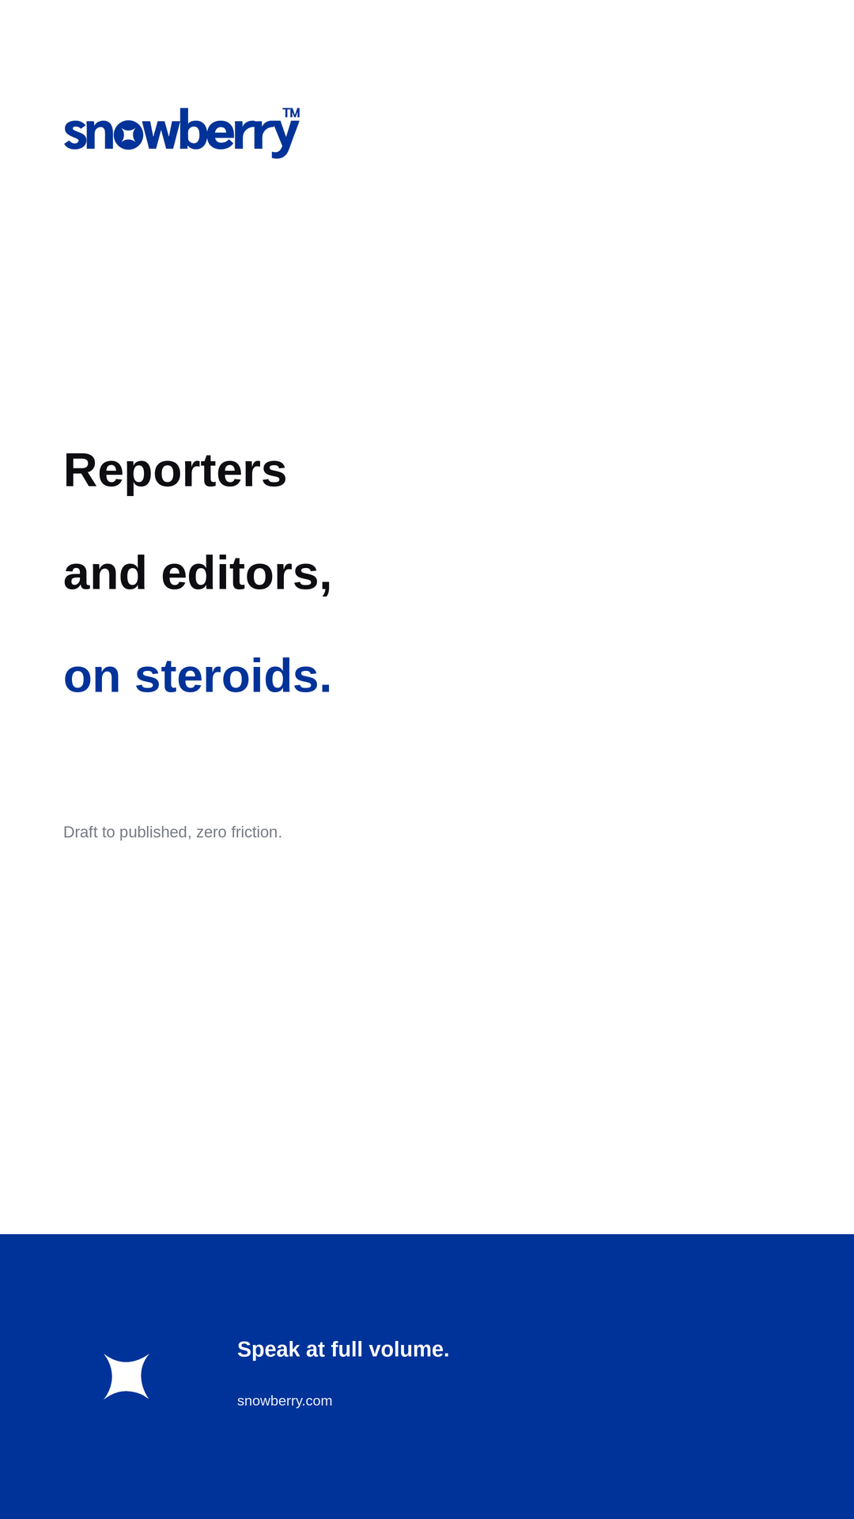
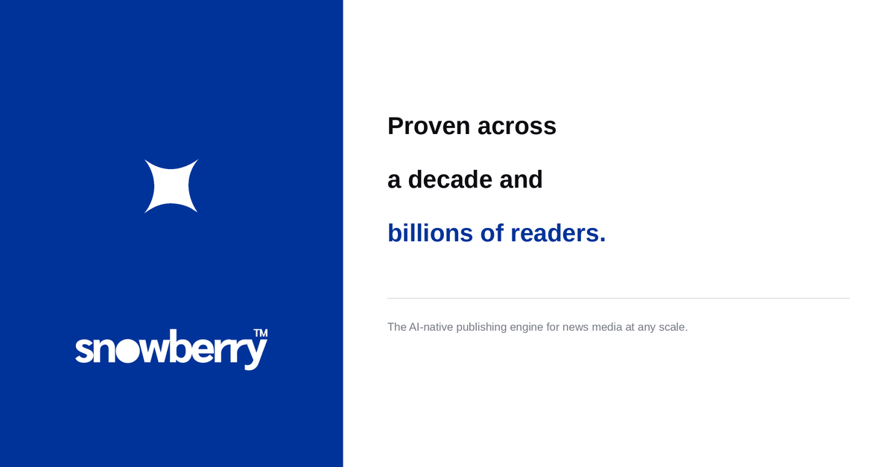
05 · APPLICATIONS / SOCIAL
Social templates
Post · 1080²
Story · 1080×1920
LinkedIn · 1200×627
One idea per frame. Blue or white ground, bold line, the mark present but never crowding the message.
snowberry
28

Slide 29
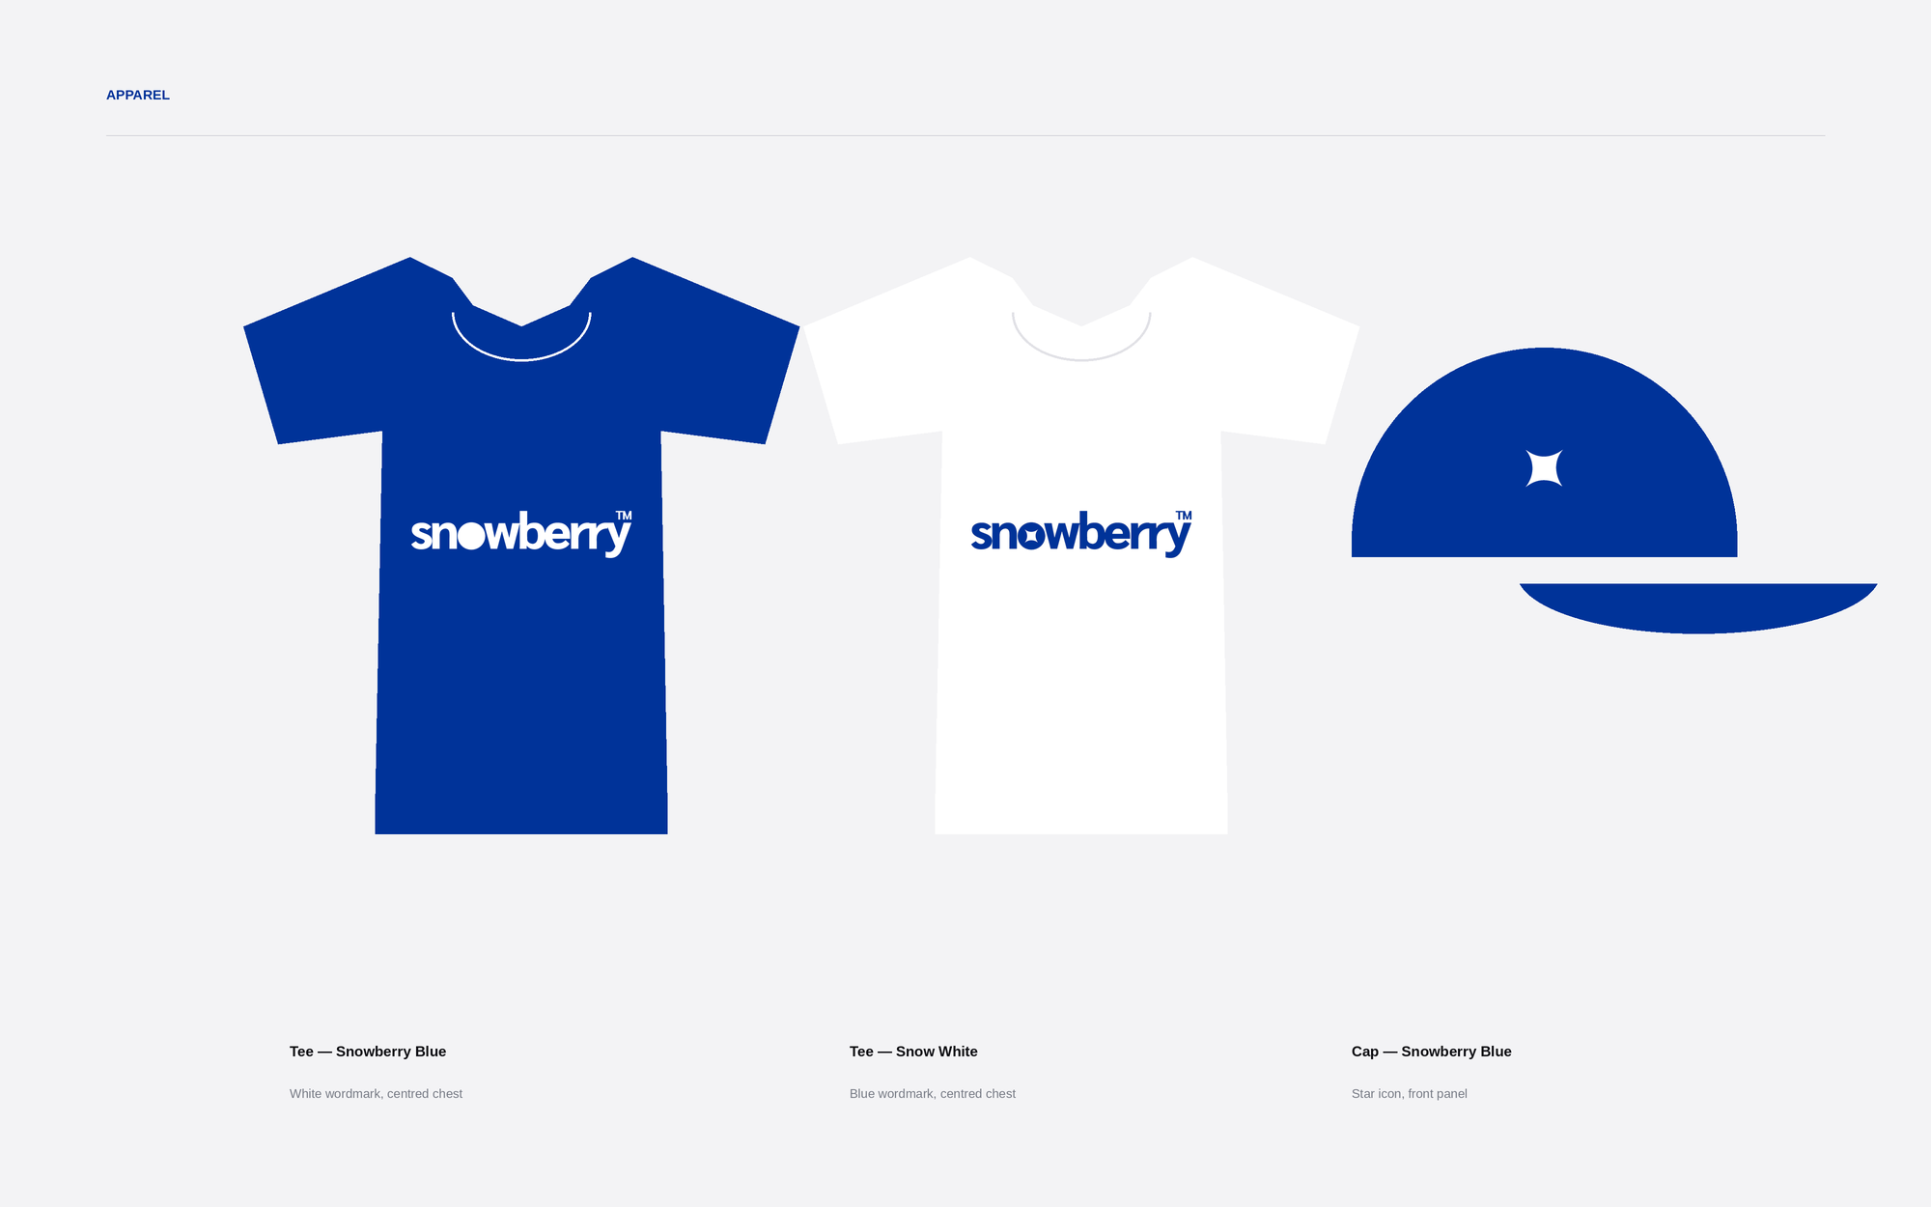
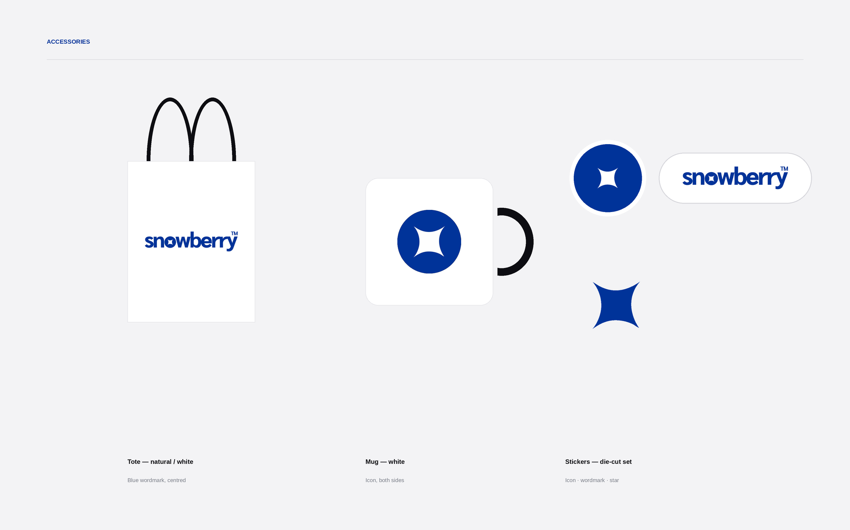
05 · APPLICATIONS / MERCHANDISE
Merch
snowberry
29

Slide 30
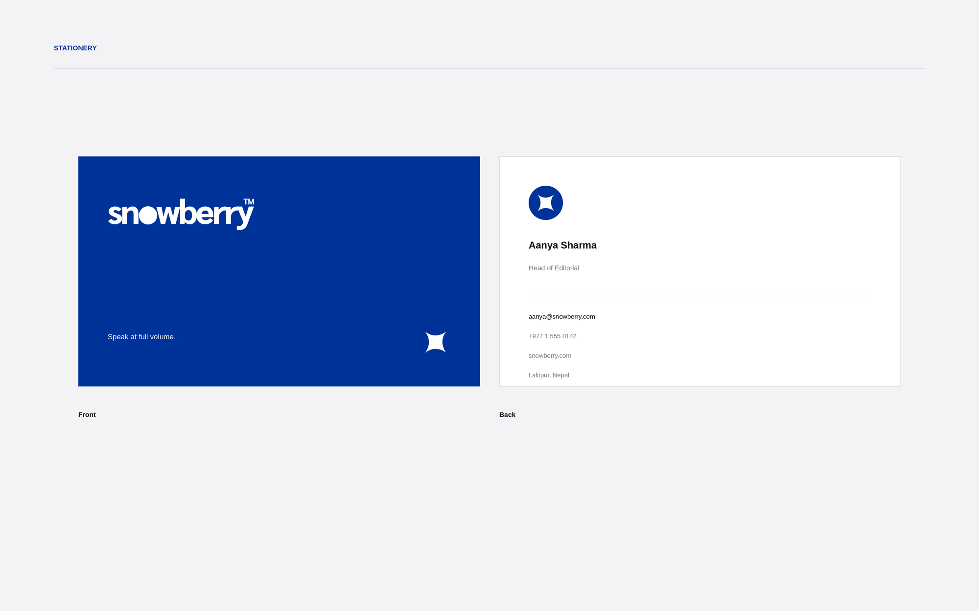
05 · APPLICATIONS / STATIONERY
Business card
snowberry
30

Slide 31
Speak at full volume.
The story was always yours. We built the room.
by Prixa Technologies · Lalitpur, Nepal

