Slide 1
Metric Tree Labs Data Science Case Study
21-Feb-2021
Solution Provider Kumar Abhishek

Slide 2
AGENDA
Problem Statement
Data Leveraged
Solution Demo

Slide 3
Problem Statement
Finding trends in the overall Advertisement flow year-on-year for each PLAYER
Identifying 5 Super Categories & Advertisers where each Player is strong
Post examining the performance of both Players in FY 2020-21, recommendations to each Player to achieve growth going forward
Identifying 10 Advertisers for having extended great support to its PLAYER 1

Slide 4
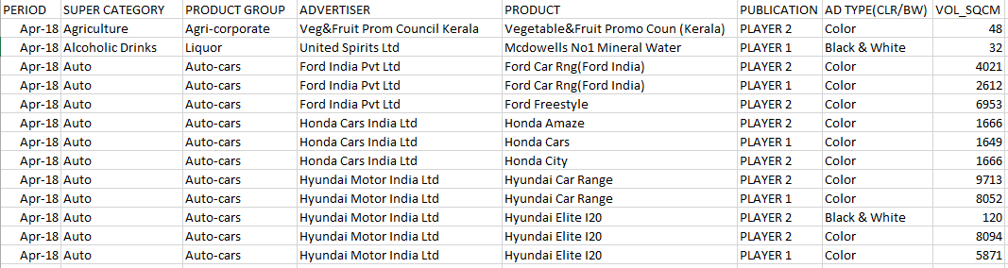
Data Leveraged
Description:
Data contains ~ 70K data points of two Publication (PLAYER 1 & PLAYER 2)
Month-wise data has been compiled over three Financial Years (Fy18-19, Fy19-20, Fy20 till date)
Features
PERIOD
SUPER CATEGORY
PRODUCT GROUP
ADVERTISER
PRODUCT
PUBLICATION
AD TYPE(CLR/BW)
VOL_SQCM
~Size 10 MB
Data File
Format (CSV)
GLOSSARY
1) AD - Advertisement
2) CLR -Color
3) BW – Black & White
4) VOL_SQCM - Volume in Square Centimeter

Slide 5
Solution Demo

Slide 6
Finding trends in the overall Advertisement flow year-on-year for each PLAYER

Slide 7
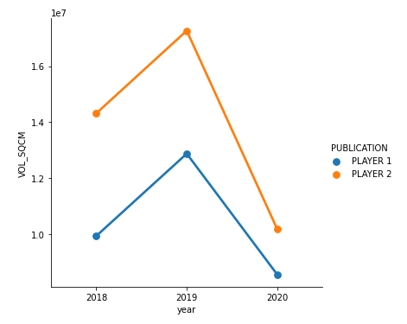
Visual Check
From 2018 to 2019, both have an upward trend and from 2019 to 2020 Player-1 & Player-2 have a downward trend
Let’s Check it Statistically by decomposing the time-series

Slide 8
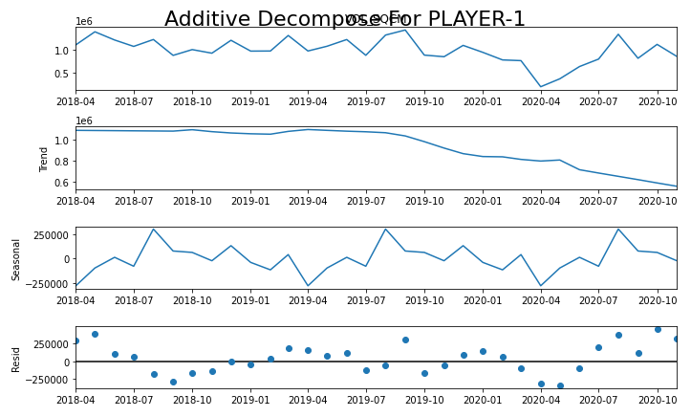
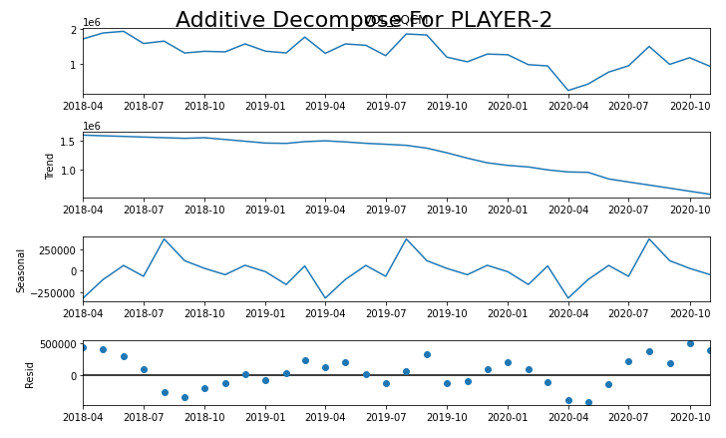
Statistical Check – By Decomposing Time-Series

Slide 9
In Summary, From 2018 to 2019, both have an upward trend and from 2019 to 2020
Player-1 & Player-2 have a downward trend. The hypothesis is also verified statistically. And, Overall trend is downward for both Players.

Slide 10
Identifying 5 Super Categories & Advertisers where each Player is strong

Slide 11
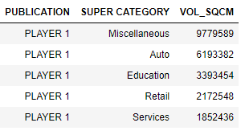
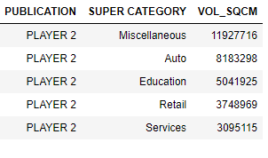
Top 5 Super Categories for Player 1 and Player 2
PLAYER 1
PLAYER 2

Slide 12
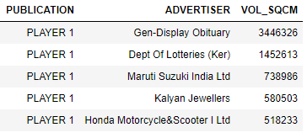
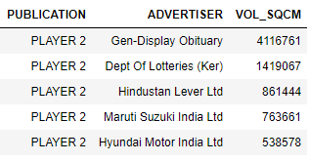
Top 5 Advertiser for Player 1 and Player 2
PLAYER 1
PLAYER 2

Slide 13
Post examining the performance of both Players in FY 2020-21, recommendations to each Player to achieve growth going forward

Slide 14
Examining Performance of Player-1 at Super Category Level
SUPER CATEGORY | VOL_SQCM | pct_share_within_group | pct_share_wrt_overall
Miscellaneous | 2918673 | 34.11140755 | 3.991239676
Auto | 1780261 | 20.80644475 | 2.434479072
Education | 857403 | 10.02072626 | 1.172485192
Services | 538974 | 6.299150941 | 0.737038515
Banking/Finance/Investment | 527321 | 6.162958832 | 0.72110322
Retail | 418825 | 4.894933509 | 0.572736637
Personal Accessories | 331152 | 3.870272838 | 0.45284518
Durables | 260288 | 3.042063996 | 0.355939769
Food & Beverages | 249141 | 2.911785661 | 0.340696421
Personal Healthcare | 120605 | 1.409546841 | 0.164925451
Household Products | 112606 | 1.316060127 | 0.153986944
Laundry | 77821 | 0.909517389 | 0.106419
Building, Industrial & Land Materials/Equipments | 77102 | 0.90111422 | 0.105435779
Textiles/Clothing | 68011 | 0.794864974 | 0.093003979
Personal Care/Personal Hygiene | 60793 | 0.710506041 | 0.083133477
Corporate/Brand Image | 46853 | 0.547585077 | 0.064070745
Computers | 33553 | 0.392143984 | 0.045883203
Media | 28632 | 0.334630779 | 0.039153812
Telecom/Internet Service Providers | 20861 | 0.24380877 | 0.028527091
Hair Care | 14680 | 0.171569567 | 0.02007467
Fuel/Petroleum Products | 9884 | 0.115517275 | 0.013516215
Telecom Products | 1265 | 0.014784435 | 0.001729868
Tobacco & Related Products | 872 | 0.010191326 | 0.001192446
Agriculture | 480 | 0.005609904 | 0.000656392
Office Automation | 240 | 0.002804952 | 0.000328196

Slide 15
Examining Performance of Player-2 at Super Category Level
SUPER CATEGORY | VOL_SQCM | pct_share_within_group | pct_share_wrt_overall
Miscellaneous | 3165435 | 31.09410268 | 4.328682852
Auto | 2067638 | 20.31043072 | 2.827462625
Education | 1180625 | 11.59729231 | 1.614486221
Retail | 696228 | 6.83905527 | 0.9520809
Services | 693625 | 6.813485972 | 0.948521338
Banking/Finance/Investment | 554444 | 5.446309485 | 0.758193498
Durables | 421708 | 4.142442303 | 0.576679094
Personal Accessories | 413045 | 4.057345559 | 0.564832577
Food & Beverages | 251917 | 2.47458345 | 0.344492557
Household Products | 113241 | 1.112367583 | 0.154855296
Building, Industrial & Land Materials/Equipments | 112833 | 1.108359795 | 0.154297363
Corporate/Brand Image | 112218 | 1.102318643 | 0.15345636
Personal Care/Personal Hygiene | 100621 | 0.988401185 | 0.137597644
Laundry | 79645 | 0.782353707 | 0.108913292
Personal Healthcare | 44563 | 0.437742837 | 0.060939205
Computers | 39414 | 0.387164154 | 0.053898029
Telecom/Internet Service Providers | 37253 | 0.365936627 | 0.050942895
Textiles/Clothing | 34304 | 0.336968568 | 0.046910183
Media | 19413 | 0.190694112 | 0.026546974
Telecom Products | 16328 | 0.160390123 | 0.022328285
Fuel/Petroleum Products | 13418 | 0.131805161 | 0.018348905
Babycare | 5349 | 0.052543286 | 0.007314674
Hair Care | 2984 | 0.029311865 | 0.004080573
Office Automation | 2672 | 0.026247085 | 0.003653918
Agriculture | 1257 | 0.012347525 | 0.001718928
pct_share_within_group &
pct_share_wrt_overall are
calculated field. We can use these fields as a performance indicator of each Player.
Calculation :-
pct_share_within_group = (VOL_SQCM/sum(VOL_SQCM for respective player))*100
pct_share_wrt_overall = (VOL_SQCM/sum(VOL_SQCM ))*100

Slide 16
From a growth perspective, Both players have to focus on the SUPER CATEGORY where pct_share_within_group is greater than 1 strategically and tactically. However, there is a whole lot of SUPER CATEGORY where both players have minimal pct_share_within_group. They need to do Market Mix Modelling and leverage the demographical information to target the audience. In this way, they can cut down their extra expenses and grow organically by taking strategic decisions.

Slide 17
Identifying 10 Advertisers for having extended great support to Player 1

Slide 18
Selection Approach:- The simplest way to select 10 Advertiser is to calculate their percentage of contribution in a given period and order them in descending order and select the first ten rows.
List Of Advertisers
ADVERTISER | VOL_SQCM | pct_share
Gen-Display Obituary | 3446326 | 10.98854904
Dept Of Lotteries (Ker) | 1452613 | 4.631630668
Maruti Suzuki India Ltd | 738986 | 2.356243694
Kalyan Jewellers | 580503 | 1.850923472
Honda Motorcycle&Scooter I Ltd | 518233 | 1.652376687
Hyundai Motor India Ltd | 479959 | 1.53034072
Logical Steps Interactive Solutions Pvt | 475343 | 1.515622686
Hindustan Lever Ltd | 468510 | 1.493835787
Govt Of Kerala | 443505 | 1.41410779
Renault India | 441020 | 1.406184412
pct_share is a calculated field.
Calculation:-
pct_share=(VOL_SQCM/sum(VOL_SQCM))*100

Slide 19
Thank You

