Slide 1
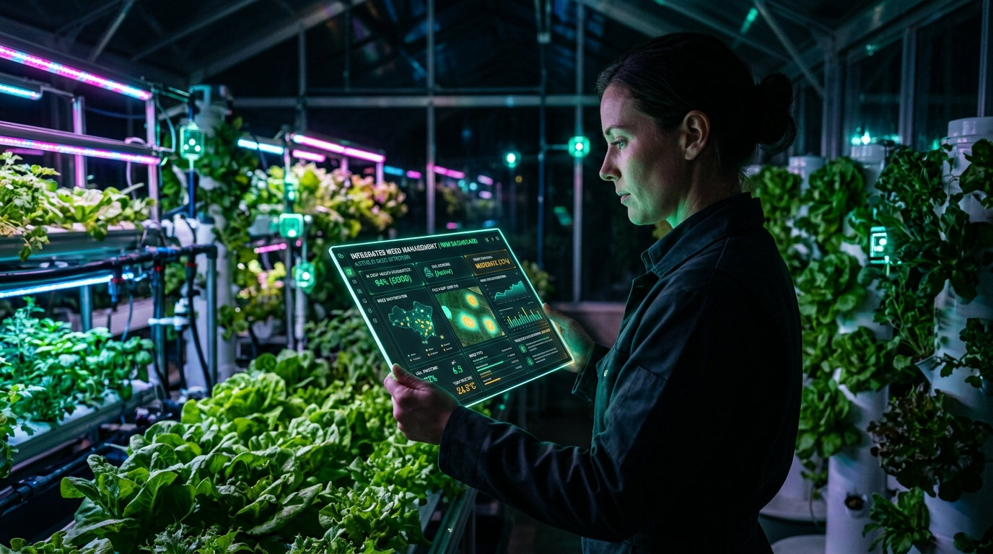
AGRICULTURE & CROP SCIENCE
Weed Management in Agriculture
Key Topics Covered:
▪ Meaning of Weed & Weed Management
▪ Importance & Core Principles
▪ Preventive, Cultural, Mechanical & Biological Methods
▪ Mulching Methods (Organic & Plastic)
▪ Advantages & Practical Limitations
Notes:
PRESENTER NOTES (Slide 1 - Welcome):
Welcome everyone. Today we are presenting a complete guide to Weed Management in Agriculture.
We will go through the definition of weeds, why managing them is critical for crop production, core principles, all key control methods—including preventive, cultural, mechanical, mulching, and biological—and discuss their advantages and limitations.

Slide 2
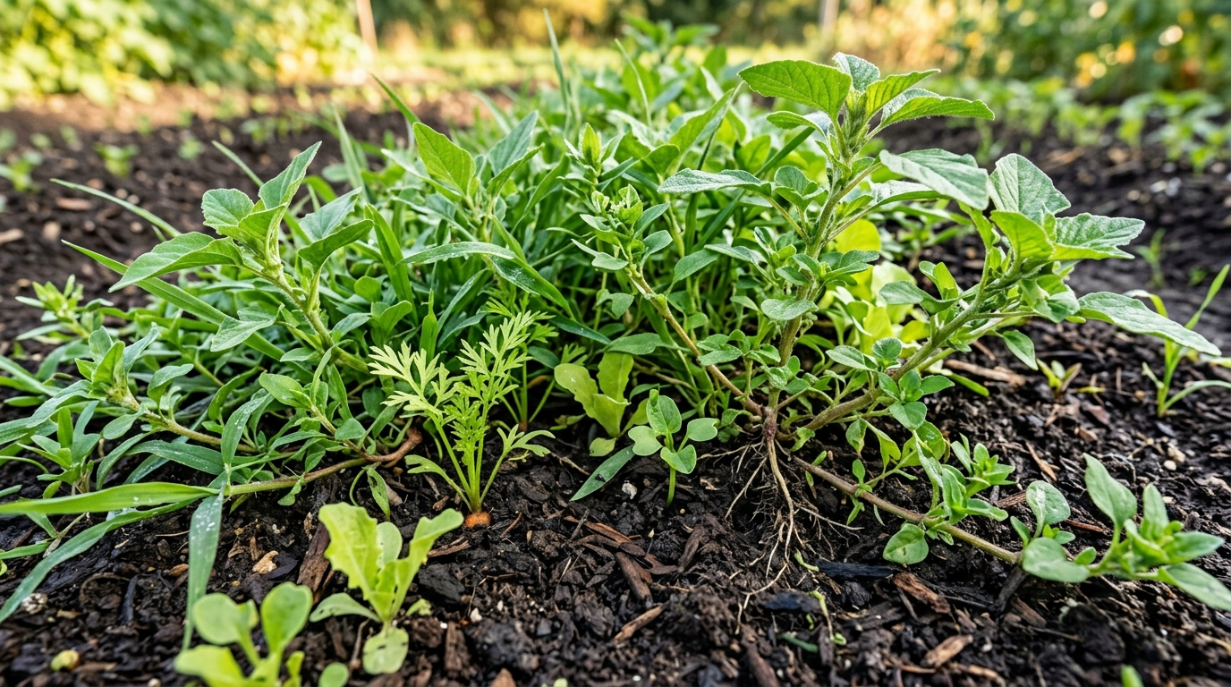
• WEED MANAGEMENT
Slide 02 / 12
Meaning: What is a Weed & Weed Management?
🌿 What is a Weed?
A weed is any plant growing where it is not wanted. For example, wild plants that grow in crop fields and compete with crops for food and water.
🎯 What is Weed Management?
The practice of controlling and suppressing unwanted weeds so crops can grow healthy, receive full nutrients, and produce good harvest yields.
⚠️ How Weeds Harm Crops
Weeds compete directly with main crops for sunlight, soil moisture, space, and fertilizers, reducing overall harvest quality and quantity.
💡 Key Farming Goal
Keep fields clean and free from heavy weed growth, especially during early crop development.
Notes:
PRESENTER NOTES (Slide 2 - Meaning of Weed & Weed Management):
Let us start with the basic definition:
1. What is a weed? It is simply a plant growing where it is not wanted. Even a tomato plant in a wheat field is a weed because it competes with the wheat.
2. What is weed management? It is the organized method of controlling weeds so our main crops get the water, fertilizer, and sunlight they need to produce a high yield.

Slide 3
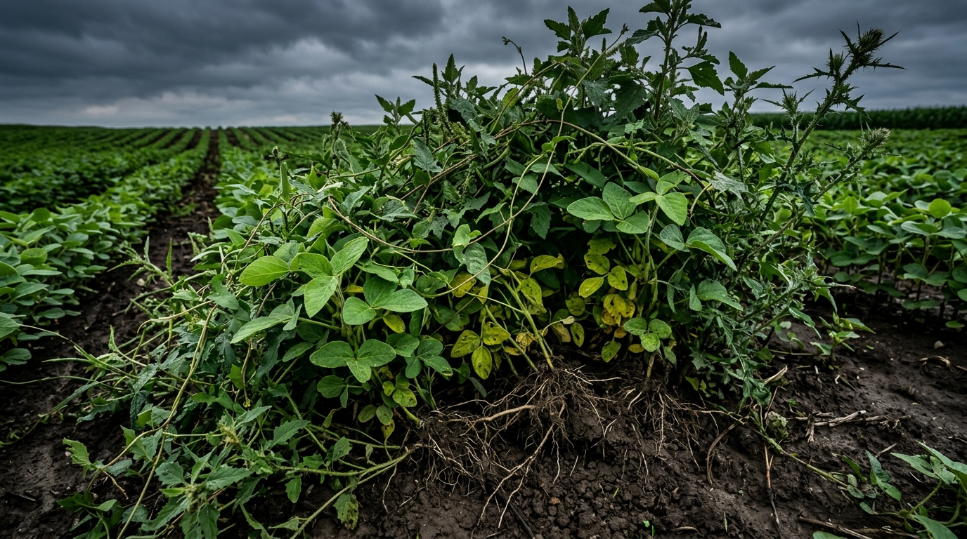
• WEED MANAGEMENT
Slide 03 / 12
Importance: Why Weed Management is Important
📈 Protects Crop Yield & Harvest
Weeds rob crops of sunlight, space, and nutrients. Controlling weeds prevents large yield losses.
💧 Saves Water & Expensive Fertilizers
Weeds absorb water and fertilizers very rapidly. Managing weeds ensures inputs nourish the crop.
🛡️ Prevents Pests & Crop Diseases
Weeds provide hiding and breeding grounds for harmful insects, viruses, and plant pathogens.
💰 Improves Produce Quality & Income
Clean fields yield higher quality produce free from weed seeds, resulting in better market prices.
Notes:
PRESENTER NOTES (Slide 3 - Importance of Weed Management):
Why is weed management so important for farmers?
1. Yield protection: Without weed control, crop yield can drop heavily.
2. Resource efficiency: Weeds drink the irrigation water and eat the costly fertilizer intended for your crops.
3. Disease and pest prevention: Weeds host pests and fungi that attack your crops.
4. Higher market prices: Clean grain and produce sell at higher prices in the market.

Slide 4
• WEED MANAGEMENT
Slide 04 / 12
Principles of Weed Management
🛡️ 1. Prevention First
Prevent weed seeds from entering the field in the first place. Keeping seeds out is much easier than removing grown weeds.
▪ Use certified clean seeds.
▪ Clean equipment before moving to fresh fields.
⏱️ 2. Critical Early Window (Timing)
Crops are most sensitive during early growth (first 20 to 35 days). Keeping fields weed-free during this window ensures healthy crop establishment.
▪ Focus weeding efforts early.
▪ Crop leaves will naturally shade out late weeds.
🔄 3. Combine Multiple Methods
Do not rely on just one single technique. Using cultural, mechanical, and biological tools together gives the best results.
▪ Combines mechanical and natural tools.
▪ Prevents weeds from adapting.
📉 4. Stop Weed Seed Production
Never let weeds flower and produce seeds in your field. Removing weeds before seed formation steadily reduces weeds in future seasons.
▪ 'One year's seeds make years of weeds.'
▪ Remove weeds before they flower.
Notes:
PRESENTER NOTES (Slide 4 - Principles of Weed Management):
Here are the four key principles of weed management:
1. Prevention: Stop weed seeds before they enter the farm.
2. Timing: Protect the crop during its critical first 30 days.
3. Integration: Combine different methods for better results.
4. Seed control: Remove weeds before they flower and produce seeds.

Slide 5
• WEED MANAGEMENT
Slide 05 / 12
Preventive Methods: Stopping Weeds Before They Enter
🌾 Clean Certified Seeds
Always use certified, pure seeds that are free from any weed seed contamination.
Benefit: Stops weeds before they ever start growing.
🚜 Clean Farm Machinery
Wash tractors, cultivators, and harvesting equipment before moving from field to field.
Benefit: Stops weeds before they ever start growing.
🧪 Well-Rotted Compost & Manure
Only apply fully decomposed manure so that any weed seeds inside have been destroyed by natural heat.
Benefit: Stops weeds before they ever start growing.
🌊 Clean Irrigation & Field Borders
Keep irrigation canals and field borders clear of weeds so seeds do not wash or blow into crops.
Benefit: Stops weeds before they ever start growing.
Notes:
PRESENTER NOTES (Slide 5 - Preventive Methods):
Preventive methods are the most cost-effective way to manage weeds:
1. Certified seeds: Make sure no foreign weed seeds are planted with your crop.
2. Clean machines: Harvesters and tractors carry seeds from field to field if not washed.
3. Well-rotted manure: Fresh manure contains active weed seeds.
4. Clean canals: Stops weed seeds from traveling in irrigation water.

Slide 6
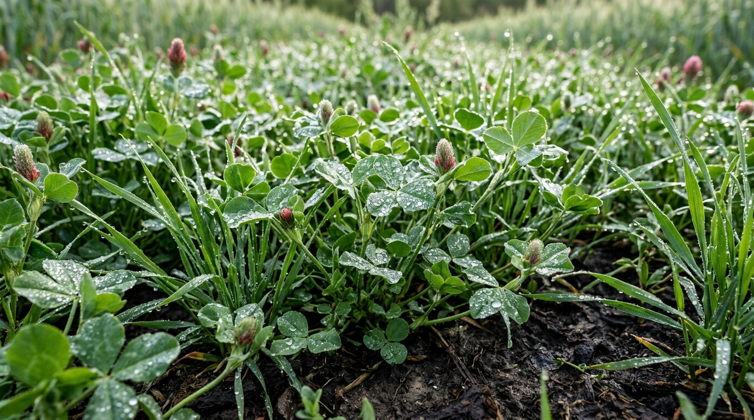
• WEED MANAGEMENT
Slide 06 / 12
Cultural Methods: Agronomic Farming Practices
🌱 Stale Seedbed Preparation
Water the soil before sowing, let weeds sprout, kill them with shallow tillage, and then sow your crop into a clean bed.
🔄 Crop Rotation
Alternate different crops each season to disrupt the life cycles of specific weeds.
📐 Proper Plant Spacing & Density
Plant crops at the right spacing so crop leaves grow together quickly and shade out weeds.
🌿 Cover Crops & Intercropping
Grow fast-growing cover crops between crop rows to blanket the soil and smother weeds.
Notes:
PRESENTER NOTES (Slide 6 - Cultural Methods):
Cultural methods use smart farming habits to suppress weeds:
1. Stale Seedbed: Irrigating early sprouts weeds so they can be removed before the real crop is sown.
2. Crop Rotation: Rotating crops prevents any single weed type from dominating.
3. Spacing: Proper spacing makes crops form a dense canopy that shades out weeds.
4. Cover Crops: Growing ground-cover plants smothers weed growth naturally.

Slide 7
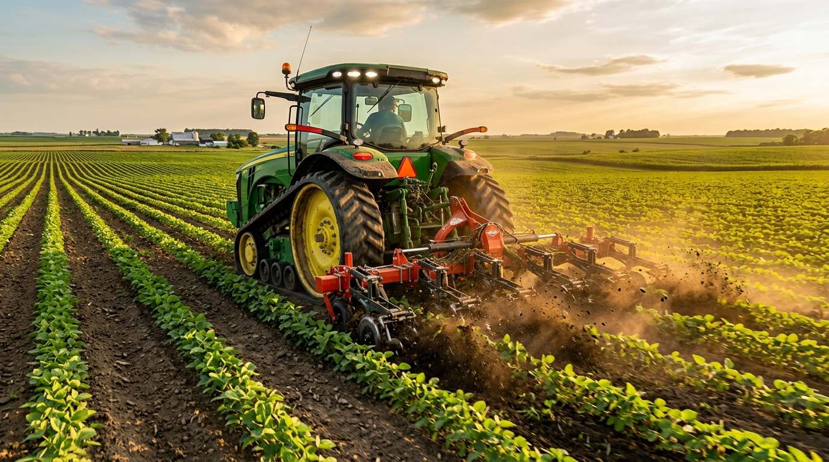
• WEED MANAGEMENT
Slide 07 / 12
Mechanical Methods: Physical Tools & Machinery
🛠️ Hand Weeding & Hoeing
Physically pulling or cutting weeds using simple hand tools like a hoe or khurpi around crop plants.
🚜 Tractor Inter-Row Cultivators
Using tractor-mounted rotary weeders or tines to cultivate and uproot weeds between crop rows quickly.
✂️ Mowing & Slashing
Cutting tall weeds before they flower, especially along field borders, orchards, and plantation rows.
☀️ Soil Solarization
Covering moist soil with clear plastic sheets during hot sunny weeks to heat the soil and kill weed seeds.
Notes:
PRESENTER NOTES (Slide 7 - Mechanical Methods):
Mechanical methods use physical tools to destroy weeds:
1. Hand Weeding: Great for small farms and close to delicate plants.
2. Tractor Cultivation: Fast and efficient for large acreage.
3. Mowing: Stops weeds from producing flowers and seeds.
4. Soil Solarization: Uses summer sun heat under plastic sheets to sterilize weed seeds.

Slide 8
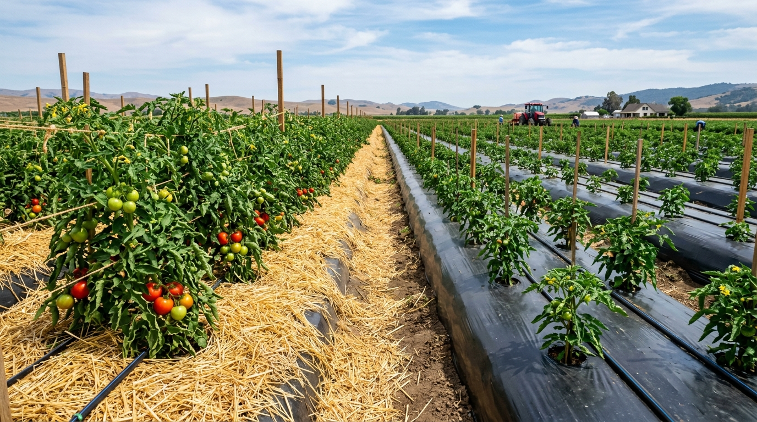
• WEED MANAGEMENT
Slide 08 / 12
Mulching Methods: Organic & Plastic Soil Covers
🛡️ What is Mulching?
Mulching means covering the bare soil around crops. It blocks sunlight so weed seeds cannot sprout, while holding moisture in the soil.
🌾 Organic Mulch (Straw & Leaves)
Using dry straw, dried leaves, or crop residue. Naturally decomposes over time and adds organic matter to the soil.
🖤 Plastic Mulch (Black Film)
Laying black or silver polyethylene sheets over raised beds with small holes for crop seedlings. Widely used for vegetables and fruits.
⭐ Key Benefits of Mulching
• Blocks 90%+ of weed growth. • Saves up to 50% of irrigation water. • Keeps soil cool and prevents soil erosion.
Notes:
PRESENTER NOTES (Slide 8 - Mulching Methods):
Mulching is one of the best non-chemical weed control methods:
1. How it works: By covering the soil, it blocks sunlight so weed seeds cannot germinate.
2. Organic Mulch: Made of straw or dry leaves that eventually nourish the soil.
3. Plastic Mulch: Black plastic film commonly used in vegetable and fruit farming.
4. Benefits: Stops weeds, saves water, and keeps the soil healthy.

Slide 9
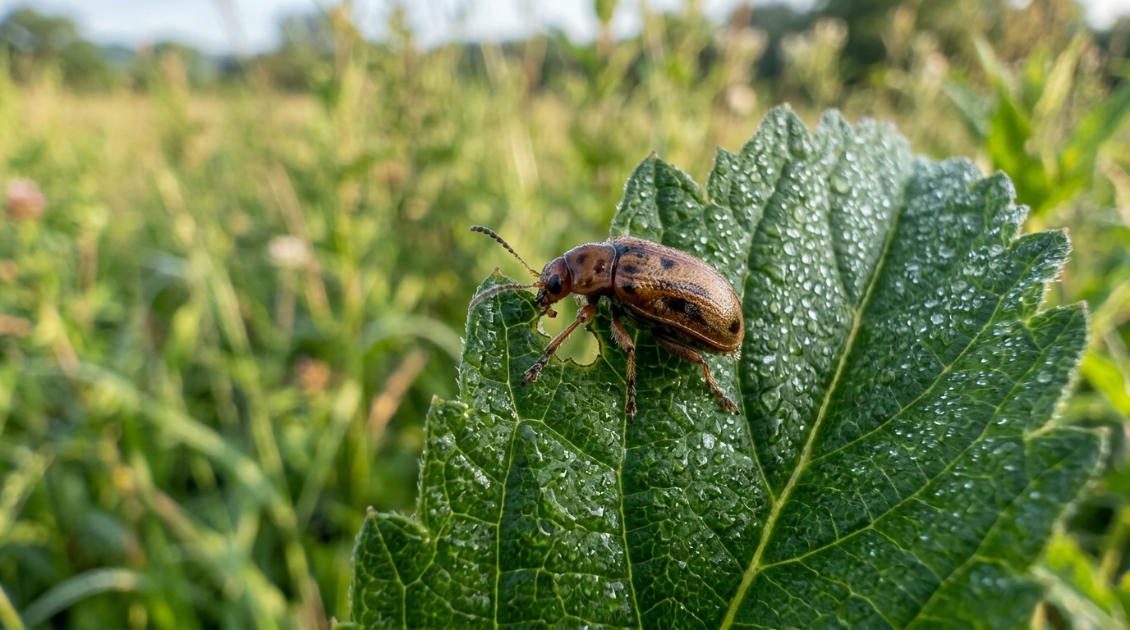
• WEED MANAGEMENT
Slide 09 / 12
Biological Methods: Natural Weed Control
🐞 Beneficial Insects
Releasing specific insects that feed exclusively on harmful weeds without eating or damaging farm crops.
🍄 Natural Bio-Agents & Fungi
Using specific natural fungi or microorganisms that target and weaken particular weed species.
🦆 Grazing Animals & Ducks
Using ducks in rice fields or grazing animals in orchards to eat weed shoots naturally.
🌿 Major Benefit
100% eco-friendly, zero chemical residues, and completely safe for soil, pollinators, and people.
Notes:
PRESENTER NOTES (Slide 9 - Biological Methods):
Biological methods use living organisms to control weeds:
1. Specific insects that eat only the problem weed without touching crops.
2. Natural bio-agents and fungi that suppress target weeds.
3. Grazing animals like ducks in rice fields to consume weed sprouts.
4. This method is completely natural with zero chemical residues.

Slide 10
• WEED MANAGEMENT
Slide 10 / 12
Comparison: Advantages & Practical Limitations
✅ Advantages of Weed Management
✔ Higher Crop Yields
↳ Increases harvest yield by giving crops full access to nutrients and light.
✔ Saves Water & Fertilizers
↳ Ensures irrigation and fertilizer nourish crops, not weeds.
✔ Better Produce Quality
↳ Delivers clean, weed-free harvest that commands higher market prices.
✔ Fewer Pests & Diseases
↳ Removes the shelter and breeding places of harmful crop pests.
✔ Long-Term Soil Health
↳ Reduces weed seed buildup in the soil for easier future farming.
⚠️ Limitations & Practical Challenges
✖ High Labor Demand
↳ Hand weeding requires significant time and manual labor during busy seasons.
✖ Equipment & Material Costs
↳ Tractor weeders and plastic mulches require upfront purchase costs.
✖ Weather Dependence
↳ Heavy rains and wet soil can delay mechanical weeding operations.
✖ Plastic Waste Management
↳ Plastic mulch sheets must be collected after harvest to avoid farm waste.
Notes:
PRESENTER NOTES (Slide 10 - Advantages & Limitations):
Here is a balanced comparison:
Advantages: Higher yields, efficient fertilizer and water use, fewer pests, and cleaner harvest.
Limitations: Hand labor is hard to find, equipment costs money, wet weather can delay weeding, and plastic mulch needs disposal.
Combining different methods helps overcome these limitations.

Slide 11
• WEED MANAGEMENT
Slide 11 / 12
Conclusion: 5 Key Golden Takeaways
🎯 Summary for Successful Weed Management
✔ 1. Start Clean:
Always use certified clean seeds and sanitized equipment before planting.
✔ 2. Act Early:
Keep crops weed-free during the critical first 30 days of growth.
✔ 3. Protect the Soil:
Use organic or plastic mulch to conserve water and block weed emergence.
✔ 4. Combine Methods:
Integrate cultural, mechanical, and biological practices for best results.
✔ 5. Prevent Seed Setting:
Remove weeds before they flower to stop weed buildup in future years.
Notes:
PRESENTER NOTES (Slide 11 - Conclusion):
In conclusion, remember these five simple rules:
1. Start clean with certified seed.
2. Act early during the first 30 days.
3. Protect the soil with mulch.
4. Combine multiple methods.
5. Never let weeds produce seeds.

Slide 12
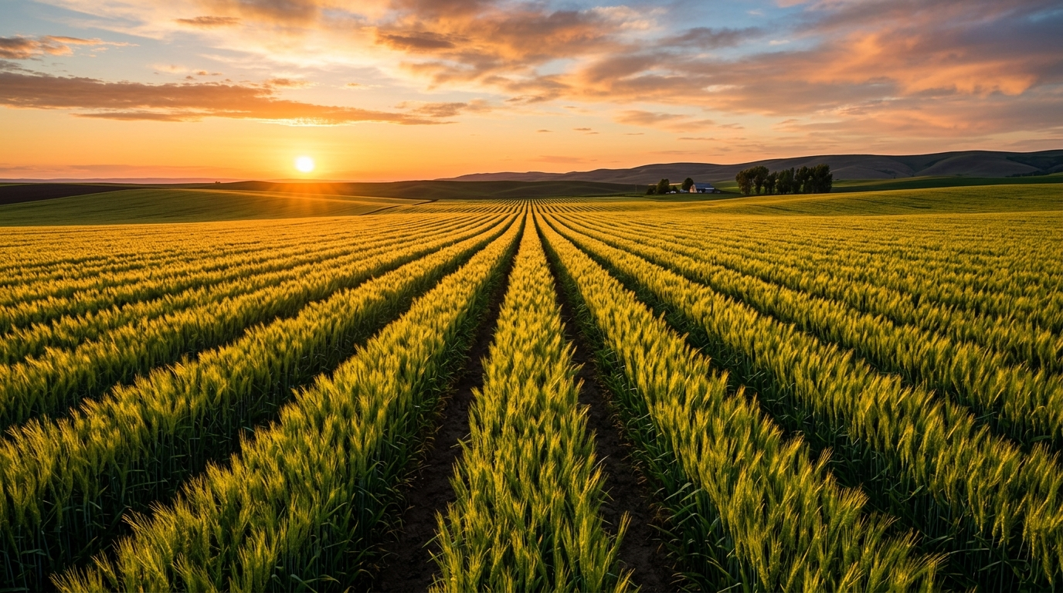
🌾 THANK YOU!
Thank you for your time and attention.
Healthy Crops • Thriving Farms • Higher Yields
💬 Questions & Discussion Welcome!
Notes:
PRESENTER NOTES (Slide 12 - Closing):
Thank you very much for your attention!
We are now open for any questions, thoughts, or discussion on weed management.

