Slide 1
AI for Everyone
Presidential Initiative for Artificial Intelligence and Computing

Slide 2
Objectives of this Course
The meaning behind common AI terminology, including neural networks, machine learning, deep learning, and data science
What AI realistically can--and cannot--do
How to spot opportunities to apply AI to problems in your own organization
What it feels like to build machine learning and data science projects
How to work with an AI team and build an AI strategy in your company
How to navigate ethical and societal discussions surrounding AI

Slide 3
$13 Trillion
AI value creation by 2030
Source: McKinsey Global Institute

Slide 4
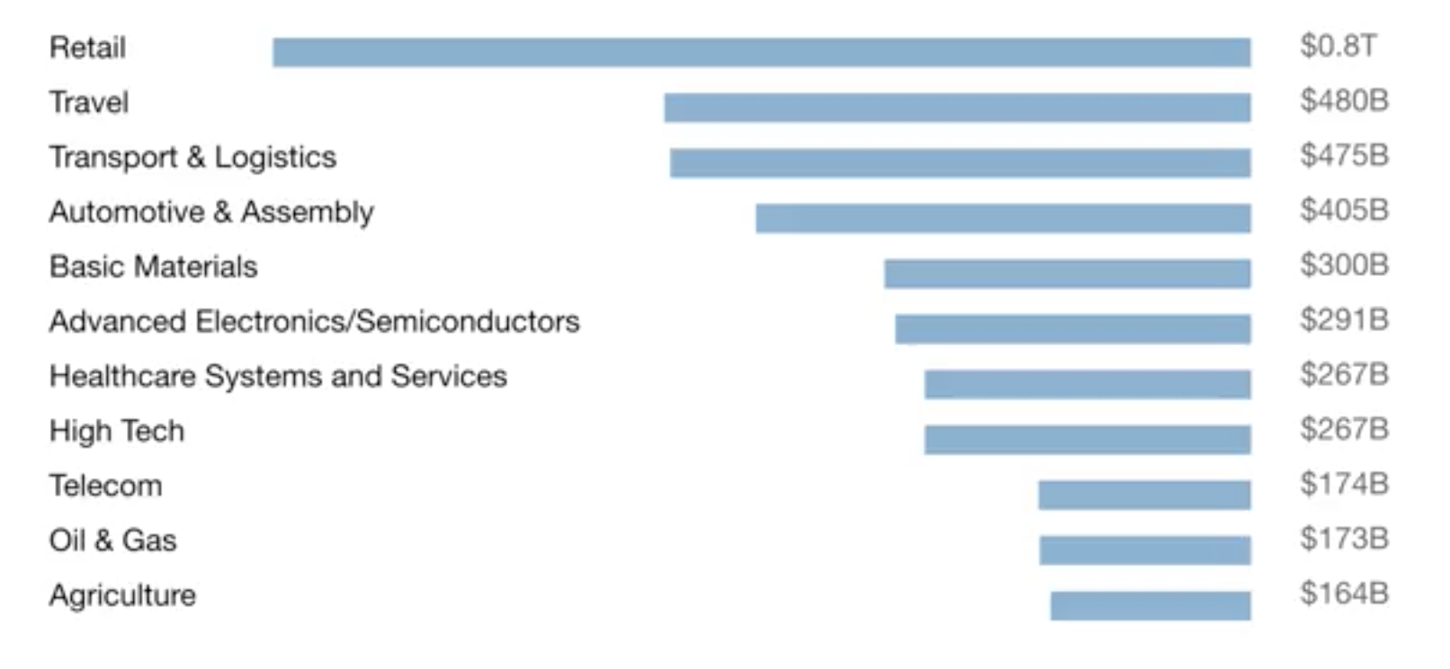
A lot of the value created by AI will be outside the software industry. AI will have a huge impact on all the major industries.

Slide 5
There are 2 types of AI
ALMOST NO PROGRESS
ANI
Artificial Narrow Intelligence
AGI
Artificial General Intelligence
LOTS OF PROGRESS
Notes:
There is a lot of excitement but also a lot of unnecessary hype about AI.
AI is actually two separate ideas.

Slide 6
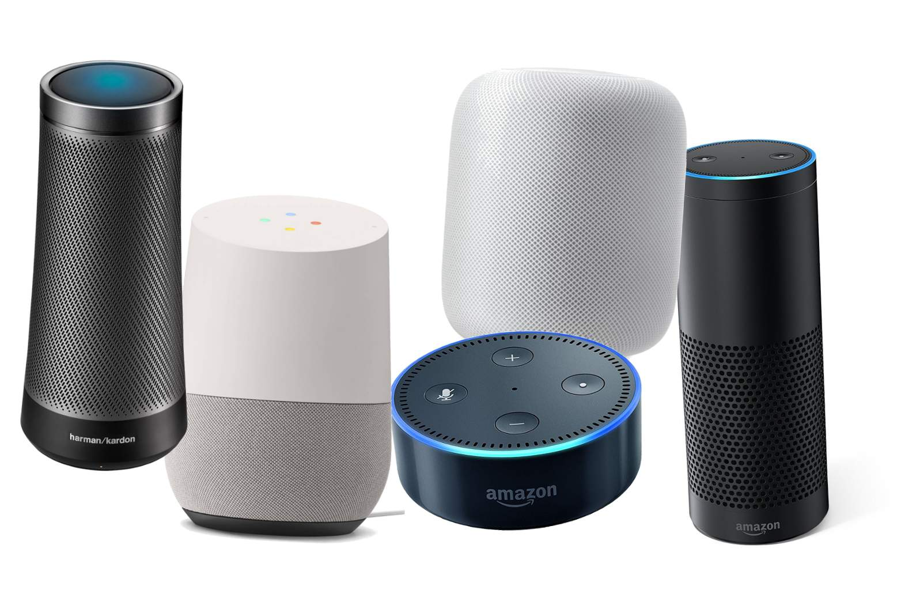
Artificial Narrow Intelligence (ANI)
These are AIs that do one thing such as:
smart speaker
self-driving car
AI to do web search
AI applications in farming or in a factory.
These types of AI are one trick ponies but when you find the appropriate trick, this can be incredibly valuable.

