Slide 1
Introduction
Online Marketplace
Abhishek Sharma, Atharv Bharadwaj, Abhishek Rathore, Kunal Gupta
GLA University, Mathura
CEA
15-04-2024

Slide 2
Introduction
Addressing the challenges faced by college students in acquiring and disposing of items, Online Marketplace aims to simplify campus life through a user-friendly online platform.
Online Marketplace is motivated by the need to create a seamless solution, streamlining the exchange process and enhancing the overall Online experience.

Slide 3
Objectives
Enhance Campus life by improving the overall student experience.
Create a virtual hub for buying, selling, renting, and lending items.
Establish a trustworthy environment through secure transactions, user ratings, and a reliable feedback system.

Slide 4
Problem Statement
Traditional methods of buying, selling, and exchanging items on Online are often cumbersome and lack efficiency.
Students face hurdles in finding or disposing of items relevant to Campus life due to a lack of a centralized and user-friendly platform.
Improves the overall student experience by providing a convenient and streamlined solution for acquiring and disposing of items.

Slide 5
Literature Review
Peer Online Marketplaces:
Several universities have embraced similar platforms, facilitating peer-to-peer transactions within their Online communities.
Lack of Online-Centric Platforms:
Gap: Many Campuses lack dedicated platforms tailored to the specific needs of students for buying, selling, and lending items.
Solution: Online Marketplace serves as a centralized, Campus-centric platform, streamlining transactions within the student community.

Slide 6
Methodology
Conducted comprehensive requirement analysis based on user needs and feedback.
Ensured the project development aligned with the preferences and expectations of college students.
Front-End Development : React
Backend Development : Node.js, Express.js, MongoDB

Slide 7
System Architecture
The Online Marketplace system is designed with a modular architecture to ensure scalability, efficiency, and a seamless user experience.
Front-End Component :User interface for students to interact with the platform.
Backend Component :Server-side logic handling HTTP requests and responses.
Database Component :Stores and retrieves data related to user accounts, listings, and messages.

Slide 8
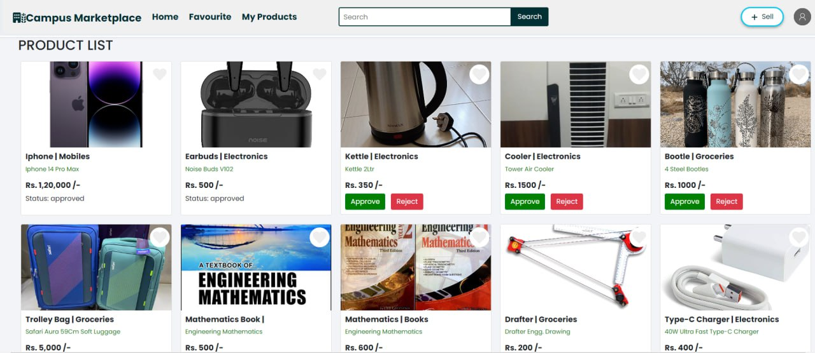
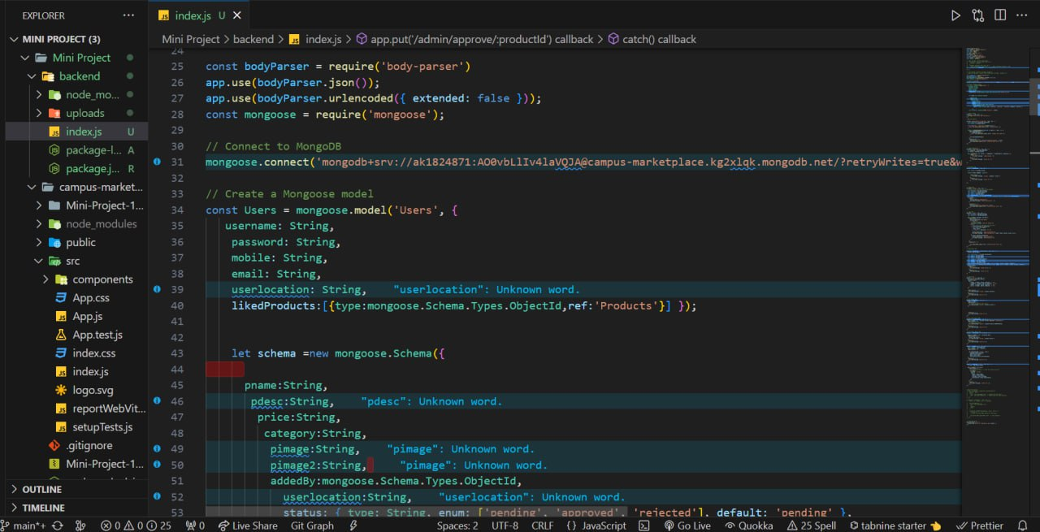
Implementation
Utilized collaborative tools such as Git for version control and Visual Studio Code for code development.
Embraced an iterative design process focused on user experience.

Slide 9
Features
User Registration and Authentication
Item Listing and Search
Real-Time Messaging System
User Profiles and Ratings
Categories and Filters
Mobile Responsiveness
Feedback and Reporting System

Slide 10
Results
Streamlined process for buying, selling, renting, and lending items within the Campus community.
Promotion of sustainability by facilitating the reuse and sharing of items.

Slide 11
Challenges Faced
Challenge: Iterative refinement of the user interface to align with user preferences and expectations.
Resolution: Conducted frequent usability testing, collected user feedback, and iteratively adjusted design elements, ensuring an optimal user experience.
Challenge: Meeting project milestones within a tight development timeline.
Resolution: Adopted an agile development approach, prioritized features based on criticality, and conducted frequent progress assessments to ensure on-time delivery.

Slide 12
Future Work
In-App Payment System
Blockchain for Transaction Transparency
Geolocation Integration
AI-Powered Recommendation Engine
Augmented Reality (AR) Features
Community Challenges and Rewards
Integration with Online Clubs and Organizations

Slide 13
Conclusion
User Registration and Authentication: Secure account creation and login.
Item Listing and Search: Easy listing, powerful search, and filtering.
Providing students with a platform to save money.
Empowering a financially conscious Campus community.
Building trust through transparent user ratings.
Creating a safe and reliable online environment.
Elevating Campus Life with Online Marketplace.

Slide 14
Acknowledgments
We extend our heartfelt gratitude to everyone who played a crucial role in the success of the Online Marketplace project.
Special thanks to Mr. Akash Kumar Chaudhary Sir for his invaluable guidance and mentorship throughout the project. His expertise in Web Development and unwavering support significantly contributed to the project's success.
Thanks to our peers and friends for their encouragement, constructive feedback, and belief in the project's potential.

Slide 15
Q&A
Q1: How does Online Marketplace contribute to sustainability on Campus?
A: Online Marketplace promotes sustainability by encouraging the reuse and sharing of items, reducing waste and fostering an eco-conscious Campus culture.
Q2: How was user feedback collected, and how is it being used for continuous improvement?
A: User feedback was collected through structured mechanisms, such as surveys and direct interactions. We prioritize user suggestions for feature improvements and overall platform enhancements.
Thank you for your insightful questions. We're here to address any more queries and appreciate your engagement.

