Slide 1

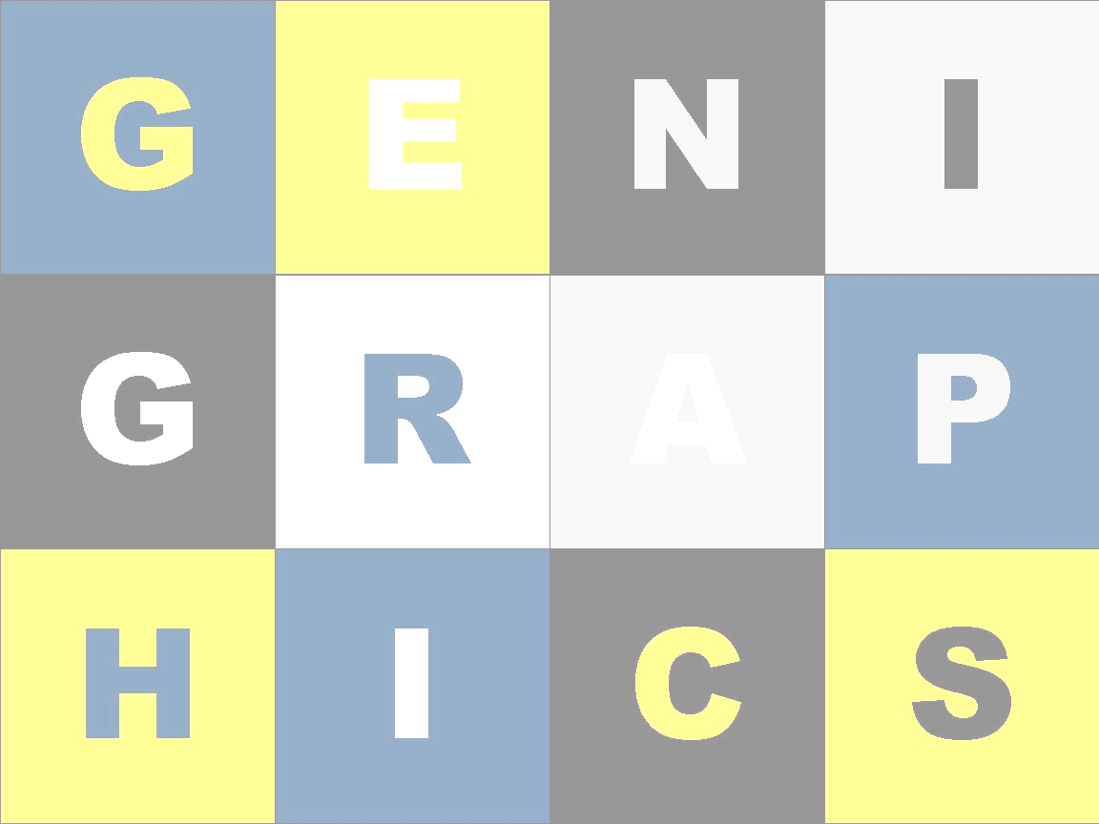
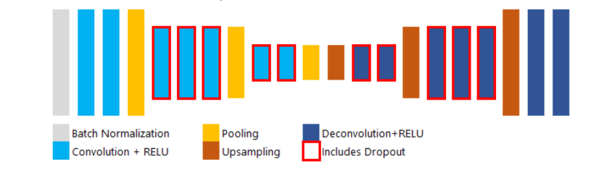
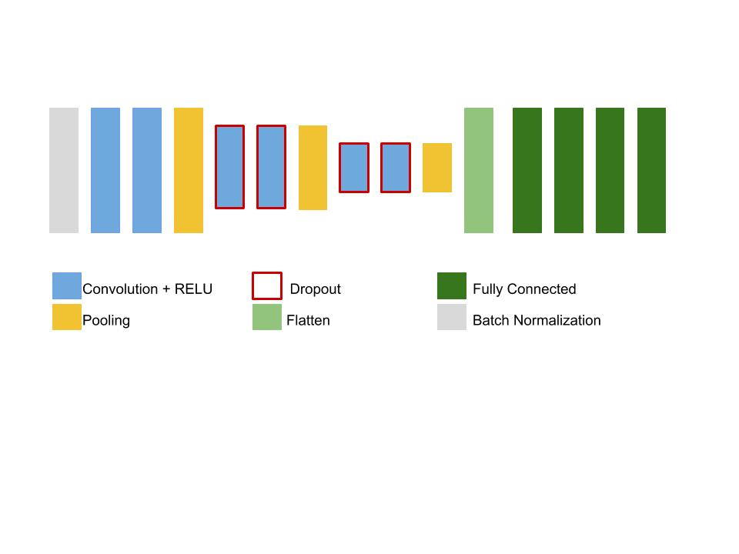
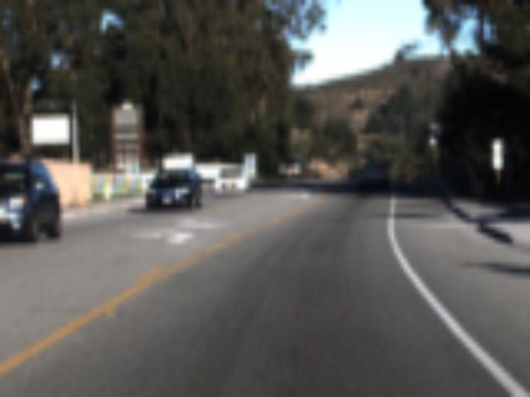
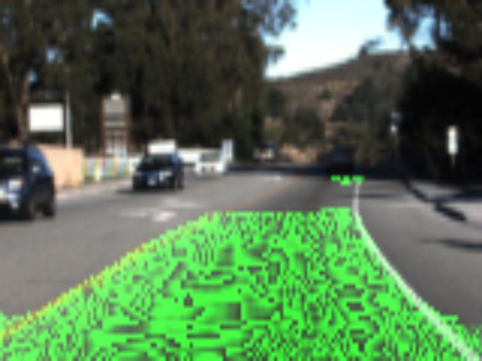
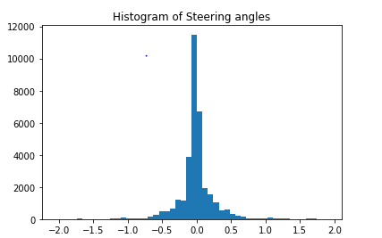
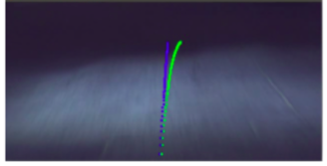
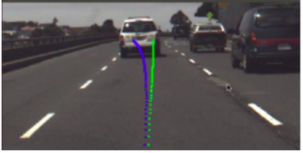
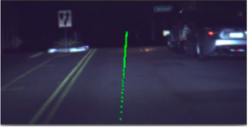
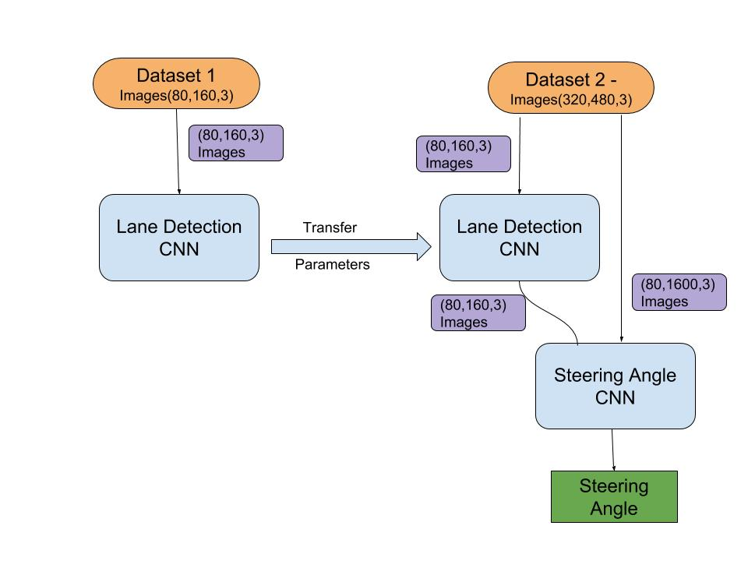
REPLACE THIS BOX WITH YOUR ORGANIZATION’S
HIGH RESOLUTION LOGO
Steering Control for Self-Driving cars
Abhishek Singhal; Dilip Chakravarthy
University of Massachusetts, Amherst
Abstract
Methods and Materials
Self driving cars are on the rise today and expected to become mainstream few years down the line. One of the key subsystems of such vehicles to become successful is that of a robust steering angle prediction to navigate the vehicle in an organized manner.
Udacity has released a dataset of images along with steering angle while driving.
We attempt to investigate if lane detection beforehand can help improve the existing model for steering angle control. We test our transfer learning approach for 2 existing architectures of steering angle networks.
To test our hypothesis, we use 2 existing architectures for steering angle control - baseline model (VGG type architecture) and Nvidia model (give reference) (see figure 5.). For each architecture of steering control network, we train with and without lane detection system.
Vanilla Training (w/o Lane Detector)
Transfer Learning (with Lane Detection) – This method involves 2 steps:-
2a) Lane detection system – The architecture is similar to VGG with 7 convolution layers and 7 trans-convolution layers. (see fig. 4). The model converged in __ epochs. Then model is freezed.
2b) Steering angle network - The inputs to this network are 2 fold - lane detected outputs and original images.
Data Augmentation – Most of the images in Udacity dataset have neutral angle(+-0.010). Some neutral labels are removed to overcome skewness of data (see fig.3).
Loss function – Mean Square error (MSE) was used as loss function across all training models.
Introduction
Fig 4. Architecture of Lane Detection CNN
Udacity, with the intention of building the world's first open source self driving car platform has released a set of online challenges that aim to solve different parts of the platform.
However, the motivation for our attempt at this challenge is that the problem can be segmented into 2 parts : lane detection and steering angle prediction and that the latter is dependent on the former. We approach this problem to improve the predictions by augmenting data obtained from detecting lanes from an optimally trained lane detection module and use it on few of the best architectures and methods that have already been attempted (see fig.1).
Datasets:
Fig 5. Architecture of Steering Control Network
Source | Size | Output
Github Repo (Mvirgo) | Training – Testing – | Image (80,160,1) in green channel. Lanes are colored green.
Udacity – Challenge 2 | Training – Testing – | Scalar – Steering angle
Fig 2. Lane detector works well on Udacity dataset
Fig 3. Training data is skewed
Results
Lane detection system pretty well on Udacity dataset, although it is seeing these images for the first time (see fig.2).
Hypothesis – Correct or Wrong?
Fig 6. Visualization of Steering angle on test images (Blue- actual, Green-predicted)
Table 1. RSME errors for different models
Discussion
Training method | epochs | Training rmse | Val rmse | Testing rmse
Vanilla steering- NVIDIA | 10 | 0.0779019790277 | 0.0938397028303 | 0.133360102313
Vanilla steering- NVIDIA | 15 | 0.0690621819147 | 0.0757158849813 | 0.142470523841
Vanilla steering- NVIDIA | 20 | 0.137966916901 |  | 0.156531051125
Transfer Learning Steering - NVIDIA
Vanilla steering – Baseline/VGG
Transfer Learning steering – Baseline/VGG
Conclusions/Future Work
Figure 1. Concept of Transfer Learning for Steering Control
References

