Slide 1


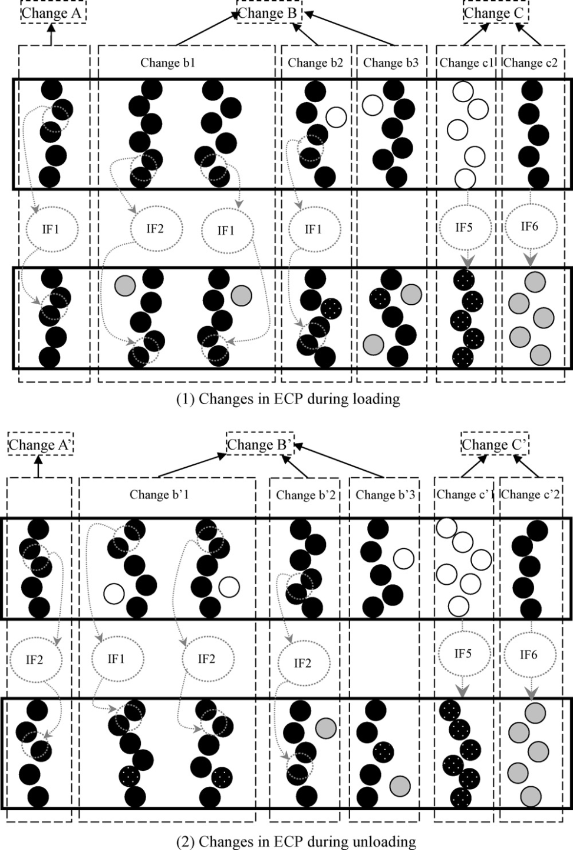
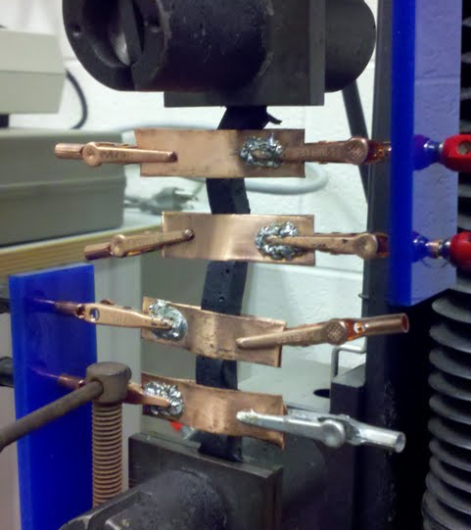
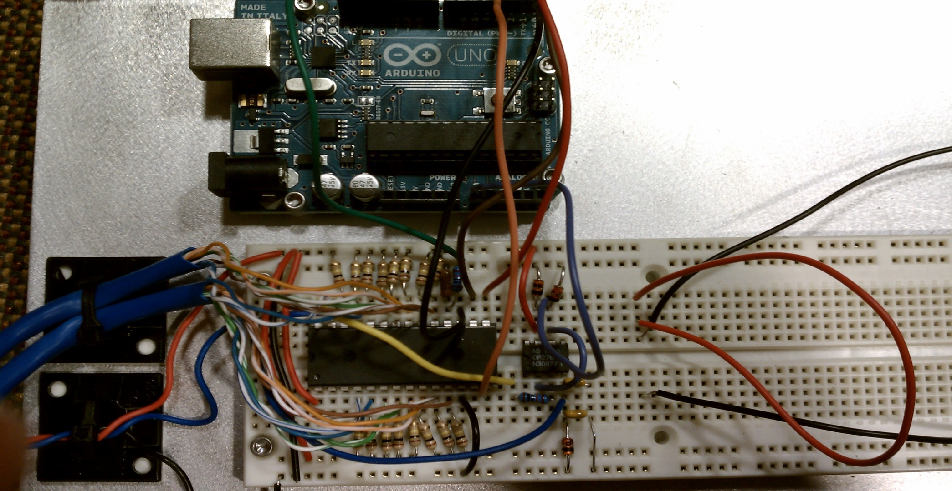
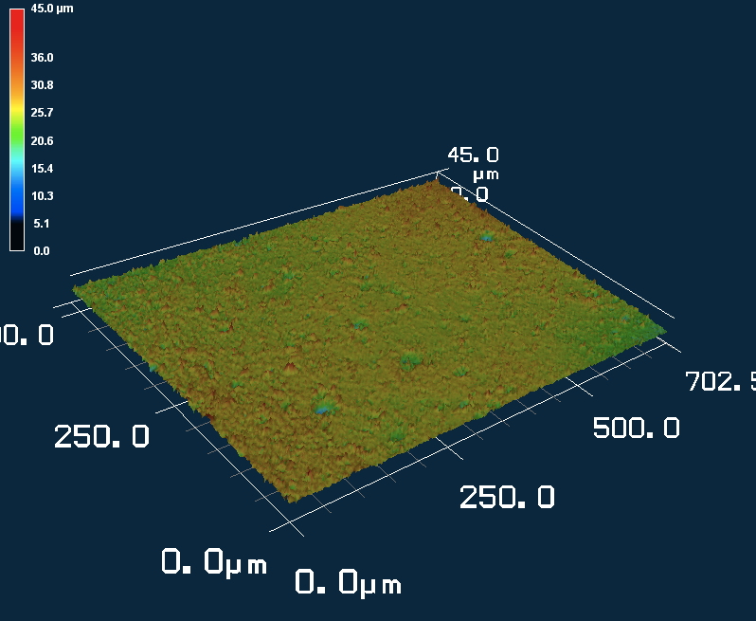
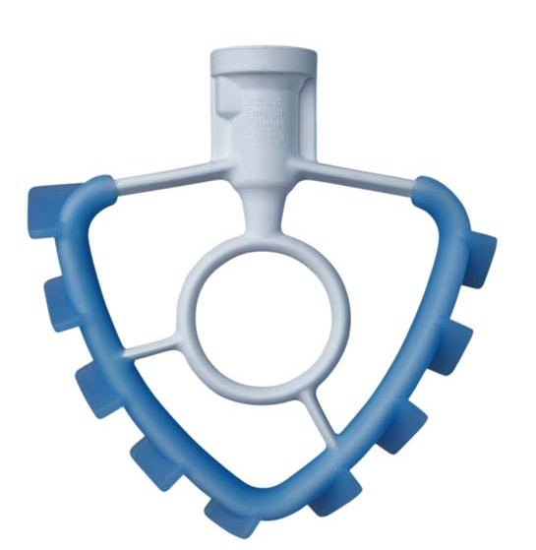
High Elongation Strain Sensors Based on Carbon Black-Elastomer Composites
Stephanie Moran, Ryan Rosario, Zachary Stauber, Bethany Tomerlin, Juan Carlos Ybarra
Objective
The goal of our project was to create a flexible high elongation strain sensor. This strain sensor could be used for motion capture and joint therapy technologies. We defined our success according to the following objectives:
Strain measurements greater than 10%
High Precision
Fast response time for dynamic loading
Background
Testing
e⁻
e⁻
Current
Voltage
30nm
Figure 1.(left) Electrons in Composite
Figure 2.(right) Migration of Particles during elongation
Figure 5. 4 Point Probe Setup
Figure 6. 4 Point Probe Diagram
Electrons pass through the carbon black-elastomer composites by traveling through an insulating matrix between the highly conductive carbon black particles, as illustrated in the figure 1. The measured resistance of our composite samples changes with elongation due to the changing distance between the carbon black particles. As the distance increases, the measured resistance increases, and vice versa. However, an increase in elongation does not always directly correlate to an increased distance between carbon black particles, as illustrated in the figure to the right.
Graph 1 (right): Hysteresis of resistance vs. extension for a sample of 15% carbon black in a polyurethane matrix.
Graph 2 (below): Cycling of extension vs. resistance over time. Resistance increases as extension increases
Fabrication
Dispersing carbon black into the samples was the limiting factor in fabrication of these sensors. The carbon black tended to agglomerate causing carbon black filled voids. Switching to a higher quality carbon black, Ketjen EC-600JD, we were able to decrease the percolation threshold. The final fabrication method was to mix carbon black in the rubber with a dispersion blade.
Conclusion
Our prototype uses an Arduino microcontroller to convert resistance from our custom made sensor into a graphical readout of strain.
While our system could not currently replace existing motion capture system it could be used as a supplement thereby reducing costly rendering time and retakes. Our systems’ affordability makes it ideal for the home video game market. In addition, with the proper calibration and software our system could be used to provide feedback loops for ergonomic training, sports therapy, and occupational therapy.
KetJen Carbon Black
Polyurethane Rubber
1.) Monomer and Carbon Black mixed for 1 hour
2.) Cross Linker Added and mixed for 20 minutes
3.) Poured into Pan
Figure 7. Prototype Microcontroller and Amplifier
Figure 3. Confocial Image of Cross Section
Void Removal Was attempted by:
Calendar
Vacuum
Ultimately void removal was deemed unnecessary due to the decrease in our carbon black percentage when switching to our higher surface area to volume carbon black. Smaller void sizes were seen. Future work in void removal may be necessary though.
References and Acknowledgements
We would like to thank, Mike Tarkanian, David Bono , Joe Parse, Matt Humbert, Prof. Chiang, Prof. Thomas, Harlan Breindel, Nathan Lachenmyer, Forest Liau and James Bredt for all of their help.
Wang Luheng, et al. Study on Compressive resistance creep and recovery of flexible pressure sensitive material based on carbon black filled silicone rubber coposite. Sensors and Actuators A: Physical, Vol. 165, 207-215. 2001.
Figure 4. Dispersion Blade

