Slide 1

GURU NANAK INSTITUTE OF TECHNOLOGY Department of Computer Science and Engineering
Privacy Preserving And Trusted Keyword Search For Multi-Tenancy Cloud
UNDER THE GUIDANCE OF
Mr. G .LAKPATHI
Assistant Professor
TEAM MEMBERS
SAURAV KUMAR MANDAL 21831A05M1
DEEKSHITA THUMMA 21831A05K9
HEERAKAR ABHISHEK 20831A0561
TEAM MEMBERS
TTTTTTTTTT
SANTOSH YADAV - 21831A05H7
MD.MOTIBUL RAEEN - 21831A05E8
KAUSHAL BABU YADAV - 21831A05E5
TEAM MEMBERS
SANTOSH YADAV - 21831A05H7
MD.MOTIBUL RAEEN - 21831A05E8
KAUSHAL BABU YADAV - 21831A05E5

Slide 2
Table Of Content:
INTRODUCTION
Abstract
Introduction
objective
LITERATURE SURVEY
Existing system
Existing system disadvantages
PROPOSED SYSTEM
ADVANTAGES OF PROPOSED SYSTEM
DISADVANTAGES OF PROPOSED SYSTEM
System architecture
Technology used
Hardware Requirement
Software Requirement
Future Enhancement
Conclusion
REFERENCES

Slide 3
ABSTRACT
Cloud service models intrinsically cater to multiple tenants. In current multi-tenancy model, cloud service providers isolate data within a single tenant boundary with no or minimum cross-tenant interaction. With the booming of cloud applications, allowing a user to search across tenants is crucial to utilize stored data more effectively. However, conducting such a search operation is inherently risky, primarily due to privacy concerns. Moreover, existing schemes typically focus on a single tenant and are not well suited to extend support to a multi-tenancy cloud, where each tenant operates independently. In this article, to address the above issue, we provide a privacy preserving, verifiable, accountable, and parallelizable solution for “privacy-preserving keyword search problem” among multiple independent data owners. We consider a scenario in which each tenant is a data owner and a user’s goal is to efficiently search for granted documents that contain the target keyword among all the data owners. We first propose a verifiable yet accountable keyword searchable encryption (VAKSE) scheme through symmetric bilinear mapping. For verifiability, a message authentication code (MAC) is computed for each associated piece of data. To maintain a consistent size of MAC, the computed MACs undergo an exclusive OR operation. For accountability, we propose a keyword-based accountable token mechanism where the client’s identity is seamlessly embedded without compromising privacy. Furthermore, we introduce the parallel VAKSE scheme, in which the inverted index is partitioned into small segments and all of them can be processed synchronously. We also conduct formal security analysis and comprehensive experiments to demonstrate the data privacy preservation and efficiency of the proposed schemes, respectively.

Slide 4
INTRODUTION:
Cloud computing enables data storage and access over the internet.
Multi-tenancy allows multiple users (tenants) to share cloud resources securely.
Traditional keyword search in the cloud lacks privacy, risking data exposure.
This project introduces a privacy-preserving and trusted keyword search method.

Slide 5
Privacy-Preserving and Trusted Keyword Search for Multi-Tenancy Cloud is a research-driven project focused on enhancing data security and search efficiency in cloud environments. In multi-tenancy cloud systems, multiple users or organizations share the same cloud infrastructure, making privacy protection a critical challenge. Traditional search mechanisms often expose sensitive data to the cloud provider or external attackers, leading to potential breaches. This project aims to develop a secure and efficient keyword search mechanism that ensures data confidentiality while maintaining trust among tenants. By leveraging advanced encryption techniques and access control mechanisms, the system will allow users to search encrypted data without compromising privacy. The solution will also focus on optimizing search performance to ensure scalability and usability, making it a viable approach for real-world cloud
.

Slide 6
Objective:
To develop a secure and efficient keyword search mechanism for multi-tenancy cloud environments.
To ensure data privacy while allowing fast and accurate retrieval
.To establish trust using cryptographic techniques and access control mechanisms

Slide 7
Literature Survey:
Title: Efficient Multi-Keyword Search over Encrypted Cloud Data with Privacy Protection
Author(s): Xiaodong Lin, Sherman S. M. Chow
Year: 2017
Description:
With the increasing use of cloud computing, ensuring data privacy while enabling efficient keyword searches has become a challenge. This paper introduces a privacy-preserving multi-keyword search approach over encrypted cloud data. The system ensures that users can perform searches without revealing the keyword contents to the cloud service provider. It employs an index-based searchable encryption scheme with trapdoor privacy and controlled searchability, preventing unauthorized access and mitigating leakage risks.

Slide 8
LITRATURE SURVEY
Title: Secure and Efficient Multi-Keyword Ranked Search over Encrypted Cloud Data
Author(s): Ning Cao, Cong Wang, Ming Li
Year: 2014
Description
:This paper presents an advanced searchable encryption scheme supporting multi-keyword searches in cloud storage. Unlike conventional single-keyword search approaches, this work implements a ranking mechanism that improves efficiency. By leveraging the "coordinate matching" technique, the proposed scheme ranks search results based on keyword relevance while ensuring strong privacy guarantees. It also introduces a dynamic update mechanism to handle data modifications in multi-user environments.

Slide 9
EXISTING SYSTEM
In early research, most works on SSE focused on the honestbut-curious cloud service provider (CSP).
In such a model, the search result is fully trusted and the CSP is assumed to honestly follow the protocol specification.
Search results in practice may contain corrupted data due to underlying hardware/software failures.
In addition, for self-interest, the CSP may deviate from the protocol specification. For example, to reduce computational costs, CSP may randomly choose data as a search result.

Slide 10
EXISTING SYSTEM DISADVANTAGE
Low security of data processing.
This is a critical feature that allows a flexible number of data owners in the system, who have complete control of their multiple data owners, and allows a legitimate client to search across parties

Slide 11
Proposed System:
This paper proposed an authenticated Merkle hash tree to verify the search result. The proposed privacy-aware attribute-based encryption with user accountability and applied it to the file storage system. However, their scheme relied on attribute-based encryption, which is different from SSE because SSE uses symmetric encryption. In the proposed scheme, each data owner encrypts its own data (with its unique key) and outsources the storage and processing tasks for operations to the CSP. In their scheme, each keyword is encrypted in two layers. The first layer is implemented via pseudo-random permutation and used to hide the keyword. The second layer is realized by the pseudo-random function and used to support encrypted keyword searches. To improve search efficiency

Slide 12
Advantage Of Purposed System:
Enhanced Privacy: Uses encryption to secure keyword searches.
Efficient Search: Optimized algorithms reduce latency.
Multi-Tenancy Support: Ensures data isolation and role-based access.
Trust Establishment: Cryptographic verification of search queries.

Slide 13
Disadvantage Of Purposed System:
Computational Overhead: Encryption increases processing time.
Storage Overhead: Encrypted indexes require more space.
Complex Key Management: Secure key distribution is necessary.

Slide 14
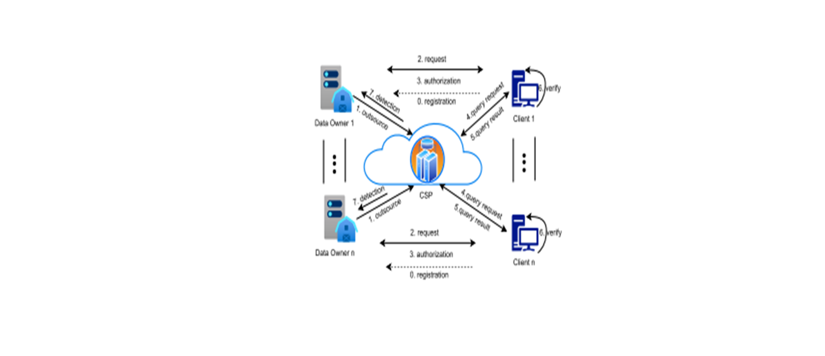
SYSTEM ARCHITECTURE
Fig 1: System Architecture

Slide 15
Technology Used:
Programming Language: Java
cloud Platform: AWS / Google Cloud / Azure (Specify if applicable)
Security Algorithms: AES, RSA, Bloom Filters, Homomorphic Encryption
Database: MySQL / MongoDB Frameworks: Spring Boot /

Slide 16
SYSTEM REQUIREMENTS: HARDWARE REQUIREMENTS
MINIMUMSYSTEM REQUIREMENTS
Processor : Dual core 2 duo.
Ram : 8 Gb DD RAM
Hard disk : 250 Gb

Slide 17
SOFTWARE REQUIREMENTS
Front End : J2ee (jsp, servlet)
Back End : My Sql 5.5
Operating System : Windows 10
Ide : Eclipse

Slide 18
Future Enhancement
Certainly! Here's a concise paragraph summarizing a future enhancement project for privacy-preserving and trusted keyword search in multi-tenancy cloud environments:
In a bid to enhance privacy-preserving and trusted keyword search for multi-tenancy cloud environments, a novel project proposes the integration of blockchain and AI technologies. The project aims to develop a blockchain-based searchable encryption scheme that supports multi-keyword, multi-owner models, addressing issues like single-point failures and privacy breaches. By leveraging AI algorithms, the system will optimize index construction and improve query processing efficiency. Additionally, incorporating decentralized storage solutions, such as IPFS, will ensure data availability and robustness. Security proofs and experiments will be conducted to validate the system's effectiveness. This innovative approach promises to deliver a robust, scalable, and efficient solution for secure keyword search in multi-tenancy clouds, benefiting organizations that handle sensitive data and require advanced privacy-preserving search capabilities

Slide 19
CONCLUSION
Project ensures privacy-preserving, efficient, and trusted keyword search in a cloud-based multi-tenant environment.
It balances security and performance using advanced encryption techniques.
Future scope includes machine learning-based optimizations for improved search accuracy

Slide 20
REFERENCES:
[34] R. A. Mollin, An Introduction to Cryptography. Boca Raton, FL, USA:
CRC Press, 2006.
[35] R. W. van der Heijden, S. Dietzel, T. Leinmüller, and F. Kargl, “Survey on misbehavior detection in cooperative intelligent transportation
systems,” IEEE Commun. Surveys Tuts., vol. 21, no. 1, pp. 779–811,
4th Quart., 2018.
[36] S. Ruj, M. A. Cavenaghi, Z. Huang, A. Nayak, and I. Stojmenovic,
“On data-centric misbehavior detection in VANETs,” in Proc. IEEE Veh.
Technol. Conf. (VTC Fall), Sep. 2011, pp. 1–5.
[37] (2022). Enron Email Dataset. [Online]. Available: https://www.cs.
cmu.edu/
[38] (2022). CPU Cores Threads per CPU Core per Instance
Type. [Online]. Available: https://docs.aws.amazon.com/AWSEC2/
latest/UserGuide/cpu-options-supported-instances-values.html
[39] R. Curtmola, J. Garay, S. Kamara, and R. Ostrovsky, “Searchable
symmetric encryption: Improved definitions and efficient constructions,”
in Proc. 13th ACM Conf. Comput. Commun. Secur., 2006, pp. 79–88.

Slide 21
REFERENCES:
[40] A. De Caro and V. Iovino, “JPBC: Java pairing based cryptography,” in
Proc. IEEE Symp. Comput. Commun. (ISCC), Jun. 2011, pp. 850–855.
[41] (2022). Java Security Message Digest. [Online]. Available: https://
docs.oracle.com/javase/7/docs/api/java/security/MessageDigest.html
[42] Oracle. JavaTM Platform, Standard Edition 8 API Specification.
Accessed: Feb. 1, 2023. [Online]. Available: https://docs.oracle.com/
javase/8/docs/api/javax/crypto/Cipher.html
[43] Wikimedia Foundation. Wikimedia Downloads. Accessed: Feb. 1, 2023.
[Online]. Available: https://dumps.wikimedia.org
Xiaojie Zhu (Member, IEEE) received the M.S.
degree from the University of Chinese Academy of
Sciences in 2015 and the Ph.D. degree from the
University of Oslo in 2021. He is currently a Staff
Research Scientist with KAUST. His research interests include cloud security, applied cryptography,
and distributed systems.
4330 IEEE

Slide 22


