Slide 1
Presentation on
SOURCE CAMERA IDENTIFICATION BY FEATURE EXTRACTION USING LOCAL BINARY PATTERN
Department of Computer Science & Engineering
Ramkrishna Mahato Government Engineering College
Purulia – 723103, West Bengal

Slide 2
Guided By –
Prof. Pabitra Roy
Assistant Professor
Department of Computer Science & Engineering RKMGEC,Purulia
Presented By –
GROUP B: (CSE,4th year)
35000118040 - Shashank Singh
35000118045 - Rohan Roy
35000118074 - Abhishek Mondal
35000118025 - Super Kumar Murmu
35000119047 - Sumit Mahato
35000119050 – Bindeeya Darnal

Slide 3
ACKNOWLEDGEMENT
We would like to express our greatest appreciation to Prof. Pabitra Roy (Assistant Professor of CSE,RKMGEC) who gave us the golden opportunity to do this wonderful project of Source Camera Identification by Feature Extraction using Local Binary Pattern. We deem it a pleasure to acknowledge our sense of gratitude to our respected professor for his ongoing support during the project, from initial advice, and encouragement, which led us to do this project with a great enthusiasm.
We wish to reciprocate in full measure the kindness shown by Dr. Prasun Halder (H.O.D, Computer Science and Engineering) who inspired us with his valuable suggestions in successfully completing the project work.
We shall remain grateful to Dr. Bibek Chakrabarti, Principal, Ramkrishna Mahato Government Engineering College, for providing us a strong academic atmosphere by enforcing strict discipline to do the project work with utmost concentration and dedication.

Slide 4
Presentation Flow
Introduction, Definition and Objective
Background
Imaging Pipeline of a Camera
Image preprocessing
De-noising
Demosaicing
Re-balancing
Predicting
Methods of Source Camera Identification
Our Work
Feature Extraction Framework
Local Binary Pattern
Dataset
Experimental Set up
Result Analysis
Conclusion
References

Slide 5
Introduction
Digital image producing devices such as cameras, cell phones, camcorders and scanners are nowadays popular. Images as a proof of some important facts are sometimes used as evidence in court. Meanwhile, the popularity of image manipulation software enables simple manipulation of both the contents and source information of digital images, thereby compromises the convincingness of them as evidence. Therefore, knowing the source and authenticity of the images used as evidence is important. Although embedding watermarks at the image producing stage is a solution, it is not widely implemented by manufacturers of image producing devices. Usually, digital image forensics relies only on the digital image itself. Here in this project, we address the problem of source camera identification from given images. Interested images are assumed to be captured by digital still cameras.

Slide 6
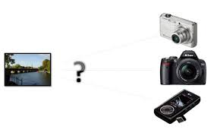
What is Source Camera Identification:
A robust and well-known way to identify the source of an image is the use of Photo Response Non-Uniformity. The ability to be able to extract the PRNU-pattern from images is both used for camera-identification (linking one or more images to a camera) and common-source identification (linking images to images).
Source camera identification enables forensic investigator to discover the probable source model that are employed to acquire the image under investigation. It is important whenever digital content is presented as a silent witness.

Slide 7
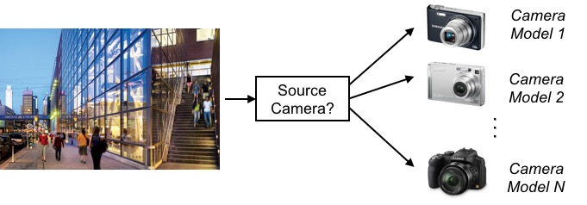
Objective of the project:
Source camera identification aims at determining and authenticating the original sources of digital images to support forensics and get the trace of digital images.
If the image we are interested in are captured by a digital camera, then, what is the model of the camera?

Slide 8
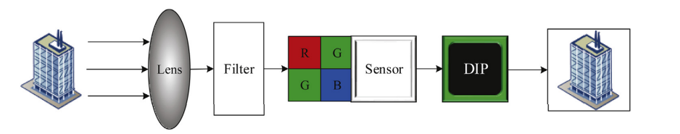
Imaging Pipeline of a Camera
An image pipeline or video pipeline is the set of components commonly used between an image source (such as a camera, a scanner, or the rendering engine in a computer game), and an image renderer (such as a television set, a computer screen, a computer printer or cinema screen), or for performing any intermediate digital image processing consisting of two or
more separate processing blocks.
An image/video pipeline may be implemented as computer software, in a digital signal processor, on an FPGA, or as fixed-function ASIC.

Slide 9
Image preprocessing
Image preprocessing is the core of this framework and is also the basis of residual image calculation in the next step. In this section, four preprocessing algorithms are considered, namely denoising, demosaicing, re-balancing, and predicting.
De-noising is used to extract the SPN noise of the image.
Demosaicing and re-balancing can capture information about the image processing algorithms by generating some sub-images.
Predicting can explore the impact of the camera imaging process on image smoothness. In the following, the four preprocessing algorithms will be described in detail.

Slide 10

De-noising
Nr=I-F(I)
where I is the actual sensor output, I0 is the noiseless sensor output and Nr represents the additive random noise.
KI0 is the signal of our interest, that is, SPN noise.
Unfortunately, it is difficult to extract the SPN directly from the actual output I.
Instead, we can first estimate the noiseless output I0 by de-noising the actual sensor output I where F represents the de-noising algorithm and KI0 is an approximate estimation of I0.
Then, the estimated SPN can be obtained by subtracting I0 from I.

Slide 11
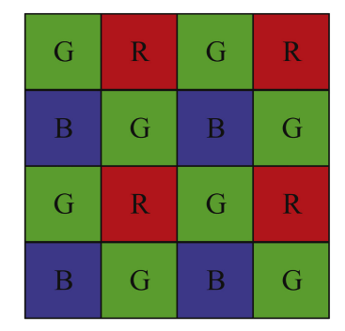
Demosaicing
Considering cost efficiency and robustness, most commercial cameras add a CFA in front of the sensor to record the three color components of light (R, G, and B) using one sensor.
Although only one color value is observed at each pixel, the remaining two color values can be interpolated by using a process called demosaicing.
According to whether the correlation between different color channels is utilized, existing demosaicing algorithms can be divided into two categories:
correlation
non-correlation
The diversity of demosaicing algorithms gives camera manufacturers more choices, making the demosaicing algorithms become one of the camera-specific characteristics.

Slide 12
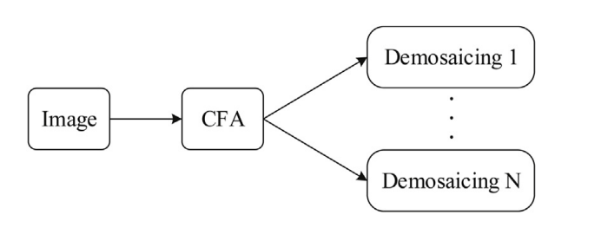
CONTD.
The estimation of algorithm parameters is complex and inaccurate. the original image is first resampled by CFA to obtain the reconstructed image, which is an approximate estimation of the camera internal image before CFA interpolation.
Then, various demosaicing algorithms are performed on the reconstructed image to obtain multiple output images.
If the demosaicing algorithms used twice are the same, the output image is similar to the original image. Otherwise, the two images are different.
Therefore, features extracted from the output images can be used to identify the source camera.

Slide 13
Re-balancing
White balance is widely used in digital cameras to correct the color deviation caused by the light source between the captured image and the actual scene.
The white balance algorithms of different camera models generally differ from each other, which can be used to identify the source camera.
Predicting
In general, it is thought that natural images are smooth in weak texture regions, that is, a pixel value can be accurately predicted by its neighboring pixel values.
However, noise and image processing algorithms during camera imaging can affect the smoothness of the image, resulting in a difference between the predicted image and the real image.
These differences related to camera-specific characteristics can be applied to source camera identification. In preprocessing, we use eight neighboring pixels to linearly predict the central pixel.

Slide 14
Methods of Source Camera Identification:
1. Using Lens Aberration:
The radial distortion causes straight lines in the object space rendered as curved lines on the film or camera sensor. It originates from the transverse magnification MT .
The transverse magnification of an image is the ratio of the image distance to the object distance.
Radial distortion arises when MT is a function of the off-axis image distance, r, rather than a constant.
In other words, the lens has various focal lengths and magnifications in different areas. The radial distortion deforms the whole image even though every point is in focus.
Limitations:
This method will fail is if there is no straight line in the images.
The authors assume that the centre of distortion is the centre of image.

Slide 15
2.Using CFA Interpolation
Different spectral filters, typically red, green and blue (RGB), are arranged in a pattern so that each CCD element only senses one band of wavelengths. This spectral filter pattern, or mask, is called the color filter array (CFA).
Image classification was determined by the correlation structure present in each color band. Each manufacturer uses different interpolation algorithms and somewhat different CFA patterns.
Using the iterative Expectation Maximization (EM) algorithm, two sets of features are obtained for classification: the interpolation coefficients from the images and the peak location and magnitudes in the frequency spectrum of the probability maps.
Limitations:
The technique is limited to images that are not heavily compressed because compression artifacts suppress and remove spatial correlations between pixels due to CFA interpolation.

Slide 16
3. Using Image Features:
Features of digital images are classified into two levels: global and local features. Global properties of an image, includes intensity histogram, frequency domain descriptors, covariance matrix and high order statistics.
Local features are defined on local regions with spatial properties, including edges, corners, lines, curves, etc.
The features that will be used to recognize camera model through various classification approaches are described here. In this work, there are 50 features like invariant moments, statistical features, GLCM and Color moments have been extracted from each color channels from a number of images of different camera models.
Features are extracted from images of different cameras, which are then used to train and test the classifier.
In this method the result is good for uncompressed images.
Limitations:
This method does not work well for cameras with similar CCD.

Slide 17
4. Sensor Imperfections:
Sensor Pattern Noise PNU based:
Pixel non-uniformity (PNU), where different pixels have different light sensitivities due to imperfections in sensor manufacturing processes is a major source of pattern noise. This makes PNU a unique feature in identifying sensors.
Photo response non-uniformity (PRNU) casts a unique pattern onto every image the camera captures. This “camera fingerprint” is unique for each camera.
The camera identification is 100% accurate even for cameras of the same model by this method. The result is also good for identifying compressed images.
Limitations:
The authors use the same image set to calculate both the camera referencepattern and the correlations for the images.

Slide 18
Our Work:
OUR METHOD – SOURCE CAMERA IDENTIFICATION BY FEATURE EXTRACTION USING LOCAL BINARY PATTERN
Feature Extraction Framework:
Inspired by the fact that a quite some of image processing algorithms, such as demosaicing, filtering, JPEG compression, are block-wise implemented inside cameras, it is reasonable to consider that some localized characteristics or artifacts have been generated.
These characteristics or artifacts could be effectively captured by the uniform local binary patterns.This process to some extent suppresses the influence of various image contents.
The introduction of ‘uniform’ local binary patterns enables a natural feature dimensionality reduction which is desired by pattern classification algorithms. Therefore, we have used the uniform local binary patterns as features to capture camera model characteristics.

Slide 19
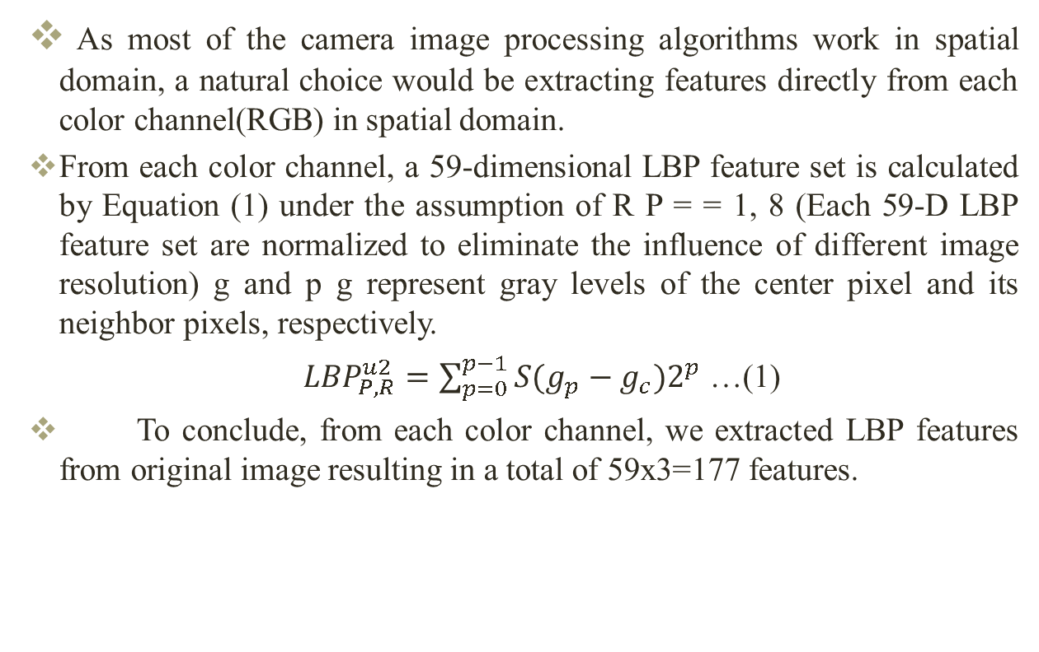
CONTD.
As most of the camera image processing algorithms work in spatial domain, a natural choice would be extracting features directly from each color channel(RGB) in spatial domain.
From each color channel, a 59-dimensional LBP feature set is calculated by Equation (1) under the assumption of R P = = 1, 8 (Each 59-D LBP feature set are normalized to eliminate the influence of different image resolution) g and p g represent gray levels of the center pixel and its neighbor pixels, respectively.
${LBP}_{P,R}^{u2}=\sum_{p=0}^{p−1}{S(g_{p}−g_{c})2^{p}}$ …(1)
To conclude, from each color channel, we extracted LBP features from original image resulting in a total of 59x3=177 features.

Slide 20
Source Camera Identification Framework
Image
Image pre-processing
Feature Extraction from each color channel (RGB)
Classification

Slide 21
Local Binary Pattern:
Local Binary Pattern (LBP) is a simple yet very efficient texture operator which labels the pixels of an image by thresholding the neighborhood of each pixel and considers the result as a binary number. Due to its discriminative power and computational simplicity, LBP texture operator has become a popular approach in various applications.
An important property is its computational simplicity, which makes it possible to analyze images in challenging real-time settings.
LBP is an operator for texture description that based on the signs of differences between neighbour pixels and central pixels.
Following fig. shows an example of the calculation of LBP values. For each pixel value in the image, a binary code is obtained by thresholding its neighbourhood with the value of the centre pixel.

Slide 22
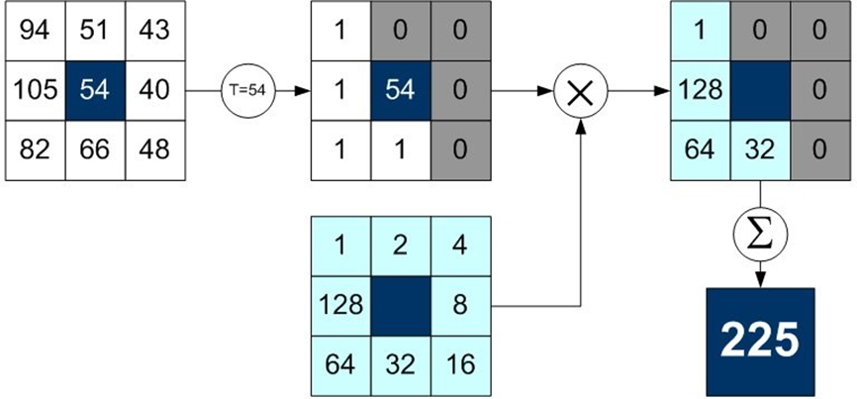

CONTD.
The basic version of LBP operator uses the centre pixel value as threshold to the 3×3 neighbour pixels. Threshold operation will create a binary pattern representing texture characteristic. The equation basic of LBP can be given as follows.
LBP($x_{c},y_{c})=\sum_{n=0}^{7}{2^{n }g{(I}_{n}−I(x_{c},y_{c}))}$

Slide 23
Dataset for Experiments:
We have taken the well known database “ Dresden Image Database” given in the following table. All the images are direct camera JPEG outputs which are captured with various camera settings.
Sl. No | Camera Model | No. of Device | Dimension of Image | No. of training Images | No. of Testing images
1 | Agfa_DC-830i_0 | 1 | 3264x2448 | 284 | 78
2 | Canon_Ixus55_0 | 1 | 2592x1944 | 179 | 45
3 | Canon_Ixus70 | 3 | 3072x2304 | 444 | 123
4 | Casio_EX-Z150 | 5 | 3264x2448 | 701 | 224
5 | FujiFilm_FinePixJ50 | 3 | 3264x2448 | 465 | 165
6 | Kodak_M1063 | 5 | 3664x2748 | 1880 | 511
7 | Nikon_CoolPixS710_0 | 5 | 4352x3264 | 699 | 226
8 | Olympus_mju_1050SW_0 | 5 | 3648x2736 | 770 | 270
9 | Panasonic_DMC-FZ50_0 | 3 | 3648x2736 | 717 | 209
10 | Pentax_OptioA40_0 | 4 | 4000x3000 | 428 | 166
11 | Ricoh_GX100_0 | 5 | 3648x2736 | 665 | 164
12 | Samsung_L74wide_0 | 3 | 3072x2304 | 521 | 165
 | total | 43 |  | 7752 | 2346

Slide 24
Experimental Set up:
In all of our experiments, multi-class support vector machines (SVM) are trained and used as the classifiers for testing. From the whole dataset, we randomly select one camera for each model, and use all the images taken by the selected cameras for testing. Images from the rest of the cameras form the training data.
The entire dataset is divided into 2 parts: one for training and others for testing. We have taken 7743 data of all camera model for training and 2344 data for testing. Features are extracted using local binary pattern.
The number of neighbors used to compute the local binary pattern for each pixel is 8.We have not encoded the rotation information. Linear interpolation method is used to compute pixel neighbours.
Experiment feature length is 177. Training features are fed into a multiclass SVM classifier to train the SVM model. The training parameter’s cost (c) = 450 and gamma (g) = 0.5 are set to check the 5 fold cross validation accuracy.

Slide 25
Result Analysis:
The experimental results using our proposed features are reported in the following table, which gives the average confusion matrix. We got the cross-validation accuracy of 97.69%.
Sl. No. | Camera Model | Accuracy(%) | Average Accuracy(%)
1 | Agfa_DC-830i_0 | 92.3
2 | Canon_Ixus55_0 | 79.1
3 | Canon_Ixus70 | 96.7
4 | Casio_EX-Z150 | 95.1
5 | Kodak_M1063 | 96.4
6 | Nikon_CoolpixS710_0 | 99.6 | 97.69
7 | Olympus_mju_1050SW_0 | 98.7
8 | Fujifilm_FinepixJ50 | 99.6
9 | Samsung_L74wide_0 | 98.6
10 | Panasonic_DMC-FZ50_0 | 98.2
11 | Pentax_OptioA40_0 | 98.2
12 | Ricoh_GX100_0 | 98.2

Slide 26
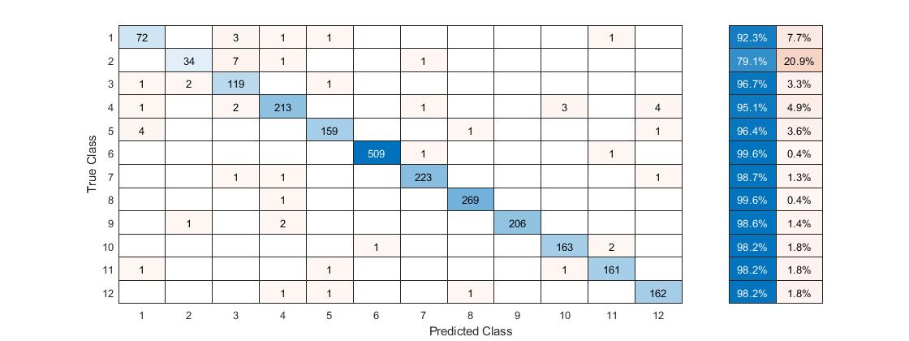
Confusion Matrix:

Slide 27
CONCLUSION
This work is a study for identifying best features of an image in order to perform source camera identification. We have demonstrated in this project the local binary patterns as features for camera model identification.By combining features extracted from the original image, the method has demonstrated 97.69% accuracy in camera model identification. Experimental results endorse that these features are usable to perform source camera identification. In order to improve the result of accuracy, in future we will try to solve the robust feature based local binary pattern for source camera identification.

Slide 28
References

Slide 29
Thank You

