Slide 1
AIML Solution Building – Campus Solutions TEAM - 5 THEME - Healthcare Claims Processing – Fraud, Waste, Abuse (FWA) Identification / Detection and Management
Lead Name - Abhishek RT
Sept, 2020

Slide 2





Team
Abhishek RT
Priyabrat Gupta
Raghunandan Reddy
Gopinath G
Mothish D
Indian Institute of Management, Tiruchirappalli
Indian Institute of Management, Tiruchirappalli
Sree Vidyanikethan Engineering College
Sri Sairam Engineering College
Sri Sairam Engineering College

Slide 3

Problem Statement
To identify Fraud Healthcare Provider Claims for a Healthcare Payer using AI-ML Driven Analytics model
Fraud
Upcoding
Unbundling
False Billing
Billing for costlier treatments than actually rendered
Billing for Multiple procedures separately that could be grouped
Billing for services not provided to the patient
3%
Fraud Detected
Massive scope for Healthcare Payers
$2.6 Bn
Collected from Healthcare Fraud Lawsuits
1
ICD Code (International Classification of Diseases) - Medical Diagnoses
CPT Code (Current Procedural Terminology) - Procedures performed
HCPCS Code (Healthcare Common Procedure Coding) - Supplies & equipment
2
3

Slide 4
Functional View
Start
Input Data for training
Validate the model with Test data
Pre-processing / Data cleaning
Plot graph based on fraud types identified with Train data
Data split into Train and Test
Use model to predict fraud type of New Providers
Train the model using Logistic Regression
Display to clients
End

Slide 5
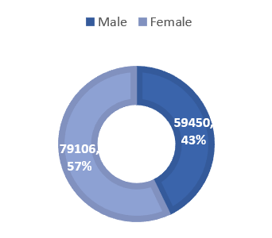
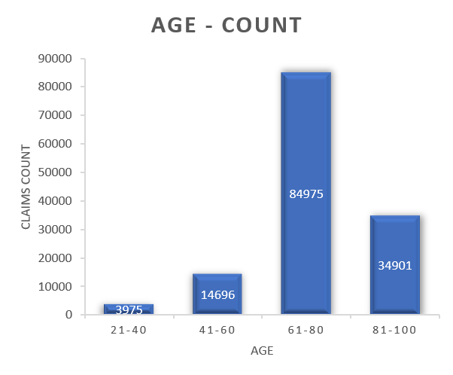
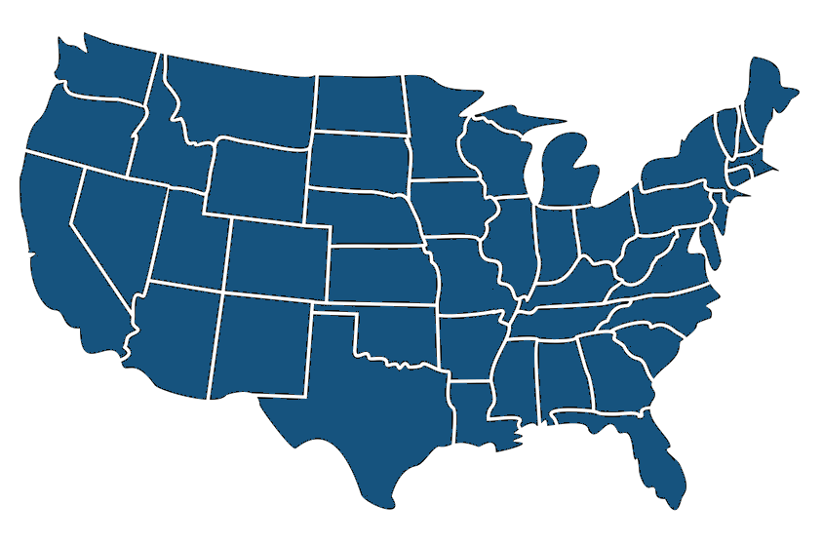
Design Details
Train Data
Logistic Regression
Classifies by Maximum likelihood
Very fast in classifying the unknown records
Easier to implement, interpret, and efficient to train
Unbundling
Provider
5410
Beneficiary
138556
Inpatient
40474
Outpatient
51773
There is repetition of same codes in more than one diagnosis column per row
States – 50
False Billing
County – 314
Claims has been made post the death of the beneficiary

Slide 6
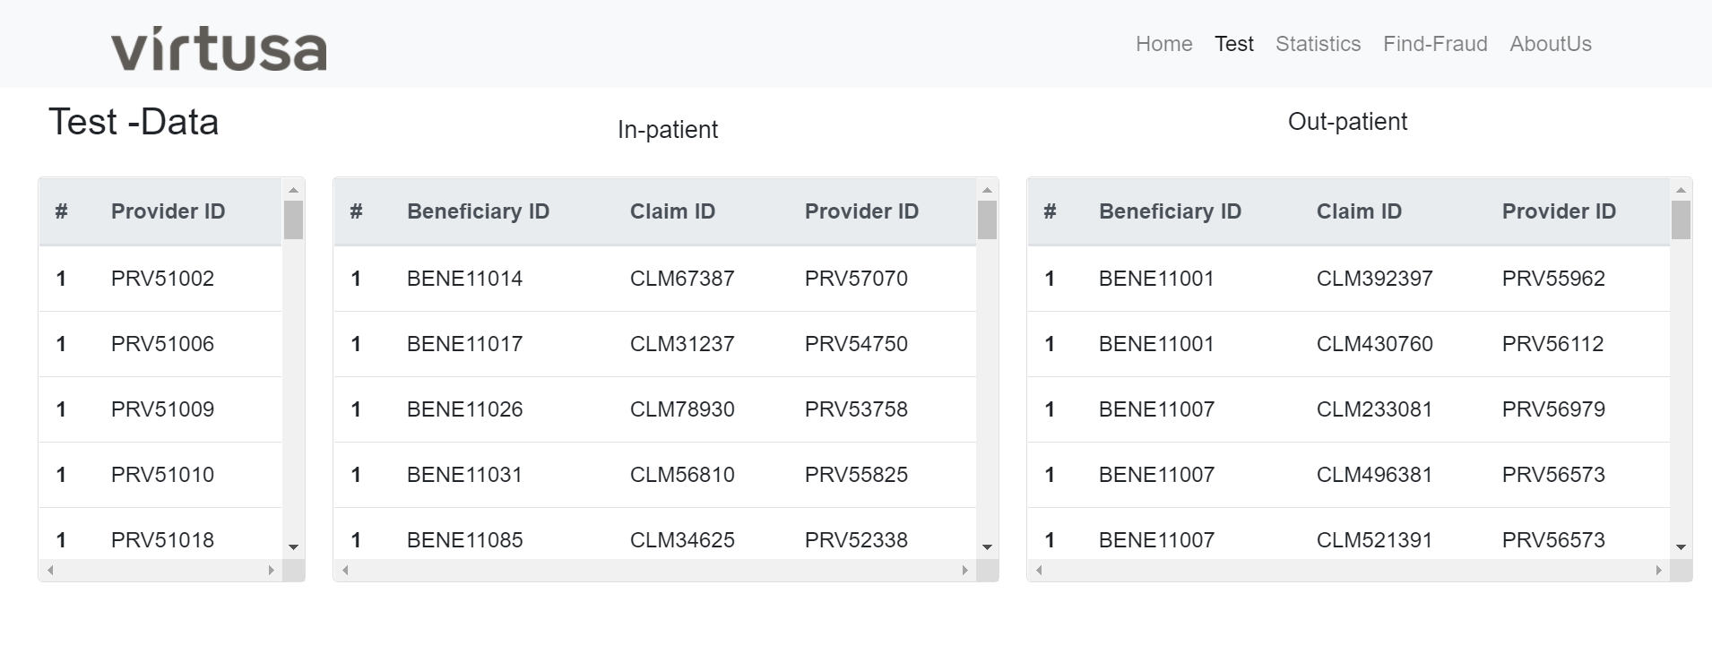
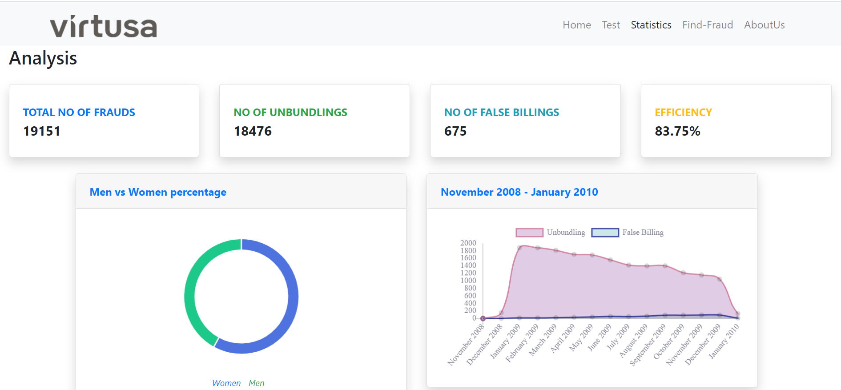
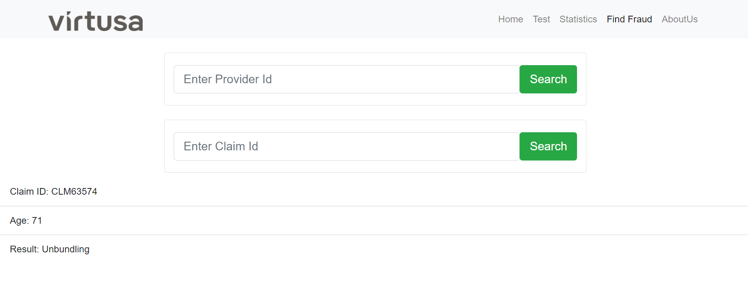
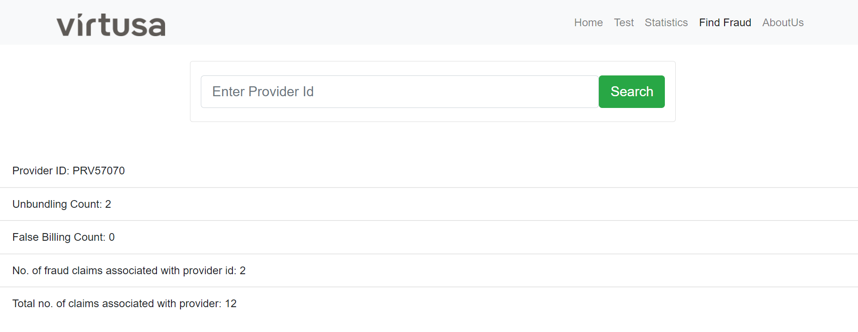
Demo Application
Test Data
Statistics – Train data
Fraud Detection - Claim
Fraud detection - Provider

Slide 7


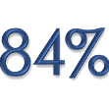


Conclusion
Detect Fraud
Types of Fraud
Efficiency
User-friendly Interface
Analyze and Report
Uses Logistic Regression to identify fraud, Waste and Abuse practice in a short time
Identifies the following type of fraud - False Billing and Unbundling
The Algorithm produces 84% efficiency with the trial data
The application is easy to access and get required result
Can use the statistics of the annual claims data to analyze the trend of fraud practices

Slide 8
Thank You

