Slide 1
8 Puzzle Problem
using
Greedy Best First Search
Course Instructor:-
Rupam Bhattacharyya

Slide 2
Group Members
Abhishek Kumar
Himanshu Ranjan
Suraj Kumar
Hitesh Kumar Sahu
Santosh Kumar

Slide 3
What is 8 Puzzle Problem?
The 8 puzzle consists of an area divided into a grid, 3 by 3 for the 8-puzzle . Thus, there are eight tiles in the 8-puzzle. A tile that is next to the empty grid square can be moved into the empty space, leaving its previous position empty in turn. Tiles are numbered, 1 to 8 for the 8-puzzle, so that each tile can be uniquely identified.
We have to solve it using Greedy Best First Search

Slide 4
Greedy Best First Search
Best-first search is a search algorithm which explores a graph by expanding the most promising node chosen according to a specified rule.
Greedy best-first search expands the node that appears to be closest to goal . Here f(n) = h(n) { where h(n) is the estimate of cost from node n to goal }

Slide 5
Properties of Greedy best-first search
Complete ? No – It can get stuck in loops.
Time ? O(bm), but a good heuristic can give dramatic improvement
Space ? O(bm) - keeps all nodes in memory
Optimal ? No

Slide 6
Start
FLOW CHART:
Search position of blank tile
Find heuristic values after doing all possible swapping
Select minimum heuristics value
No
Goal
state
Yes
End

Slide 7
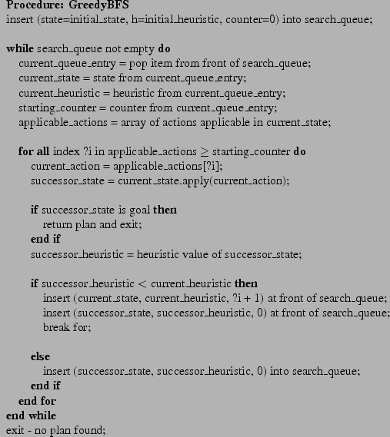
Pseudo Code of Greedy BFS

Slide 8
Figure Shows the initial and goal state of the 8 Puzzle Problem. Solve this Puzzle using Greedy BFS
Initial State
Goal State
4 | 3
6 | 7 | 2
8 | 1 | 5
 | 1 | 2
3 | 4 | 5
6 | 7 | 8

Slide 9
Here the heuristic function h(n) is the no. of misplaced tiles (excluding the blank tile) with respect to the goal position. We need to solve the above problem using Greedy Best First Search algorithm

Slide 10
4 | 3
6 | 7 | 2
8 | 1 | 5
Initially h(n)=8
4 |  | 3
6 | 7 | 2
8 | 1 | 5
4 | 3 | 2
6 | 7
8 | 1 | 5
Move left h(n)=8
Move down h(n)=7
So here the block will move down

Slide 11
4 | 3 | 2
6 | 7
8 | 1 | 5
Now h(n)=7
4 | 3 | 2
6 |  | 7
8 | 1 | 5
4 | 3 | 2
6 | 7 | 5
8 | 1
Move left ; h(n)=7
Move down ; h(n)=6
So here the block will move down

Slide 12
Now h(n)=6
4 | 3 | 2
6 | 7 | 5
8 | 1
4 | 3 | 2
6 | 7 | 5
8 |  | 1
Move left ; h(n)=6
So here the block will move left

Slide 13
Now h(n)=6
4 | 3 | 2
6 | 7 | 5
8 |  | 1
4 | 3 | 2
6 | 7 | 5
 | 8 | 1
4 | 3 | 2
6 |  | 5
8 | 7 | 1
Move left ; h(n)=6
Move up ; h(n)=5
Here we will move the block up

Slide 14
4 | 3 | 2
6 |  | 5
8 | 7 | 1
Initially h(n)=6
4 |  | 2
6 | 3 | 5
8 | 7 | 1
4 | 3 | 2
 | 6 | 5
8 | 7 | 1
4 | 3 | 2
6 | 5
8 | 7 | 1
Move up ; h(n)=5
Move left ; h(n)=5
Move right ; h(n)=6
Here we are getting equal value of heuristic function for two moves , so we will randomly choose any one of the move , lets say UP .

Slide 15
Now h(n)=5
4 |  | 2
6 | 3 | 5
8 | 7 | 1
 | 4 | 2
6 | 3 | 5
8 | 7 | 1
4 | 2
6 | 3 | 5
8 | 7 | 1
Move left ; h(n)=5
Move right ; h(n)=6
Here the block will move left

Slide 16
Now h(n)=5
 | 4 | 2
6 | 3 | 5
8 | 7 | 1
6 | 4 | 2
 | 3 | 5
8 | 7 | 1
Move down ; h(n)=5
Here the block will move down

Slide 17
6 | 4 | 2
 | 3 | 5
8 | 7 | 1
Now h(n)=5
6 | 4 | 2
3 |  | 5
8 | 7 | 1
6 | 4 | 2
8 | 3 | 5
 | 7 | 1
Move right; h(n)=4
Move down ; h(n)=5
Here the block will move right

Slide 18
6 | 4 | 2
3 |  | 5
8 | 7 | 1
Now h(n)=4
6 |  | 2
3 | 4 | 5
8 | 7 | 1
6 | 4 | 2
3 | 7 | 5
8 |  | 1
6 | 4 | 2
3 | 5
8 | 7 | 1
Move up h(n)=4
Move down ; h(n)=5
Move right ; h(n)=5
Here the block will move up

Slide 19
Now h(n)=4
6 |  | 2
3 | 4 | 5
8 | 7 | 1
 | 6 | 2
3 | 4 | 5
8 | 7 | 1
6 | 2
3 | 4 | 5
8 | 7 | 1
Move left h(n)=3
Move right ; h(n)=5
Here the block will move left

Slide 20
Now h(n)=3
3 | 6 | 2
 | 4 | 5
8 | 7 | 1
 | 6 | 2
3 | 4 | 5
8 | 7 | 1
Move down h(n)=4
Now from here if we try to move the block down, the value of heuristic function becomes 4 , and so we have no option to move anywhere as Greedy BFS Does not allows us to do so. So this problem cannot be solved completely.
Let’s take a look at another example

Slide 21
Example:-
3 | 2 | 5
6 | 1
7 | 4 | 8
 | 1 | 2
3 | 4 | 5
6 | 7 | 8
Initial state
Final state

Slide 22
3 | 2 | 5
6 | 1
7 | 4 | 8
Initially h(n) = 7
3 | 2
6 | 1 | 5
7 | 4 | 8
3 | 2 | 5
6 | 1 | 8
7 | 4
3 | 2 | 5
6 |  | 1
7 | 4 | 8
Move up ; h(n) = 6
Move down ; h(n) = 7
Move left ; h(n) = 7
Here the block will move up

Slide 23
3 | 2
6 | 1 | 5
7 | 4 | 8
Now h(n) = 6
3 |  | 2
6 | 1 | 5
7 | 4 | 8
Move left ; h(n) = 5
Here the block will move left

Slide 24
3 |  | 2
6 | 1 | 5
7 | 4 | 8
Now h(n) = 5
3 | 1 | 2
6 |  | 5
7 | 4 | 8
 | 3 | 2
6 | 1 | 5
7 | 4 | 8
Move down; h(n) = 4
Move up ; h(n) = 5
Here the block will move down

Slide 25
3 | 1 | 2
6 |  | 5
7 | 4 | 8
Now h(n) = 4
3 | 1 | 2
 | 6 | 5
7 | 4 | 8
3 | 1 | 2
6 | 4 | 5
7 |  | 8
3 | 1 | 2
6 | 5
7 | 4 | 8
Move left ; h(n) = 4
Move down ; h(n) = 3
Move right ; h(n) = 5
Here the block will move down

Slide 26
3 | 1 | 2
6 | 4 | 5
7 |  | 8
Now h(n) = 3
3 | 1 | 2
6 | 4 | 5
 | 7 | 8
3 | 1 | 2
6 | 4 | 5
7 | 8
Move left ; h(n) =2
Move right ; h(n) = 4
Here the block will move left

Slide 27
3 | 1 | 2
6 | 4 | 5
 | 7 | 8
Now h(n) = 2
3 | 1 | 2
 | 4 | 5
6 | 7 | 8
Move up ; h(n) = 1
Here the block will move up

Slide 28
3 | 1 | 2
 | 4 | 5
6 | 7 | 8
Now h(n) = 1
3 | 1 | 2
4 |  | 5
6 | 7 | 8
 | 1 | 2
3 | 4 | 5
6 | 7 | 8
Move right; h(n) =2
Move up ; h(n) = 0
This is the required final state. So here if the block moves up , the h(n) value becomes 0 and we get the result.

Slide 29
CONCLUSION
We receive the optimal solution only for some of the specific inputs .
We will not always get optimal solution.
If the value of heuristic function does not decrease, it gets stuck in loops.

Slide 30
Thank You

