Slide 1
Synergy between Quantum Circuits and Tensor Networks
Abhishek Abhishek, Daniel Kong, Harmeeta Dahiya, Mushahid Khan

Slide 2
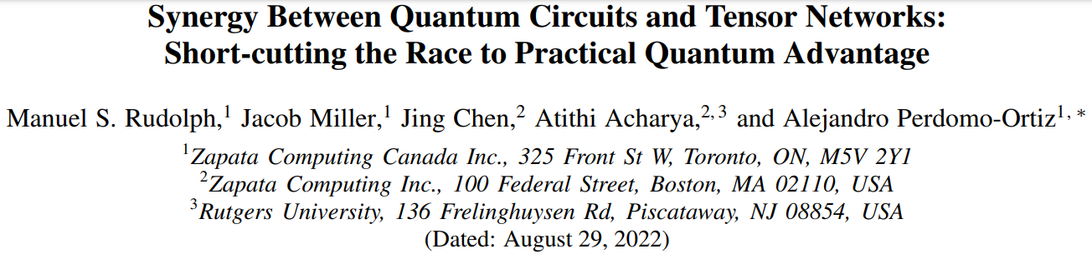
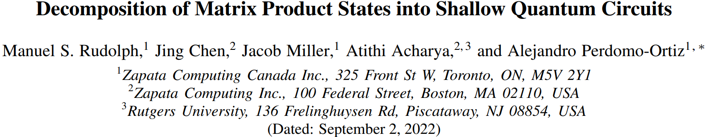
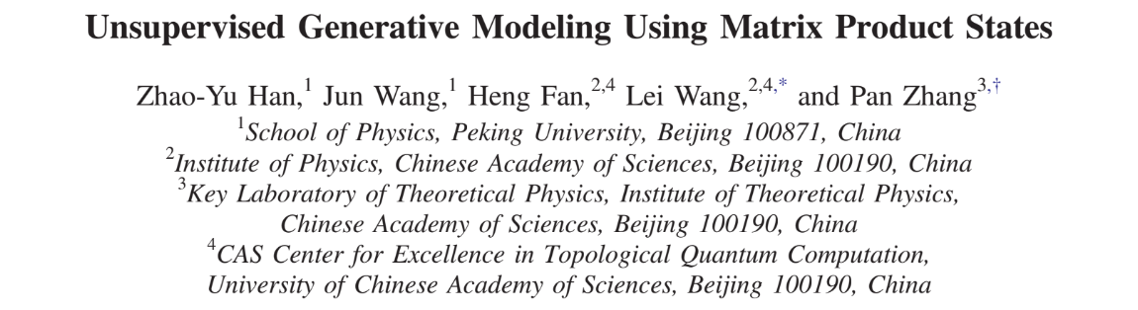
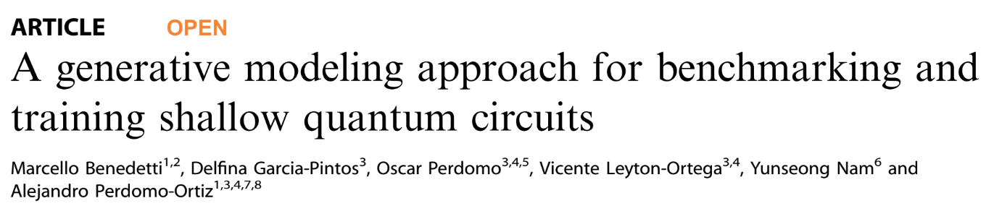

Slide 3
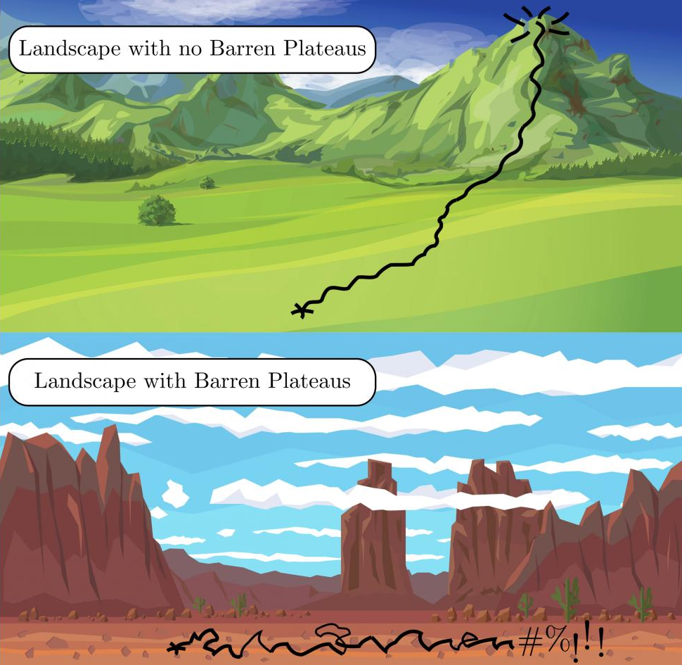
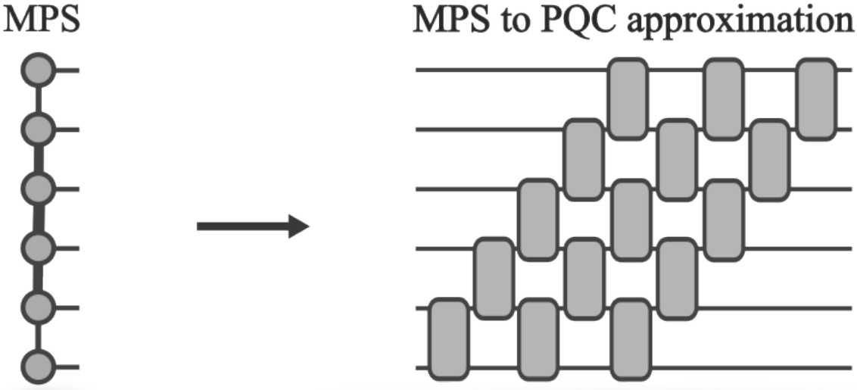
Main idea
Generic initialization schemes for parameterized quantum circuits (PQCs)
barren plateaus
local minima
Use classical resources to find good task-specific initializations and further optimize using quantum hardware
classical + quantum 🥳
⚛
🖥
Image credit: https://discover.lanl.gov/news/0319-barren-plateaus/
Image credit: Fig 1. https://arxiv.org/abs/2208.13673

Slide 4
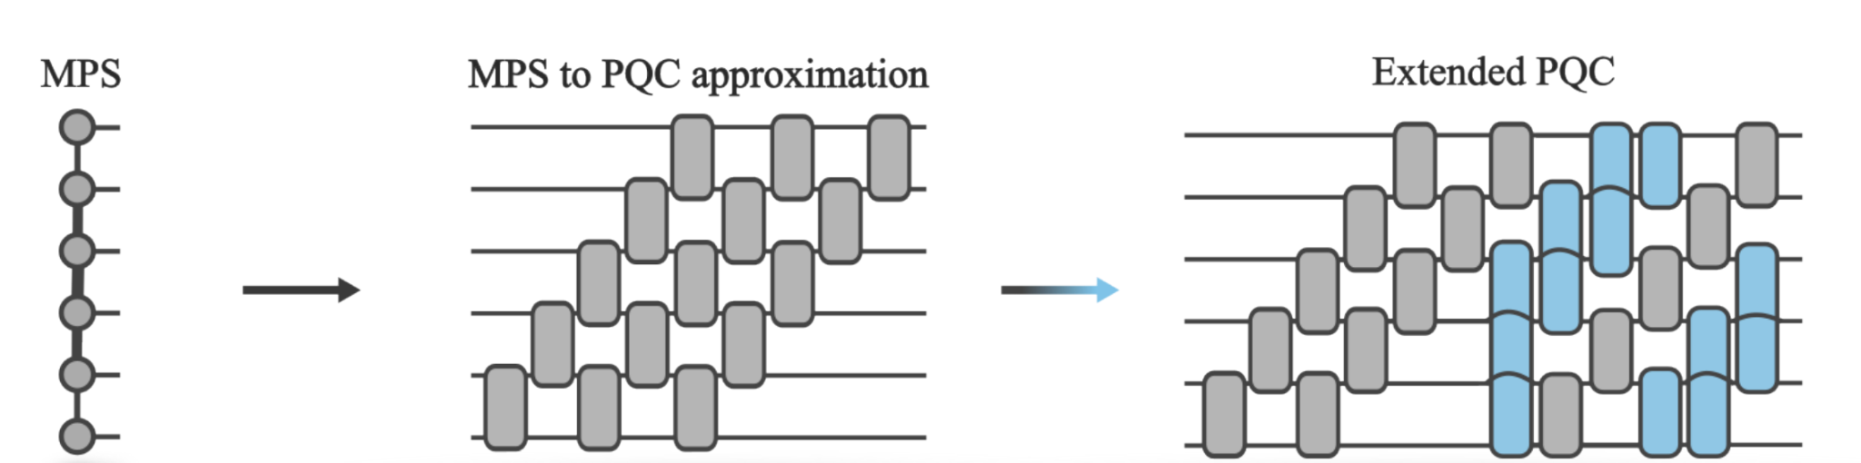
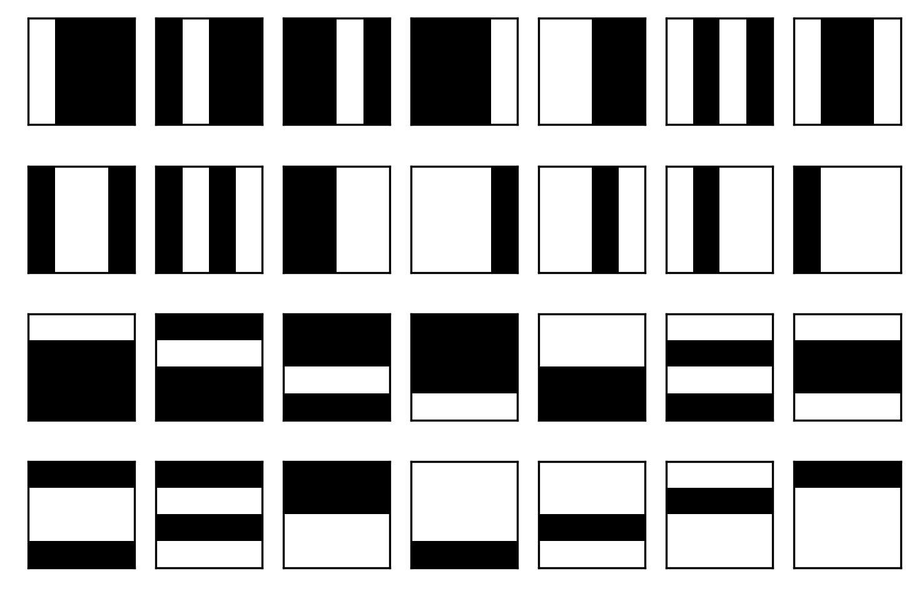
Overview of Approach
Train a Tensor Network (TN) called Matrix Product State (MPS) as a generative model on the bars and stripes dataset
Transfer the trained MPS to a MPS-PQC circuit
Extend and train the MPS-PQC circuit with additional gates
Generate bars and stripes images
Image Credit: https://arxiv.org/abs/2208.13673

Slide 5
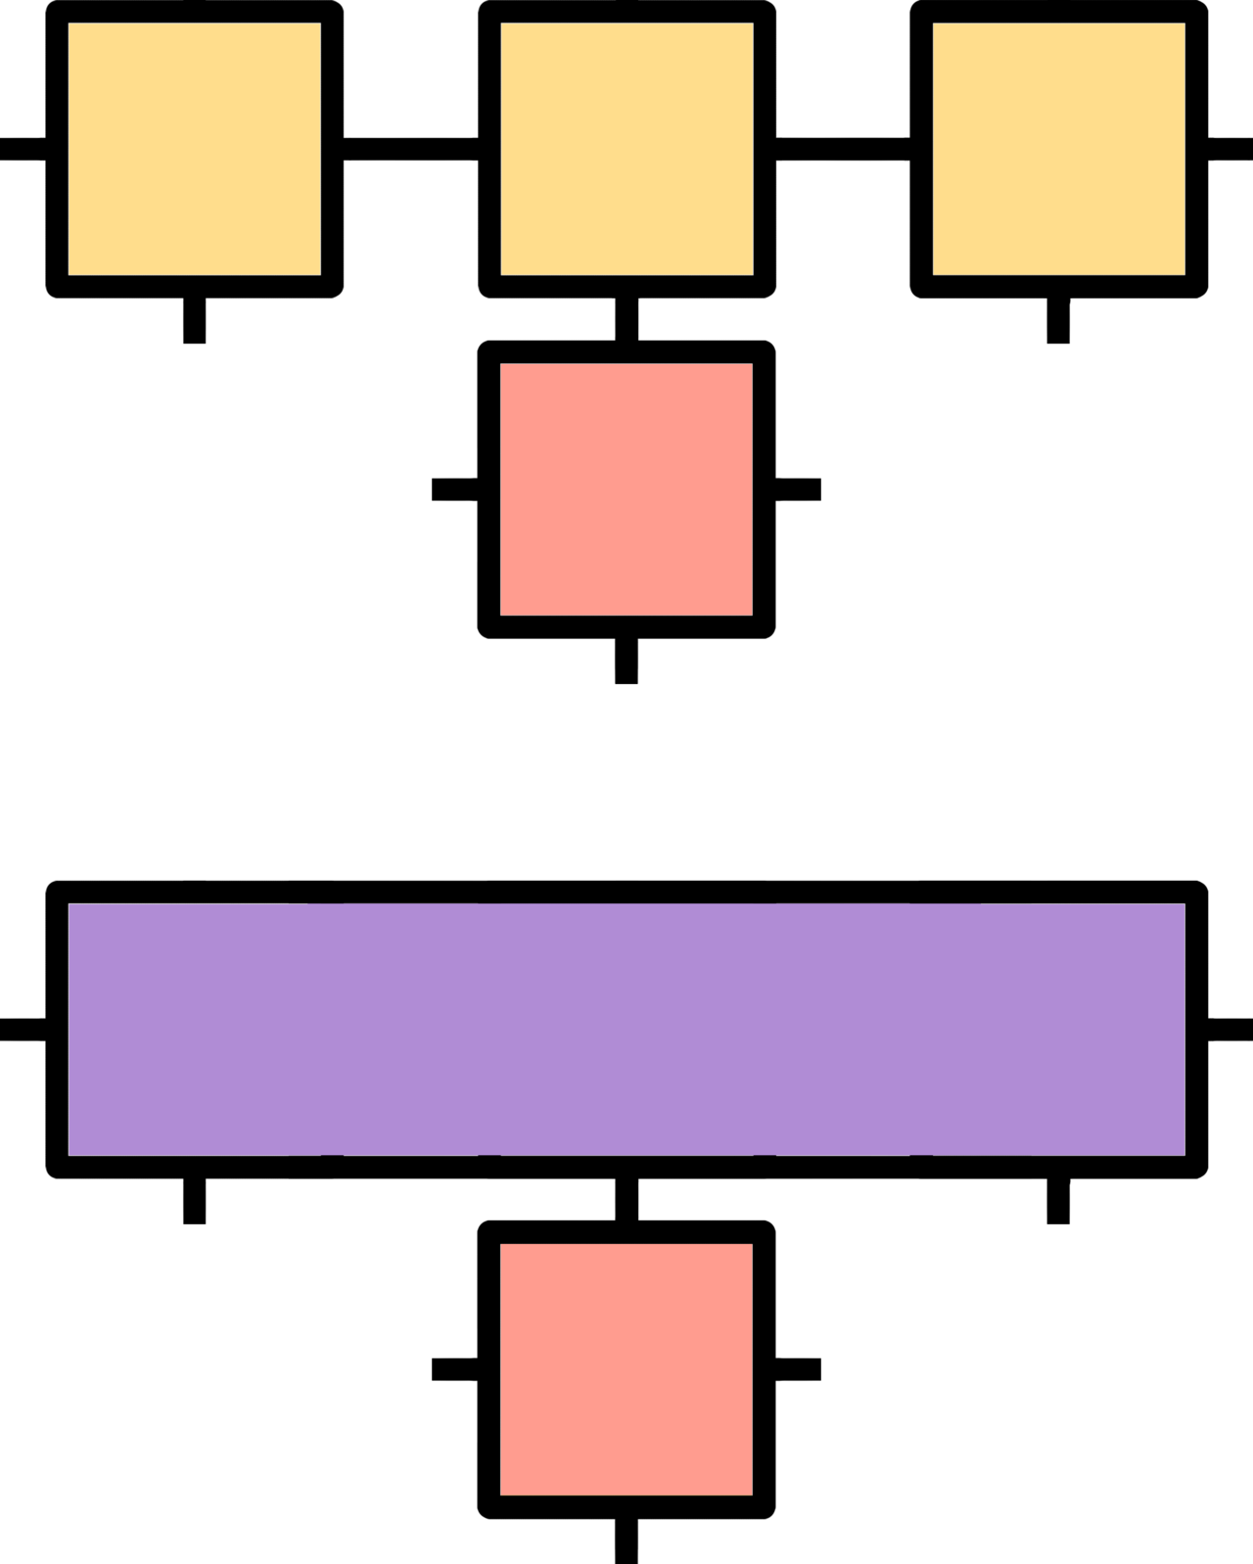

Train MPS
TNs are linear algebraic models for classically simulating complex many-body quantum systems, that have been employed recently as machine learning models
No. of nodes in a TN = No. of qubits in the quantum computer
the topology of the N-node graph determines the forms of entanglement
MPS are computationally tractable TN models whose cores are connected along a line graph
Image Credit: https://arxiv.org/pdf/1709.01662.pdf

Slide 6
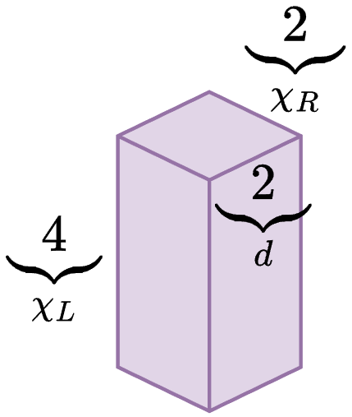
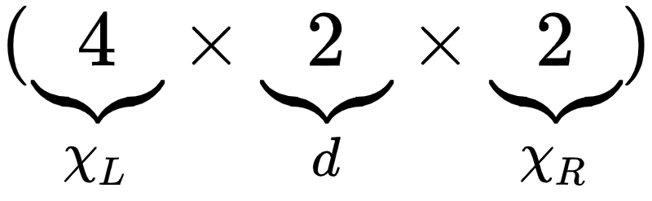
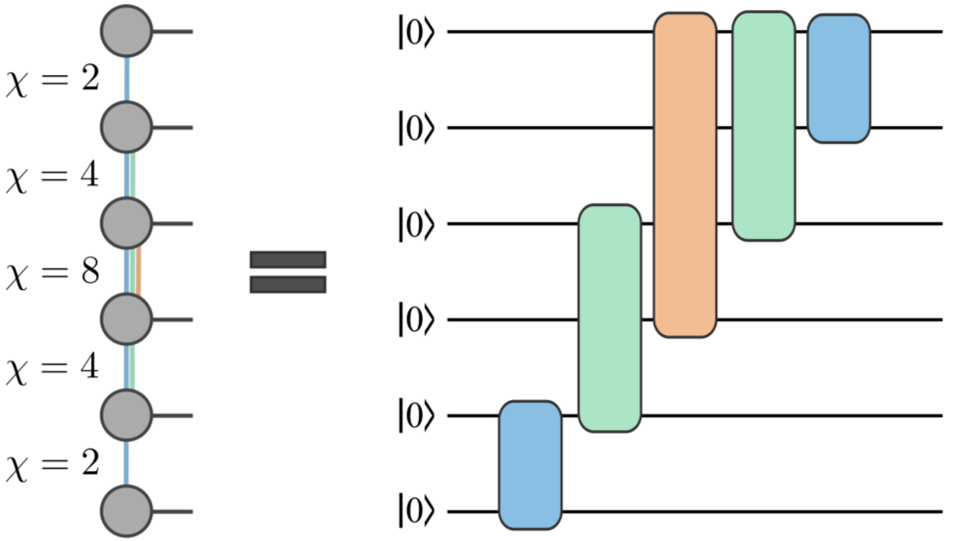
MPS to PQC
How do we map a Matrix Product State (MPS) tensor network to a parameterized quantum circuit ?
The parameters of the model are stored in the tensor cores
These 3-d tensors are clearly not unitaries but can be converted to one
model parameters
Image credits: https://arxiv.org/abs/2209.00595, https://muellergroup.lassp.cornell.edu/bt2020chap4.pdf

Slide 7
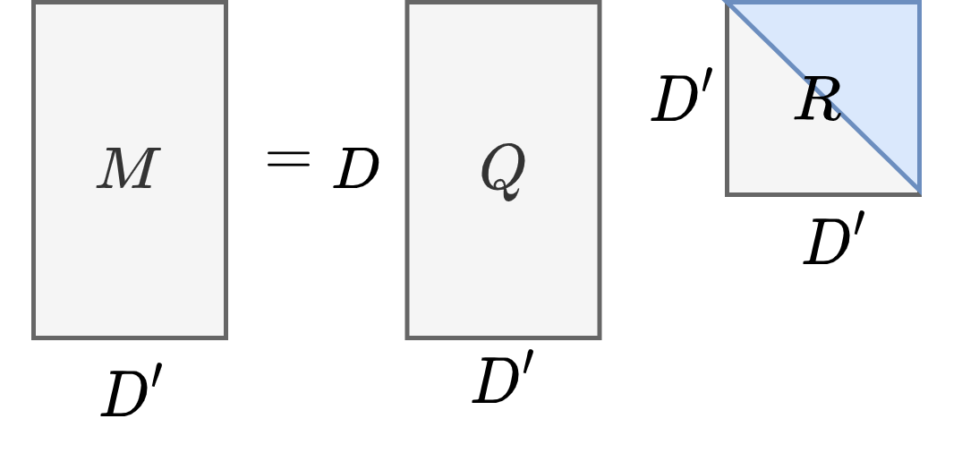
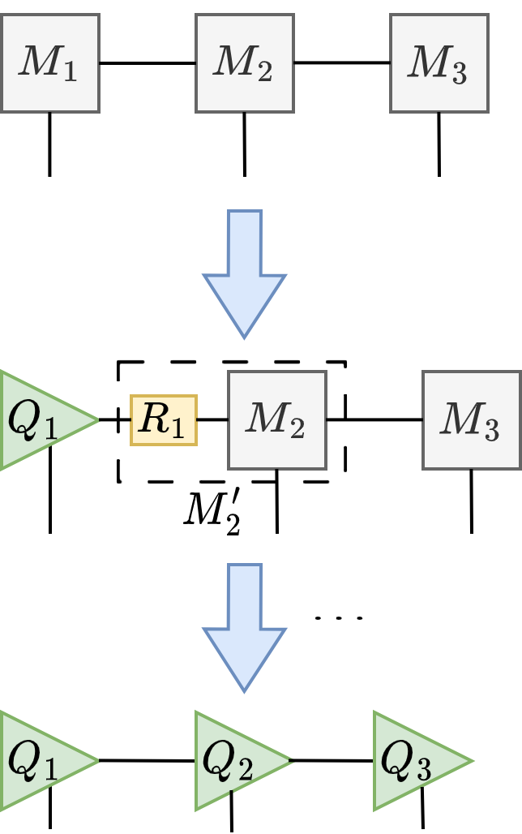

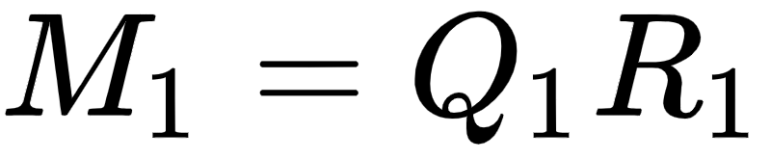
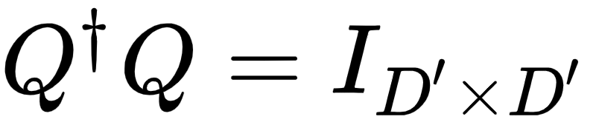
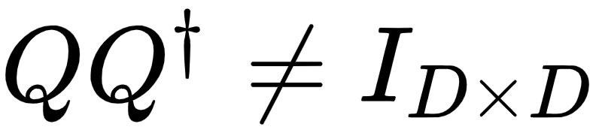
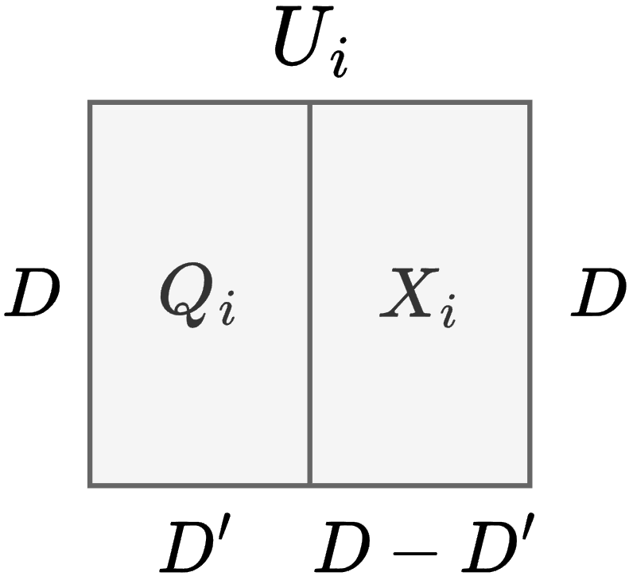
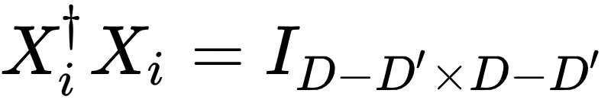
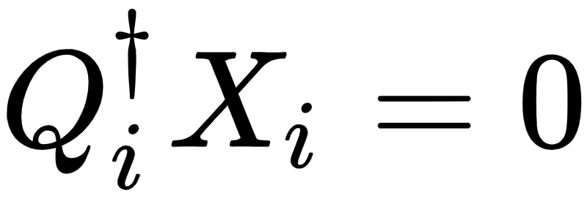
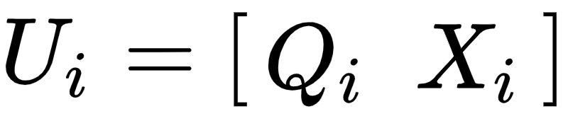
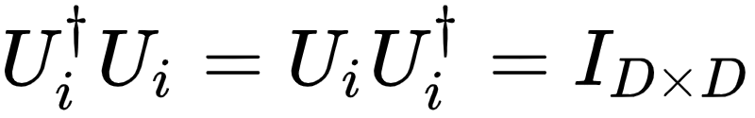
MPS to PQC
QR-factorization
Left-normalization
Two key steps:
Left-normalization of the MPS via iterated QR factorizations
Extend the left-isometries in the MPS to multi-qubit unitaries
Left-isometry
Reference: https://arxiv.org/abs/2209.00595

Slide 8
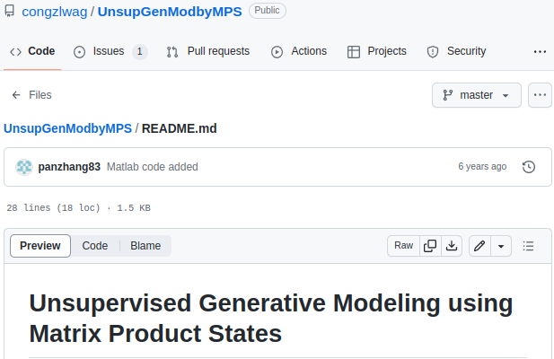
Code Overview
Existing codebase for MPS training and normalization.
Numpy.linalg and scipy.linalg for extracting the multi-qubit unitaries from the MPS.
Pennylane to define and further train parameterized quantum circuits

Slide 9
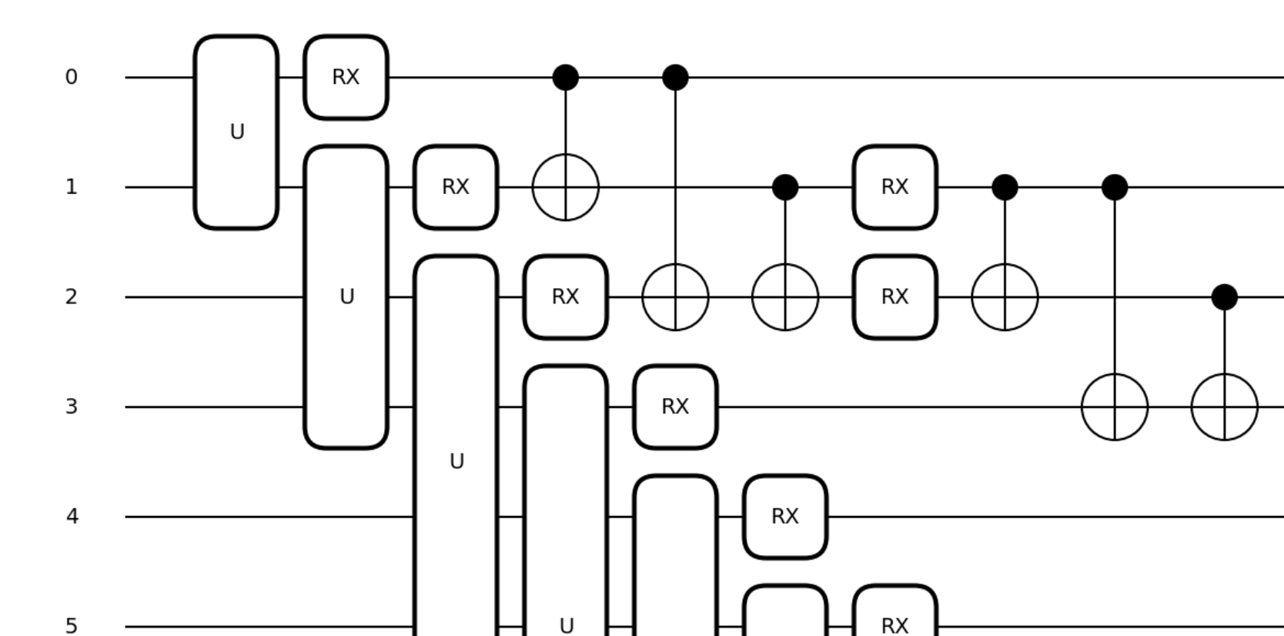
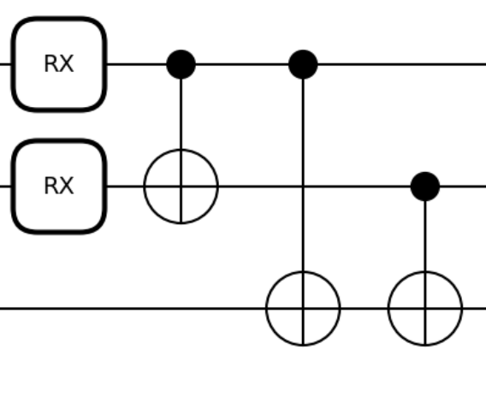
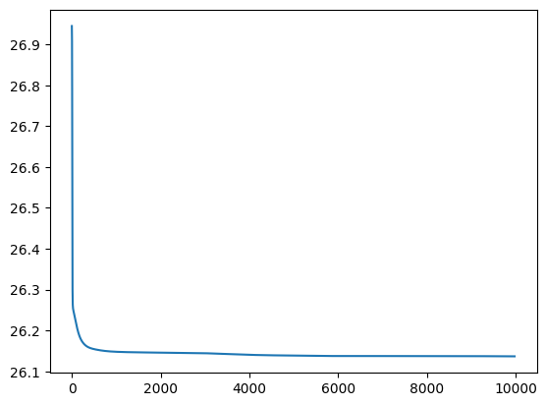
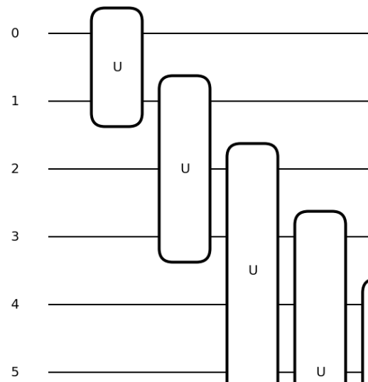
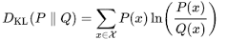
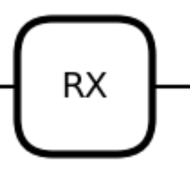
Results
Kullback–Leibler (KL) Divergence
KL - Divergence
Iterations

Slide 10
Future Work
To have a chance at improving the previously found MPS results, one needs to extend the linear layers with additional gates and train gates generated by MPS
This will require increasing the circuit depth, more flexible entangling topologies, or both
Train the unitary matrices generated by MPS alongside the additional gates added
After training extended PQC, compare results with a randomly initialized circuit

