Slide 1
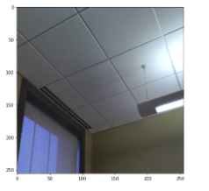
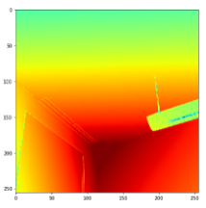
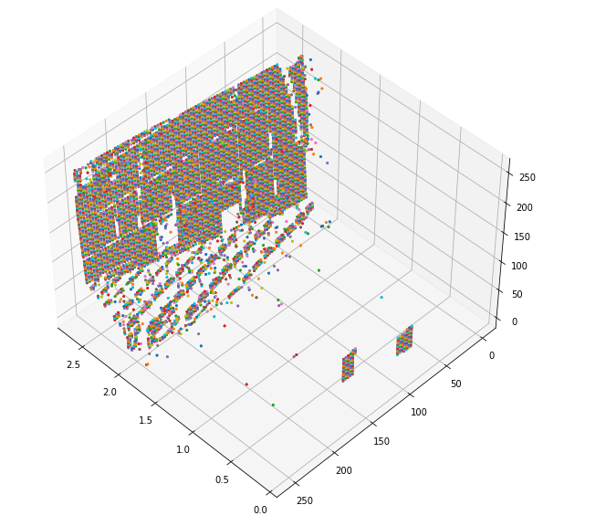
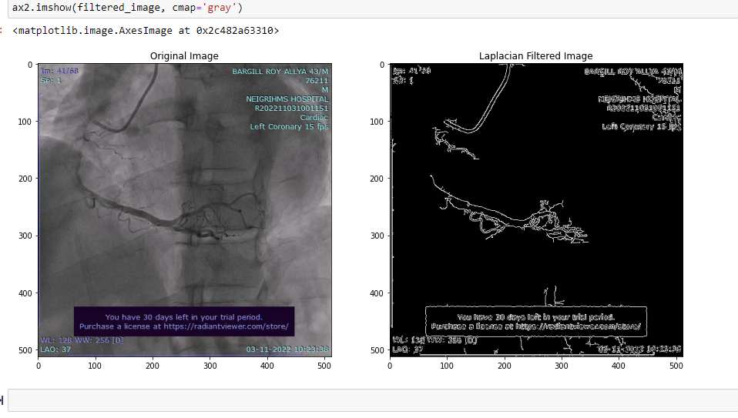
Tried to cover the basic anatomy of heart, especially the Coronary Arteries
Got some ideas about angiogram of coronary artery like Cranial, Caudal, LOA,ROA angulation from the materials which were shared(not completed yet)
worked on the datasets which were provided:
Initially it was in DICOM format with embeddings not supported by python library so converted this into mp4 format using radiant and then using OpenCV captured these videos frame wise, each frame having separate image.
Used edge filter for each frame and tried to capture only coronary artery from the frame
Trying to develop a model which converts the features of a frame of coronary artery into 3D space, currently it is still under progress
Its inspiration is basically from depth features extraction as show in figure

