Slide 1
Runtime state-management architectures

Slide 2
Runtime state-management services help keep track of user session information across a group of servers (called a cluster). This allows multiple servers to work together like one system when handling things like single sign-on (SSO) and logout. In large setups with many servers, it can be faster and more efficient to share session details with just a few of them, instead of all.
PingFederate offers two ways to manage this: adaptive clustering and directed clustering.

Slide 3
Adaptive Clustering
is a built-in feature in PingFederate that automatically manages and shares user session data across multiple servers (called nodes). This helps servers handle login, logout, and session tracking together without needing manual setup for each one.
No manual config needed: You don’t have to edit individual files to decide which nodes track sessions — the system handles it for you.
How it works: Each session gets a unique address. Multiple nodes store the same session (called a replica set), usually on 3 nodes by default. This setup helps with redundancy — if two nodes fail, the third can still respond.
Dynamic scaling: If a node joins or leaves the cluster, the system automatically rebalances session data to maintain full coverage.

Slide 4
Setup: Turn it on by setting pf.cluster.adaptive=true in the run.properties file (found in <pf_install>/pingfederate/bin). This is the default for new installs. If this setting is false or missing, PingFederate switches to directed clustering instead.
File updates: If you change config files like cluster-adaptive.conf, you must manually copy changes to every node, since these settings don’t sync automatically. Restart PingFederate after updates.
Important Limitations:
SAML 2.0 Single Logout (SLO) over SOAP is not supported with adaptive clustering. If you need SLO with SOAP, use directed clustering instead.
Adaptive clustering doesn’t apply to the Artifact-Message Persistence and Retrieval Service, which handles message sharing differently.

Slide 5
Configuration
You can fine-tune session behavior using various config files in the <pf_install>/pingfederate/server/default/conf/ directory. Key settings include:
Property | Description
rpc.timeout | How long (in ms) a node waits for a response. Default: 500 ms.
synchronous.retrieve.majority.only | If true (default), waits for the majority of replica nodes to respond. If false, waits for all.
bulk.revoked.sris.timeout | Applies to session revocation. Sets how long to wait (in ms) when downloading a full revocation list. Default: 10,000 ms (10s).
read.local.only | If true (default), uses only local data for session revocation status. If false, contacts other nodes.

Slide 6
Multi-Region Support in Adaptive Clustering
PingFederate supports running clusters across multiple geographic regions using adaptive clustering. This setup helps improve performance and resilience, especially in large, distributed environments.
How It Works:
You can assign region identifiers to different groups of servers.
When a server needs to save session-state data, it sends that data to replica sets in both the local region and at least one remote region.
When only reading session data, the request is handled locally to improve speed.
If servers are added or removed in a region, PingFederate automatically redistributes session data within that region, which reduces network traffic between regions.

Slide 7
What’s Supported Across Regions:
Cross-region support works for several key services:
User session data: Managed by IRSM, IdP Session Registry, and SP Session Registry.
Assertion Replay Prevention Service
Account Locking Service
OAuth reference token management: Includes token replication, validation, and revocation. ⚠️ Important Notes:
To reduce network traffic, PingFederate does not replicate SSO transaction states (used during login flows) between regions by default.
This can cause login failures if a user starts an SSO login in one region, but due to DNS or routing, ends up in another region to finish it. In this case, PingFederate shows an error:
Unable to resume processing because saved state was not found for key.
If you need SSO sessions to work across regions, you can enable replication by editing the cluster-adaptive.conf file and setting:
inter.group.replicate.transaction.state = true

Slide 8
OAuth Tokens and Cross-Region Behavior:
By default, reference tokens are shared across regions when region identifiers are defined.
If you disable cross-region support for reference tokens, PingFederate will not be able to validate or revoke tokens issued in other regions.
In such cases, it’s recommended to use self-contained tokens, which do not rely on shared session data and can be validated independently.

Slide 9
Configuring multi-region support
Define region identfiers and configure cross-region settings for multi-region PingFederate server clusters.
Steps
To define a region identifier for a given node, update the node.group.id value in the <pf_install>/pingfederate/server/default/conf/cluster-adaptive.conf file, which is a per-server configuration.
Example:
For example, if you have five engine nodes in the West Coast and six engine nodes in the East Coast, you can update the node.group.id value to W for each of the West Coast nodes and E for each of the six nodes in the East Coast.
Restart PingFederate after making changes to the cluster-adaptive.conf file.
Result:
Once defined, the identifiers for all nodes are displayed on the System → Server → Cluster Management menu.
To configure cross-region support for individual areas, follow the inline instructions in the cluster-adaptive.conf file to update the relevant setting values.

Slide 10
Directed Clustering
is a manual approach to managing how PingFederate servers (called nodes) share session-state data with each other. Unlike adaptive clustering, which handles everything automatically, directed clustering puts the control in your hands.
How It Works
In directed clustering, you manually define which nodes share session data with each other. This is done using configuration files for each service. You assign preferred nodes using their indexes — meaning you choose which nodes a given node should talk to.
Think of it like giving each server a “contact list” of which other servers it should share data with.

Slide 11
Key Concepts and Properties
Each service in PingFederate has its own config file in: <pf_install>/pingfederate/server/default/conf/
Here are the important properties and what they do:
Property | Description
preferred.node.indices | A list of node indexes this node should share data with. If left blank, data is shared with all nodes. This helps control network traffic. Not supported by the Artifact-Message and Session Revocation services.
preferred.node.group.id | (Only in cluster-idp-session-registry.conf) Assigns a group ID to subclusters. Ensures that requests go to the right group of servers, helping manage session extensions and reduce early timeouts. Must be unique.
rpc.timeout | Sets how long (in milliseconds) a node should wait for a response before timing out. Default is 500 ms.
synchronous.retrieve.majority.only | If true (default), the node waits for a majority of responses. If false, it waits for all responses.
bulk.revoked.sris.timeout | (Only in cluster-session-revocation.conf) Controls how long (default 10,000 ms or 10 sec) to wait when downloading revocation lists during startup or reconnect.
read.local.only | (Only in cluster-session-revocation.conf) If true (default), checks revocation status using local data only. If false, queries other nodes too.

Slide 12
Configuration Files by Service
Configuration File | Service
cluster-account-locking.conf | Account Locking
cluster-artifact.conf | Artifact-Message Persistence and Retrieval
cluster-assertion-replay-prevention.conf | Assertion Replay Prevention
cluster-idp-session-registry.conf | Identity Provider (IdP) Session Registry
cluster-inter-request-state.conf | Inter-Request State Management (IRSM)
cluster-session-revocation.conf | Session Revocation
cluster-sp-session-registry.conf | Service Provider (SP) Session Registry
❗Note: Changes in config files must be manually copied to all nodes. There’s no automatic sync like in adaptive clustering.

Slide 13
Deployment Strategies with Preferred Nodes
You can mix and match how services talk to each other using preferred nodes. Three common setups include:
Sharing all nodes Every node shares session data with all others. Easiest to manage, but may increase traffic.
Designating state servers Some nodes are assigned as state servers, and only they store session data. Good for limiting memory usage and traffic.
Defining subclusters Nodes are split into groups (subclusters), each with its own group ID. Useful for large, region-based deployments. Sessions can be routed to the right subcluster based on the group ID in the session ID.

Slide 14
Performance Tuning
Using preferred.node.indices wisely can:
Reduce network traffic
Lower memory use
Improve scalability
However, performance depends on your traffic patterns. For deeper optimization, check the PingFederate Performance Tuning Guide.
Final Notes
Directed clustering is ignored if adaptive clustering is enabled.
It's more hands-on, but gives you fine control over how session data is distributed.
You can also set authentication behavior to vary by node, using Cluster Node Authentication Selector.

Slide 15
🔄 Sharing All Nodes – What Does It Mean?
Imagine you have several PingFederate servers (called nodes) working together.
In the "Sharing All Nodes" setup:
Every server shares session data with every other server.
You don’t tell the servers who to talk to — they just talk to everyone.
This is the default setup in directed clustering.
🛠️ How Do You Set It Up?
Just leave the preferred.node.indices setting blank in all your config files.
That tells PingFederate:
"Don't limit who I talk to — just share session data with all other nodes.“
✅ Why Is This Setup Good?
Very easy to set up — no special configuration.
Works with basic traffic distribution like round-robin (where requests are just rotated through each server).
Great for small clusters with just a few servers.

Slide 16
⚠️ What’s the Downside?
Let’s say you have 3 servers — no problem.
But if you add 10, 20, or more servers, every new one must:
Send session data to every other server
Store data from every other server
That means:
More network traffic
More memory use
Less performance gain from adding new servers
So, it’s simple, but it doesn’t scale well for large systems.
🧠 Simple Analogy
Imagine a classroom where every student must share their notes with every other student.
In a class of 3 students, it’s easy.
In a class of 30 students, it becomes chaotic and slow — everyone’s too busy sharing notes!

Slide 17
Designating State Servers
To improve scalability, PingFederate supports a state server clustering model. This separates engine nodes into two types:
1. Request-Handling Nodes
Handle incoming user requests like login, SSO, and OAuth.
Communicate with specific state server nodes to store and retrieve runtime data (e.g., session info, tokens).
Must be configured with:
preferred.node.indices=<state_server_indices>
2. State Server Nodes
Dedicated to managing runtime state.
Do not handle user traffic or authentication requests.
Kept separate from end-user requests via the load balancer.
preferred.node.indices setting is not needed here.
Even with this setup, all nodes must still be able to communicate due to the underlying cluster protocol. The use of preferred nodes just optimizes how state data is handled.

Slide 18
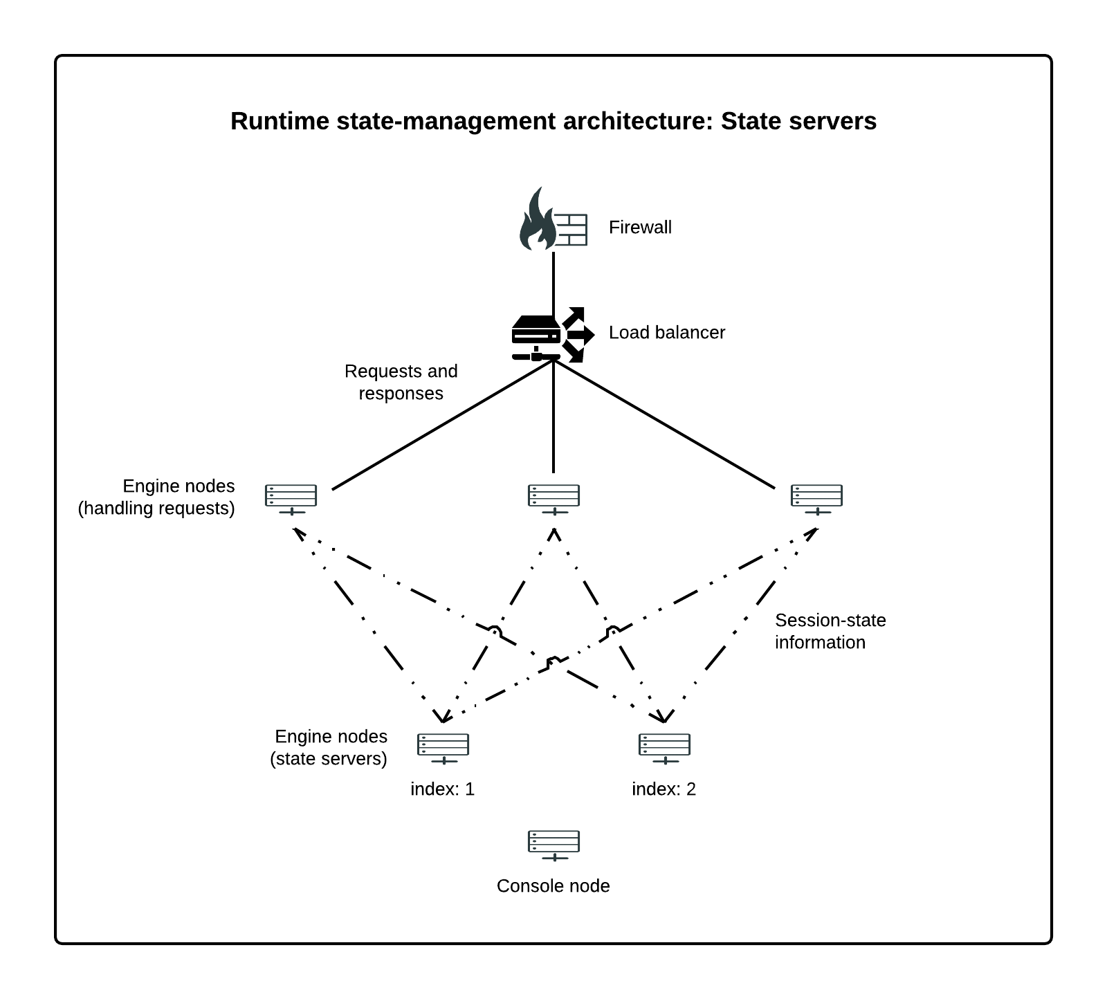
The following diagram illustrates the state-server approach.
Note:
OAuth and Reference Tokens
When PingFederate works as an OAuth Authorization Server and uses reference tokens (instead of self-contained tokens):
The Resource Server (RS) sends a request to PingFederate to look up the full token details — this is called "de-referencing" the token.
Since OAuth clients and resource servers send their requests separately, PingFederate needs to make sure all engine nodes can access the token data.
➡️ That’s why reference token data is shared across all engine nodes, no matter how you’ve set up state servers or clusters.
This setup makes sure token validation always works correctly, even in large or distributed environments.

Slide 19
Defining subclusters
Subclustering is a way to improve performance by splitting your PingFederate cluster into smaller groups of nodes. Each group is called a subcluster.
How It Works:
You group engine nodes using their node indices.
Each subcluster shares session-state data only within its group.
A load balancer must make sure that each user always goes to the same subcluster (this is called session stickiness).
Why Use It?
It helps PingFederate scale better. Adding more subclusters won’t slow down the existing ones.
It reduces the amount of data being shared between nodes.
Things to Keep in Mind:
All nodes still need to communicate with each other — that’s required for clustering.
This setup is just an optimization to handle session data more efficiently.
⚠️ Limitations of Subclustering:
Subclustering does not support the following features:
OpenID Connect back-channel logout
SAML 2.0 Single Logout (SLO) using SOAP
Revoking sessions after a user changes or resets their password
👉 If you need any of these features, you should use one of these instead:
All nodes share state
Designated state servers setup

Slide 20
How the Subcluster Flow Works After User Authentication:
User Sends Request:
The user tries to log in or authenticate to the app.
The request is sent to PingFederate (which acts as the OAuth Authorization Server or SSO provider).
Load Balancer Routes Request:
The load balancer decides which subcluster the user should go to.
It uses session stickiness, meaning the load balancer makes sure the user’s session always goes to the same subcluster each time.
Authentication Happens in Request-Handling Node:
The request-handling node in the subcluster processes the user’s login, authenticates the user, and creates a session.
The user’s session data (like session tokens, identity info) is stored within the same subcluster.
Session State Shared Within Subcluster:
The session data is only shared with the other nodes within the same subcluster. It doesn't go beyond that group.
This keeps the session data more efficient and reduces unnecessary communication between nodes.
User Makes Further Requests:
Once the user is authenticated, any subsequent requests (like accessing resources or services) are sent to the same subcluster (thanks to session stickiness).
The request-handling node within that subcluster will process the requests using the session data it already has.
Subcluster Stays Efficient:
The other subclusters are not affected by this user’s session, meaning their performance stays unimpacted.
Each subcluster is independent in terms of session-state management, so they scale better.
User Logs Out or Session Expires:
When the user logs out, the session information will be cleared from the subcluster.
Since subclusters are isolated, the logout process affects only the user’s session in that subcluster, not others.
Key Points to Remember:
Session stickiness keeps the user going to the same subcluster for all their requests.
Session data stays inside the same subcluster — no need to share it with other subclusters.
This setup scales better because adding more subclusters doesn’t affect performance elsewhere.
No cross-subcluster communication unless necessary.

Slide 21
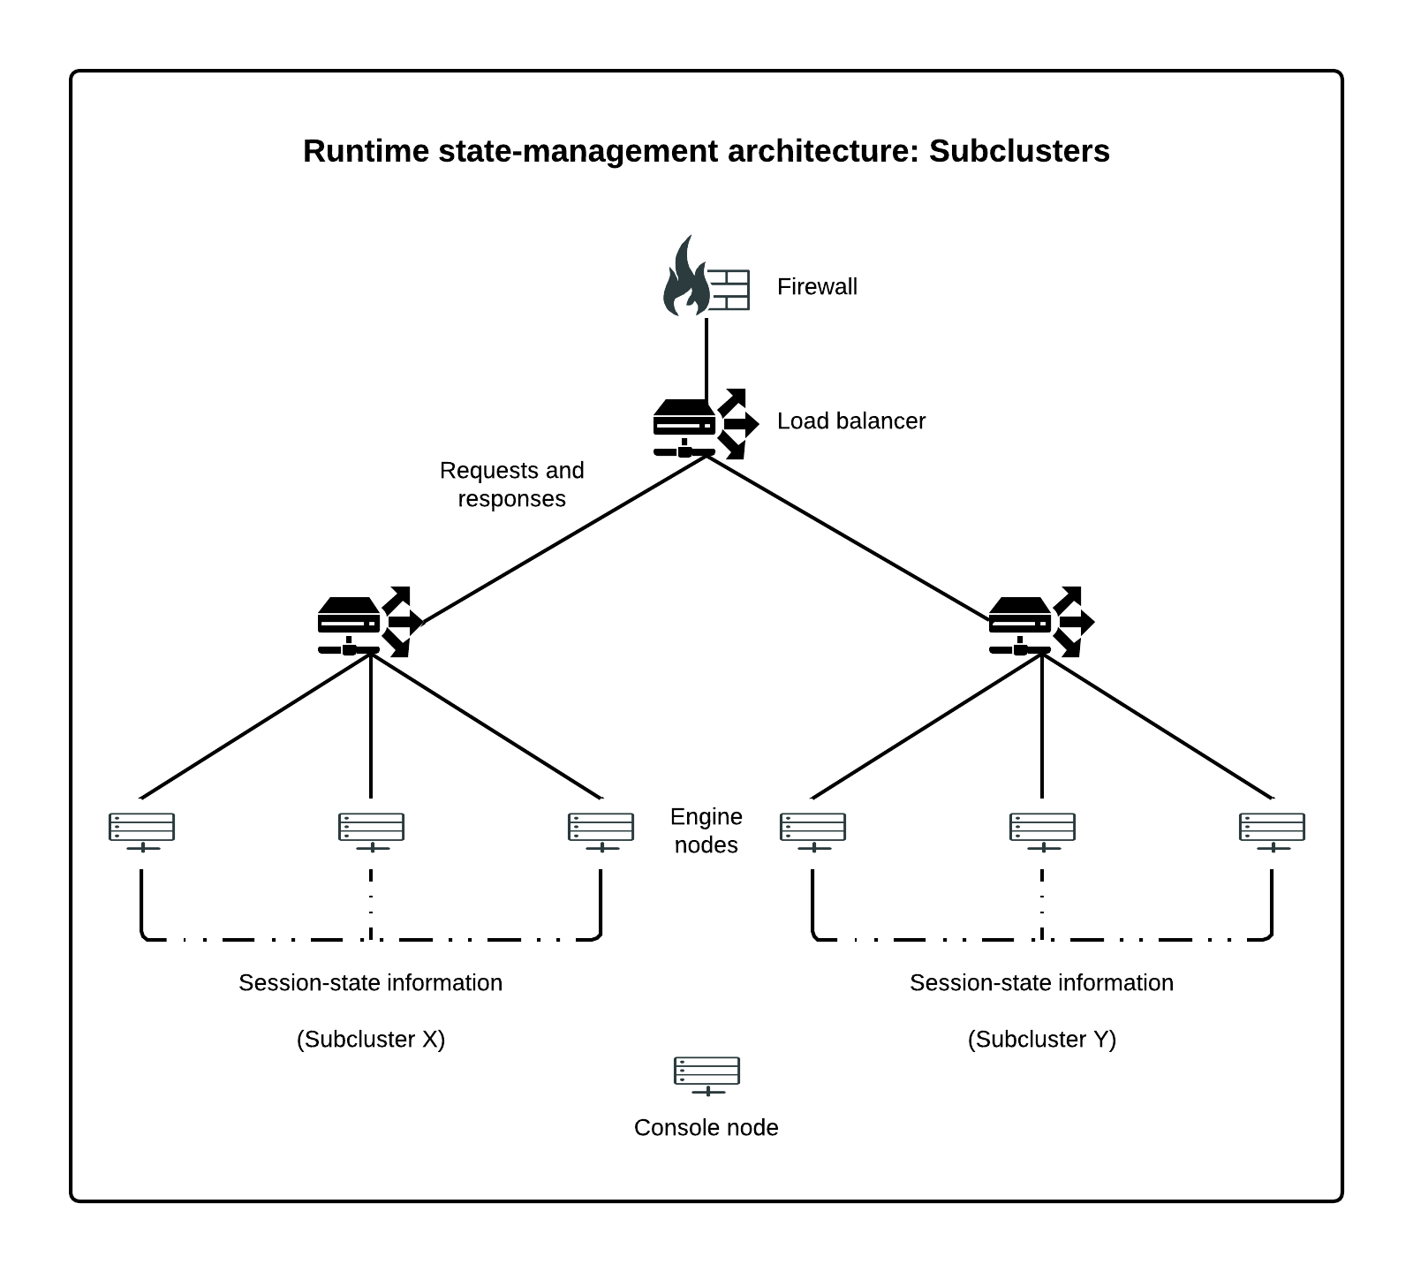
The following diagram illustrates the subcluster approach.
In this example, the preferred.node.indices property of each server in the cluster lists the indices of all nodes in its subgroup (including itself). Requests are directed to all nodes but the load balancer directs user sessions to the same subcluster.

Slide 22
Note:
OAuth and Reference Tokens in PingFederate
When PingFederate acts as an OAuth Authorization Server (AS) and uses a reference token model (where access tokens are not self-contained but reference external data), things work like this:
The Resource Server (RS) needs to look up the actual information tied to the access token (like the user's identity and permissions).
To do this, the RS sends a request to PingFederate to "de-reference" the token — basically, PingFederate looks up the token and returns the information the RS needs.
Since OAuth clients (like apps) and the RS send their requests separately, PingFederate makes sure that all engine nodes (the servers running PingFederate) have access to the reference token information.
This happens regardless of how the state servers or subclusters are set up, meaning PingFederate shares the token data across all nodes to ensure smooth access and validation.

Slide 23
Thank You

