Slide 1
Bank Loan Case Study
Presented by: Abhishek Aware
Data Analyst
https://docs.google.com/spreadsheets/d/1RAYV0KC0jRy3OAa-xdEbDmkwUs6B6qpn/edit?usp=sharing&ouid=106287796857122184484&rtpof=true&sd=true

Slide 2
Overview
Project description
Project objectives
Approach
Methodology and Tech-Stack used
Insights
Key findings
Conclusions
Achievements

Slide 3

Project Overview
This project analyzes a loan application dataset to identify key factors influencing loan defaults, with a focus on data completeness, outliers, and class imbalance.
Ensuring reliable results requires careful handling of missing data and the use of statistical analysis to uncover patterns within the dataset.
Exploratory Data Analysis (EDA) helps us detect trends that highlight applicants likely to default due to insufficient credit histories, while supporting approval decisions for qualified candidates.

Slide 4
Project Objectives
Thoroughly explore the loan dataset, handling missing data and outliers to ensure a solid foundation for analysis.
Assess data imbalance to mitigate issueclassification and improve model accuracys in binary.
Conduct univariate, segmented univariate, and bivariate analyses to uncover meaningful trends.
Identify top correlations between features and the target variable, revealing insights into factors linked to loan defaults.

Slide 5
Project Objectives
Explore and gain insights from the loan application dataset by thoroughly examining its structure and content.
Effectively manage missing data and identify outliers to maintain data quality and strengthen analysis reliability.
Address data imbalance to improve accuracy in binary classification outcomes.
Perform univariate, segmented univariate, and bivariate analyses to reveal deeper insights into patterns and relationships.
Identify significant correlations between features and the target variable to understand factors influencing loan defaults.

Slide 6
Approach
Adopted a structured approach to analyze the loan application dataset.
Conducted data preprocessing and cleaning to enhance data accuracy and quality.
Leveraged Microsoft Excel and Power BI for data analysis and visualizations, and Microsoft PowerPoint to create the presentation.
Applied statistical functions and visualization methods to derive insights and support analysis.

Slide 7
Tech-stack used
The analysis utilizes Microsoft Excel 2016, PowerPoint, and Power BI for data processing and presentation.
Key data processing steps include managing missing values, identifying outliers, and addressing data imbalances.
Statistical techniques applied include calculating mean, median, correlation, and additional functions to support in-depth analysis

Slide 8
Insights-Data Cleaning
Data cleaning was the crucial first step to ensure accuracy before analysis. The initial dataset contained 122 columns with 307,512 rows in some columns, while others had only 50,000 rows. Cleaning involved:
Identifying missing data within the dataset.
Removing unnecessary columns and those with over 30% null values.
Imputing missing values in numerical columns (under 30% nulls) using the median method

Slide 9
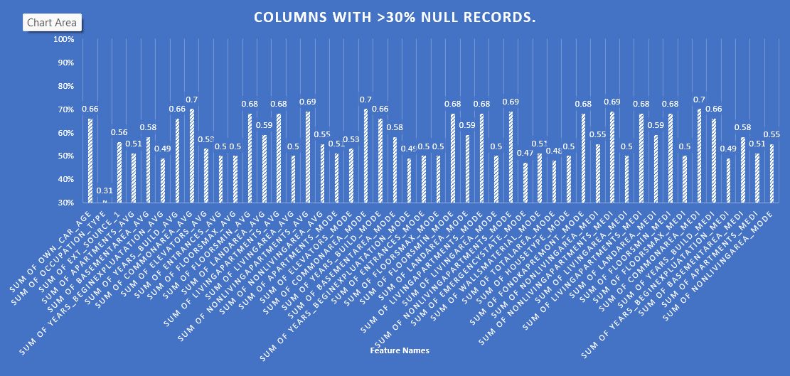
Insights-Data Cleaning

Slide 10
Insights-The Outliers
The outliers in the dataset were identified by analyzing numerical variables, specifically by comparing the TARGET feature with other numerical columns that provide insights into the distribution of defaulters and conformists. The following features were used to detect the outliers:
CNT_OF_CHILDREN
AMT_OF_INCOME
AMT_CREDIT
DAYS_EMPLOYED_IN_YEARS

Slide 11
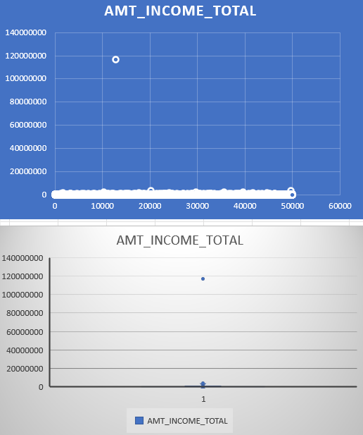
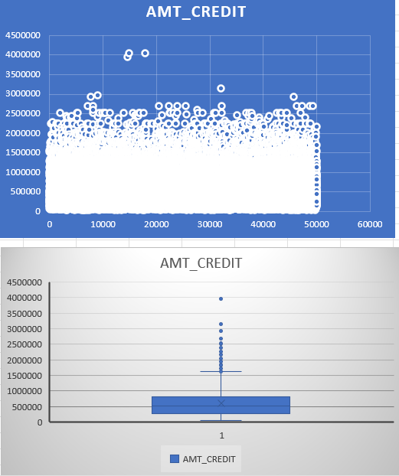
Insights-The Outliers

Slide 12
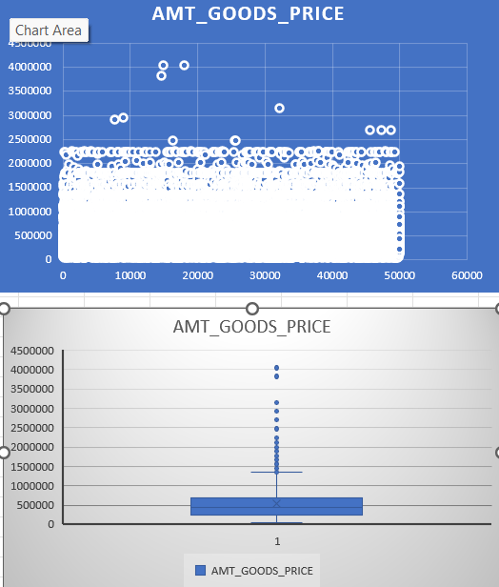
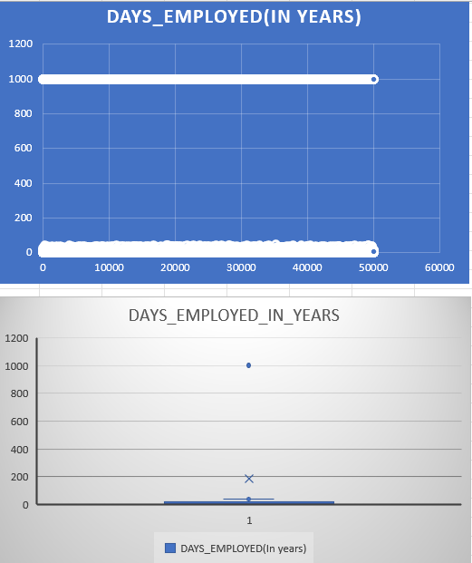
Insights-The Outliers

Slide 13
Insights-Data imbalance
• Data imbalance can affect the accuracy of the analysis, hugely. • In the given dataset the TARGET feature was the choice for calculating the Data imbalance since this feature actually identifies the basic information on customers(0 for customers who are not defaulters in payment and 1 for the customers who were defaulters in payment) • A pivot table of the TARGET feature was created and then the counts of both the values(0 and 1) were calculated followed by the Pie-chart. • Out of 49999 values, only 4026 values are 1 and others are 0.

Slide 14
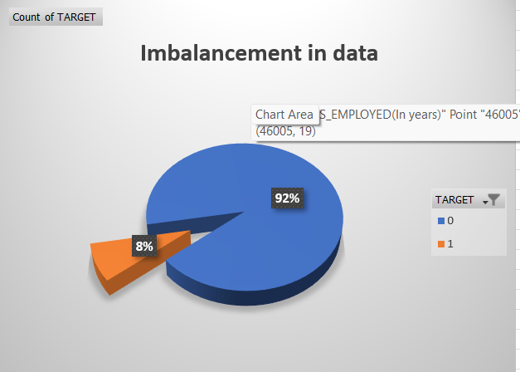
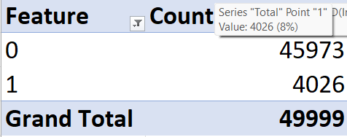

Slide 15
Insights-Univariate and Segmented Analysis
To understand the key factors contributing to loan defaults, I performed various analyses on both consumer and loan attributes.
I conducted univariate analysis on the target variable to examine the distributions of individual features.
Segmentation techniques were applied to compare the distributions of variables across different scenarios.
The findings were visually presented using informative column charts and line charts.
The univariate and segmented analyses were carried out on the following features:
Age (binned) and segmented age (percentage count of targets)
Years employed and segmented years employed
Gender code and segmented count of gender
Name type suite and segmented name type suite
Education type and segmented education type
Occupation type and segmented occupation type

Slide 16
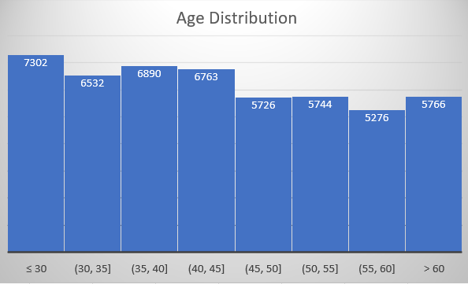
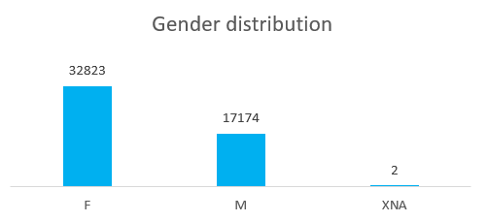
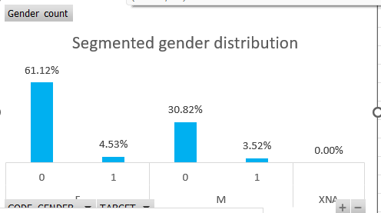
Insights-Univariate and Segmented Analysis

Slide 17
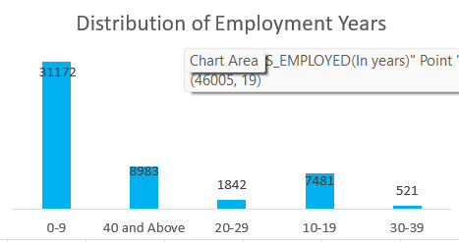
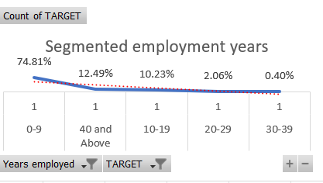
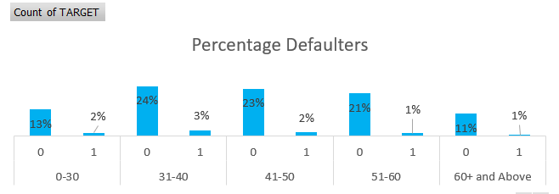
Insights-Univariate and Segmented Analysis

Slide 18
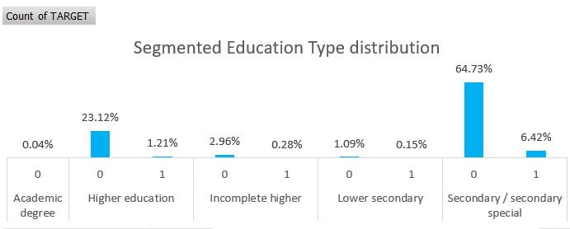
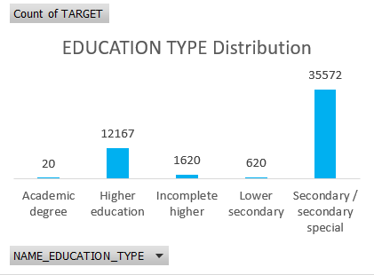
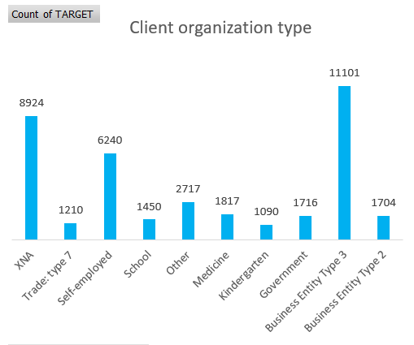
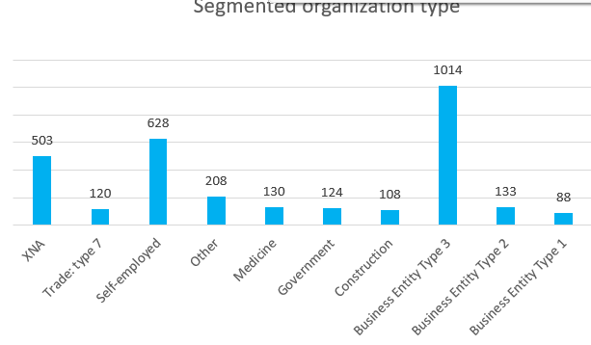
Insights-Univariate and Segmented Analysis

Slide 19
Insights-The correlations
Understanding the correlation between variables and the target variable is essential for identifying key predictors of loan default. In this project:
I segmented the dataset to identify the top correlations between various variables and the target variable.
I calculated correlation coefficients using Excel functions.
I highlighted the top 10 correlations through correlation matrices.
The correlation analysis was performed on the following features:
YEARS_OF_EXPERIENCE and FLAG_EMP_PHONE
OBS_30_CNT_SOCIAL_CIRCLE and OBS_60_CNT_SOCIAL_CIRCLE
AMT_CREDIT and AMT_GOODS_PRICE
REGION_RATING_CLIENT and REGION_RATING_CLIENT_WITH_CITY
CNT_CHILDREN and CNT_FAMILY_MEMBERS
REG_REGION_NOT_WORK_REGION and LIVE_REGION_NOT_WORK_REGION
DEF_30_CNT_SOCIAL_CIRCLE and DEF_60_CNT_SOCIAL_CIRCLE
REG_CITY_NOT_WORK_CITY and LIVE_CITY_NOT_WORK_CITY
AMT_ANNUITY and AMT_GOODS_PRICE
AMT_CREDIT and AMT_ANNUITY

Slide 20
KEY FINDINGS
During the data cleaning process, 48 columns with more than 30% missing values were removed, and the missing values were filled using the median.
Outliers were identified in income, children, and credit amount, particularly among clients facing payment difficulties (TARGET = 1).
The dataset was highly imbalanced, with only 8% of clients experiencing payment difficulties.
The analysis revealed that the bank tends to favor senior clients (ages 31-40) for loans, with fewer defaulters in the 60+ age group.
Newly employed clients had higher default rates, indicating a potential risk.
Default rates were slightly higher for females compared to males, but when compared to the total number of loans, females accounted for a smaller portion.
Clients with secondary education represented the largest group of loan applicants.
Business Entity Type 3 had the highest number of loan applicants, while Type 1 exhibited the lowest default rate.
Strong correlations between several features were observed, providing valuable insights for risk assessment and decision-making.

Slide 21
Conclusions
During the data cleaning process, 48 columns with more than 30% missing values were removed, and the missing values were filled using the median.
Outliers were identified in income, children, and credit amount, particularly among clients facing payment difficulties (TARGET = 1).
The dataset was highly imbalanced, with only 8% of clients experiencing payment difficulties.
The analysis revealed that the bank tends to favor senior clients (ages 31-40) for loans, with fewer defaulters in the 60+ age group.
Newly employed clients had higher default rates, indicating a potential risk.
Default rates were slightly higher for females compared to males, but when compared to the total number of loans, females accounted for a smaller portion.
Clients with secondary education represented the largest group of loan applicants.
Business Entity Type 3 had the highest number of loan applicants, while Type 1 exhibited the lowest default rate.
Strong correlations between several features were observed, providing valuable insights for risk assessment and decision-making.

Slide 22
Achievements
This project, being a statistical and data analysis-focused endeavor, has provided me with valuable learning experiences in various areas:
Thorough Analysis: I began by exploring the loan data to gain insights into default patterns.
Effective Data Handling: I learned how to manage missing values and handle outliers effectively.
Balanced Analysis: I became familiar with methods for addressing data imbalance in classification tasks.
Strong Correlations: I gained experience in identifying key indicators for defaults by analyzing correlations.
Impactful Visualization: I improved my ability to create clear and informative charts, especially for complex calculations.
Tech Expertise: I enhanced my proficiency in tools like Excel, PowerPoint, and Power BI.
Business Optimization: I developed a deeper understanding of how to work with and analyze real-world complex data to drive business improvements.

Slide 23

Thank You

