Slide 1
Inventory management system
Presented By-
Abhishek Bhandari
Anurag Choudhary
Nitish Kumar Patel

Slide 2
mODULE
Manage Stock
Update Product Quantity In Stock
View Stock
Sale
Insert Product Sale Details
Update Product Sale
View Product Sale Details
Manage Product
Add New Product
View All Product
Remove Product
View Profit Details
Exit

Slide 3
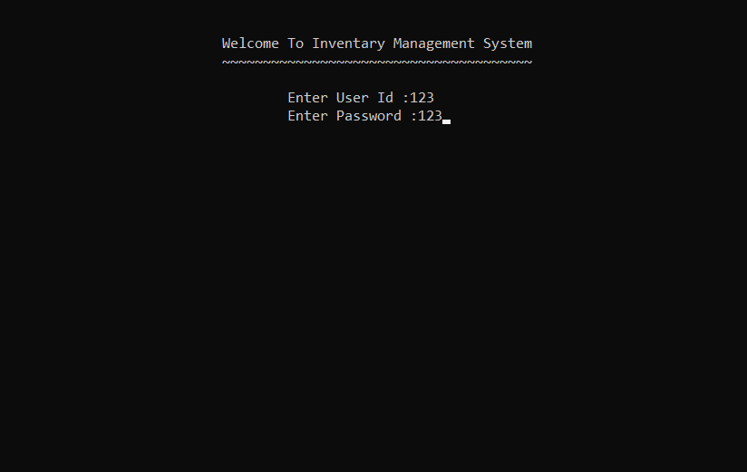
Login page

Slide 4
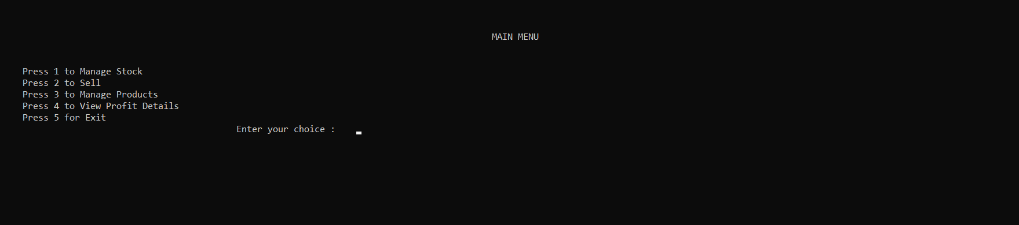
HOME SCREEN

Slide 5
Manage Stock
1. Update Product Quantity In Stock
2.View Stock

Slide 6
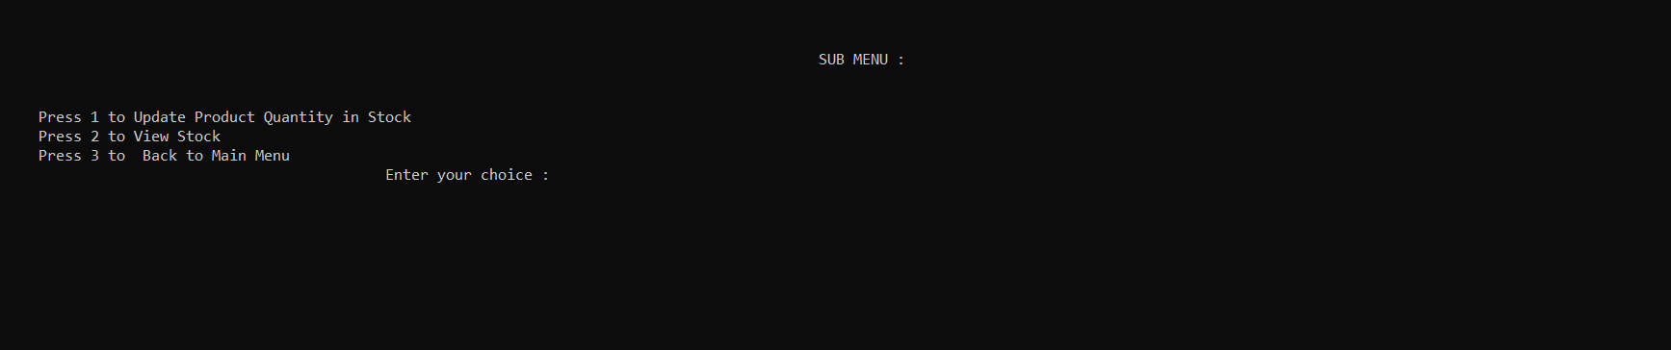
Manage Stock

Slide 7
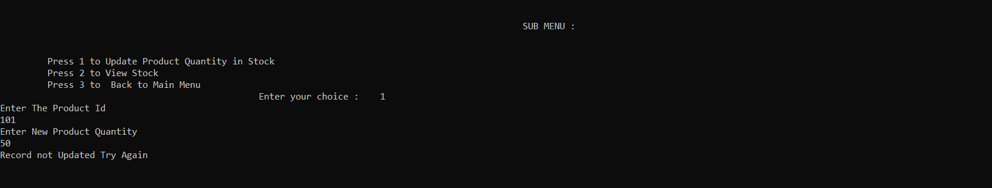
Update Product Quantity In Stock

Slide 8
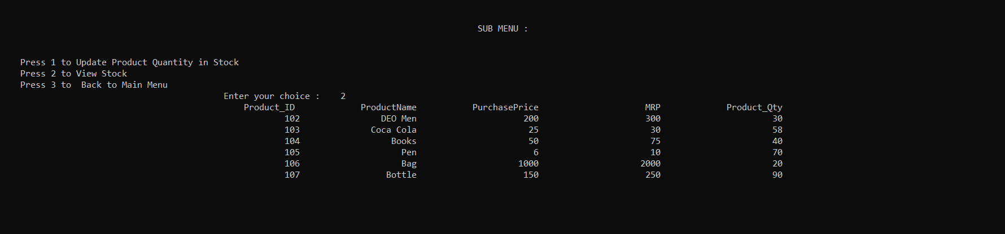
View Stock

Slide 9
sale
1. Insert Product Details
2. Update Product Details
3. View Product Details

Slide 10
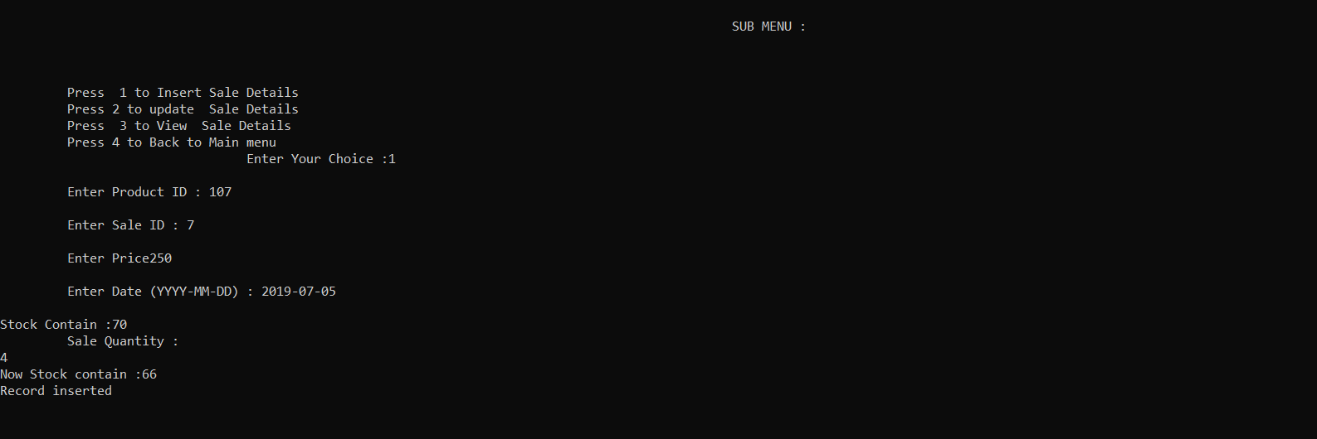
Insert Product Details

Slide 11
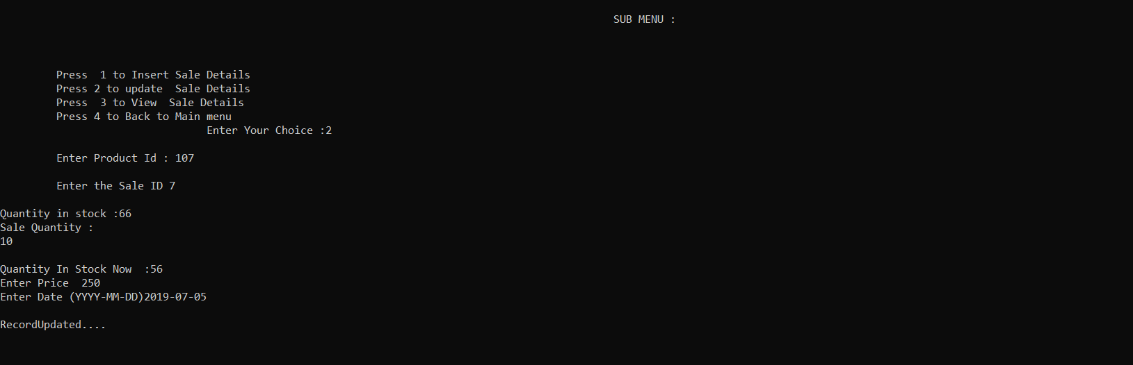
Update Product Details

Slide 12
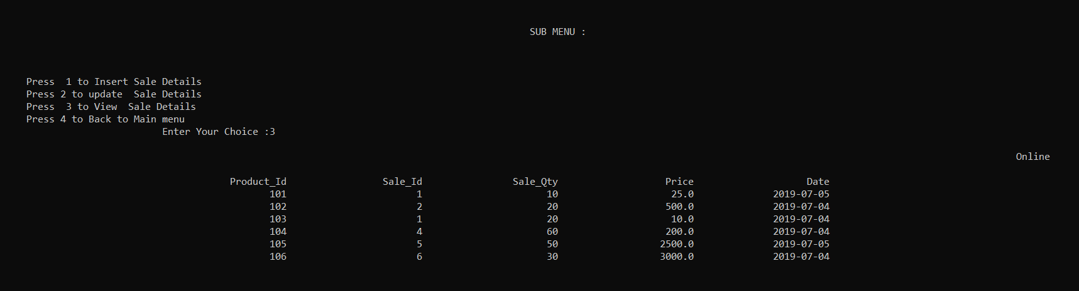
View Product Details

Slide 13
Manage Product
1.Add New Product
2.View All Product
3.Remove Product

Slide 14
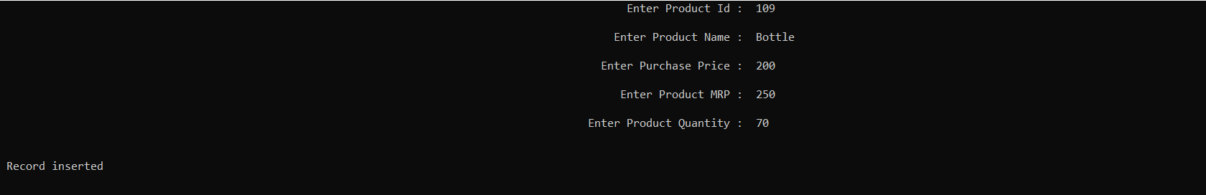
Add New Product

Slide 15
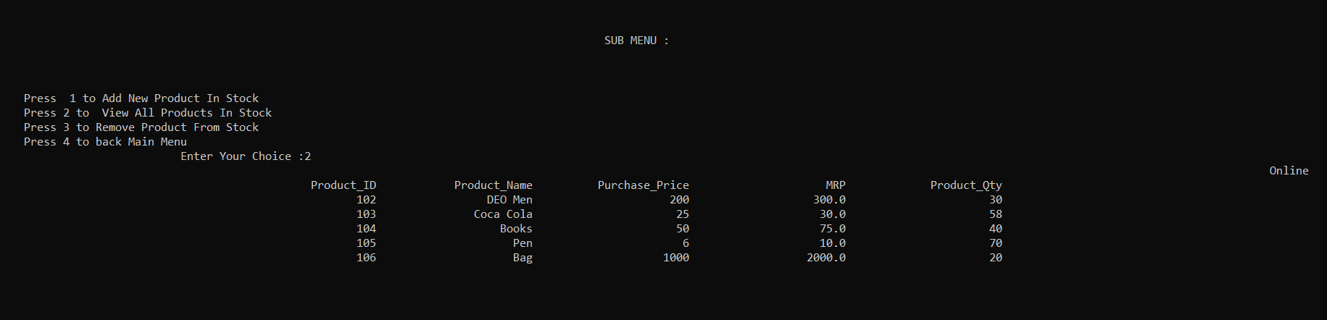
View All Product

Slide 16
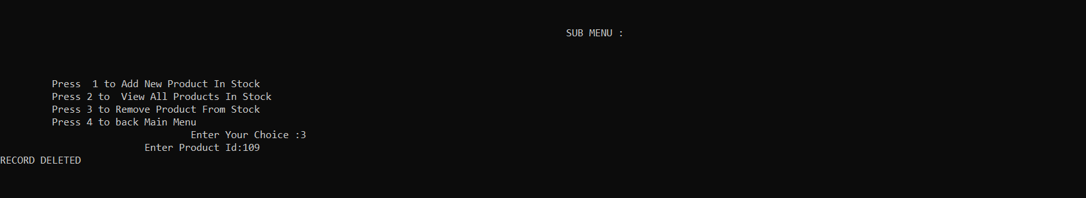
Remove Product

Slide 17
View Profit details
1. Day-Wise Profit Loss Statement

Slide 18
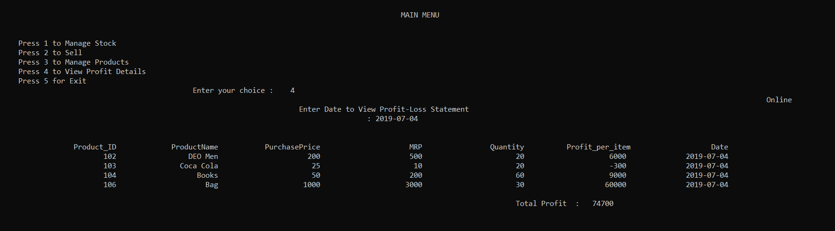
Day-Wise Profit Loss Statement

Slide 19
Thank You

