Slide 1
WELCOME
RABI – 2008-09
NEW DELHI 24th & 25th
September 2008
Presentation by
Department of Agriculture
Government of Kerala

Slide 2
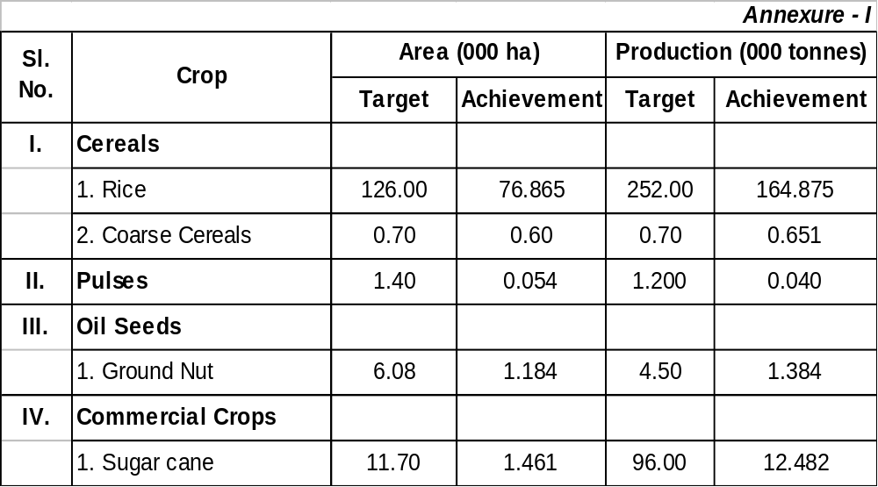
Targets and Achievements Kharif 2007-08

Slide 3
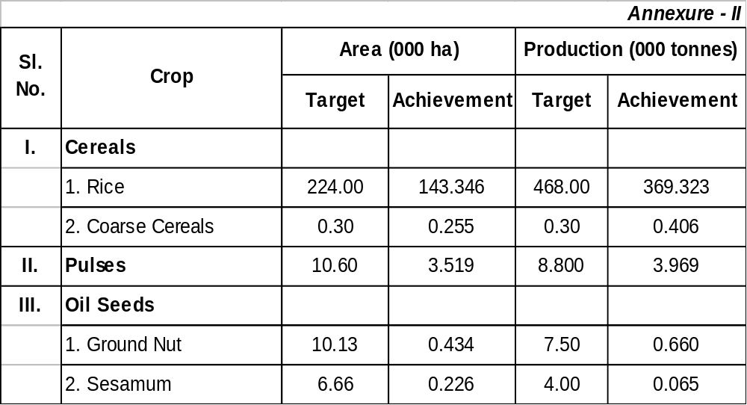
Targets and Achievements for Rabi/Summer 2007-08

Slide 4
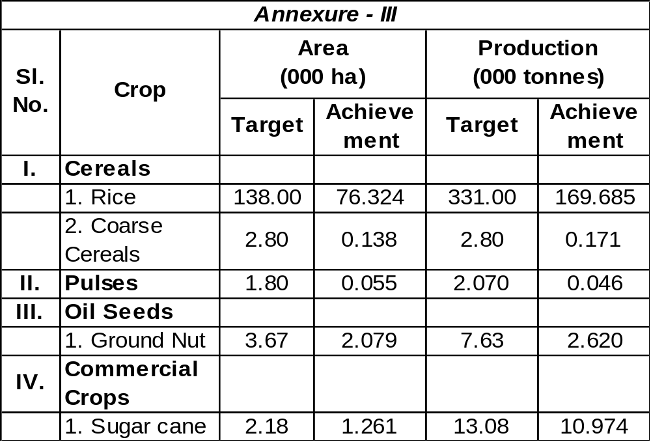
Targets and likely achievements for Kharif - 2008

Slide 5
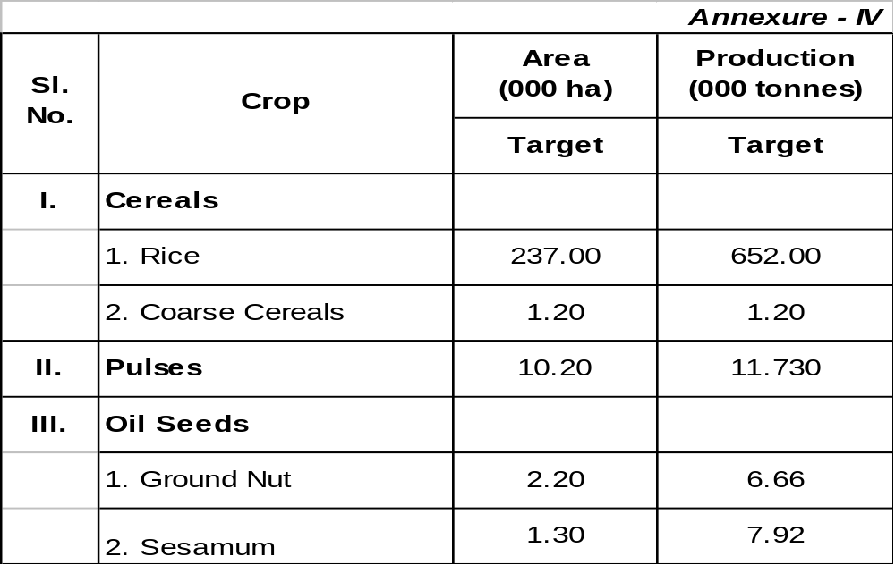
Targets of Area and Production for Rabi 2008-09

Slide 6
National Food Security Mission - Kerala

Slide 7
Activities Undertaken
Palakkad
Sanctioned amount – Rs.188.85 lakhs
Amount received – Rs.151.80 lakhs
Monitoring and Evaluation Committees formed
District level executive committee convened and formulated action plan for implementation
Area proposed to be covered for Rabi season – 18750 ha
The programme will be implemented on padasekharam basis following participatory group approach
Cont….

Slide 8
90 padasekharams selected to be developed as model padashekharams
Convergence of schemes proposed
Participatory approach: padashekharam samithies, technical officials, research organizations, LSGI’s
2400 minikits distributed by NSC
Krishi Bhavans as the nodal point and facilitator
To be implemented during the coming season

Slide 9
Constraints perceived for the implementation of National Food Security Mission
Variation in assistance under different schemes
No specific allocation for logistic support
Rigidity of components
Assistance for mechanization: not attractive
Assistance for providing seeds

Slide 10
State Food Security Project
State Food Security Project: rice, milk, eggs, tubers, and pulses.
Rice sanctuaries identified
Legislation to ban conversion of paddy land for other purposes
Raising supplementary crops like pulses, sesamum, vegetables, tubers, groundnut in paddy fields.
Establishment of small processing & marketing units .
Interest subsidy for loans of paddy farmers in selected districts achieving higher yields.
Strengthening production of seeds &planting materials
State Paddy Development Board

Slide 11
Rashtriya Krishi Vikas Yojana
Amount sanctioned (2007-08)- Rs.6000.00 lakhs
Amount released (2007-08) - Rs.5500.55 lakhs
Projects cover Crop husbandry, Animal Husbandry, Fisheries, Dairy development, Sericulture, Farm mechanization

Slide 12
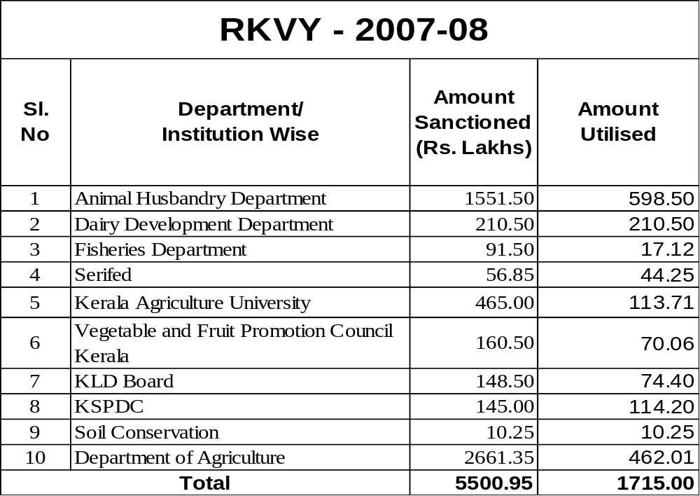

Slide 13
RKVY - 2008-09
Total amount allocated– Rs.60.11 crores
Vetting of programmes by DPC - 30th of September
SLSC to be convened in October 2008

Slide 14
Extension
Krishi Bhavans (1068) as the focal point
Agro clinics constituted
Group farming activities & Group approach, pre-season initiatives
Transfer of technology
Farmers trainings
Awards to outstanding farmers
Farm Information Bureau

Slide 15
Agriculture Technology
Management Agency
(ATMA)

Slide 16
Profile of activities during 2007-08
IDWG, ATMA, FIAC, BTT, FIGs, SAMETI
14 ATMA districts sanctioned and registered
4 IDWG meetings held
42 ATMA Governing board as well as Management Committee meetings
150 FIACs formed
456 BTT meetings held
1200 FIGs formed
Calendar of Regional Fairs

Slide 17
Profile of activities during 2007-08 (cont….)
Conducted state level Agriculture Fair at Kochi during February 2008
Three Regional fairs planned
    At Kollam (Conducted during August 2008)
    At Thrissur (October 2008)
    At Kozhikkod (November 2008)

Slide 18
ATMA financial details as on August 2008
Amount received from GOI –
2005-06 - Rs.80.00 lakhs
2006-07 - Rs.119.00 lakhs
2007-08 - Rs.125.00 lakhs
State share - Rs.22.11 lakhs
Total - Rs.346.11 lakhs
Expenditure details
District ATMAs - Rs.80.19 lakhs
SAMETI - Rs.10.50 lakhs
State level activities - Rs.14.06 lakhs
Total - Rs.104.74 lakhs

Slide 19
Programmes proposed for 2008-09 under ATMA
Amount earmarked by GOI –Rs.821 lakhs
SREP preparation completed.
SEWP preparation in progress
Beneficiary identification: process started
Implementation of approved cafeteria is in progress to utilize the unspent balance of 2007-08.

Slide 20
Activities of SAMETI Kerala
SAMETI registered under Travancore Cochin Literary Scientific and Charitable Society Act
Technical Support Group(TSG) formed

Slide 21
Expenditure details of SAMETI
Total amount received - Rs.23.6 lakhs (ATMA) (2007-08)
Amount received from other agencies - Rs.16.93 lakhs (2007-08)
Expenditure incurred as on August - Rs.10.49916 lakhs (ATMA)
(2007-08)
Expenditure other than ATMA - Rs.7.72 lakhs (State scheme,
PGDAEM, GOI schemes etc.)

Slide 22
Programmes proposed for 2008-09 for SAMETI
Training calendar for 2008-09 approved
Training programme includes
Farm Business Management
Weather Forecasting Services
Horticultural Extension Management
PGDAEM Course
Orientation training programmes on ATMA
Micro entrepreneurial programmes in Agriculture etc.
Rs. 100 lakhs earmarked for a centralized training center under SAMETI

Slide 23
Seeds
Seed availability – Rabi 2008-09
Breeder seed from KAU
Foundation seed: in departmental farms
Certified seed : under RSGP
Quality or truthfully labelled seed (farmer to farmer exchange)
Procurement-State Seed Development Authority.
Seed testing facilities - 3 labs
Seed distribution through Krishibhavans
Certified seed requirement for Rabi 2008-09 – 40266 qtls
Certified seed available with Department of Agriculture for Rabi 2008-09 – 21471 qtls
Balance of 18795 qtls: from NSC/other Government approved agencies.

Slide 24
Seed Treatment and Testing
Seed treated with carbendazim only to be distributed
During Kharif 2008 – 30420 ha of paddy area was sown using treated seeds (2425 mt) : 39% of the total area.
3 Seed testing labs
    Samples analyzed for 2008-09 – 1149 (up to 8/2008)

Slide 25
State Horticulture Mission
Expenditure incurred
2005-06
2006-07 Rs.136.24 crores
2007-08
Allocation for 2008-09
GOI Share – Rs.148.07 Crores
GOK Share – Rs.26.13 crores
Total –Rs.174.20 crores

Slide 26
Marketing
6 Agrl. whole sale markets
Procurement of green coconuts @Rs.11/kg.
Minimum Support price of milling copra - Rs.3660/Quintal and that of ball copra - Rs.3910/Quintal for 2008 season.
Procurement of paddy @Rs.10/kg
Proposal to enhance procurement rate @Rs.11/- per kg
Proposal to increase MSP for copra and green coconut
Support for rural infrastructural market development by DMI

Slide 27
Fertilizers
Requirement in Rabi 2008-09
In terms of materials |  | (in MT)
UREA | - | 73500
AMSO4 | - | 500
SSP | - | 300
MOP | - | 63000
DAP | - | 10500
FACTOMFOS | - | 62500
10:26:26 15:15:15 | - | 4000 500
ROCKPHOS | - | 15000
Total | - | 163300
In Terms of Nutrients
N | - | 50175
P | - | 22593
Total | - | 111683

Slide 28
Fertilizer Testing
  Fertilizer Quality Control Laboratories – 2
    Annual analyzing capacity of fertilizers: 5000
    Fertilizer samples analyzed for 2008-09:1720
    Annual analyzing capacity of organic manure: 1000
    Organic manure samples analyzed for 2008-09: 127

Slide 29
Integrated Nutrient Management
INM promoted on padasekharam basis for rice cultivation.
Supply of adequate quantity of green manure seeds
Assistance for establishment of vermi compost units

Slide 30
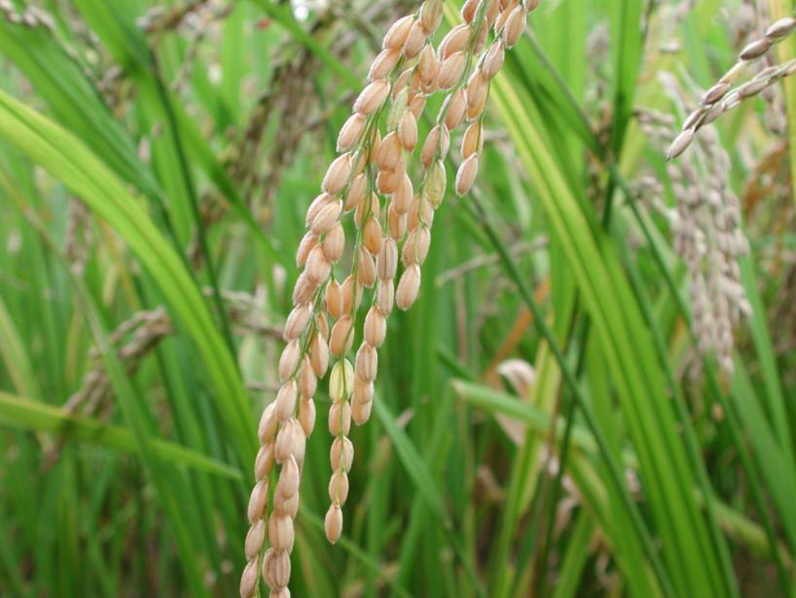
THANK YOU

