Slide 1

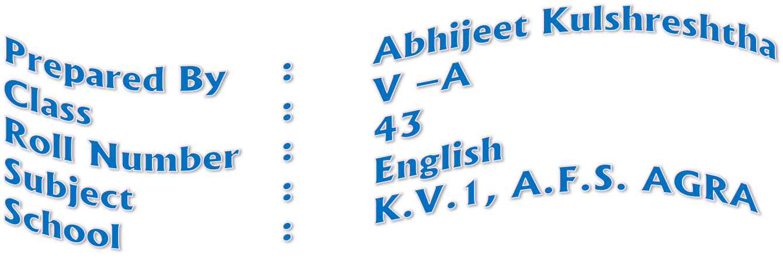

Slide 2

The culture of Kerala is a synthesis of Dravidian and Aryan cultures, developed and mixed for centuries, under influences from other parts of India and abroad. It is defined by its antiquity and the organic continuity sustained by the Malayali people. Modern Kerala society took shape owing to migrations from different parts of India through out Classical Antiquity. Kerala trace its non-prehistoric cultural genesis to its membership (around the 3rd century CE) in a vaguely-defined historical region known as Thamizhagom — a land defined by a common Tamil culture and encompassing the Chera, Chola, and Pandya kingdoms. At that time, the music, dance, language (first Dravida Bhasha — "Dravidian language"— then Tamil), and Sangan (a vast corpus of Tamil literature composed between1,500–2,000 years ago) found in Kerala were all similar to that found in the rest of Thamizhagom (today's Tamil Nadu).

Slide 3
The culture of Kerala evolved through the Sanskritization of Dravidian ethos, revivalism of religious movements and reform movements against caste discrimination. Kerala showcases a culture unique to itself developed through accommodation, acculturation and assimilation of various faculties of civilized lifestyle

Slide 4

Sanskrit drama or theatre and a UNESCO-designated Human Heritage Art. Kathakali (from katha ("story") and kali ("performance")) is a 500-year-old form ofdance-drama that interprets ancient epics; a popularized offshoot of kathakali is Kerala natanam (developed in the 20th century by dancer Guru Gopinath). Meanwhile, koothu is a more light-hearted performance mode, akin to modernstand-up comedy; an ancient art originally confined to temple sanctuaries, it was later popularized by Mani Madhava Chakyar. Other Keralite performing arts include mohiniyaattam,("dance of the enchantress"), which is a type of graceful choreographed dance performed by women and accompanied by musical vocalizations. Padayani, and theyyam are other important Keralite arts.
Kerala also has several tribal and folk art forms.For example, Kummattikali is the famous colorful mask-dance of South Malabar, performed during the festival of Onam. The Kannyar Kali dances (also known as Desathukali) are fast moving, militant dances attuned to rhythmic devotional folk songs and asuravadyas. Also important are various performance genres that are Islam- or Christianity-themed. These include oppana, which is widely popular among Keralite Muslims and is native to Malabar. Oppana incorporates group dance accompanied by the beat of rhythmic hand clapping and ishal vocalizations.

Slide 5
Margam Kali is one of the ancient round group dance of Kerala practiced by Saint Thomas Christians.
However, many of these native art forms largely play to tourists or at youth festivals, and are not as popular among ordinary Keralites. Thus, more contemporary forms — including those heavily based on the use of often risqué and politically incorrect mimicry and parody — have gained considerable mass appeal in recent years. Indeed, contemporary artists often use such modes to mock socioeconomic elites. In recent decades, Malayalam cinema, yet another mode of widely popular artistic expression, have provided a distinct and indigenous Keralite alternative to both Bollywood and Hollywood.

Slide 6

The ragas and talas of lyrical and devotional carnatic music — another native product of South India — dominates Keralite classical musical genres. Swathi Thirunal Rama Varma, a 19th-century king of Travancore and patron and composer of music, was instrumental in popularising carnatic music in early Kerala. Additionally, Kerala has its own native music system, sopanam, which is a lugubrious and step-by-step rendition of raga-based songs. It is sopanam, for example, that provides the background music used in kathakali.

Slide 7
The wider traditional music of Kerala also includes melam (including the paandi and panchari variants), as style of percussive music performed at temple-centered festivals using an instrument known as the chenda. Up to 150 musicians may comprise the ensembles staging a given performance; each performance, in turn, may last up to four hours. Panchavadyam is a differing type of percussion ensemble consisting of five types of percussion instruments; these can be utilised by up to one hundred artists in certain major festivals. In addition to these, percussive music is also associated with various uniquely Keralite folk arts forms. Lastly, the popular music of Kerala — as in the rest of India — is dominated by the filmi music of Indian cinema.

Slide 8
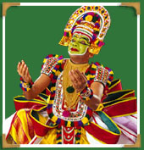
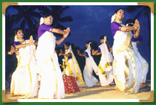

Slide 9

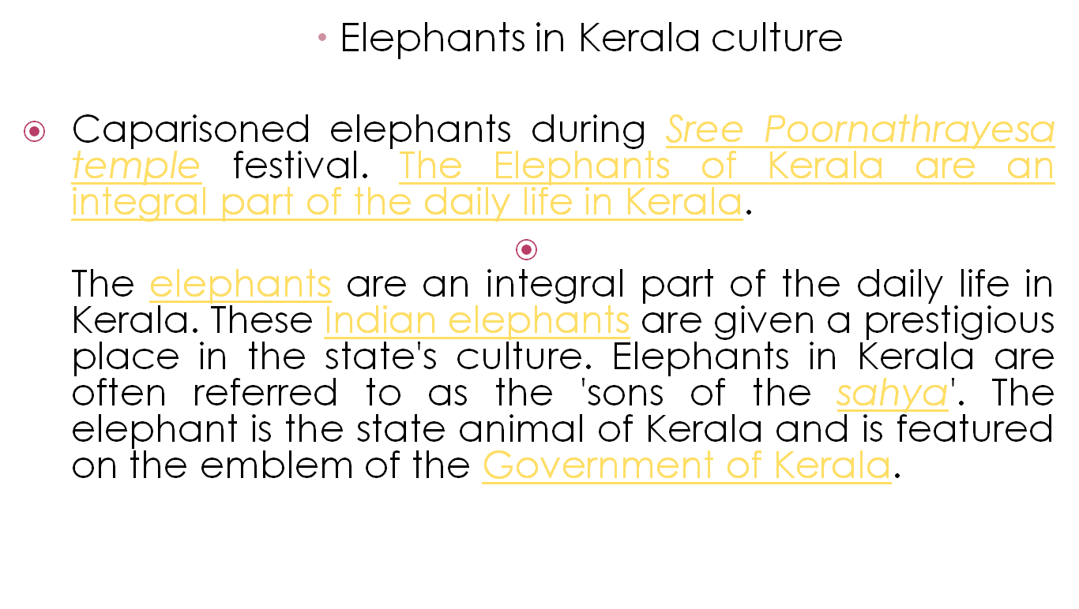

Slide 10
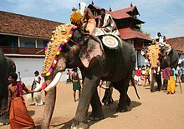

Slide 11


