Slide 1

Email
Most organizations today rely on email campaigns for effective communication with users. Email communication is one of the popular ways to pitch products to users and build trustworthy relationships with them.¶

Slide 2
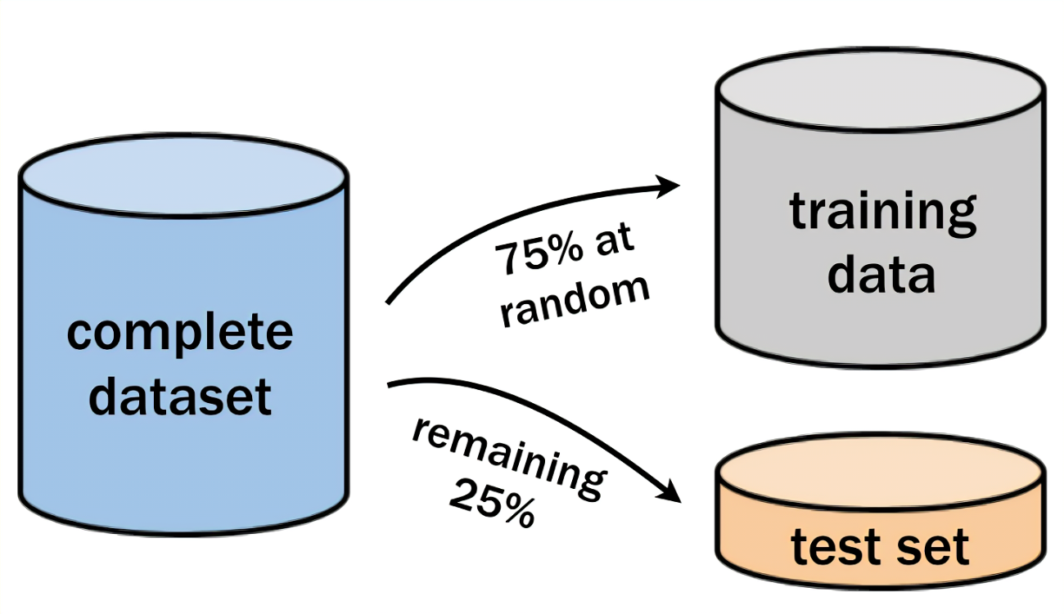
Test, Train, Sample submission data_set
Combined “Sample submission”
Merge all the data and give a name Email.

Slide 3
Shape function
It contains 2650 rows and 43 columns.
It is the data of three files.

Slide 4
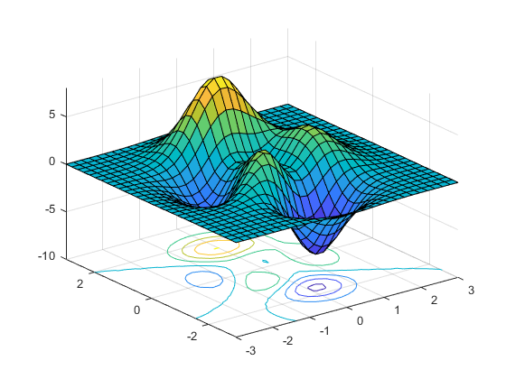
EDA (Exploratory Data Analysis)
In EDA, I have cleaned my data.
It contained lots of Nan and missing data.
I have removed some unwanted columns which contain 71% missing data.
After that I removed blank rows that do not contain values with the help of “Pair_plot”.

Slide 5

Exploring Features of Data
In this I have analyzed some columns like weekday, personalized, weekend, and timer.
Personalized email, discounted email, and price contain email got less CTA.
But with this I came to the conclusion part which is that the CTA (Click To Action) of people is very less.

Slide 6
Skewness
In all the columns I have observed all the data skewed.
The reason for skewed data is “Outliers”
No data is normally distributed

Slide 7
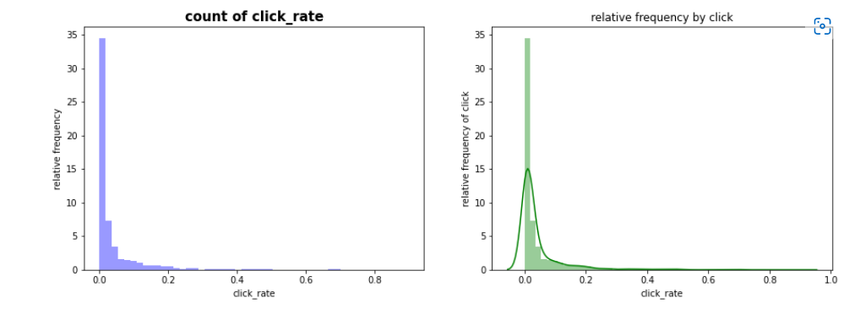
Target Variable
click rate from 0 to 0.2 and 0.2 to 0.8.
click rate of 0 is very high.
on 0.1 and 0.2 people have clicked but the relative frequency is very less
“we need to focus on the exact demand of the people. we need to target the exact customer"

Slide 8
Correlation Part
(i) Pearson (ii) Spearman

Slide 9
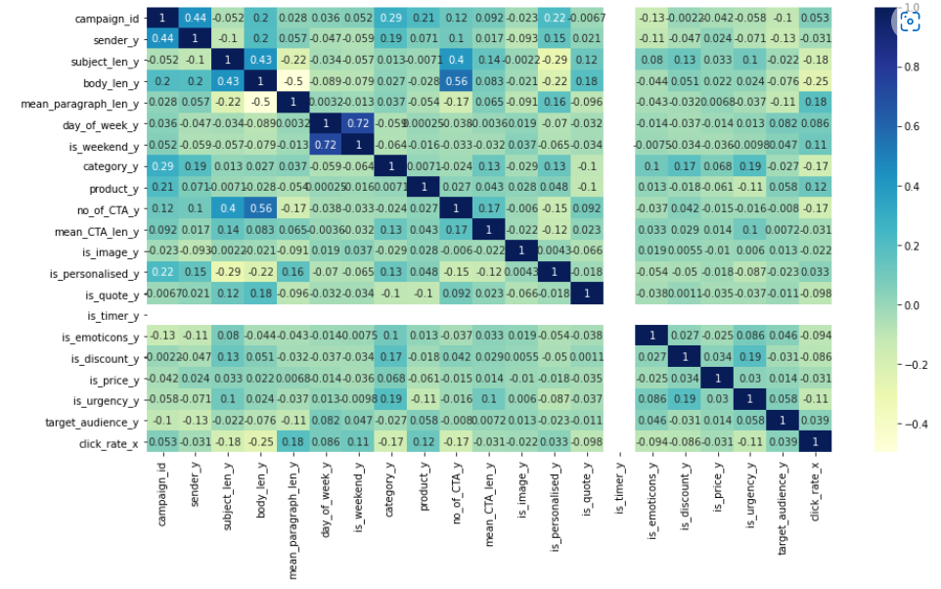
Pearson Correlation

Slide 10
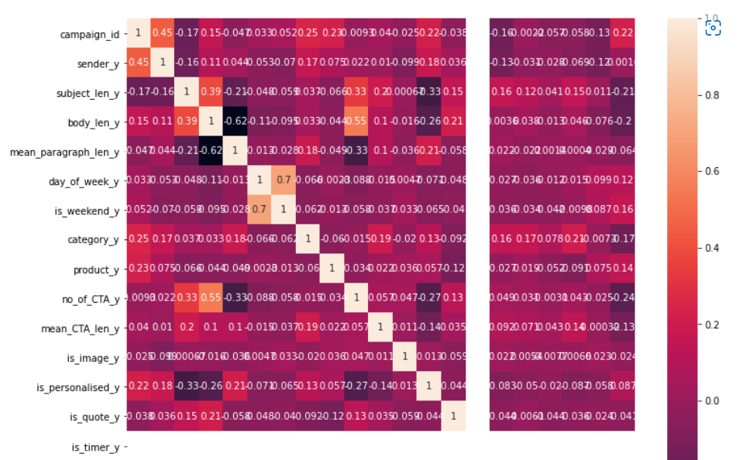
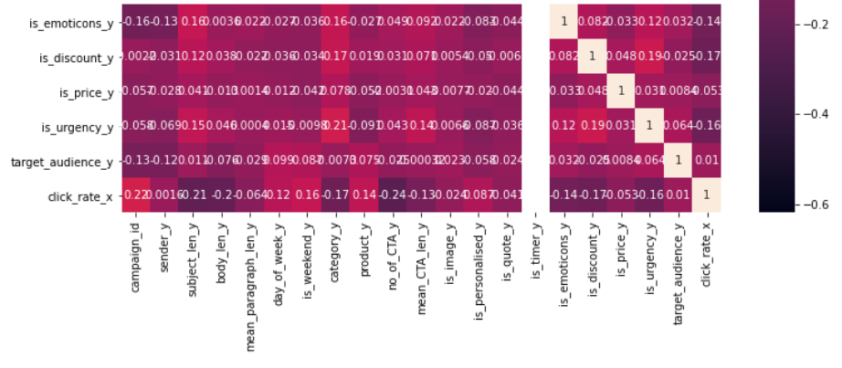
Spearman Correlation

Slide 11
Analysis Part
After that I have done some analysis part on some columns.

Slide 12
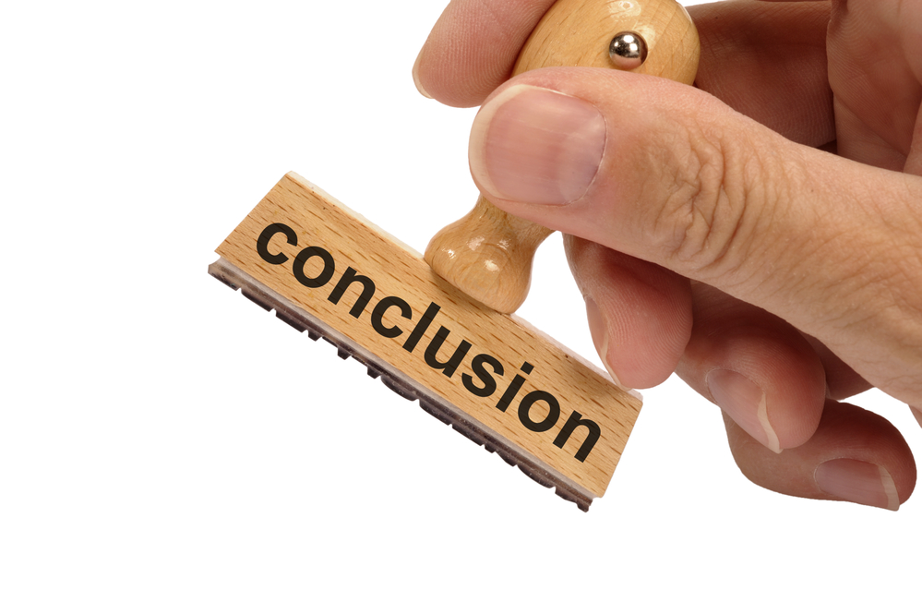
Conclusion
The conclusion is that no. of CTA is very less.
The personalized, target, click-to-action on email was less.
We need to target the exact customer.
People are interested in price and discounted email but the click rate is less. So, need to focus on that what exactly the customer wants.

Slide 13


