Slide 1

Bank plays a vital role in this era, in this we invest, save, or deposit some amount of money and do transaction also.

Slide 2
BANK MARKETING DATA SET.
Test Data Set
Train Data Set

Slide 3
This Dataset is based on the "Bank Marketing" UCI dataset http://archive.ics.uci.edu/ml/datasets/Bank+Marketing It contains information about the marketing campaign impact of a bank specifically through telemarketing. It includes 20 independent variables of which 5 are the nationwide socio-economic factors pertaining to the bank's operating country. The attributes are as follows;

Slide 4
INTRODUCTION :-
Input variables:
Age | The age of the person.
Jobs | “Admin”, “blue-collar”, “entrepreneur”, “housemaid”, “management”, “retired”, “self-employed”, “services”, “student”, “technician”, “unemployed”, “unknown”.
marital status | "divorced", "married", "single", "unknown", note: "divorced" means divorced or widowed)
education | "high-school", "illiterate", "professional-course", "university-degree", "unknown")
default | Simply, default means non-payment of a loan availed by a borrower. A willful defaulter is an entity or a person that has not paid the loan back despite the ability to repay it. ( "no","yes","unknown")
housing | Does the customer have a housing loan? ("no","yes","unknown")
loan | Does the customer have a personal loan? "no","yes","unknown")

Slide 5
Related with the last contact of the current campaign:
Contact | communication type ("cellular","telephone")
Month | last contact month of year ("jan", "feb", "mar", ..., "nov", "dec“)
day_of_week | last contact day of the week ("mon","tue","wed","thu","fri")
Duration | last contact duration, in seconds. Important note: this attribute highly affects the output target (e.g., if duration=0 then y="no"). Yet, the duration is not known before a call is performed. Also, after the end of the call ‘y’ is obviously known. Thus, this input should only be included for benchmark purposes and should be discarded if the intention is to have a realistic predictive model.

Slide 6
Other attributes:
Campaign | Number of contacts performed during this campaign and for this client includes last contact
pdays | 14- number of days that passed by after the client was last contacted from a previous campaign (numeric, -1 means client was not previously contacted) 15 - previous: number of contacts performed before this campaign and for this client (numeric)
Previous | number of contacts performed before this campaign and for this client
poutcome | "failure", "nonexistent", "success")

Slide 7
Social and economic context attributes:
emp.var.rate | employment variation rate - quarterly indicator
cons.price.idx | consumer price index - monthly indicator
cons.conf.idx | consumer confidence index - monthly indicator
euribor3m | euribor 3 month rate - daily indicator
nr.employed | number of employees - quarterly indicator
Output variable:
Y (subscription) | has the client subscribed to a term deposit? ("yes","no")

Slide 8
Attributes analysis
Please combine the two datasets provided into a single data frame before starting the analysis.
Give a summary of the attributes involved and then carry on with the proper data analysis
Few guiding questions for the analysis;
Please show how the categorical variables are related to each other and also their distribution among the numerical variables
The socio-economic variables are a statistical indicator of the customer themselves based on various other factors, so it has a lot of information in it which should be used for analysis.
Depending on the analysis performed above see if you can divide the customers into specific groups with some common characteristics between them.
Try and find out which campaign was effective for which type/group of people and see if they have anything common among them
Do the same for the people who did not respond to a campaign well and see if they have anything in common with each other.

Slide 9
LIBRARIES
Numpy - NumPy is faster than python. It is like c-language.
Pandas - By this, we upload data and do the eda part.
Matplotlib - Matplotlib is the 2D library.
Missingno - By this, we can find statistics of missing values and patterns.
Seaborn - It is the next-level library of Matplotlib. By this, we can make 3D forms.

Slide 10
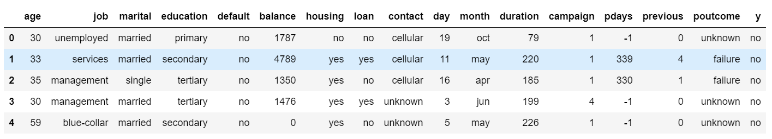
HEAD OF THE TABLE

Slide 11
EDA
Head
Tail
Shape
Null value
Unique value
Info function
Changed “unknown” values in Nan
Changing column Dtype
Summary
Statistics of missing value
Checking patterns of null values
Heat map (checking coorelation of null value)
Pair plot (checking numerical value)
Skewness
ML (Machine Learning)
Log transformation

Slide 12
show how the categorical variables are related to each other and also their distribution among the numerical variables?
Univariate analysis
Bivariate analysis
Multivariate analysis

Slide 13
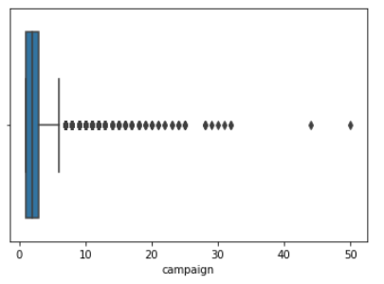
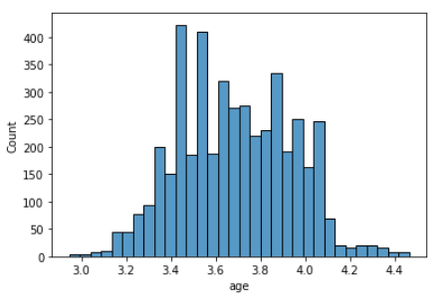
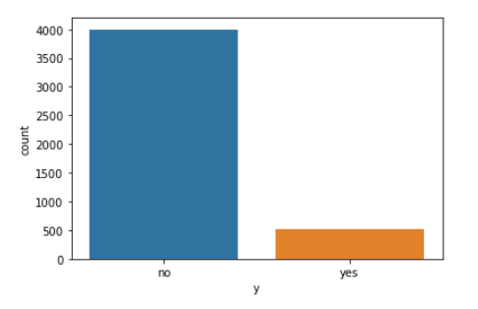
Univariate analysis
COUNT PLOT
here i am using count plot.
in this i have seen, there are lot's of people are not subscribing "deposit".
there are less people who is interested in subscription. i can say that people who is not subscribing is retired person, student, unemployed, etc.
BOX PLOT
here i am seeing number of contact performed during this campaign.
in this analysis there is lot's of outliers.
the maximum contact performed is 50.
HIST PLOT
i am doing analysis of age columns.
most of age group people are engage in 3.4 or 34 to 35.

Slide 14
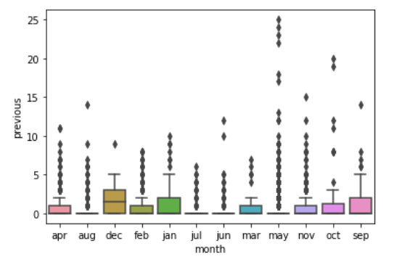
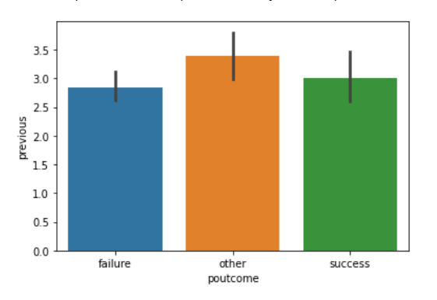
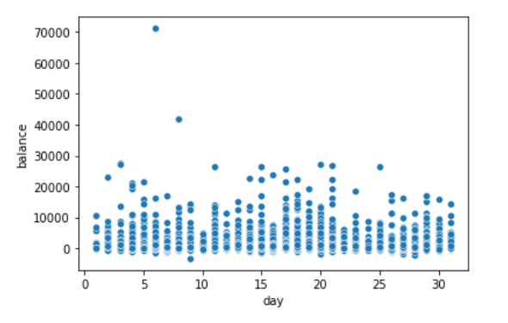
BIVARIATE analysis
BOX PLOT
here i am comparing month with previous.
previous means, number of contacts performed before this campaign.
in this i am judging the most previously contacted in month is "may". because "may" month have higher outliers.
BAR PLOT
here i am comparing poutcome with previous.
It means that most of the customers are new customers who have not been contacted earlier.
the most previous contacted is "other". and outliers is also high in this.
SCATTER PLOT
here I am analyzing the day with balance.
according to my understanding in every day in month balance is not reaching beyond to 30,000
The highest outliers is on 7th day.

Slide 15
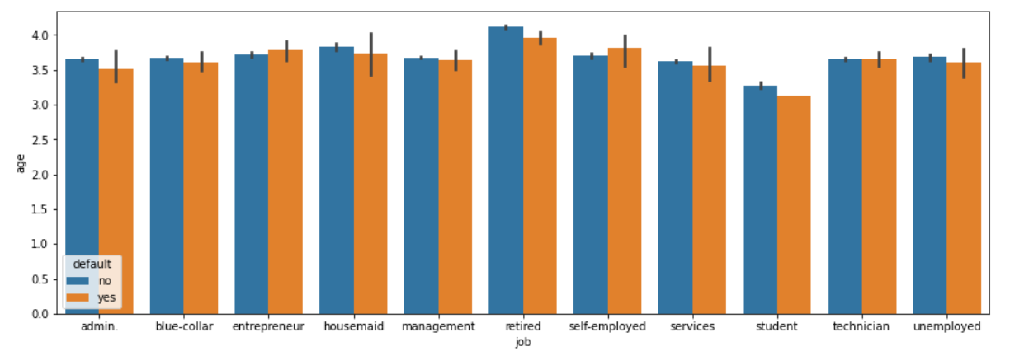
MULTIVARIATE analysis
BAR PLOT
here i am checking which age group people with job profile has default rate.
here default status of every category whether it is a retired person, student, self-employed. In this, I have seen everything is fine some are paying and some have high default rates. but the maximum default rate is for retired persons.

Slide 16
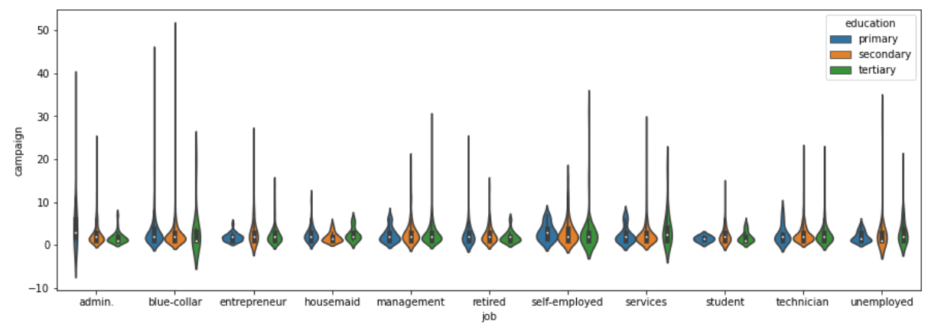
VIOLIN PLOT
here i am checking education level with job profile. campaign - it is a phone call (number of contact performed during this campaign.)
in the blue-collar job have the highest no. of outliers in the campaign. means, they have a secondary level of education and they are daily wagers. So, the bank did the most contact to the blue-collar job for the benefit of this category group and by the deposit, they can secure their future.
if i talk the lowest outliers then it is admin job profile have primary education. bank did less or never contact this job profile.

Slide 17
The socio-economic variables are a statistical indicator of the customer themselves based on various other factors, so it has a lot of information in it which should be used for analysis?
It is a kind of status, value, and education also.

Slide 18
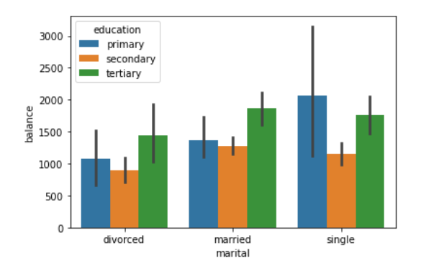
BAR PLOT
here i am checking marital status with balance and education.
Here is checking the marital status with education qualification and balance of every person. singles have the highest level of balance but education level is primary.

Slide 19
Try and find out which campaign was effective for which type/group of people and see if they have anything common among them?

Slide 20
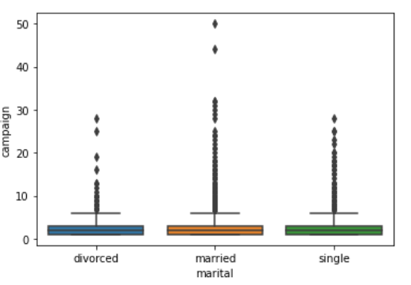
BOX PLOT
here i am comparing campaign with marital.
The married person has the highest outliers in the campaign. it means, the bank did most contact to married person for the subscription of deposit for the future safety and children also. And this category may also be interested in saving for future use.

Slide 21
Do the same for the people who did not respond to a campaign well and see if they have anything in common with each other?

Slide 22
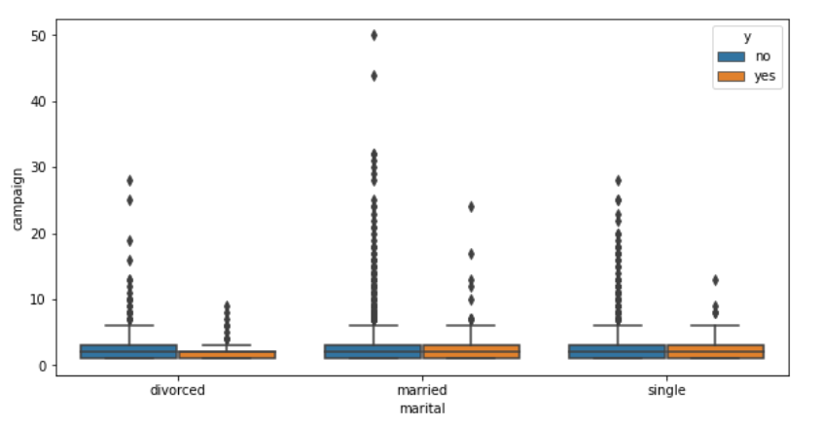
BOX PLOT
here i am comparing marital and campaign with y.
in this analysis, i have seen married people have high subscription rate.
but if I talk about in “no subsciption” then married people are on top also.
According to my understanding, the bank did contact all categories or groups of people. But married people are on top in the subscription deposit policy of banks as compared to others. Singles and divorced people are less interested in this subscription.

Slide 23
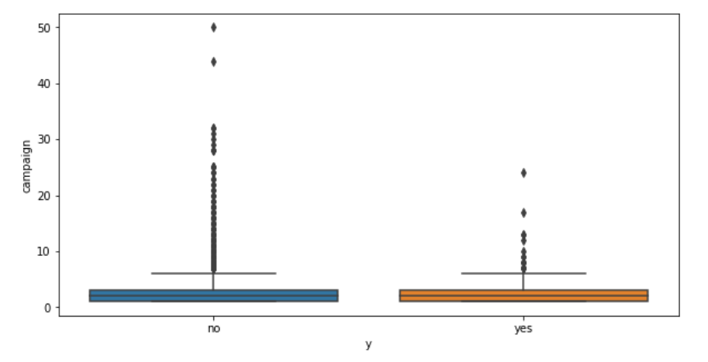
BOXPLOT
here i am comparing campaign with y(subscription).
here I can see the result, bank did a lot of contact to people. but the result is less. because in this so many categories fall under like the single, divorced, married, etc. everyone has a different type of understanding.

Slide 24

CONCLUSION
According to my understanding, in this analysis, I have seen the most last contact is a “blue-collar” job.
Bank tried to reach married people. Because married people are interested in savings for the future.
They tried to reach “blue-collar” job category because in this category people are labor, daily wagers, etc. So, according to me the spending level of this category is high. Without a deposit subscription, they can’t save more amount of money.

