Slide 1
Python project
Data Visualization
Sumer Pariani
Raghothama Rao pranesha
Abhishek Bhogal
Siddhesh Dhoot
Under the guidance of Prof. Rabih Neochi

Slide 2
Long-term Occupational Projection
For the state of California

Slide 3
Introduction
Dataset - Long Term Occupational Employment Projection
Projection for a period of 10 years from 2018-2028 and 2020-2030
More than 15,000 Rows and 17 columns
Categorical variables 8
Numerical variables 9

Slide 4
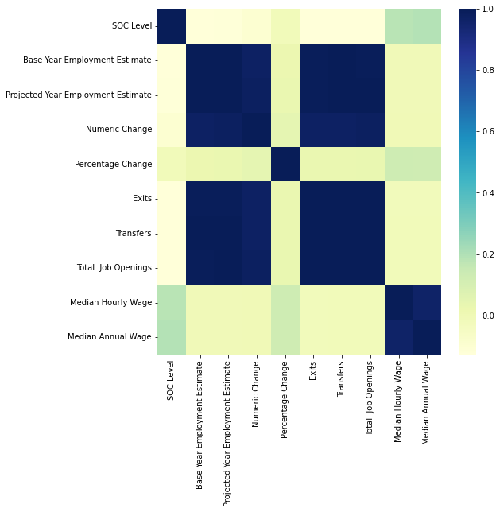
Heat map
A Heat map is to find dependency of one variable with other.
In our heat map we observe that median hourly wage and median annual wage columns have a high co relation with SOC level as we have used SOC level to fill the missing values in these two columns which were later used for visualizations.

Slide 5
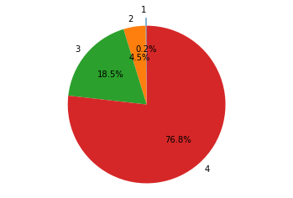
Pie chart
Count of SOC LEVELS in forecasted occupational data
In the next ten years, the job market will need top executives to take managerial decisions and flourish their Business.
This clearly shows that the people studying management, people who have gained sufficient experience as managers, and the people who have experience of more than five years and have been promoted to senior designations like executives will have a lot of job openings.

Slide 6
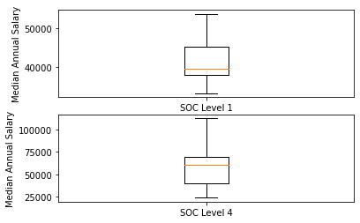
Box plot
We can see less variability in salaries for the unorganised sector. This also means that the organised sector's growth potential is shallow. There is a possibility that you can earn nearly the same as 25% of the managerial jobs.
Still, the growth potential under an unorganised sector will not allow you to grow if you keep working in that sector.
In contrast, administrative jobs, top executives and senior positions show excellent variability in income.
You may earn less in the initial years. Still, the growth opportunities are there, seeing the varied salaries offered to senior designations.

Slide 7
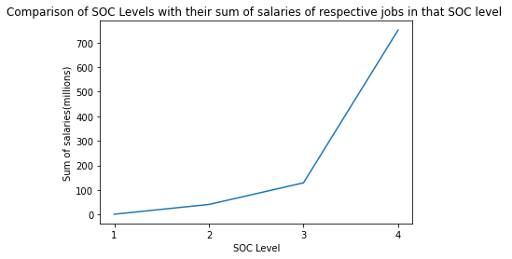
Line Graph
Fewer people will work in unorganised sectors that offer an average salary of 40k in a year.
We can see that the difference between people working under SOC level 2 and SOC level 3 is a little, but their sum salaries have a considerable difference.
We can also see that his salary will increase exponentially if a junior Engineer gets promoted to a Senior engineer or managerial position.
We can infer this from this line graph of the Sum of salaries.

Slide 8
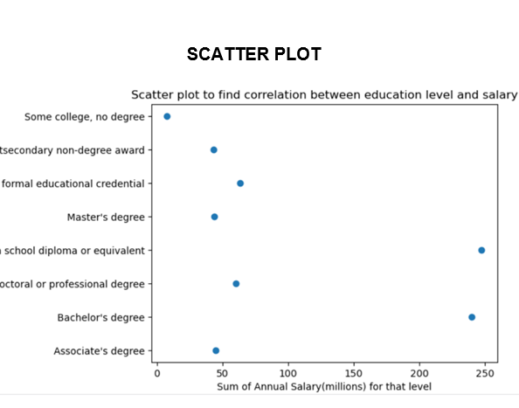
Scatter Plot
Few people plan to Secure a senior position during their academic years; thus, we can see that the number of people with master's and PhD is less.
Many people come under SOC levels 3 and 4 with just a high School Diploma and bachelor's degree;
Thus, Education plays a small role in career growth potential, but Work Experience and job training are significant to growth in their career paths.

Slide 9
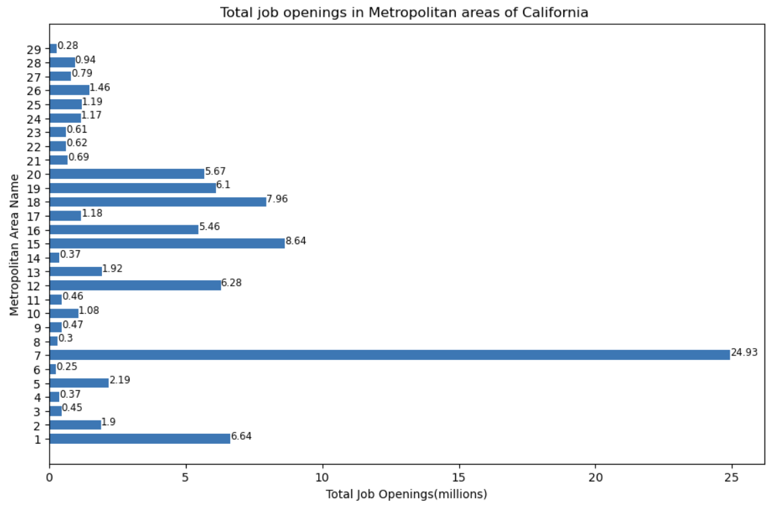
Bar Graph
These graph will help people finding job openings in different locations. Based on job opening places, counties are divided into categories.
A cold category where job openings are between 0.28 to 2.9 million
A warm type where job openings are between 5 million to 7 million
A hot variety where job opening is above 10 million. Which include Bernadino and Los Angeles

Slide 10
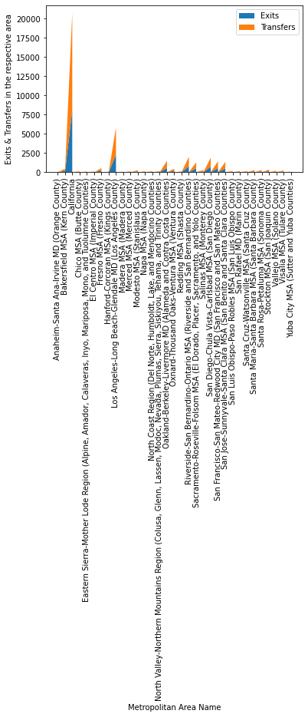
Stacked plot
This graph shows that the number of exits and transfers are high for Chico MSA county.
And other places of cold and warm categories also witness average number of exits and transfers.
Individual working in cold and warm categories place witness high number of exits and move towards hot category counties because the greater number of job opening at that location.

Slide 11
Conclusion
In Next 10 years the focus will change from technology to management side. There will be ample of job opening in the management sector.
There is a possibility that even after becoming a manager you still earn the same as any person working under unorganised sector but the variability of the salaries in organised sector in great if you are working in management area there is potential to go beyond 150k annually, whereas variability is less under un organised sector.
We also came to know that people working under SOC level 1 to try to switch to SOC level 2 to exponentially increase their earnings and the same is possible for SOC level 3 and SOC level 4.
We also got to know that very less people plan their career when they are studying which is shown by less number of people attending Masters and PHD courses and they depend more on work experience and job training to grow in their career .
The job openings also depend on the location of the company where we see places are divided cold, warm and hot categories according to job openings and we also say that places under cold and warm categories see high number of exits and transfers portraying people are shifting from cold and warm places to hot categories counties.

Slide 12
Suggestions
According to the visualizations it is suggested that
An Individual should learn managerial skills
And grab opportunities to gain work experience and job training rather than depending upon courses
Find jobs in categories coming under Hot categories
And try to switch their jobs to get immediate promotions to next SOC level for having a financial healthy and secure job in state of California.
Data set Suggestion
It would be of great help if we could have added a column which shows the population of people who in the first year of corporate life to see yearly influx of people under each SOC level.

