Slide 1


EDA: Summer Olympics

Slide 2
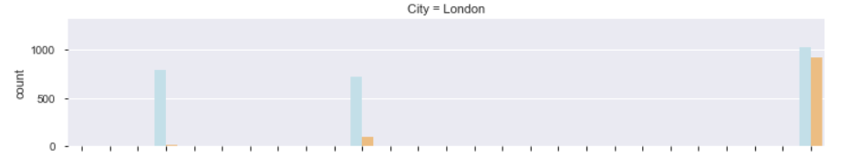
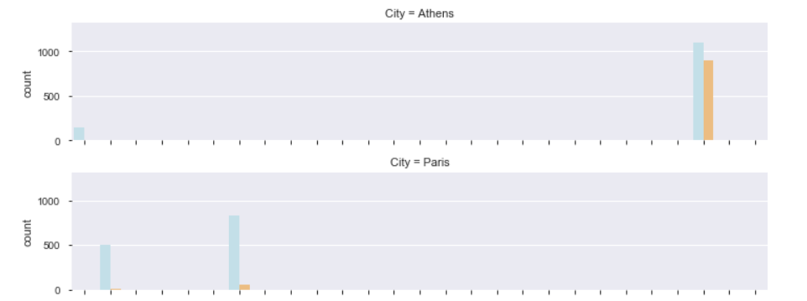
Which are the cities hosting Olympic games multiple times?
London hosted the Olympics 3 times in 1908, 1948 and 2012
Athens, Paris and Los Angeles hosted 2 times each

Slide 3
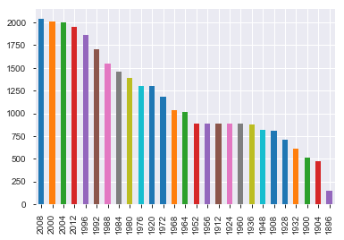
Which is the year in which maximum and minimum number of events were conducted?
The maximum number of events were conducted during the 2008 Summer Olympics and the least in 1896.

Slide 4
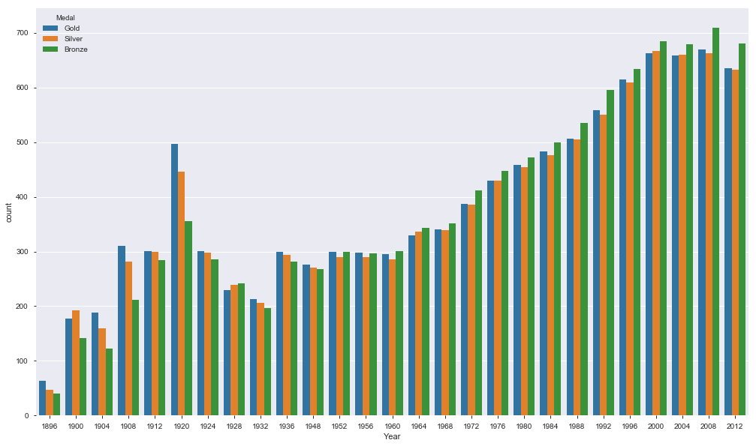
In which year maximum medals were won?
Year 2008 has the highest number of medals won
Year 2008 has the highest number of Gold and Bronze Medals won
Year 2000 has the highest number of silver medals won
.

Slide 5
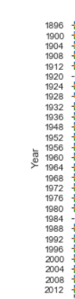
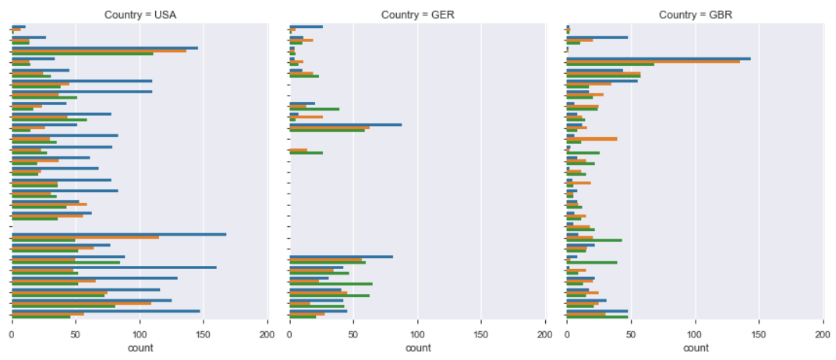
How the participating countries have performed over the years?
USA has been a consistent performer at all the Olympics.
GER has improved since it has started way back in 1896.
GBR has shown the signs of inconsistency over the years.

Slide 6
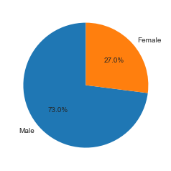
What is the ratio of Men vs Women Athletes?
The total no. of Athletes is 22762.

Slide 7
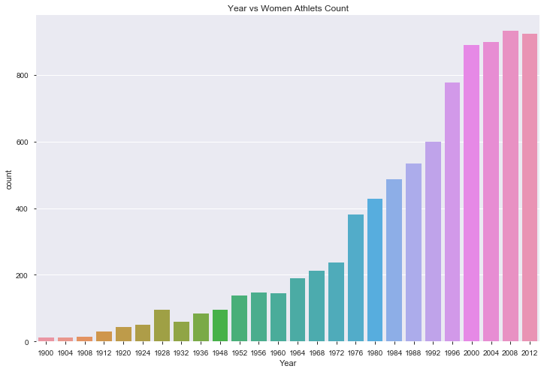
What is the Year in which Maximum women have participated?
Year 2008 marked the maximum women athlete participation

