Slide 1


INSTITUTE FOR ADVANCED COMPUTING AND SOFTWARE DEVELOPMENT AKURDI, PUNE

Slide 2
Project Title Predicting Room Occupancy Based on Environmental Factor.
Machine Learning Project Presentation
Submitted By:
Group No: 5
Avinashkumar Mishra - 1307
Abhishek Chaudhari – 1311
Mr. Prashant Karhale
Centre Coordinator
Project Guides :-
Akshay Tilekar(External Guide)
Tejal Mehetre (Internal Guide)
Rahul Pund (Internal Guide)
Manish (Internal Guide)

Slide 3
Introduction
Occupancy detection in buildings estimated to save energy in the order of 30 to 42%
Detecting the presence of the occupants without using a camera is very interesting due to privacy concerns.
This predictions might help Heating, Ventilating and Air Conditioning. For instance, we are using sensors like thermostats to get information about the environment and with that info our system decides to heat or not situation.
We’ll use a famous dataset called ‘Occupancy Detection’, and like it’s not so cool name, it has features such as Temperature, Humidity, Light and other …..Stuff

Slide 4
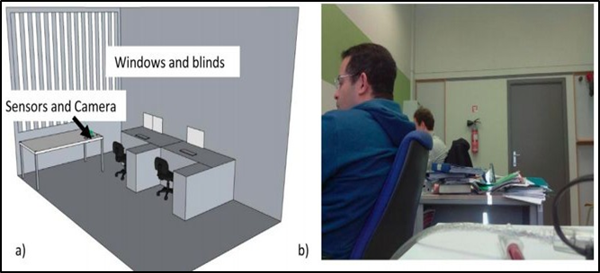
Data Collection and Setup

Slide 5
Data & Data Description
Data is provided with date-time information and six environmental measures taken each minute over multiple days, specifically:
Temperature in Celsius.
Relative humidity as a percentage.
Light measured in lux.
Carbon dioxide measured in parts per million.
Humidity ratio, derived from temperature and relative humidity measured in kilograms of water vapor per kilogram of air.
Occupancy as either 1 for occupied or 0 for not occupied.

Slide 6
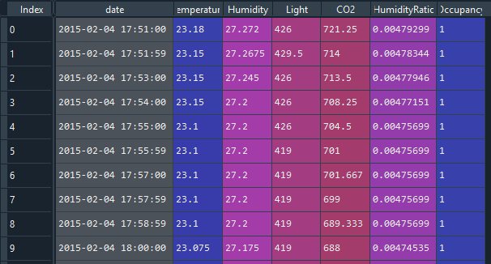
Snapshot /Problem
The main purpose of the project is to determine whether the room is occupied and not ,
based on the environmental factors.

Slide 7
Techniques Applied
Logistic Regression
Ridge Classifier
Bagged Decision Trees
KNN Algorithm
Support Vector Machine
Random Forest

Slide 8
Other Concepts Used
Confusion Matrix
Sensitivity and Specificity
Accuracy
AUC and ROC

Slide 9
Project Flow
Get Data
Data Processing
Descriptive Statistics
Data Visualisation
Model Building
Hyper parameter Tuning
Optimal Model Selection

Slide 10
Data Processing
Data is provided in 3 different files with total observations of 20560 observation
We have concatenated all three datasets into a single data frame .
The date variable in the dataset is of string type , we have converted the date
variable in the python date variable
To make the data balance , by analysing the data visualisation we have created
period of day feature which is as follows
if the time lies between 7 am : 5 pm the period of day is 1 else it is 0.

Slide 11
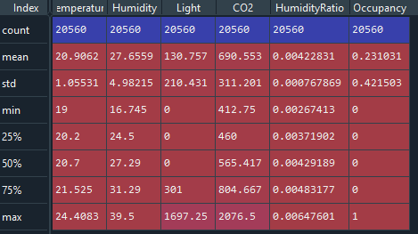
Descriptive Statistics
We can see that the light variable has 0 observation also , that means may be during
night period lights are off .
2. We can see the value of CO2 are very high as compared to others
3. The humidity ration has low values , this is due to the variable is derived from ratio of
Humidity and ratio

Slide 12
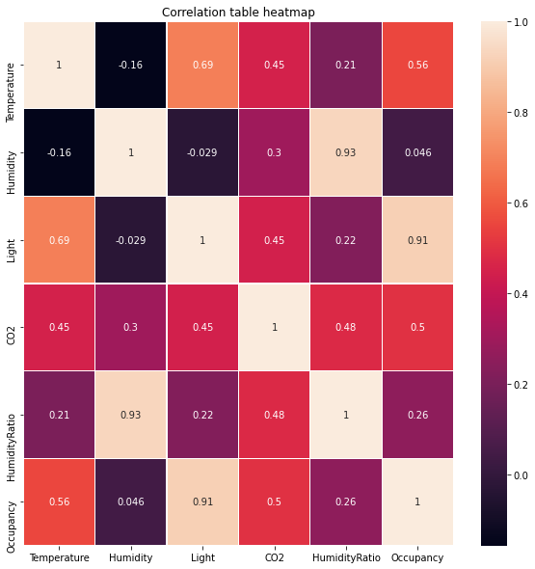
Data Visualisation
The Light variable is the highest correlation with occupancy i.e 0.91

Slide 13
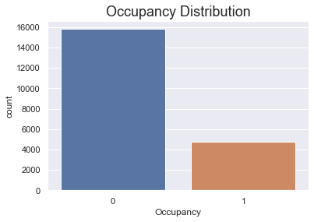
The data distribution is unbalanced i.e The not occupied variables are high as compare
to occupied variables

Slide 14
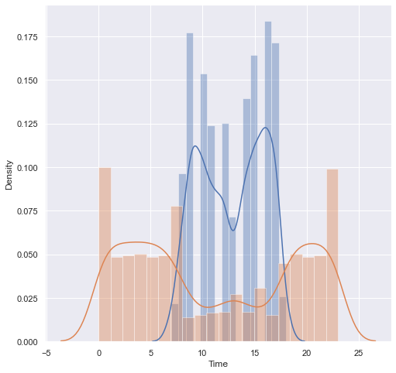
From above histogram, what can you say? Between 07:00 and 18:00 there are occupants in the environment or not. But the time come to non-working hours, then we can absolutely say that there is no occupant.

Slide 15
Training and Testing Data Set
Separating data into training and testing sets is an important
part of evaluating data mining models.
A training set is a set of data used to discover potentially
predictive relationships.
A test set is a set of data used to assess the strength and
utility of a predictive relationship.
We have divided the original data, into training (65%) and test (35%) data sets.

Slide 16
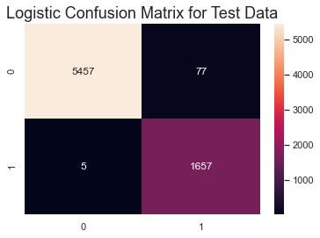
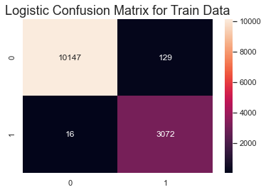
Data Modelling (Logistic Regression)
For the original data,
The confusion matrix for testing and training dataset is given in below

Slide 17
The results of Logistic Regression for original data,
We can see that the accuracy of both train and test data are good , as they are predicting 98%
Correctly.

Slide 18
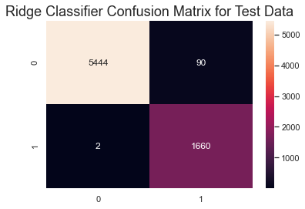
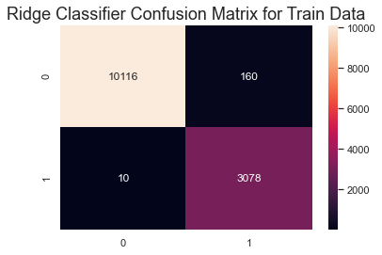
Ridge Classifier
For the original data,
The confusion matrix for testing and training dataset is given in below

Slide 19
The results of Ridge Classifier for original data,
We can see that the accuracy of both train and test data are good , as they are predicting 98% Correctly.

Slide 20
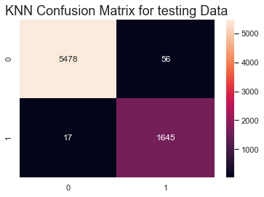

KNN Algorithm
For the original data,
The confusion matrix for testing and training dataset is given in below

Slide 21
The results of KNN Algorithm for original data,
We can see that the accuracy of both train and test data are good , as they are predicting 99% Correctly, on train data the algorithm works perfectly.

Slide 22
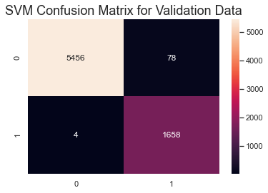
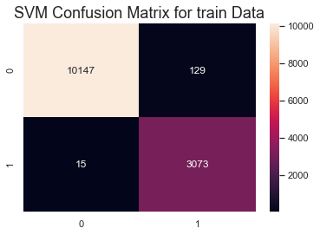
SVM Algorithm
For the original data,
The confusion matrix for testing and training dataset is given in below

Slide 23
The results of SVM Algorithm for original data,
We can see that the accuracy of both train and test data are good , as they are predicting 99% Correctly.

Slide 24


Random forest
For the original data,
The confusion matrix for testing and training dataset is given in below

Slide 25
The results of Random Forest for original data,
We can see that the accuracy of both train and test data are good , as they are predicting 99% Correctly.

Slide 26

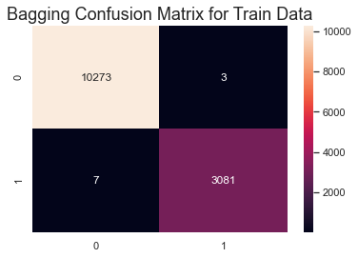
Bagged Decision Tree
For the original data,
The confusion matrix for testing and training dataset is given in below

Slide 27
The results of Bagged Decision Tree for original data,
We can see that the accuracy of both train and test data are good , as they are predicting 99% Correctly.

Slide 28
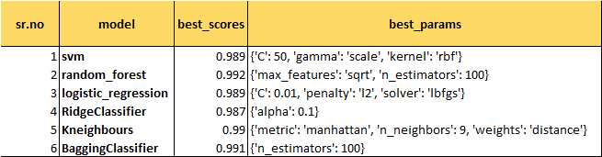
Hyper parameter Tuning

Slide 29
Optimal Model
We can see among all these models Random forest model has best fitted it has giving
the maximum accuracy

