Slide 1
C S S
Cascading Style Sheets

Slide 2
What is CSS?
A simple mechanism for controlling the style of a Web document without compromising its structure.
It allows you to separate visual design elements (layout, fonts, colors, margins, and so on) from the contents of a Web page.

Slide 3
CSS vs. just HTML
What can we do with CSS that we can’t do with HTML?
Control of backgrounds.
Set font size to the exact height you want.
Highlight words, entire paragraphs, headings or even individual letters with background colors.
Overlap words and make logo-type headers without making images.
Precise positioning.
Linked style sheets to control the look of a whole website from one single location.
And more.

Slide 4
How to write CSS?
Selector
HTML element tags (examples: p, h2, body, img, table)
class and ID names
Property (examples: color, font-size)
Value (examples: red, 14pt)

Slide 5
How to write CSS:
The basic syntax of a CSS rule:
selector {property 1: value 1; property 2: value 2}
Example:
p {font-size: 8pt; color: red}
Notice the { } around the rule and the : before each value!

Slide 6
Properties - Font
font-family
Name, or serif, sans-serif, cursive, monospace
font-style
normal, italic
font-weight
normal, bold, 100, 200, 300, 400, 500, 600, 700, 800, 900
font-size
absolute-size, relative-size, length, percentage
font-variant
small-caps

Slide 7
Properties - Text
text-decoration
underline, line-through,none
text-transform
capitalize, uppercase, lowercase, none
text-align
left, right, center, justify
text-indent
<length>, <percentage>

Slide 8
Properties - Position
position
absolute, relative,static,fixed,scroll
top
<length>, <percentage>, auto
left
<length>, <percentage>, auto
Z-index
<number>, auto

Slide 9
Backgrounds
background-color
Hex
background-image
URL(image.jpg)
background-repeat
No-repeat, repeat-x, repeat-y
background-attachment
Fixed, scroll
background-position
Top, left
p { background-position: 70px 10px; background-repeat: repeat-y; background-image: url(background.gif) }
Example

Slide 10
Link Style
a:link {color: #FFFFFF; text-decoration: none}
a:visited {color: #808080; text-decoration: none}
a:hover {color: red; text-decoration: none}

Slide 11
Three ways to include CSS:
Global (Embedded, or Internal)
Linked (External)
Local (Inline)

Slide 12
1. Global
Embedded or internal style sheet
Applicable to an entire document
Styles are defined within the
<style>
Write css code ….
</style>
tag, which is placed in the header of the html file (i.e., within <head> and </head>).

Slide 13
Global (Internal)
Example:
<html> <head> <title>Title</title> <style type="text/css"> <!----> </style> </head>
<body> [DOCUMENT BODY GOES HERE] </body>
</html>

Slide 14
2. Linked(External )
External style sheet
Styles are saved in a separate file, with the extension .css
This single stylesheet can be used to define the look of multiple pages.

Slide 15
Linked (External)
To apply the stylesheet “abc.css“ to an HTML document, call it in from the header:
<head> <link rel="stylesheet" href=“abc.css" type="text/css">
</head>
We can add n num of external css file

Slide 16
Linked (External)
Example
Save this text file as abc.css
In TextPad,Notepad, etc.…
p {font-family: verdana, sans-serif; font-size: 12pt; color: red}
h1 {font-family: serif; font-size: 14pt; color: green}
h2 {font-family: serif; font-size: 11pt; color: blue}

Slide 17
3. Local
Inline style sheet.
Placed inside tags.
Specific to a single instance of an html tag on a page.
Must be used instead of <font> tags to specify font size, color, and typeface and to define margins, etc.
Use to override an external or embedded style specification.

Slide 18

Local (inline)
Example
<p style="font-size: 10pt; color: red; font-weight: bold; font-family: Arial, Helvetica, sans-serif">
This is a local stylesheet declaration. </p>
On the browser:

Slide 19
CSS selectors Type
Element type
Grouping selectors
Class selectors
Id selectors
Pseudo

Slide 20
Grouping selectors
Separate selectors with a comma
Example:
h1,h2,h3,h4,h5,h6 { color: green }
(each header will be green)
Separate selectors with a space
Example:
p li { color: red }
(only items within a list and a paragraph tag will be red)

Slide 21
The class Selector
With a class selector you can define different styles for the same type of HTML element
Examples:
p.right {text-align: right; color: red; font-style: italic}
p.blue {text-align: center; color:blue}
<p class="right"> This paragraph will be right-aligned, italic, and red. </p>
<p class=“blue"> This paragraph will be center-aligned and blue. </p>

Slide 22
The class Selector
You can also omit the tag name in the selector to define a style that will be used by all HTML elements that have this class.
Example:
.poem {text-align: center; font-style:italic}
Any HTML element with class=“poem" will be center-aligned and italic.

Slide 23
The class Selector
Example (continued)
Both elements below will follow the rules in the ".poem“ class:
<h1 class=“poem"> This heading will be center-aligned and italic </h1>
<p class=“poem"> This paragraph will also be center-aligned and italic. </p>

Slide 24
The id Selector (Uniq)
With a id selector you can define different styles for the same type of HTML element
Examples:
#right {text-align: right; color: red; font-style: italic}
#blue {text-align: center; color:blue}

Slide 25
<p id="right"> This paragraph will be right-aligned, italic, and red. </p>
<p id=“blue"> This paragraph will be center-aligned and blue. </p>

Slide 26
What are Pseudo-classes?
A pseudo-class is used to define a
special state of an element.
For example, it can be used to:
Style an element when a user mouses over it
Style visited and unvisited links differently
Style an element when it gets focus

Slide 27
Syntax
The syntax of pseudo-classes:
selector:pseudo-class { property:value; }

Slide 28
CSS Pseudo Classes
Selector | Example | Example description
:active | a:active | Selects the active link
:link | a:link | Selects all unvisited links
:nth-child(n) | p:nth-child(2) | Selects every <p> element that is the second child of its parent
:visited | a:visited | Selects all visited links
:hover | a:hover | Selects links on mouse over
:nth-of-type(n) | p:nth-of-type(2) | Selects every <p> element that is the second <p> element of its parent
:nth-last-of-type(n) | p:nth-last-of-type(2) | Selects every <p> element that is the second <p> element of its parent, counting from the last child

Slide 29
Applying styles to portions of a document:
<div>
A division tag: to “package” a block of document into one unit. It defines a block element.
Causes a line break, like <br> and <p>
<span>
“Wraps” a portion of text into a unit, but doesn't cause a line break. Allows styles to be applied to an 'elemental' region (such as a portion of a paragraph).
.

Slide 30
Block-level Elements
A block-level element always starts on a new line and takes up the full width available (stretches out to the left and right as far as it can).
The <div> element is a block-level element.
Examples of block-level elements:
<div>
<h1> - <h6>
<p><form>

Slide 31
Inline Elements
An inline element does not start on a new line and only takes up as much width as necessary.
This is an inline <span> element inside a paragraph.
Examples of inline elements:
<span>
<a>
<img>

Slide 32
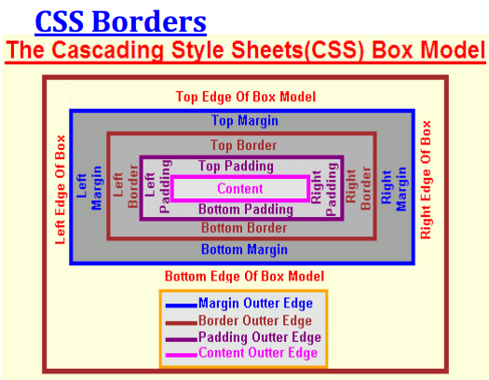
CSS Box Model

Slide 33
Box Model Properties
Margin | Border | Padding | Outline
Margin-Left | Border-Left | Padding-Left | Outline-Left
Margin-Right | Border-Right | Padding-Right | Outline-Right
Margin-Top | Border-Top | Padding-Top | Outline-Top
Margin-Bottom | Border-Bottom | Padding-Bottom | Outline-Bottom
Ex:
.box1{margin:10px solid red;}

Slide 34
Border Style
dashed • dotted • double • groove • hidden • inset • none • outset • ridge • solid

Slide 35
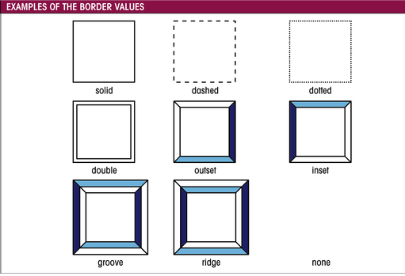
Border values

Slide 36
Typical Web Page (Browser)
Container
header
menu
main
footer

Slide 37
CSS Combinators
A CSS selector can contain more than one simple selector. Between the simple selectors, we can include a combinator.

Slide 38
There are four different combinators in CSS3:
descendant selector (space)
child selector (>)
adjacent sibling selector (+)
general sibling selector (~)

Slide 39
Descendant Selector
The descendant selector matches all elements that are descendants of a specified element.
The following example selects all <p> elements inside <div> elements:
div p { background-color: yellow; }

Slide 40
Child Selector >
The child selector selects all elements that are the immediate children of a specified element.
div > p { background-color: yellow; }

Slide 41
Adjacent Sibling Selector +
The adjacent sibling selector selects all elements that are the adjacent siblings of a specified element.
Sibling elements must have the same parent element, and "adjacent" means "immediately following".
div + p { background-color: yellow; }

Slide 42
General Sibling Selector
The general sibling selector selects all elements that are siblings of a specified element.
div ~ p { background-color: yellow; }

Slide 43
Cursor
The cursor property specifies the type of cursor to be displayed when pointing on an element.
Crosshair, hand, move, text, wait, etc.

