Slide 1
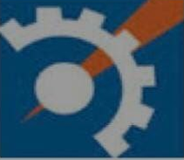
Seminar
On
“Market Basket Analysis ”
Delivered By:
Mr. ABHISHEK CHAWARE
Mr. SAGAR BOPCHE
Mr. ADITYA DHORE
U.G. Program Computer Science and Engineering
Department of Data Science
Abha Gaikwad-Patil College of Engineering & Technology, Nagpur
Academic Year : 2024-2025

Slide 2
INDEX
Introduction
Literature Review
Conclusion
References

Slide 3
Introduction
Market basket analysis is a data mining technique used by retailers to increase sales by better understanding customer purchasing patterns
The adoption of market basket analysis was aided by the advent of electronic point-of-sale (POS) systems
In market basket analysis, association rules are used to predict the likelihood of products being purchased together
Implementation of market basket analysis requires a background in statistics and data science , as well as some algorithmic computer programming skills
Market basket analysis can increase sales and customer satisfaction

Slide 4
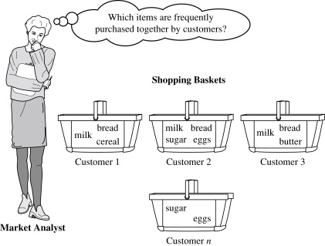
Market Basket Analysis Example:-
When you go to the supermarket, usually the first thing you do is grab a shopping cart. As you move up and down the aisles, you will pick up certain items and place them in your shopping cart.
A typical example of frequent itemset mining is market basket analysis. This process analyzes customer buying habits by finding associations between the different items that customers place in their “shopping baskets”
The discovery of these associations can help retailers develop marketing strategies by gaining insight into which items are frequently purchased together by customers.
This information can lead to increased sales by helping retailers do selective marketing and plan their shelf space.

Slide 5
Literature review
Sr. no | author | Published year | aim
1 | Tanushi Gorakh | 2024 | Study and Analysis of Market Basket Analysis Using Aparri Algorithm ,2024
2 | Bhatnagar, R., & Gupta, P. | 2021 | "Market Basket Analysis: A Review of Techniques and Applications" - This comprehensive review discussed recent advancements in MBA techniques and their applications across various sectors.
3 | Khan, M. A., & Khan, M. A. | 2022 | "A Survey of Market Basket Analysis Techniques and Applications" - This survey analyzed existing MBA techniques and highlighted their practical applications in e-commerce and retail settings.
4 | Choudhury, S., & Ghosh, S. | 2023 | "Market Basket Analysis Using Machine Learning Techniques: A Survey" - This paper reviewed the integration of machine learning methods with traditional MBA approaches to enhance predictive capabilities.

Slide 6
Conclusion
Market basket analysis is an important method of data analysis that can reveal essential details about the behavior and buying habits of your customers. Businesses can make well-informed decisions that enhance sales, customer pleasure, and overall business performance by examining data on which goods are frequently purchased together.
Cross-selling and upselling is the secret mantra of the retail industry that pushed the consumer to buy more. It has become a thriving factor for such industries that harness patterns with market basket analysis in data mining and derive customer insights to upscale their brand's performance.

Slide 7
Reference
[1] Raorane, A. A., R. V. Kulkarni, and B. D. Jitkar. "Association rule–extracting knowledge
using market basket analysis." Research Journal of Recent Sciences ISSN 2277 (2012): 2502.
[2] Usharani, S., P. Manju Bala, T. Ananth Kumar, R. Rajmohan, and M. Pavithra. "Smart
Energy Management Techniques in Industries 5.0." Hybrid Intelligent Approaches for Smart
Energy: Practical Applications (2022): 225-252.
[3] Aguinis, Herman, Lura E. Forcum, and Harry Joo. "Using market basket analysis in
management research." Journal of Management 39, no. 7 (2013): 1799-1824.
[4] Badhe, Vivek, Ramjeevan Singh Thakur, and G. S. Thakur. "Profit Pattern Mining Using
Soft Computing for Decision Making: Pattern Mining Using Vague Set and Genetic
Algorithm." In Pattern and Data Analysis in Healthcare Settings, pp. 213-239. IGI Global,
2017.

Slide 8
Thank you !

