Slide 1



Garbage Classification

Slide 2

Learning Objectives
1. Understand the importance of waste classification in environmental sustainability.
2. Explore and preprocess image datasets for classification tasks.
3. Apply DL(CNNs) and transfer learning for image classification.
4. Perform data augmentation, normalization, and proper dataset splitting.
5. Evaluate model performance using accuracy, confusion matrix , and classification report.
GOAL
Source :
www.freepik.com/

Slide 3
Tools and Technology used
Programming Language: Python
Frameworks & Libraries:
TensorFlow / Keras (Model building & training)
NumPy, Pandas (Data handling)
Matplotlib, Seaborn (Visualization)
scikit-learn (Model evaluation)
Pre-trained Model: MobileNetV2 (Transfer Learning)
Dataset Source: Kaggle (Garbage Classification Dataset)
Environment: Jupyter Notebook / VS Code

Slide 4
Methodology
Problem Definition: Identified the need for automated garbage classification to support smart waste management.
Data Collection & Understanding: Used a labeled image dataset from Kaggle, categorized into plastic, metal, glass, etc.
Exploratory Data Analysis: Visualized class distribution, image dimensions, and data imbalance.
Preprocessing: Resized images, normalized pixel values, applied data augmentation, and split into training, validation, and test sets.
Model Development: Built a CNN as a baseline, then improved performance using transfer learning with MobileNetV2.
Evaluation: Assessed model using accuracy, confusion matrix, and classification report.

Slide 5
Problem Statement:
Manual waste segregation is inefficient and error-prone . There is a need for an automated system that can accurately classify garbage into categories like plastic, paper, metal, and organic using image recognition to support smart waste management and sustainability efforts

Slide 6
Solution:
Develop a deep learning-based image classification model using Convolutional Neural Networks (CNNs) and transfer learning to automatically identify and classify garbage into predefined categories. This model can be integrated into smart bins or mobile applications to enable efficient and automated waste segregation.

Slide 7
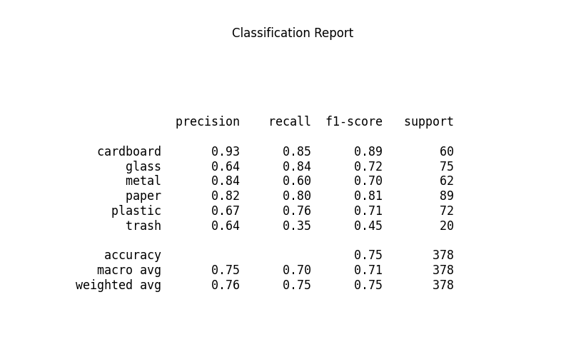
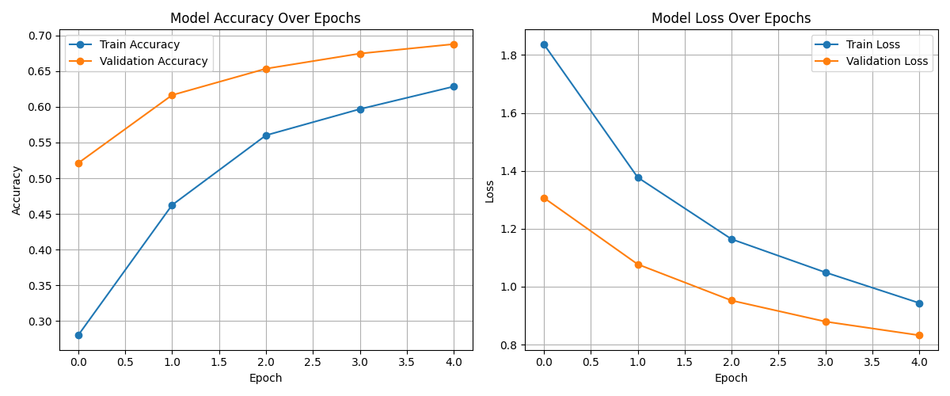
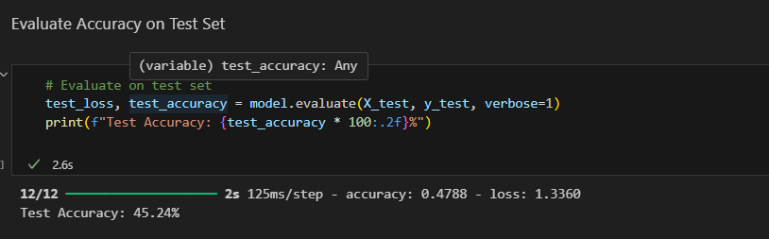
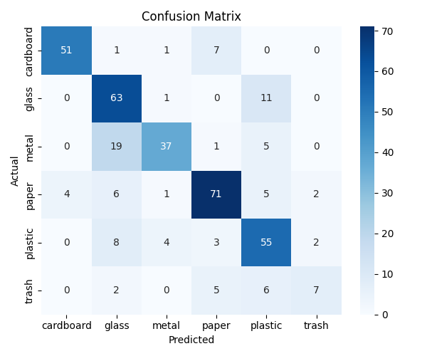
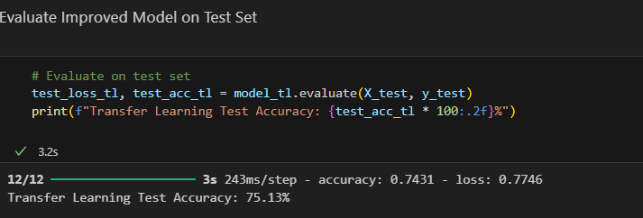
Screenshot of Output:

Slide 8
Conclusion:
This project successfully implemented a deep learning model to classify images of garbage into different categories such as plastic, paper, metal, glass, organic, and others. Through image preprocessing, CNN modeling, and performance evaluation, the model achieved reliable classification accuracy.
The results demonstrate that machine learning can effectively assist in automating waste segregation and contribute to data-driven environmental solutions. This project also strengthened understanding of computer vision techniques, data preprocessing, and model evaluation.

