Slide 1
A Stock Decision Support System Based on ELM
By: Abhishek Dabas

Slide 2
Concepts:
Extreme Learning Machine
Oscillation Box Theory
Gray Correlation Degree

Slide 3
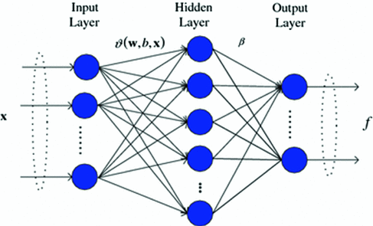
ELM – Extreme Learning Machine
Methodology for learning Single hidden layer feedforward Neural Networks(SLFN)
Different from Traditional Neural Network Training algorithm such as back propagation algorithms
It is fast as it assigns hidden weights and biases at random
Low computational complexity
Better performance in short time
It has perfomed really well in case of missing values
Disadvantage:
It does not perform accurately in all the situation
Insufficient with unlabeled dataset
Doesn’t work with image dataset
Evaluation speed is more important than training speed

Slide 4
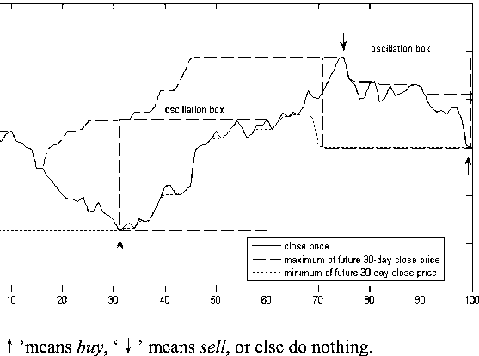
Oscillation Box Theory
Also called box theory- which indicates the price of stock would oscillate in a certain range in a period of time (a box)
In this box the price will fall when closer to upper boundary and rise in opposite situation
If price breaks this box, a new oscillation box created. Hence best time to buy and sell the stock is inferred from whether it follows an upward trend or lower trend

Slide 5
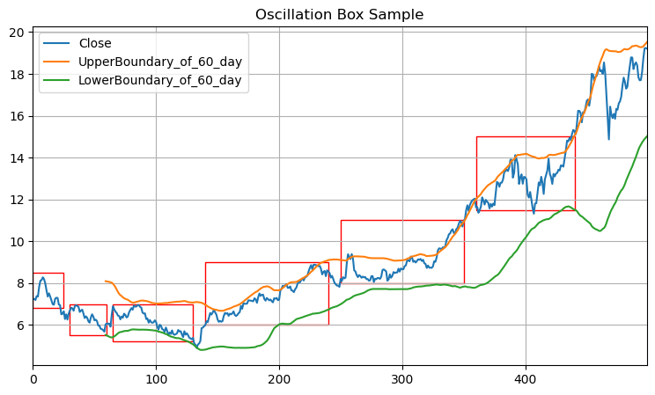

Slide 6
Grey Correlation Degree
It uses the geometric shape of sequence curve to present the relational degree between data sequences
A better measure of Inferring closeness between two curves
Closer the two curves, higher the degree

Slide 7
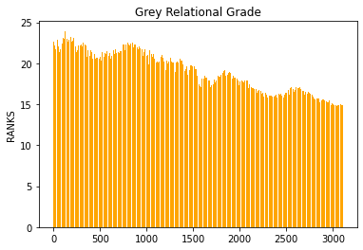

Slide 8
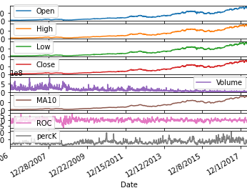
Additionals Features
Rate-of-change (ROC): ROC measures the percentage change in price between the current price and the price a certain number of periods ago.
Relative Strength Index (RSI): RSI compares the size of recent gains to recent losses, it is intended to reveal the strength or weakness of a price trend from a range of closing prices over a time period.

Slide 9
Decision Support System
Calculate the related indicators from historical data. Obtain a relationship of scaled indicators and stock price time series, set an input value weight of ELM
Training the ELM using weighted indicators sequence as input values and stock prices time series as target value.
Trained ELM to predict stock price sequence for next period of time, in order to get minimum and maximum value of stock price, by setting lower and upper bounds for oscillation box

Slide 10
3.1 Data Preprocessing
Input features are: Open, High, Low , Close, Vol
New feature made through the boundary of a period of few days. For n1 days the highest price and lowest price is used
Normalizing the indicators
Enlarge the indicator which has considerable impact on result

Slide 11
3.2 Stock price Prediction based on ELM
Features selected using GCD
Input Vector, I = Fi . Wi (Features and their weights)
Fi = [Ok , Hk , Lk ,Ck , VOLk , MAk , ROCk , RSIk , FastKk , SlowKk ,SlowDk ,Upk , Lowk]
Train the ELM, for making test after ith day possible, with window size set to n days
Training I as input metric and T as target metric, then we predict stock price Ti

Slide 12
3.3 Trading strategy based on Box theory
Set standards too detect whether the price series cross the border
When price series up, it is closer to lower boundary of new box and lower boundary of new box is moved upwards
When it crosses the lower boundary, the price will close to the upper boundary of new box and the upper boundary of the new box will move down
This strategy is proven to be more effective than the buy & Hold strategy

Slide 13
Buy & Sell
A bull market is a market that is on the rise and is economically sound, while a bear market is a market that is receding, where most stocks are declining in value
Bull data, has more noise over a long period of time
Bear data, has more noise data
Optimal set of parameters: short term to learn

Slide 14
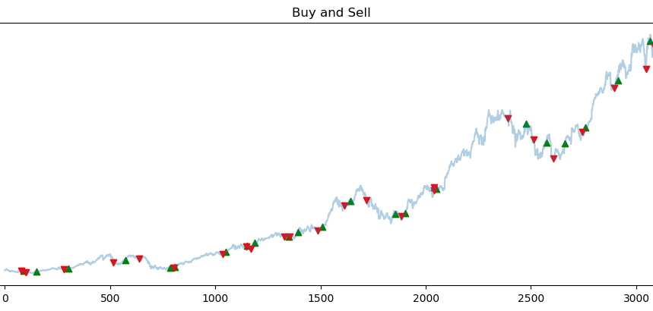

Slide 15
Stock Decision Support
System is capable of superior performance because
Fast learning & high precision
Reduces the impact of noise & uncertainity by using box theory
GCD helps obtain each factor weight to certain extent, helps get the results more precise
ELM can only reach a certain level of prediction accuracy
ELM on historical data to predict the highest and lowest stock price for predicting boundary of oscillation box
Then we build inspection rule for stock price breakout from boundary

Slide 16
Improvements
Reasonably model on the stock market and select more representative and comprehensive features
OSELM:
Online sequential extreme learning machine (OSELM) is an excellent online learning algorithm, and some improved OSELM algorithms incorporating forgetting mechanism have been developed to model and predict the time-varying system.
OS-ELM has well addressed the problem encountered by the conventional batch-mode learning algorithms which generally require that all training samples are available at hand for model constructions.
It has an additional step to sequential learning phase with new collected samples. In the initialization phase, OS-ELM adopts the basic ELM to train the SLFN
Handle new captured data in both one-by-one and chunk-by-chunk with fixed or varying chunk sizes cases
Source: https://www.hindawi.com/journals/mpe/2018/6195387/

Slide 17
Other Methods
Ensemble based ELM
employs multiple SLFNs to construct the decision model
voting based ELM ensemble (V-ELM)
voting online sequential ELM ensemble (VOS-ELM)

Slide 18
THANK YOU!!!

