Slide 1
PROJECT REVIEW 2
Regime-Aware Multi-Asset Volatility Forecasting
Using Temporal Fusion Transformers for Indian Equity Markets
Abhishek Deep
M.Tech — AI and Data Science Engineering Christ University, Bangalore
Guide: [Guide Name]

Slide 2
Agenda
1. Abstract
2. Problem Statement
3. Objectives
4. System Architecture
5. Module Description
6. Implementation Details
7. Results & Analysis
8. Conclusion
9. Future Scope

Slide 3
01
Abstract

Slide 4
Abstract
▸ A hybrid deep learning framework to forecast next-day realized volatility across 14 stocks on the NSE (India)
▸ Integrates high-frequency 5-minute data (~2.65 million observations over ~10 years)
▸ Combines HMM-derived market regimes, GARCH conditional volatility, and DCC cross-asset correlations
▸ Uses a Temporal Fusion Transformer (TFT) — an interpretable attention-based deep learning model
▸ Model achieves R² = 0.976 with just 1.90% error (MAPE)
▸ Ablation study quantifies contribution of volatility persistence vs. feature-based prediction
▸ Interpretability analysis reveals the model learns HAR-RV-like autoregressive structure

Slide 5
02
Problem Statement

Slide 6
Problem Statement
▸ Accurate volatility forecasting is critical for risk management, option pricing, and portfolio optimization
▸ Traditional models (GARCH, HAR-RV) have inherent limitations:
– GARCH assumes parametric distributions and is restricted to univariate settings
– HAR-RV captures long memory but assumes linear dynamics only
▸ Indian equity markets are under-studied compared to US/EU markets
▸ Existing deep learning models for volatility lack interpretability — they act as black boxes
▸ No comprehensive study combines regime-awareness, cross-asset learning, and interpretable deep learning for Indian markets

Slide 7
Problem Statement — Formulation
▸ Given 5-minute OHLCV data for 14 NSE blue-chip stocks (~2.65M observations):
Can we build a model that:
① Forecasts next-day realized volatility with high accuracy
② Adapts to different market regimes (calm, normal, volatile, extreme)
③ Learns across multiple stocks simultaneously (multi-asset)
④ Provides interpretable predictions (not a black box)
▸ Key challenge: Disentangling genuine predictive signal from autoregressive persistence

Slide 8
03
Objectives

Slide 9
Objectives
1. Build an end-to-end data pipeline for processing 5-minute intraday data from 14 NSE stocks
2. Engineer 47 financial features including multi-scale realized volatility, jump detection, and range estimators
3. Implement a 4-state Hidden Markov Model for market regime detection (Low / Normal / High / Extreme volatility)
4. Integrate GARCH(1,1) conditional volatility and DCC cross-asset correlations as hybrid features
5. Train a Temporal Fusion Transformer (TFT) for multi-asset volatility forecasting
6. Conduct ablation study to quantify autoregressive contribution vs. feature-based prediction
7. Analyze model interpretability using TFT's Variable Selection Networks and attention mechanisms
8. Evaluate regime-specific model performance across all market conditions

Slide 10
04
System Architecture

Slide 11
System Architecture — Overview
The system follows a 6-stage pipeline:
Stage 1 → Raw 5-min OHLCV data ingestion (14 NSE stocks, ~2.65M rows)
Stage 2 → Data preprocessing (outlier removal, missing values, seasonality adjustment)
Stage 3 → Parallel feature engineering (5 feature groups → 47 features)
Stage 4 → Statistical model fitting (HMM regime labels + GARCH/DCC features)
Stage 5 → Feature consolidation into TFT input format
Stage 6 → Temporal Fusion Transformer → Next-day RV forecast

Slide 12
System Architecture — Pipeline Flow
Raw 5-min OHLCV Data
(14 NSE Stocks)
Data Preprocessing
(Cleaning, Deseasonalization)
Realized
Volatility
HAR-RV
Lags
Jump
Detection
Range
Estimators
Volume
Features
HMM (4-state)
→ Regime Labels
GARCH(1,1) + DCC
→ σ_t, ρ_t
Feature Pool (47 features) + Temporal Encoding
Temporal Fusion Transformer
(VSN → LSTM Encoder-Decoder → Multi-Head Attention → Output)

Slide 13
05
Module Description

Slide 14
Module 1 — Data Pipeline
▸ data_loader.py — Loads raw 5-minute OHLCV CSV files for all 14 stocks
▸ preprocessor.py — Filters trading hours (9:15 AM – 3:30 PM IST), removes bad ticks
▸ feature_engineering.py — Computes all 47 features:
– Multi-scale Realized Volatility (1h, half-day, 1d, 1w windows)
– HAR-RV lagged features (1-bar, 1-hour, 1-day, 1-week lags)
– Jump detection (Bipower Variation, Jump ratio, circuit breakers)
– Range estimators (Parkinson, Garman-Klass, Rogers-Satchell)
– Temporal encodings (cyclical sin/cos for hour, day, month)
▸ pipeline.py — Orchestrates: load → preprocess → feature engineering → target creation → pooling
▸ Output: pooled_data.parquet (2.65M rows × 47 features)

Slide 15
Module 2 — Statistical Models (HMM, GARCH, DCC)
▸ HMM Regime Detection (hmm_module.py):
– 4-state Gaussian HMM trained on market-average log-returns and daily RV
– States: Low Volatility → Normal → High → Extreme
– Enables regime-aware conditioning of the TFT model
▸ GARCH(1,1) Conditional Volatility (garch.py):
– Fits GARCH(1,1), EGARCH, GJR-GARCH per stock (Student-t distribution)
– Best model selected by AIC — outputs σ_t (time-varying volatility)
▸ DCC Cross-Asset Correlation (dcc.py):
– Rolling correlation of GARCH-standardized residuals with market return
– Captures dynamic inter-stock dependencies

Slide 16
Module 3 — Temporal Fusion Transformer
▸ TFT Architecture (Lim et al., 2021) — 1.9M parameters
– Variable Selection Networks → Automatic feature importance
– Gated Residual Networks → Non-linear feature processing
– LSTM Encoder (75 bars) → Decoder (1 step ahead)
– Multi-Head Attention (4 heads) → Temporal pattern learning
▸ Key TFT Advantage: Built-in interpretability
– Shows which features the model focuses on
– Reveals temporal attention patterns
▸ Target: log(1 + next-day Realized Volatility)
▸ GroupNormalizer per stock (softplus transformation)

Slide 17
Model Configuration
Parameter | Value
Total Parameters | 1.9 Million
Hidden Size / Attention Heads | 128 / 4
Encoder Length | 75 bars (1 trading day)
Prediction Length | 1 step (next day)
Dropout / Learning Rate | 0.15 / 0.001
Early Stopping Patience | 15 epochs
Batch Size / Train Batches | 64 / 1,000 per epoch
Target Normalizer | GroupNormalizer (per-stock, softplus)
Loss Function | RMSE

Slide 18
06
Implementation

Slide 19
Implementation — Technology Stack
▸ Language: Python 3.x
▸ Deep Learning: PyTorch + PyTorch Lightning + PyTorch Forecasting
▸ Statistical Models: arch (GARCH), hmmlearn (HMM), statsmodels (HAR-RV)
▸ Data Processing: Pandas, NumPy
▸ Visualization: Matplotlib, Seaborn
▸ Hyperparameter Tuning: Optuna (Bayesian optimization)
▸ Cloud Training: Kaggle (Tesla T4 GPU — 15.6 GB)
▸ Pipeline: 8-step end-to-end pipeline (run_pipeline.py)
Step 1: Data Preprocessing & Pooling
Step 2–5: HMM → DCC → Attach Regimes → GARCH Features
Step 6–8: Train TFT → Evaluate → Visualize

Slide 20
Implementation — Dataset Details
Aspect | Details
Data Source | 5-minute OHLCV bars, NSE India
Stocks | 14 blue-chip stocks (RELIANCE, HDFCBANK, TCS, INFY, etc.)
Time Span | ~10 years of intraday data
Total Observations | ~2.65 Million (75 bars/day × 250 days/year × 14 stocks)
Trading Hours | 9:15 AM – 3:30 PM IST (75 bars per day)
Features Engineered | 47 features across 6 categories
Target Variable | log(1 + next-day Realized Volatility)
Train/Val Split | Strictly temporal (no data leakage)

Slide 21
Implementation — Feature Engineering (47 Features)
Category | Features | Description
Realized Volatility | RV_1h, RV_half_day, RV_1d, RV_1w | Multi-scale RV (√Σr²) at 4 windows
HAR-RV Lags | RV_1d_lag1, lag12, lag75, lag375 | Lagged RV for autoregressive capture
Jump Detection | BV_1d, Jump_1d, Jump_ratio | Bipower variation, circuit breakers
Range Estimators | Parkinson, Garman-Klass, Rogers-Satchell | High-Low-Close based estimators
Cross-Asset | market_correlation, garch_volatility | DCC proxy + GARCH(1,1) σ_t
Temporal | hour/dow/month sin-cos, session flags | Cyclical encodings + opening/closing
Regime | regime (4 states from HMM) | Low / Normal / High / Extreme volatility

Slide 22
07
Results & Analysis

Slide 23
Ablation Study Results
Model A (with autoregressive input) vs Model B (without)
Metric | Model A (with AR) | Model B (w/o AR) | Δ (Gap)
R² | 0.976 | 0.258 | −0.718
RMSE | 0.0093 | 0.0521 | +0.043
MAPE | 1.90% | 19.26% | +17.4pp
Directional Accuracy | 52.6% | 47.5% | −5.1pp
QLIKE | −0.920 | −0.883 | +0.037
▸ 71.8 percentage point gap in R² quantifies the autoregressive contribution
▸ Model A matches HAR-RV baselines — TFT effectively learns volatility persistence
▸ Model B shows non-trivial feature-based prediction from exogenous features alone

Slide 24
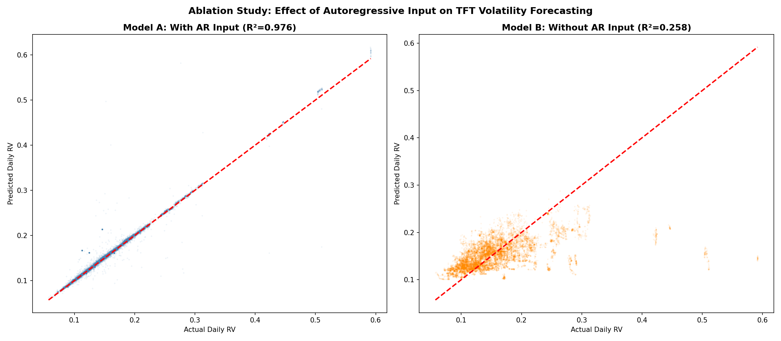
Ablation Study — Visual Comparison

Slide 25
Regime-Specific Performance
Regime | N Samples | R² | RMSE | MAPE
Low Volatility | 58,066 | 0.989 | 0.007 | 1.67%
Normal Volatility | 7,910 | 0.987 | 0.008 | 1.51%
High Volatility | 2,800 | 0.999 | 0.003 | 1.13%
Extreme Volatility | 1,764 | 0.765 | 0.036 | 6.54%
▸ Excellent performance in Low/Normal/High regimes (R² > 0.98)
▸ High Volatility achieves best R² = 0.999 — elevated but structured volatility is highly predictable
▸ Expected degradation in Extreme regime (R² = 0.765) — rare events are harder to predict
▸ Model adapts well across different market conditions

Slide 26
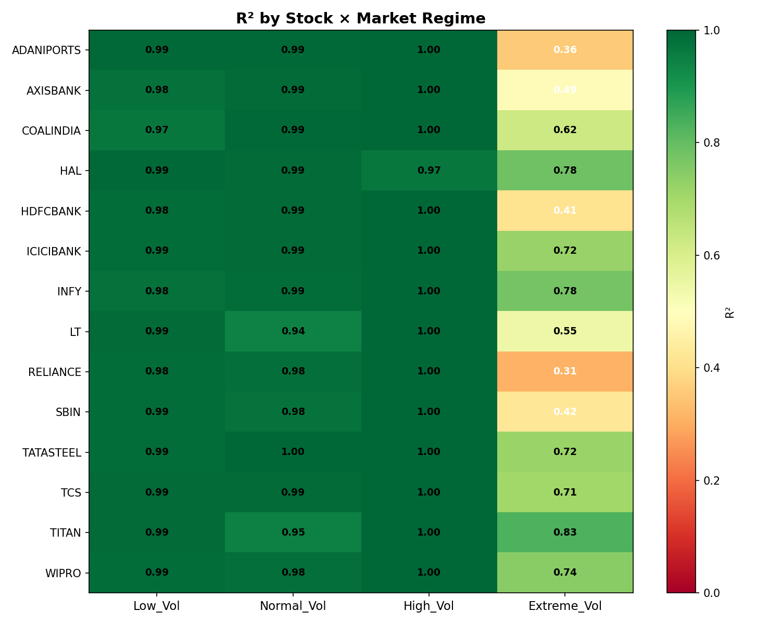
Stock × Regime R² Heatmap

Slide 27
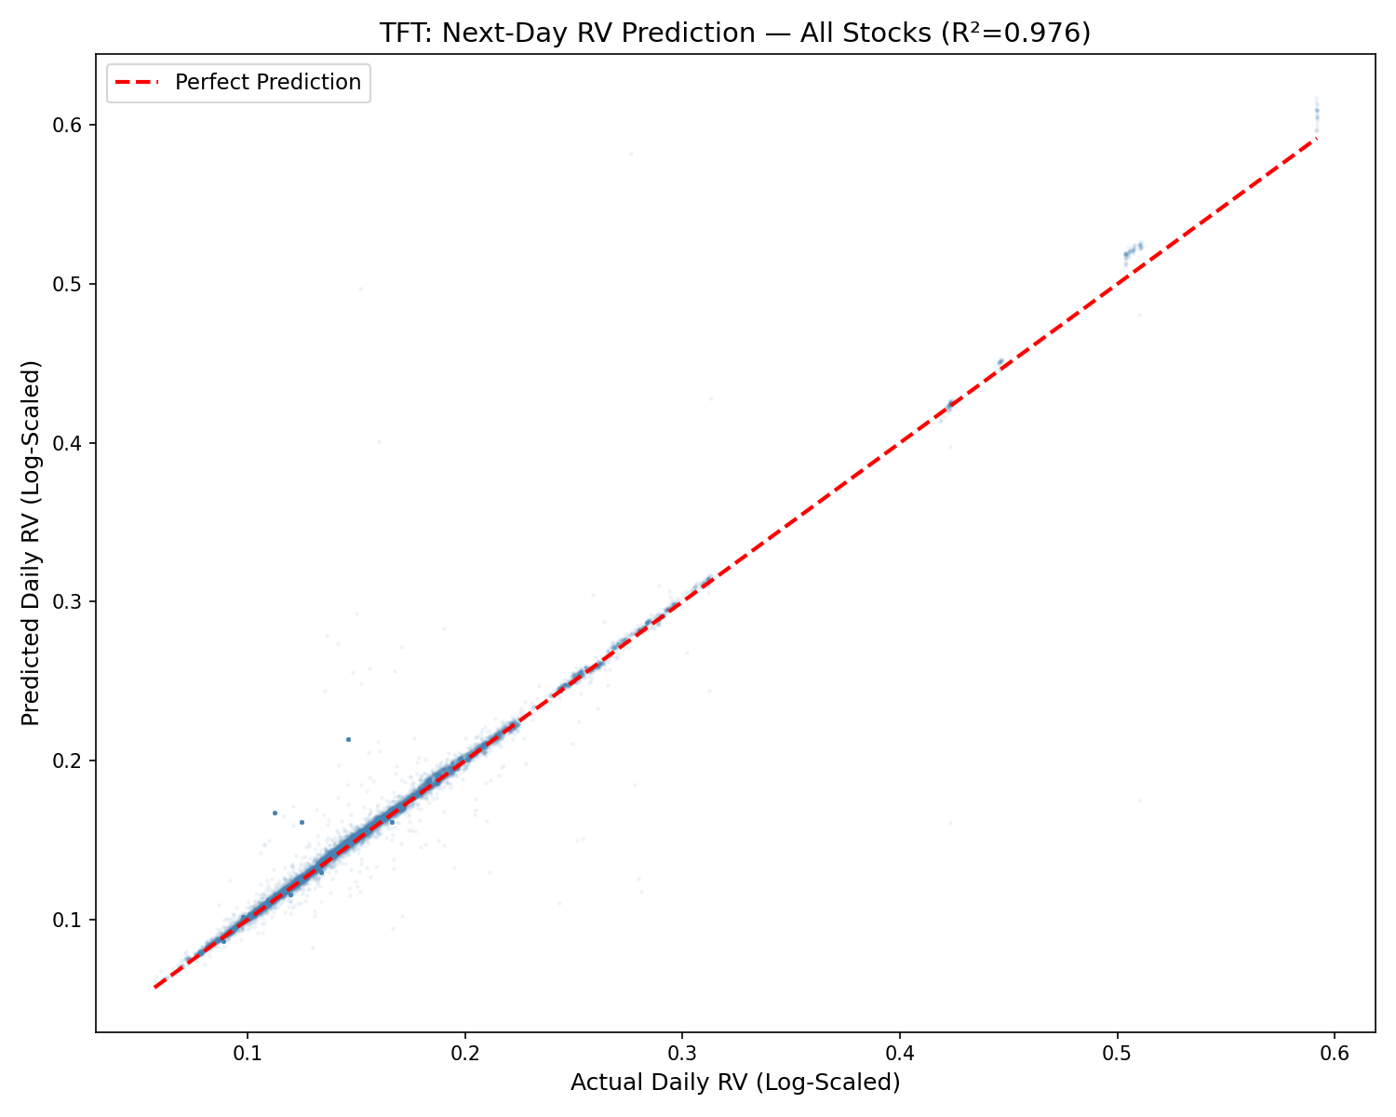
Predicted vs Actual Volatility

Slide 28
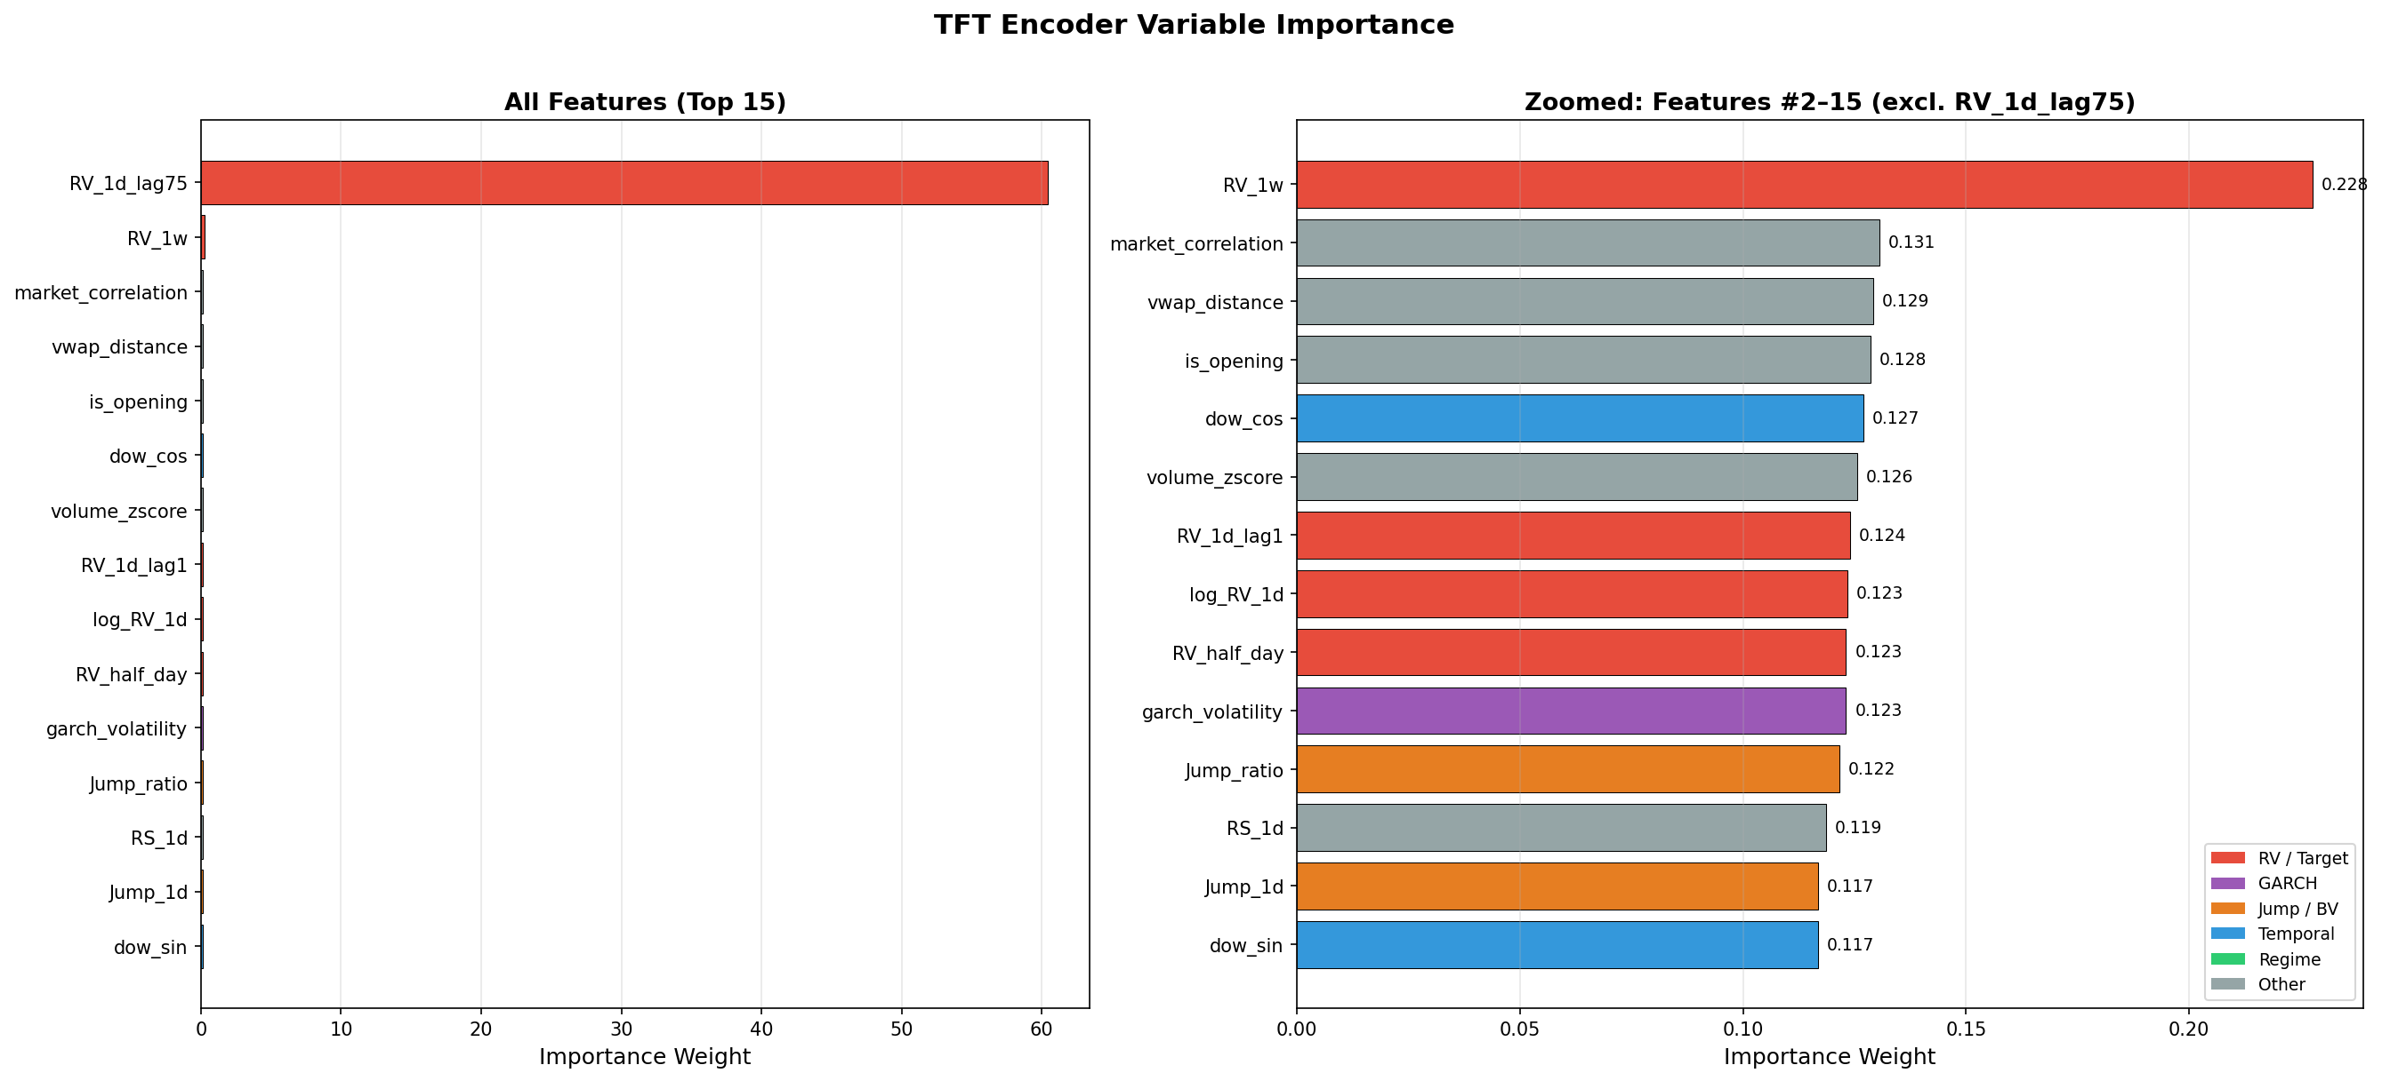
Interpretability — Variable Importance
▸ RV_1d_lag75 dominates (60.4)
— confirms HAR-RV structure
▸ Secondary: RV_1w (0.23),
market_correlation (0.13),
garch_volatility (0.12)
▸ Decoder: is_opening highest
(opening auction effect)

Slide 29
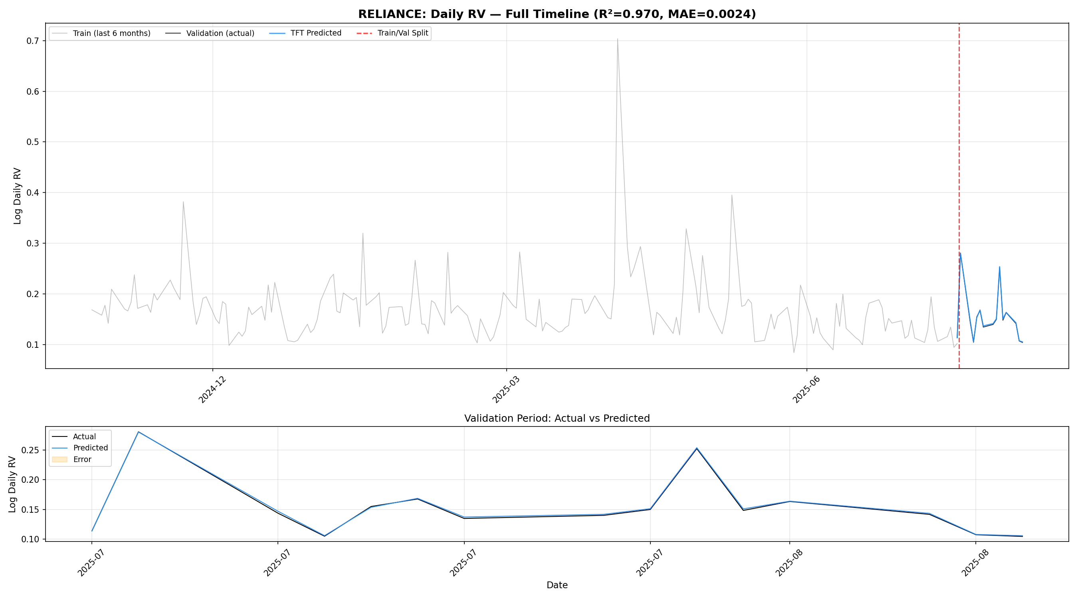
Prediction Timeline — RELIANCE

Slide 30
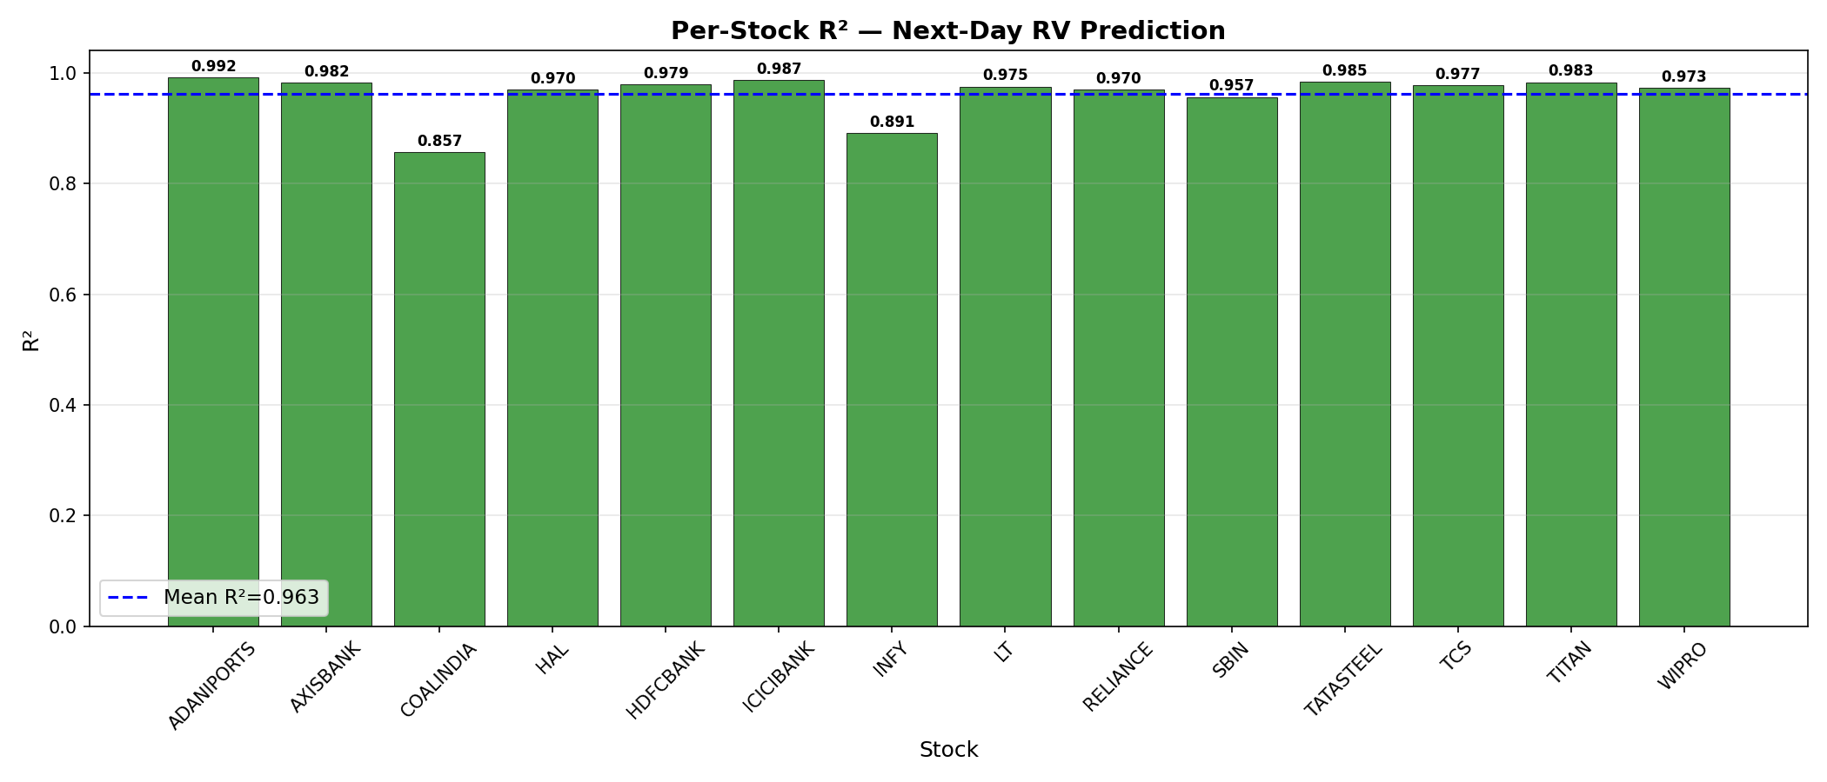
Per-Stock R² Performance

Slide 31
Baseline Comparison — GARCH & HAR-RV
Stock | Best GARCH | HAR-RV R²
RELIANCE | GARCH(1,1) | 0.993
HDFCBANK | GARCH(1,1) | 0.993
TCS | EGARCH | 0.990
INFY | GJR-GARCH | 0.981
SBIN | EGARCH | 0.993
ADANIPORTS | GARCH(1,1) | 0.994
TATASTEEL | GARCH(1,1) | 0.992
▸ HAR-RV achieves R² > 0.98 for all 14 stocks — a very strong statistical baseline
▸ Our TFT (Model A) matches this performance (R² = 0.976) while providing interpretability

Slide 32
08
Conclusion

Slide 33
Conclusion
1. Successfully built an end-to-end Regime-Aware TFT for next-day volatility forecasting across 14 Indian stocks using ~2.65M observations
2. Model A achieves R² = 0.976, MAPE = 1.90% — matching strong HAR-RV baselines while providing deep learning interpretability
3. Ablation study reveals 71.8pp R² gap → volatility persistence is the dominant predictive signal, but exogenous features provide non-trivial additional information
4. Regime analysis: Excellent performance in calm markets (R² > 0.98), expected degradation in extreme volatility (R² = 0.765)
5. TFT's Variable Selection Networks confirm the model automatically learns HAR-RV-like structure (RV_1d_lag75 importance = 60.4)

Slide 34
09
Future Scope

Slide 35
Future Scope
1. Regime-Specific Model Ensembles — Train specialized models per regime for improved extreme volatility prediction
2. Multi-Horizon Prediction — Extend from next-day to 1-hour, 4-hour, and weekly forecasts
3. Statistical Significance Testing — Diebold-Mariano tests to formally compare models
4. Real-Time Deployment — Build a live prediction system with streaming 5-minute data
5. Broader Market Coverage — Extend to Nifty 50 / sectoral indices and other asset classes
6. Advanced Architectures — Experiment with Transformer variants (Informer, Autoformer) and Graph Neural Networks for cross-asset modeling

Slide 36
Thank You
Questions?
Abhishek Deep | M.Tech AI & DS | Christ University

