Slide 1

An Introduction to
Google Chrome API
- by Abhishek Shrivastava (abhishekdelta)

Slide 2
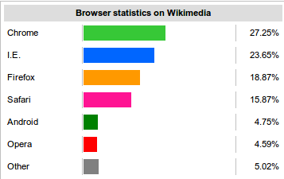
Google Chrome
A freeware web-browser by Google
”Faster” than many other browser
Largest market share as of Aug 2012 (27%)

Slide 3
Some cool info
Webkit layout engine (for HTML & CSS)
  Initiated by KDE way back in 1998
  Apple took over, used it in Safari (now you know why some sites look good in Chrome :) )
V8 Javascript engine (the best part!)
  Developed by Google.
  JS → Native code → Execute
  Others: JS → Bytecode → Native code → Execute
  Nitro in Safari, JägerMonkey in Firefox, Chakra in IE

Slide 4
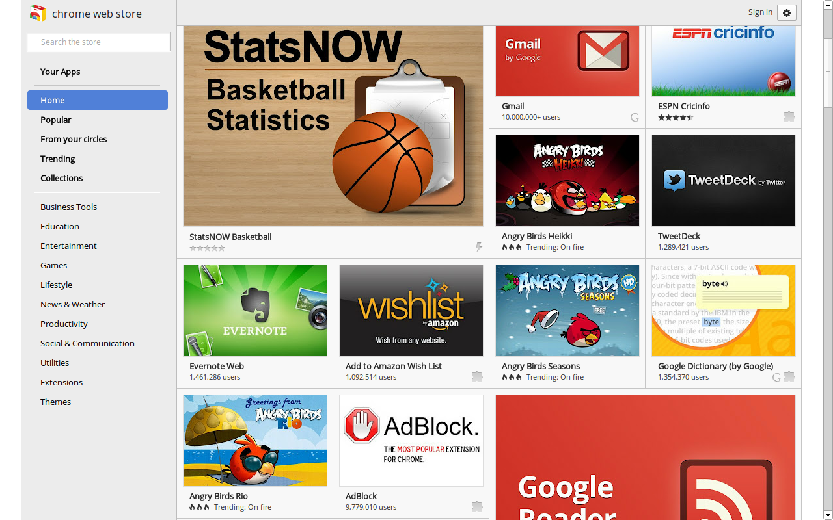
Chrome Webstore

Slide 5
Ways to develop
Extensions (tiny, like a tool)
Packaged Apps (big, advanced, better UI)
Themes (only for the chrome-obsessed)
Hosted Apps (not exactly apps)

Slide 6
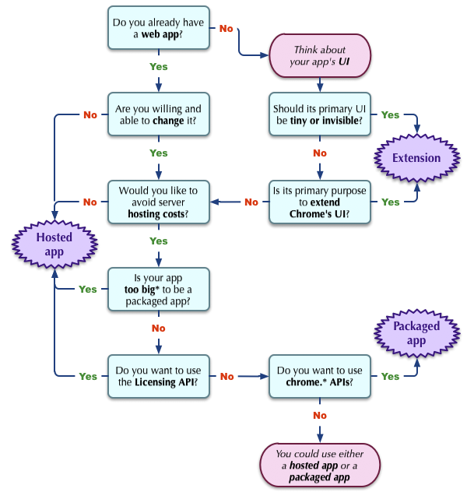

Slide 7
Hosted Apps
For those who just want to put their website on the Chrome Webstore
No access to major Chrome APIs. Totally useless from point of view of a developer
Access to Google Web Store's Licensing API – to check whether the user has paid for your app using Web Store's Payment gateway.

Slide 8
Demo Time
Let's see how to make a Hosted App out of your website in less than 30 seconds !
Let's try it with Pragyan 2013 website! http://www.pragyan.org/13
manifest.json
All files here: github.com/abhishekdelta/devfest

Slide 9
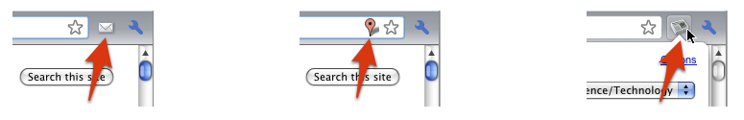
Extensions
Extensions are small software programs that can modify and enhance the functionality of the Chrome browser. You write them using web technologies such as HTML, JavaScript, and CSS.
Extensions have little to no user interface.
Browser Action
Page Action
Browser Action with Popup

Slide 10
Security Limitations
No inline javascript (onclick,etc)
No 'eval'
No <script>code</script> in html files
All javascript in .js files
All files (css, js, images, etc) must be loaded from the extension page or explicitly put in the manifest (if from other network domain)

Slide 11
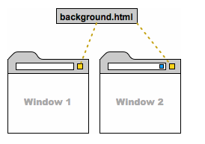
Background Pages
Runs as long as your extension lives
Only one instance at a time
"background": {
"scripts": ["background.js"],
"page": ["background.html"],
}
CAUTION: Too many can slow down Chrome!

Slide 12
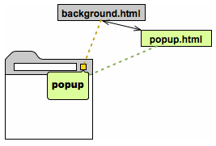
How they fit in ?
chrome.extension.getViews()
chrome.extension.getBackgroundPage()

Slide 13
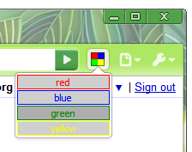
Browser Action
Manifest.json
"browser_action": {
"default_icon": "icon.png",
"default_title": "Click Me!",
"default_popup": "popup.html"
}
Background.js
chrome.browserAction.setBadgeText()
chrome.browserAction.setBadgeBackgroundColor()
chrome.browserAction.onClicked.addListener(function(tabs.Tab tab){ … })
// Only if it doesn't have a popup

Slide 14
Context Menus
Manifest.json
"permissions": [
"contextMenus"
],
"icons": {
"16": "icon-bitty.png"
}
Backgound.js
chrome.contextMenus.create({
"type": "normal",
"title": "Click Me Right Now!",
"contexts": ["all", "page", "frame", "selection", "link", "editable", "image", "video", "audio"],
"onclick": whatToDoWhenClicked });

Slide 15
Demo Time
Let's make our own notepad inside chrome for quickly copying snippets of text or codes across various pages which we browse !

Slide 16
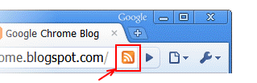
Page Action
Manifest.json
"page_action": {
"default_icon": "icons/foo.png", // optional
"default_title": "Do action", // optional; shown in tooltip
"default_popup": "popup.html" // optional
},
Backgound.js
chrome.pageAction.onClicked.addListener(function(tabs.Tab tab) {...}); // Only if it doesn't have a popup

Slide 17
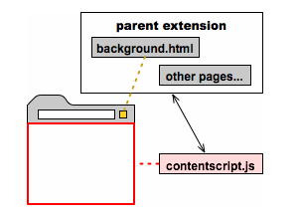
Content Scripts
A content script is some JavaScript that executes in the context of a page that's been loaded into the browser.
Think of a content script as part of that loaded page, not as part of the extension it was packaged with (its parent extension).
Content scripts can talk to
the extension using
'messages' API provided
by Chrome

Slide 18
Limitations
Cannot use chrome.* APIs (except for parts of chrome.extension used for Message Passing)
Cannot use variables or functions defined by their extension's pages
Cannot use variables or functions defined by web pages or by other content scripts

Slide 19
How to use it ?
manifest.json
"content_scripts": [
{
"matches": ["http://www.google.com/*"],
"css": ["mystyles.css"],
"js": ["jquery.js", "myscript.js"]
}
],
"permissions": [ "tabs", "http://www.google.com/*" ]
myscript.js
...
$('body').css('background-color','#FF0000');
..

Slide 20
Cross-Origin Requests
Whenever your app is making an AJAX call to some website, OR modifying the contents of some page opened in the browser using content_scripts, you need to request for permissions on that domain !
Simply add a pattern that matches the website name under 'permissions' in manifest.json. Pattern examples:
"http://www.google.com/"
"http://www.gmail.com/"
"http://*.google.com/"
"http://*/"

Slide 21
Message Passing
Sending Messages
  Content script → Extension
  chrome.extension.sendRequest(msg, function(response){...})
  Extension → Content script
  chrome.tabs.sendRequest(tab.id, msg, function(response){...})
Recieving Messages
  chrome.extension.onRequest.addListener(
  function(msg, sender, sendResponse) {
  …
  sendResponse(response); }

Slide 22
Demo Time
Lets make a quick chrome app that can toggle the images of any webpage displayed on click of a button !

Slide 23
chrome.* APIs
alarms
bookmarks
browserAction
browsingData
contentSettings
contextMenus
cookies
debugger
declarativeWebRequest
devtools.inspectedWindow
devtools.network
devtools.panels
events
extension
fileBrowserHandler
history
i18n
idle
input.ime
management
omnibox
pageAction
pageCapture
permissions
privacy
proxy
runtime
storage
tabs
topSites
tts
ttsEngine
types
webNavigation
webRequest
webstore
windows

Slide 24
Packaged Apps
As powerful as native app
As safe as Web app
Written in HTML5, JavaScript, and CSS
Looks like a native app instead of a webapp
All files local, no network depedency
Access to Chrome.* APIs and more ...
  Shells (VMWare, Citrix, SSH, RDP or VNC clients)
  Music/video streaming
  Photo/video/music editing
  Sockets API (for direct TCP and UDP connections)
  USB, Serial and Bluetooth API (for talking with hardware devices)

Slide 25
Disabled Features
Javascript methods : alert, confirm, document.cookie, document.close, document.open, document.write
Form submission
Flash
Window.history and window.location
Browser Chrome APIs

Slide 26
Final Demo
Beam OS (Cloud Integration)
Yahoo Hackathon Project – Developed in less than 24 hours

Slide 27
That's all folks !
Q & A
You can always reach me via Gmail or Facebook or Twitter if you have any more doubts or need further help getting started.
Gmail: i.abhi27@gmail.com
Facebook: facebook.com/abhishekdelta
Twitter: @abhishekdelta

