Slide 1
NODE.JS
By Abhishek Shrivastava
@WalmartLabs

Slide 2
What is Node.JS ?
A platform built on Chrome's JavaScript runtime for easily building fast, scalable network applications.
Node.js uses an event-driven, non-blocking I/O model that makes it lightweight and efficient, perfect for data-intensive real-time applications.
Notes:
Node.JS is a platform – A set of C libraries with a JS wrapper around them exposed to you
V8 engine by Google - Very fast & efficient compared to other JS engines out there
Easily – extensive set of libraries that does almost everything you need
Fast, Scalable – Performance benchmark on the upcoming slides
Event-driven programming – A model where the flow of a program is determined by events (signals, messages). User define callbacks which are to be executed when an event occurs, like the completion of an I/O request, or an incoming HTTP connection
Non-blocking I/O – All I/O calls do NOT block. We’ll talk more in detail about it.
Lighweight & efficient – Just one thread.
Data Intensive, Real time – Real Time Applications with heavy I/O calls and less CPU bound

Slide 3
Who uses it anyway?
eBay – http://ql.io (A special language built on top of Node.js runtime to quickly write HTTP APIs)
LinkedIn - Use node.js as the server interface for mobile applications
Microsoft - Core contributor to node.js for Windows.
Trello – Node.js backend
Yahoo! – mojito, mobile search
Full list here: http://github.com/joyent/node/wiki/Projects,-Applications,-and-Companies-Using-Node
Notes:
Mojito – An awesome framework built on top of Node.js. It allows you to execute the same javascript code on the server as well as the client, allowing you to minimize code-duplication as well as improve performance against network latency. It uses client browser’s JS runtime to simulate a server environment on client side, and a Node.js runtime to simulate a browser environment on server side. More details here - http://developer.yahoo.com/blogs/ydn/posts/2012/04/yahoo%E2%80%99s-mojito-is-now-open-source/ and http://blip.tv/jsconf/jsconf2012-bruno-fernandez-ruiz-6142243

Slide 4
How fast it really is ?
C = No. of concurrent requests, N = Total no. of requests
Notes:
Simple “Hello World” program running on 4 GB RAM + 2 GHz dual-core CPU + Ubuntu 10.04

Slide 5
…
 | Requests per second | Mean Time per request | Transfer Rate
C=1,000 N=100,000 | 4725 | 0.212 ms | 373.61 Kbps | Node.JS
 | 823 | 1.215 ms | 235.91 Kbps | Apache
C=20,000 N=1,000,000 | 958 | 1.043 ms | 76.08 Kbps | Node.JS
 | 280 | 3.571 ms | 10.07 Kbps | Apache
Node.JS is really faster and it even scales well !
Source with more detailed info : http://zgadzaj.com/benchmarking-nodejs-basic-performance-tests-against-apache-php

Slide 6
Before we dig inside Node…
I/O Latency
 | Cycles
L1 cache | 3
L2 cache | 14
RAM | 250
Disk | 41,000,000
Network | 240,000,000
I/O compared to other operations that your CPU does,
is much much much times slower !
Notes:
L1 cache – Fastest, Smallest, and belongs in the same CPU chip. Small size + costly SRAM makes lookup faster.
L2 cache – Slightly bigger, and may belong to a different chip but still quite fast. Big size slightly reduces the speed.
RAM – Much larger and resides on a different chip, connected via the system bus

Slide 7
Node assumes that if you’re an I/O bound application
(like most are) then you are spending a lot of time waiting for
I/O. Like this:

Slide 8
Let’s try scaling this with Threads
Context Switching Overhead
Execution Stacks take up memory
Complicated shared-state concurrency
Notes:
But most of the threads are still waiting on I/O most of the time …
So, to handle lot of connections … we need LOT of threads.. And then we start getting into some problems like context switching overhead, high memory & concurrency issues.
We can deal with atleast the last concurrency problem by using processes instead of Threads

Slide 9
Let’s try with Processes
High Memory Usage
Process Scheduling Overhead
Notes:
Processes are still waiting on I/O most of the time… And more requests = more processes = more troubles !

Slide 10
Node scales it with Event Loop, Thread Pool & Async I/O!
Single Node Process
Network
File System
Thread Pool & Async APIs
Node delegates all I/O bound tasks to its internal thread pool and native Async I/O APIs (wherever possible) which can use interrupts & callbacks to enter back into the system.
By immediately pushing all I/O tasks out of the way, Node gets back into processing other requests!
Notes:
Node delegates all the

Slide 11
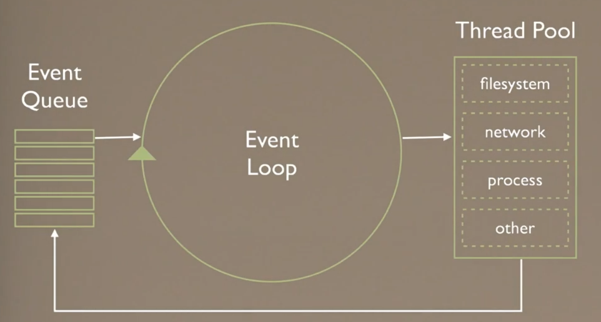
Node’s Event Loop
Notes:
Every new connection creates an event which is then added to the event queue. The node’s event loop (which is run by V8) eventually get to the event, processes the new request, executes the controller immediately delegating all I/O calls to the thread pool, and then if fetches the next event from the queue.
When an I/O calls finishes it creates another event which is added to the queue. When node reaches to that event, it executes the callback associated with it and if it has the final response ready then sends it to the client.

Slide 12
What’s under the hood !
Node’s Standard Library
(JS Environment)
Node Bindings
V8
Thread Pool (libeio)
Event Loop (libev)
Crypto (OpenSSL)
DNS
(c-ares)
(C/C++ environment)
Notes:
Node’s standard library – Basically the Node’s API that allows you to access filesystem, system calls, databases, etc. This is the Node JS code that is actually exposes to you.
Node bindings – Mainly its C++ native code that binds Node with the operating system functionality like I/O.
Remaining are the node’s dependencies that aren’t part of Node.. They are external libraries which Node uses.
V8 – Google’s fastest Javascript engine, used by Node to execute all its Javascript
Node is 20% Javascript code and 80% C++

Slide 13
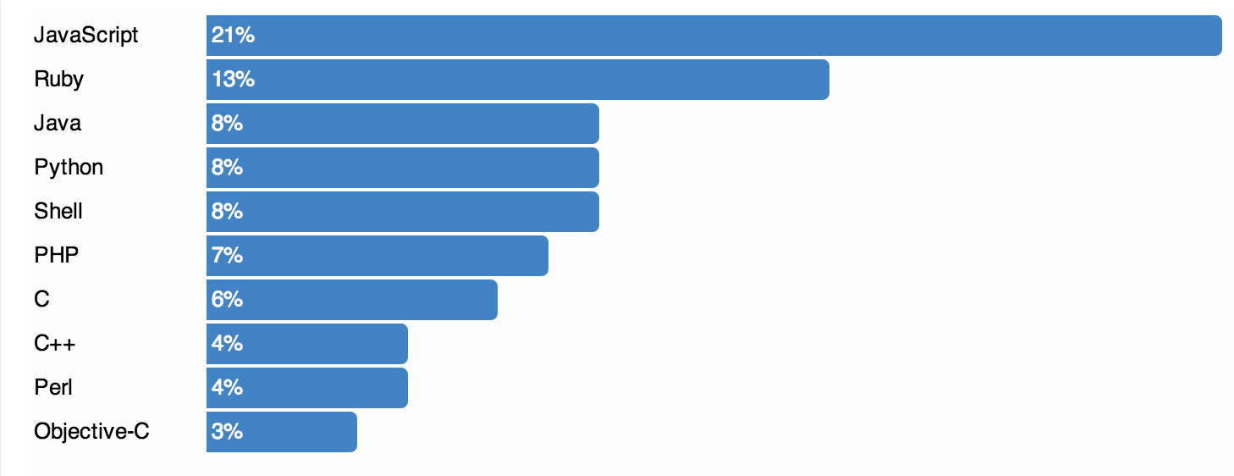
Why Javascript?
Most popular language on Github (http://github.com/languages)
Exceptionally well-suited to callback-based concurrency model
Single language on client & server (allowing Code-Reuse)

Slide 14
Google’s V8 engine
Developed by Google, written in C++
Fastest Javascript Engine
Direct compilation to Native code
Hidden Classes
Open Source (http://code.google.com/p/v8)
V8 can run standalone or it can be embedded with any C++ application (http://jcla1.com/blog/2012/01/07/exploring-the-v8-js-engine-part-1/)
Ability to run on both client & server side. It exposes a DOM API which Chrome browser uses, all other APIs are independent and can be easily integrated with other projects.
Notes:
Other engines mostly interpret JS into bytecode which is then compiled into machine code and executed
Other engines – IonMonkey in Firefox 18+ and Nitro/ SquirrelFish in Safari
Nitro also does direct compilation to native code but IonMonkey still uses bytecode

Slide 15
Why Node.js is fast if it still relies on Threads internally?
Only event loop runs on the main thread, and all asynchronous calls are handled in the Thread Pool and OS-level Async APIs
By not directly associating connections with threads, we better utilize resources
Thread Pool = Limited no. of threads = Less Context Switching = Less Memory & CPU overhead

Slide 16
When to use Node.JS ?
Build a (soft) real-time social app like Twitter or a chat app.
Build high-performance, high I/O, TCP apps like proxy servers, databases, etc.
Build backend logging and processing apps.
Add a RESTful API-based web server in front of an application server.
Code Reuse is required between server & client
Notes:
For real-time apps, Node.js is specially good if “long-polling” technique is used. In this the client creates a connection to the server but if there’s no data, the server holds on to the connection until new data is available. In other languages, a thread is required for each connection as the connection remains active. In node, it doesn’t have to be! Hence especially good for real-time chat apps sorts.

Slide 17
When NOT to use Node.JS?
Mission-critical (hard) real-time apps like heart monitoring apps or those that are CPU-intensive.
For simple CRUD apps that don’t have any real-time or high-performance needs, Node.js does not provide much of an advantage over other languages.
Enterprise apps that might need some specific libraries for which there may not be a Node.js library yet.
Notes:
CRUD – Create Read Update and Delete

Slide 18
Drawbacks of Node
Bleeding Edge Technology
New versions are released literally every month.
Can cause stability issues across versions.
Careful not to run CPU-intensive tasks in the main thread.
Difficult to debug
Significant learning curve burden to programmers used to other object-oriented languages due to the whole callback, event-driven aspect of it.
Javascript has its share of “bad parts” as a language.
Notes:
JS Bad Parts – Global variables, No block scope, Semicolons, etc
“Javascript: The Good Parts”
http://nodejs.org/illuminati0.pdf

Slide 19
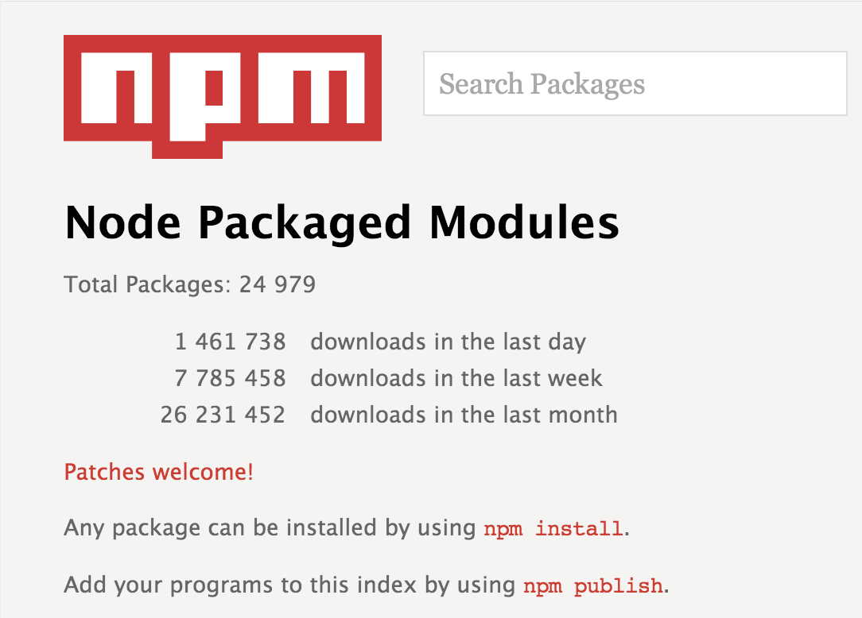
http://npmjs.org

Slide 20
Q/A and then lets write some code…

Slide 21
Basic HTTP Server
var http = require('http');
var count = 0;
http.createServer(function (req, res) { res.writeHead(200,{'Content-Type’: 'text/plain'});
res.end((++count)+'\n');
}).listen(8080);
console.log(“Listening on port 8080”);

Slide 22
Static File Server
var http = require('http');
var fs = require('fs');
http.createServer(function(req,res){
fs.readFile('/etc/passwd', function(err, data) {
if(err) {
res.writeHead(500, err.message);
res.end();
} else {
res.writeHead(200, {'Content-Type':'text/plain'});
res.end(data);
}
});
}).listen(8080);
console.log("Listening on 8080");

Slide 23
File Streaming
var http = require('http');
var fs = require('fs');
http.createServer(function(req,res){
res.writeHead(200, {'Content-Type' : 'text/plain'});
var stream = fs.createReadStream(’huge.txt');
stream.on('data', function(data) {
res.write(data);
});
stream.on('end', function() {
res.end();
});
stream.on('error', function() {
res.end();
console.log(error);
});
}).listen(8080);

Slide 24
TCP Echo Server
var net = require('net')
net.createServer(function(socket) {
socket.write("Hello\n");
socket.write("World\n");
socket.on('data', function(data) {
socket.write(data);
});
}).listen(8080);

Slide 25
TCP Chat Server
var net = require('net');
var sockets = [];
net.createServer(function(socket){
sockets.push(socket);
socket.on('data', function(data) {
console.log(data);
for(var i=0;i<sockets.length;i++) {
if (sockets[i] == socket) continue;
sockets[i].write(data);
}
});
socket.on('end', function(){
var i = sockets.indexOf(socket);
sockets.splice(i, 1);
});
}).listen(8080);

Slide 26
Packages to try:
Express (web-framework)
Async (async helpers)
Socket.io (Real-time networking, websockets)
Persist (ORM Framework)
Java (node-java bridge)
Request (HTTP request client, like curl)
Underscore (JS Utility belt)

Slide 27
Thank You!
Notes:
If Node’s actual thread pool which connects to database to make I/O calls is actually small in size, then does that mean some of the I/O calls have to wait until the previous I/O calls are completed, even though more I/O connections to database are possible. Basically, if C=1000, and thread pool size = 100, then the last batch of concurrent requests 901-1000 will experience a delay of 10x for their I/O calls. Is that true?
Same as above, does that mean the higher the concurrency the slower is the request response time. Even if that’s true, is the above the correct reason for that behaviour?
Nginx?? Why node then?
About Nginx/Apache…
http://blog.martinfjordvald.com/2011/02/nginx-primer-2-from-apache-to-nginx/
In Apache, every request spawns a new process, even a static file request like images. And in every apache process, the PHP’s binary is embedded i.e. each process easily takes up 25-50MB.. Large number of processes can hence downgrade performance. This embed PHP basically means that there’s very less overhead between Apache & PHP to talk to each other. So you just configure Apache to use PHP, write your PHP code and forget.
In NGINX, since its an event-driven webserver which requires the programming to be non-blocking, you can’t use PHP by default as PHP is blocking. And hence NGINX relies on protocols such as FastCGI to talk to PHP, which also supports FastCGI. So PHP processes are separate and completely out-of-control of Nginx. Nginx simply communicates with the running PHP processes when it needs it to do something (basically, delegating the task to it) and moves on handling other events. But since PHP processes are not embedded in the Nginx process, there’s an overhead in talking to it. Besides you have to do this process scheduling yourself.
Hence, most people say use Nginx for handling static files and Apache for PHP.
2) Node.JS have alternatives which might scale better but they are complex.
3) Node is actually faster than Nginx. http://chetansurpur.com/blog/2010/10/why-node-js-is-totally-awesome.html

