Slide 1


Data Engineering Internship
— CitiusTech
Project Team: Arcadia Data Management • Duration: 6 months • Presented by: Tejas Desai

Slide 2




About CitiusTech
Who they serve
Healthcare providers, payers, medtech and life sciences — specialised in clinical and operational data solutions.
Core capabilities
Healthcare data platforms, analytics, cloud transformation and AI- driven solutions for enterprise scale.
Commitment
Security, compliance and trusted delivery across regulated healthcare environments.

Slide 3

Internship Objective & Learning Goals
Gain hands-on experience in healthcare data engineering: build cloud-native data pipelines, apply validation & ETL best practices, and contribute to POCs that solve real business problems.
Practical cloud data processing (AWS)
End-to-end pipeline development (ETL/ELT)
Exposure to AI/LLM integrations for operational knowledge

Slide 4

Onboarding & Training
Domain & Tools
Healthcare domain induction, Python for data engineering, PySpark fundamentals.
AWS & Data Platforms
S3 data lake patterns, Athena, Redshift, Serverless orchestration, Kinesis basics.
Modern Stack
DBT, Snowflake concepts, SQL best practices, CI/CD for data engineering.
Daily hands-on sessions, assignments, and continuous mentor feedback accelerated learning.

Slide 5

Team Structure & Work Culture
Arcadia Data Management: cross-functional team with assigned managers and mentors. Cadence included daily stand-ups, task tracking and design reviews.
Agile methodology and sprint-based delivery
Close collaboration with Data Engineers & Architects
Emphasis on clear requirements and professional communication

Slide 6
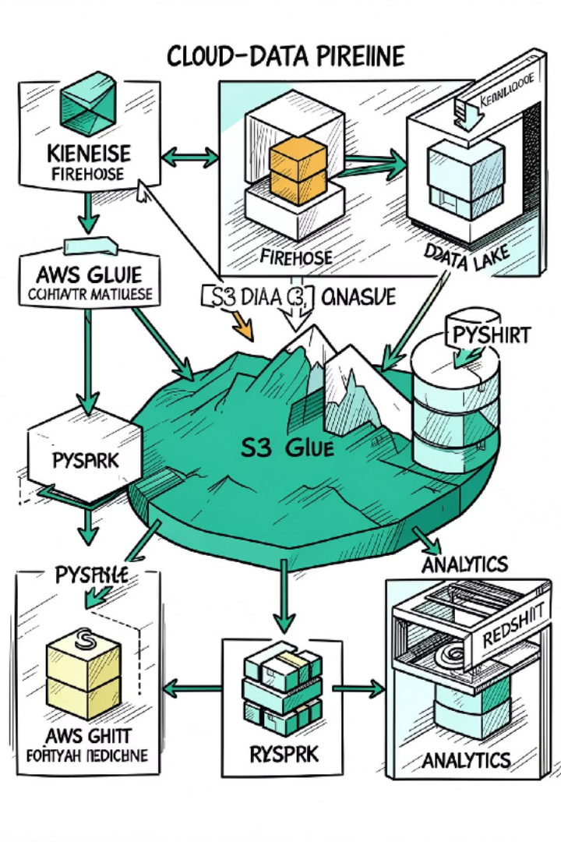
Healthcare Data Engineering Architecture
Orchestration: AWS Step Functions. Technologies used: S3, Kinesis, Glue (PySpark), Redshift, Athena, Step Functions, SQL. This architecture supports high-throughput ingestion, scalable ETL, and analytic-ready tables.

Slide 7

Work In Progress — Validation Module
Contributed to the WIP stage of the pipeline focusing on customer data validation. Responsibilities included:
Designing Python-based validation scripts and rules
Implementing data quality checks (missing fields, schema validation, range checks)
Flagging and classifying incorrect or incomplete records for downstream handling
•
Impact: Increased reliability of downstream processes and reduced data-quality incidents entering analytics.

Slide 8

Proof of Concept — AI-powered RAG Solution
Objective: Build a Retrieval-Augmented Generation system to surface operational knowledge quickly from logs and documentation.
Ingested sources: AWS logs, Confluence pages
Pipeline: chunking → embeddings → FAISS vector store → retriever → LLM Features: semantic search, context- aware retrieval, question-answering interface
•
•
Technologies: Python, LangChain, FAISS, LLM APIs. Outcome: Demonstrated feasibility and received leadership feedback for next-phase integration.

Slide 9
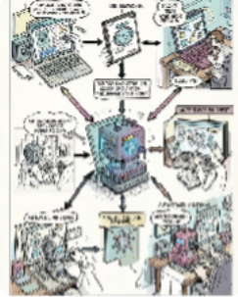

AI Agent Research & Contributions
Use-case exploration
Mapped agentic automation opportunities for routine operational tasks and runbook execution.
Knowledge transfer
Prepared concise research notes and walkthroughs to help the team understand Agent workflows and constraints.
Outcome: Improved team readiness to evaluate agentic automation in future projects.

Slide 10
Skills Gained & Key Takeaways
Summary: Developed strong fundamentals in cloud-based healthcare data engineering, improved pipeline reliability through validation efforts, delivered a successful RAG POC, and contributed to AI adoption discussions.
Technical
Python, PySpark, SQL, AWS (S3, Glue, Redshift, Athena), Snowflake, DBT, ETL/validation, RAG systems.
Professional
Agile delivery, cross-team collaboration, requirement analysis, presentation & stakeholder communication.
Next steps: Expand POC into staging, integrate retriever with runbooks, and formalise validation rule library.
Thank you — Questions & Answers

