Slide 1
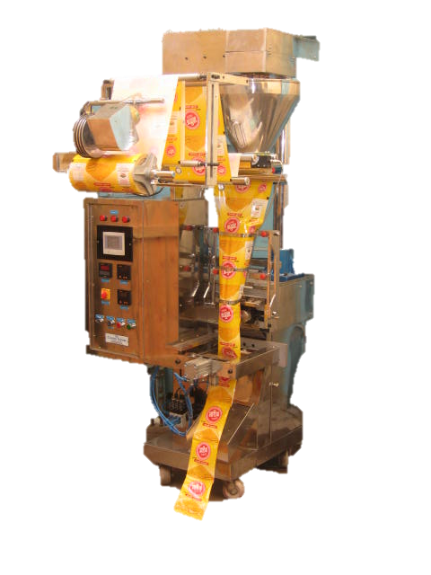
© CENTURY MACHINERIES

Slide 2
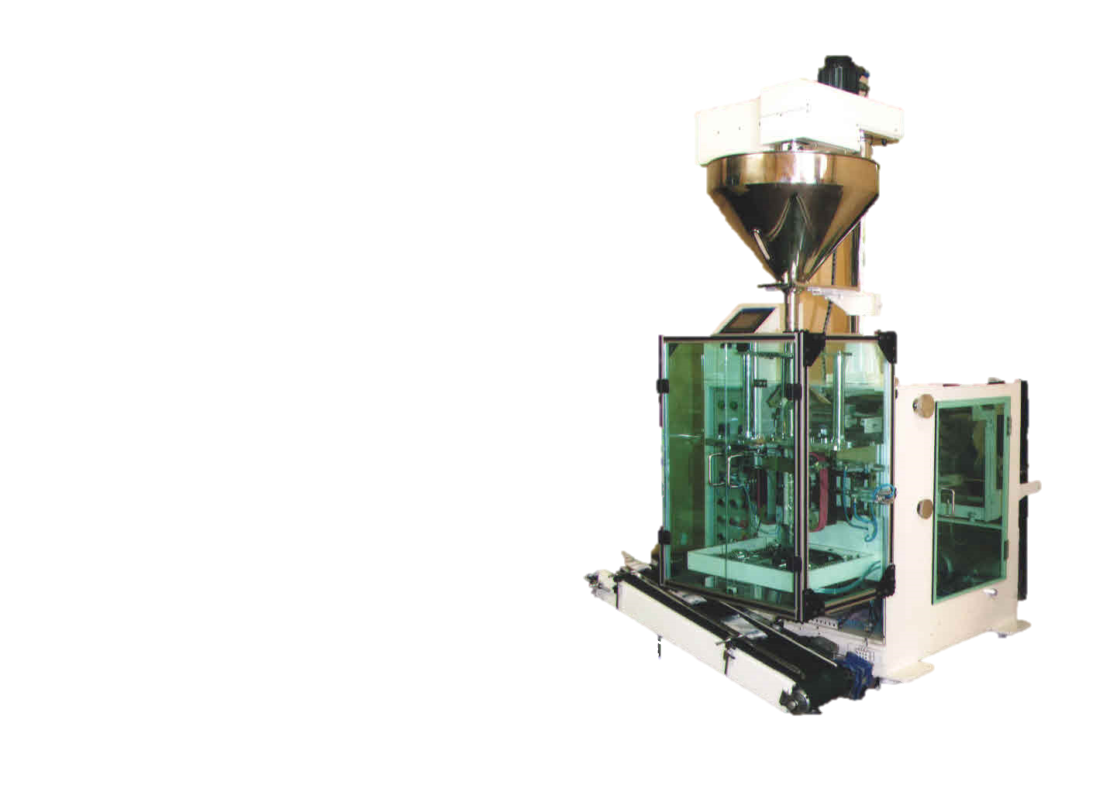
© CENTURY MACHINERIES

Slide 3
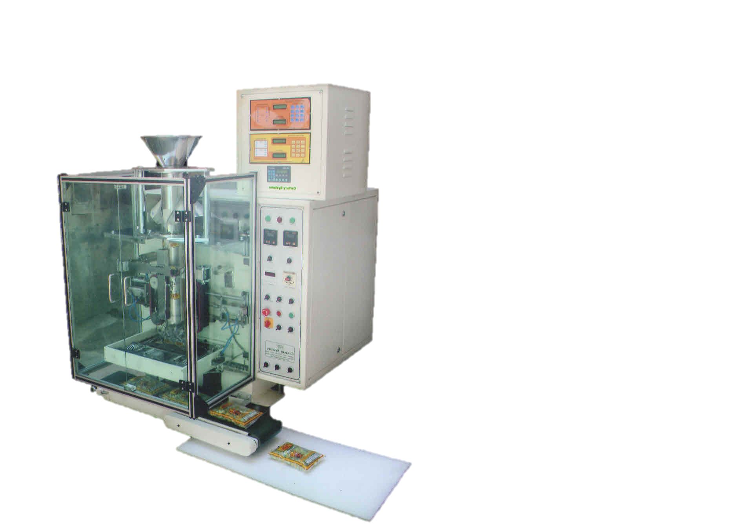
© CENTURY MACHINERIES

Slide 4
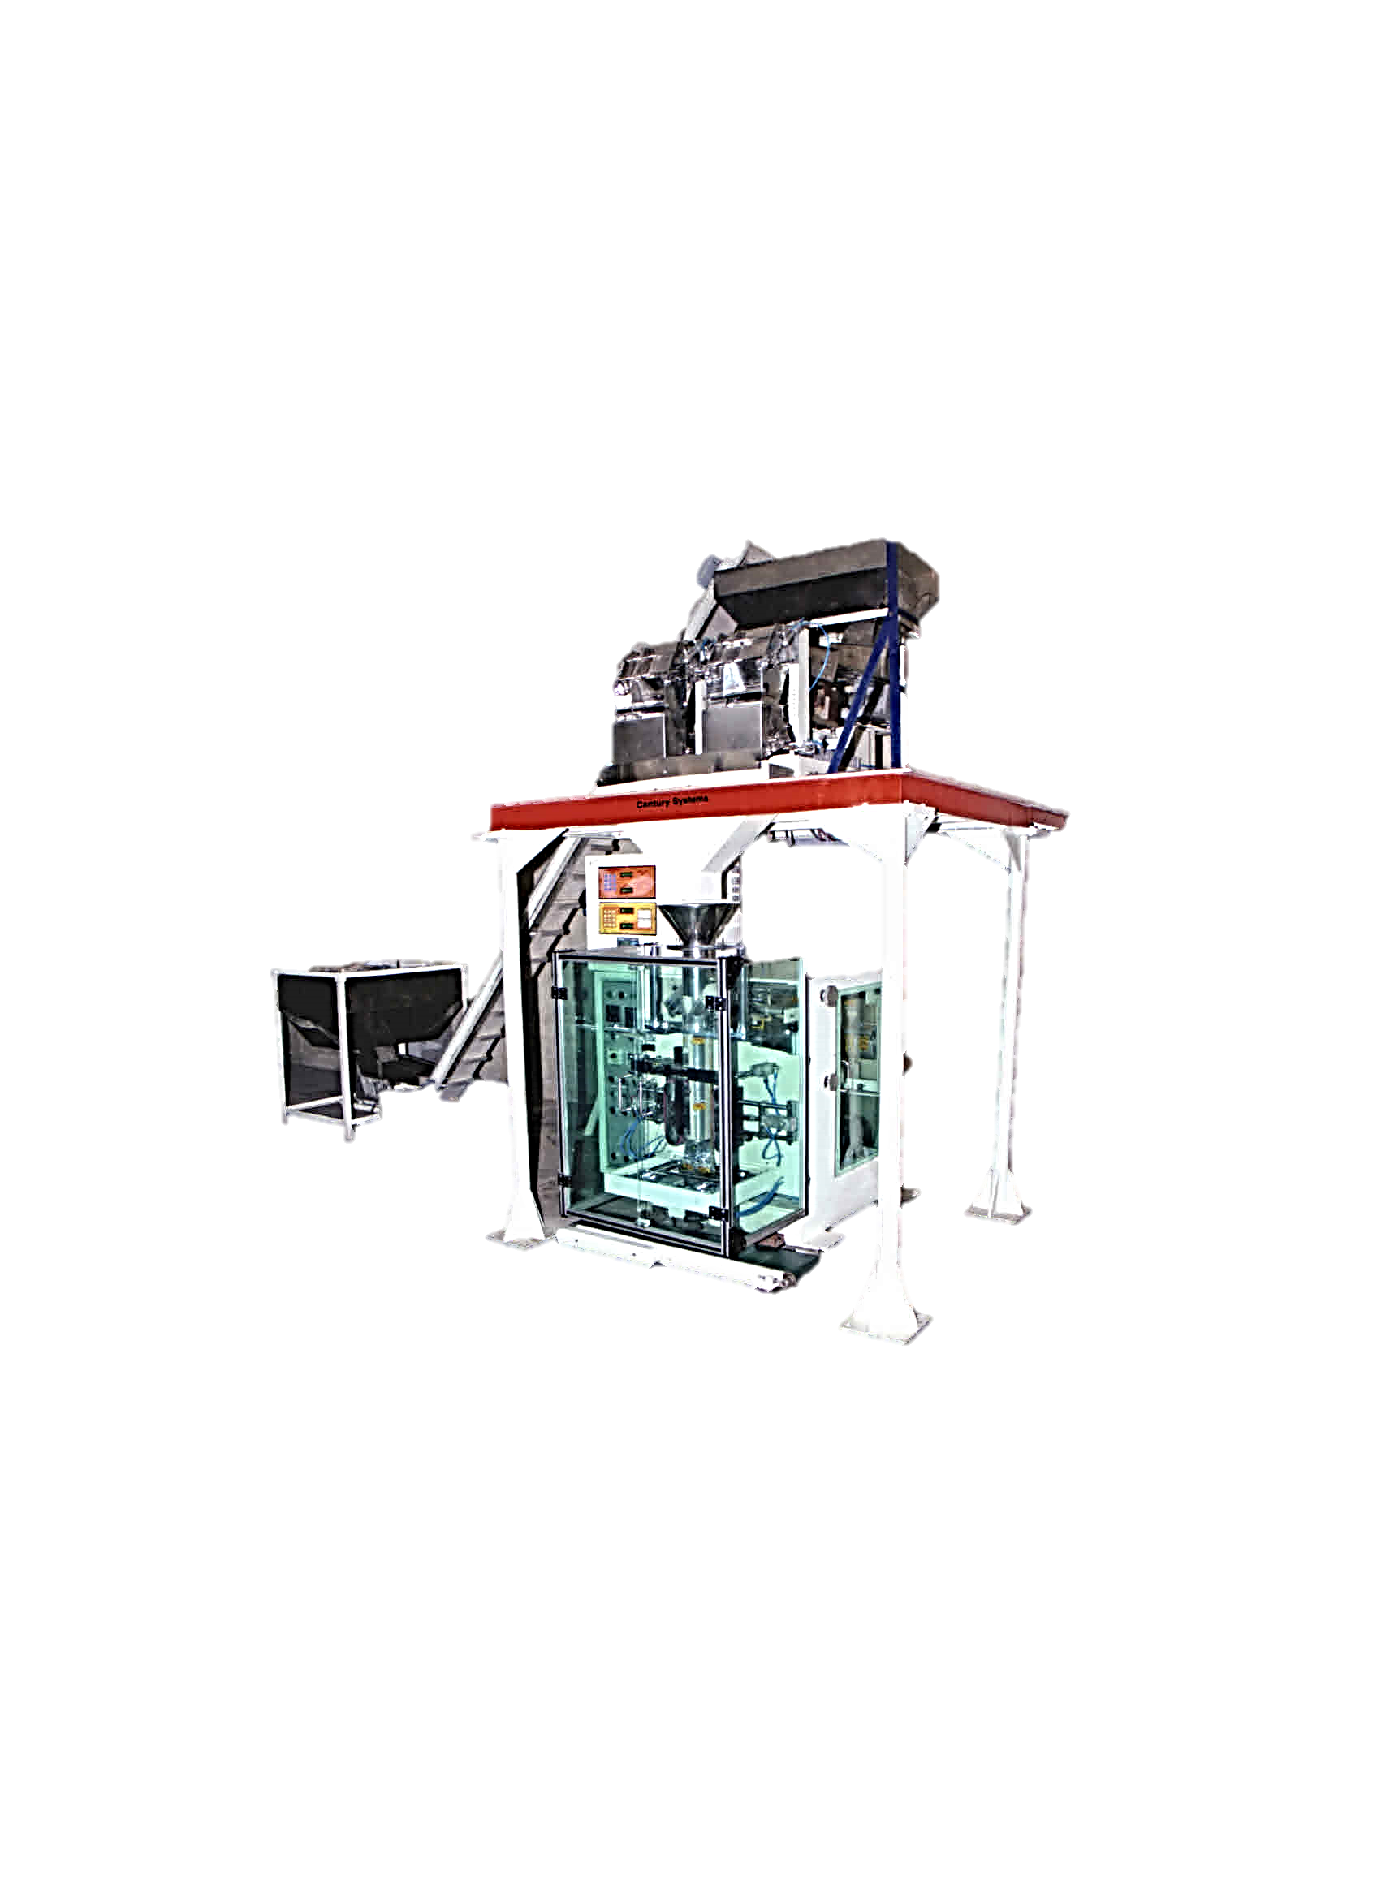
© CENTURY MACHINERIES

Slide 5
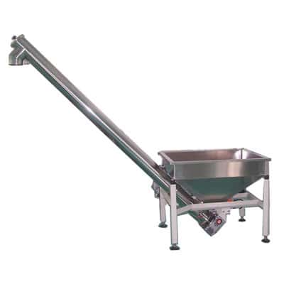
© CENTURY MACHINERIES

Slide 6
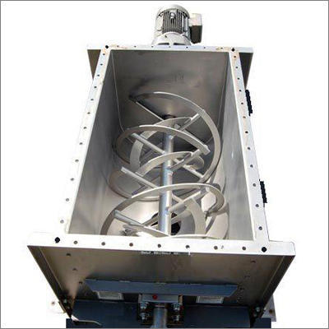
© CENTURY MACHINERIES

