Slide 1
MENTOR :MS NIDHI JAIN SUBMITTED BY:
PRIYANKA GUPTA
SHUBHAM SHRIVASTAVA
VINI SAXENA
URVASHI RAWAT
Presentation on:
Online Movie Booking System

Slide 2

Introduction
This project aims at development of an Online Movie Ticket Booking Utility which facilitates the customers to manage their movie tickets online, and the Theatre administrators to modify the backend databases in a User-Friendly manner.
The Customers are required to register on the server for getting access to the database and query result retrieval.
The administrator has the right to modify any information stored at the server database.

Slide 3
Technology used
Front End:
HTML
CSS
JavaScript
Back End
Php
MySQL server Database
JSP
Tools Used:
IBM Rational Software Architect
Microsoft office tools
Apache Tomcat Server

Slide 4
Top Key Functionalities of the Project
USER MODULE:
User Registration
User Login
Check Availability
Book Ticket
ADMIN MODULE:
Admin User Login.
Show Manage.
Movie Mange.
Schedule Manage.
User Manage
Counter Control

Slide 5

The existing system has two ways of booking tickets for a movie:
One is to book tickets at the ticket counter of respective cinema hall and the other one is through online application called as online booking
Customers may view the movie timings, their name and availability of seats.
After checking the number of seats available the customers can book the tickets for movie.
After checking the number of seats available the customers can book the tickets for movie.

Slide 6

The project is a web based application where one can buy tickets with just one click. The system facilities the customer:
To book tickets at any time of the day.
Provide all the necessary information regarding the booking of tickets.
Facilities for cancellation and confirmation of tickets.
Providing facility for placing the order from the canteen of theatre by online means.
Provide rating to latest movies.

Slide 7

Book tickets from any corner with availability of internet.
Online payment for tickets.
Online cancellation of tickets.
Online placing cafeteria order.
Rating of latest movies.

Slide 8
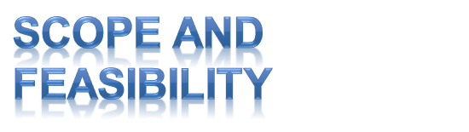
Implementations of this project idea are in industrial use in the form of many websites.
With availability of internet any user can access the website for booking online movie tickets.
Hence, this can be used for suggesting improvements in design, performance and greater usability.

Slide 9


